Slide 1













YOUNG REPORTERS FOR THE ENVIRONMENT
PHOTOGRAPHY ACTIVITY
Overview of the photography categories & activities to get started
GETTING STARTED
WITH PHOTOGRAPHY

Slide 2




TODAY’S
OBJECTIVES
WHAT MAKES A GOOD PHOTOGRAPH?
PHOTOGRAPHY TECHNIQUES
TELLING A STORY WITH PHOTOGRAPHS
HOW TO APPLY

Slide 3
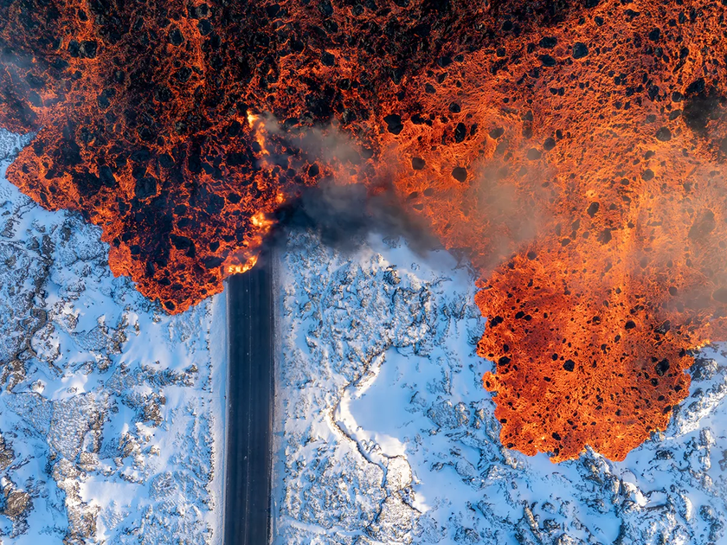
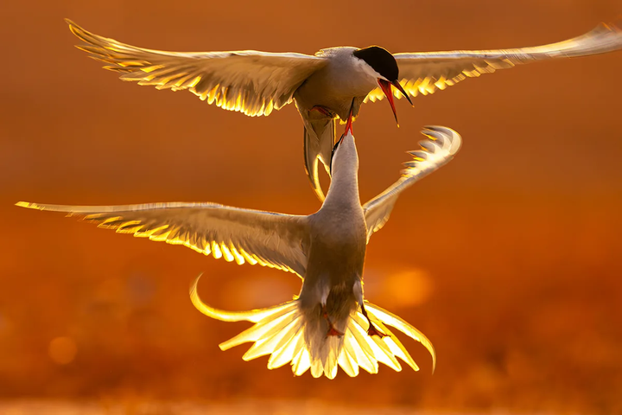
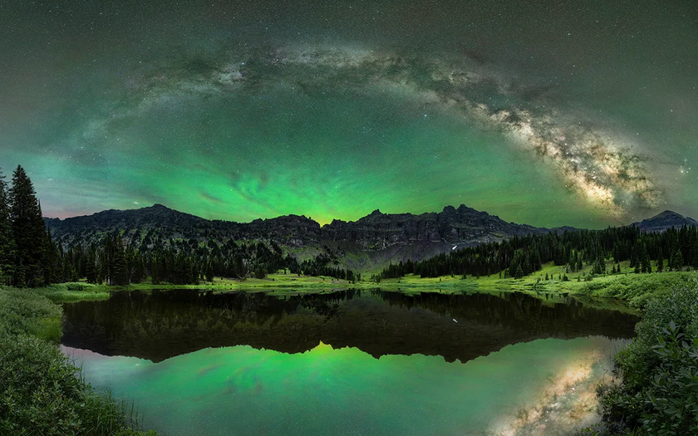
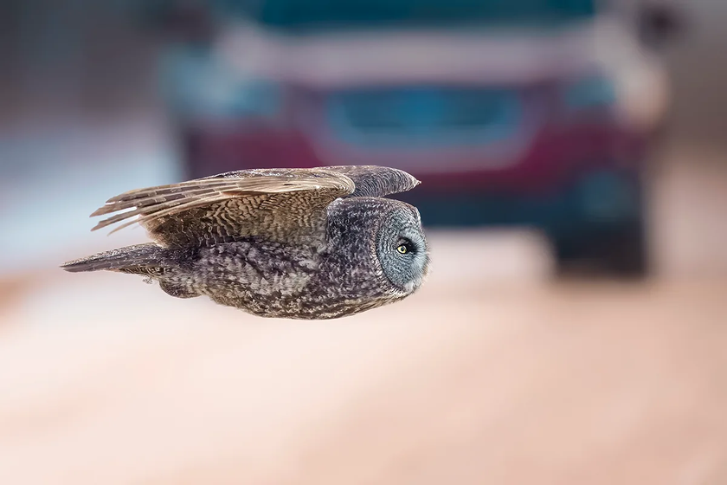
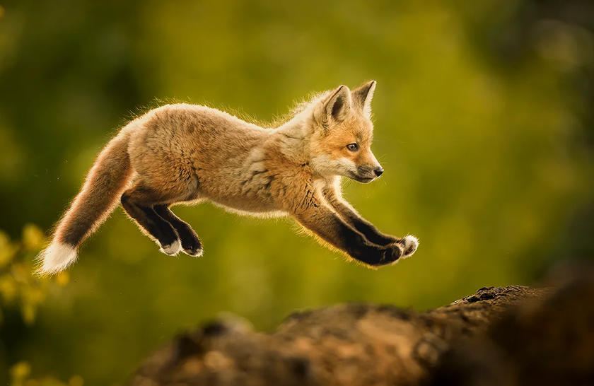
WHAT MAKES A GOOD PHOTOGRAPH?
Using your own knowledge and looking at these professional nature photographs, what do you think makes a good photograph?
Photos from BBC Science Focus

Slide 4
PHOTOGRAPHY TECHNIQUES
What are some simple ways to make your photographs more effective and visually appealing?
Composition
CONSIDER YOUR MAIN SUBJECT, ITS CONTEXT, AND HOW YOU WANT TO FRAME IT. USE “RULE OF THIRDS, NATURAL LINES IN THE SHOT TO LEAD TO THE MAIN SUBJECT, AND CREATIVE FRAMING.
Lighting & Contrast
MAKE SURE TO USE EFFECTIVE LIGHTING AROUND YOUR SUBJECT. TAKE ADVANTAGE OF NATURAL LIGHT AND “GOLDEN HOUR” OPPORTUNITIES. CONTRAST WITH SHADOWS TO CREATE A DRAMATIC EFFECT.
Depth of Focus
CONSIDER WHAT ELEMENTS OF THE PHOTO YOU WANT TO BE IN FOCUS. DO YOU WANT THE ENTIRE SHOT IN FOCUS, OR WOULD A BLURRED BACKGROUND GIVE A BETTER IMPACT TO FOCUSING ON YOUR SUBJECT?
Perspective & Angles
EXPERIMENT WITH DIFFERENT ANGLES--SHOOTING FROM ABOVE OR FROM A LOWER ANGLE CAN CREATE DIFFERENT IMPRESSIONS OF THE SUBJECT. CONSIDER HOW CLOSE YOU WANT TO TAKE THE SHOT.
What other techniques can you use when taking a photograph?

Slide 5

PHOTOGRAPHY TECHNIQUES
What are some simple ways to make your photographs more effective and visually appealing?

Slide 6
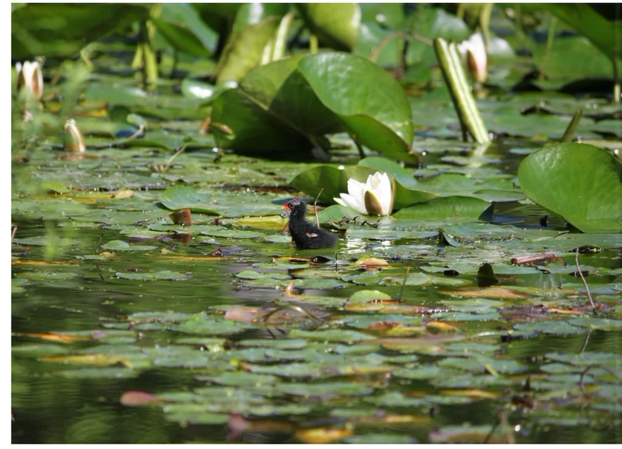
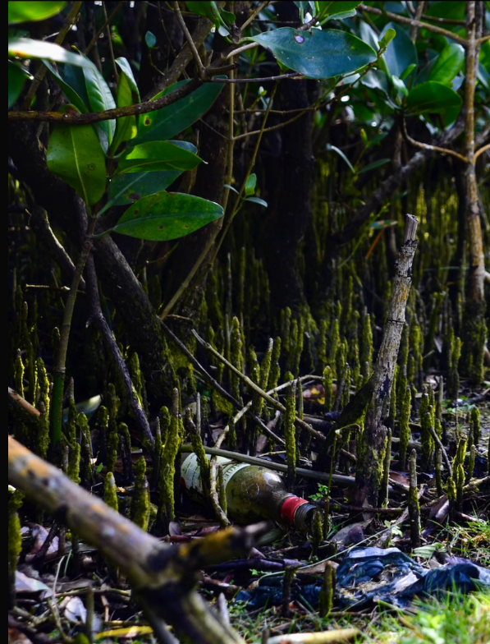
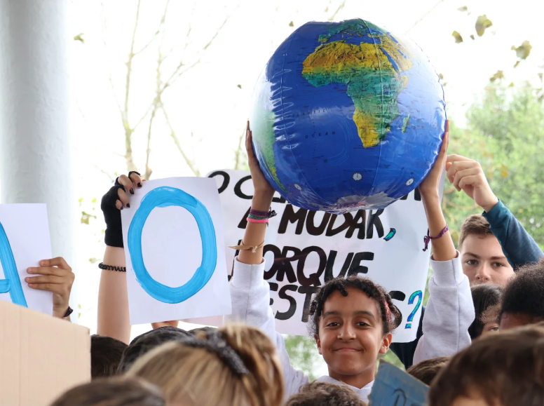
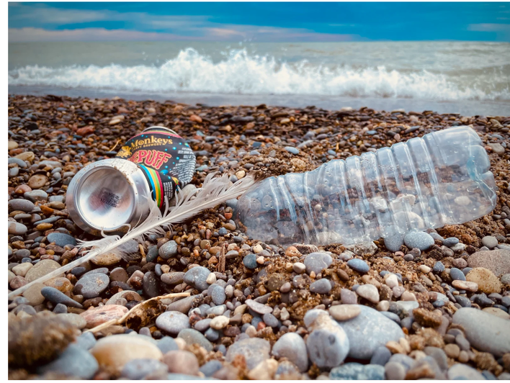
These are all photos taken by students. Which do you think is the best photo & why?

Slide 7
HOW CAN A PHOTO TELL A STORY?
What is happening in each of these photos? What story does it tell? Discuss and then click on each photo for more information.
How does a caption add to a photograph’s effect?

Slide 8
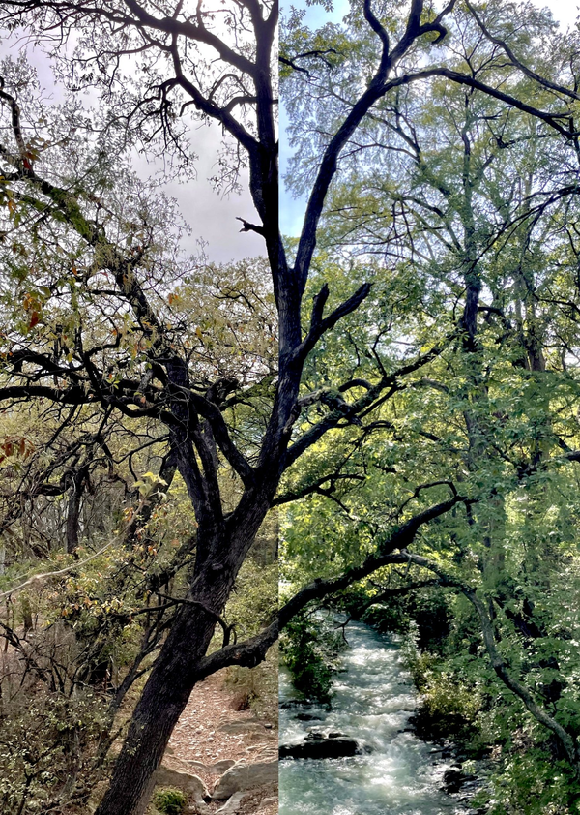
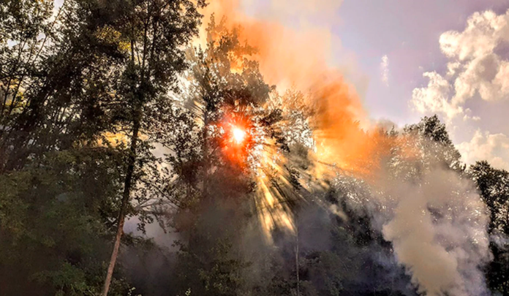
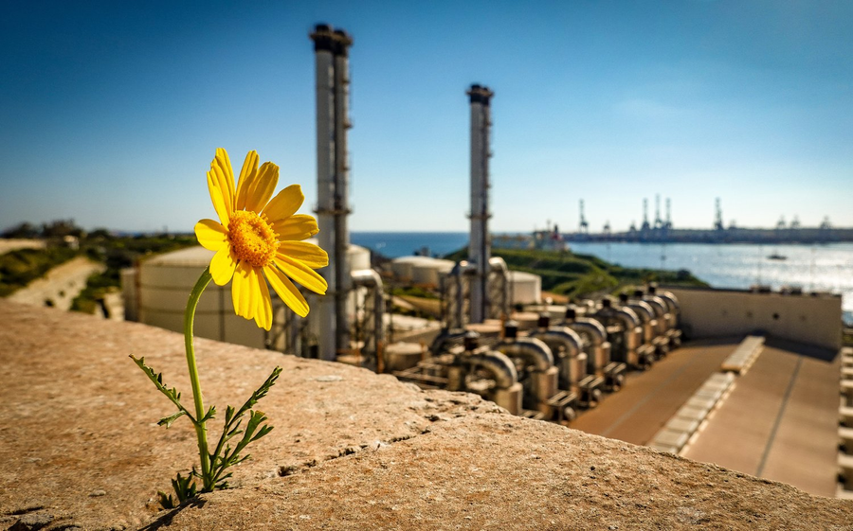

Single Photo Reportage
“Terrifying Light” by Arijana Adrović, Montenegro 2022
“Nature Finds a Way, But at What Cost?”
by Elizabeth Jade Pace and Zoe Zammit, Malta 2023
“The Northern Drought” by Victoria Margarita Andrade Morell, Mexico 2023
More examples of student photography
Discuss each photo with a partner.
What story does each photograph tell? Who is the audience? What is the purpose?
Is the photo effective? Does it primarily inform, evoke an emotion, or have another effect?
Which is your favourite, and why? What techniques might you use to have a similar effect?
Report on a Live Here Love Here campaign, beach clean up, or local environmental event!

Slide 9
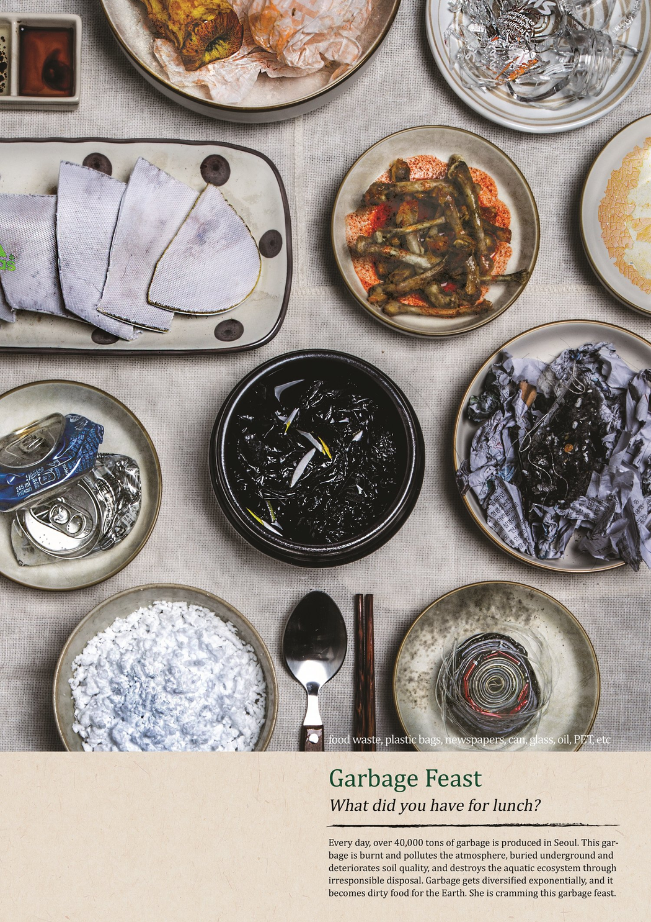
Single Photo Campaign
The purpose of the Environmental Campaign Photo is to raise awareness of an issue, promote certain values, and/or inspire positive action through a photograph. The photograph can be staged, and the subject can be posed with the intention of sending a message to the viewers. An environmental lens or perspective is required.
Before revealing the caption, discuss...
What techniques are being used for this photograph?
What story is being told in this photograph?
Who do you think the audience is for this photo?
What emotions are evoked through this photo? How is this achieved?
Is there a clear message? If so, what is it?

Slide 10
Single Photo Campaign
The purpose of the Environmental Campaign Photo is to raise awareness of an issue, promote certain values, and/or inspire positive action through a photograph. The photograph can be staged, and the subject can be posed with the intention of sending a message to the viewers. An environmental lens or perspective is required.
How does the caption add to the photograph?
What techniques are being used for this photograph?
What story is being told in this photograph?
Who do you think the audience is for this photo?
What emotions are evoked through this photo? How is this achieved?
Is there a clear message? If so, what is it?

Slide 11
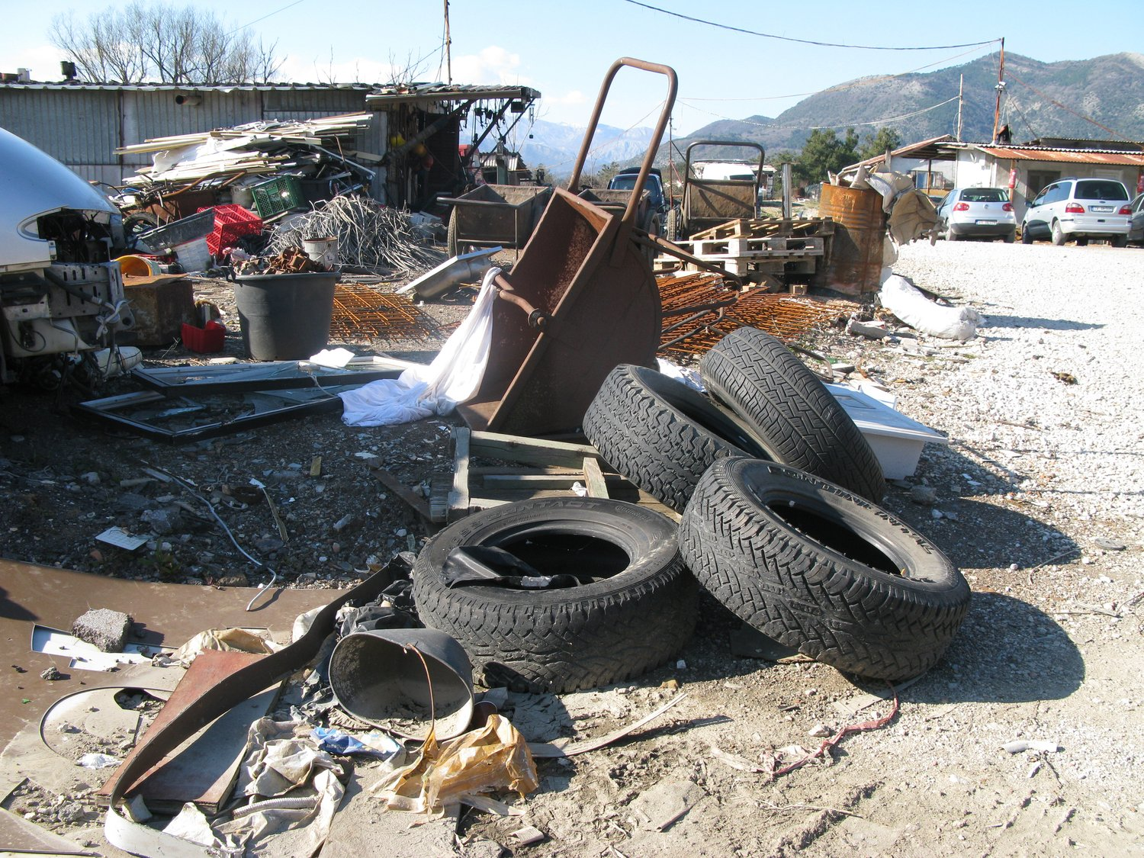
Using a series of photos to tell a story
“Recycling Embrace, No Disgrace” (Montenegro)
By Nikola Kovač
Photo Story
(3-5 photos)
The purpose of a Photo Story (3-5 Photographs) is to tell a story through a series of photographs to help the viewer better understand environmental issues, events, or phenomena. Like photo reportage, a photo story aims to tell a truthful and accurate story through a series of candid photographs.
Click on the link in the photograph to see the whole story.

Slide 12
What environmental issues have you been learning about?
ACTION
Go outside, choose a “subject” and take up to 6 photographs. Consider composition and, if possible, the story you want to tell.
How could you capture an aspect of that issue in a photograph (or series of photographs).
Even if you don’t have a topic in mind, find an interesting subject to photograph & try out a few different teachniques.

Slide 13
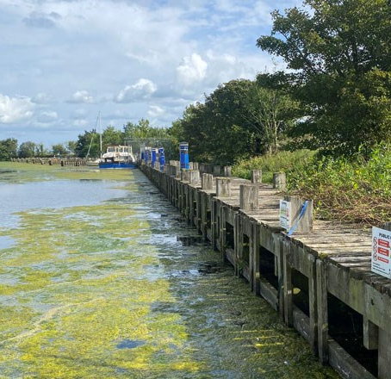
Find your story
Over the next week, keep an eye out for potential stories that you could capture with photography. Consider subjects that can make a statement about a local environmental issue.
Lough Neagh algae, 4NI.co.uk

Slide 14


OPEN NOW!
Young Reporters for the Environment
NATIONAL
COMPETITION
18 APRIL 2025
IF YOU ARE AGED 11-25,
PASSIONATE ABOUT THE ENVIRONMENT
AND FULL OF CREATIVITY,
THIS IS FOR YOU!
Monetary Prize of £50
for winners of each category

Slide 15


How to Apply
Go to eco-schoolsni.org
Register using the online form on the Eco-Schools NI website
Report on a local issue & disseminate
Read through the awarding criteria for your category
Complete the relevant form for your category
Email your final work + your completed form to
eco-schools@
keepnorthernirelandbeautiful.org

Slide 16



Questions?
CONTACT US
eco-schools@keepnorthernirelandbeautiful.org
MICHELLE GALLAGHER, EE COORDINATOR
michelle.gallagher@
keepnorthernirelandbeautiful.org

