Slide 1






Slide 2








Assembly by Year __

Slide 3









Global Perspective

Slide 4



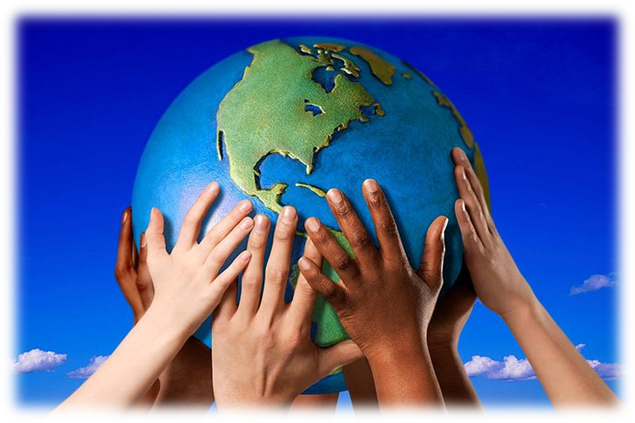

Global Perspective
Global perspective explores our connections with the rest of the world.
With a global perspective, we can engage with complex global issues and explore the links between our own lives and people, places and issues throughout the world.
Global perspective can inform the whole school ethos, leading to a school that is inclusive, just and democratic and promotes social and environmental responsibility, respect and co-operation.

Slide 5







Global Citizenship

Slide 6

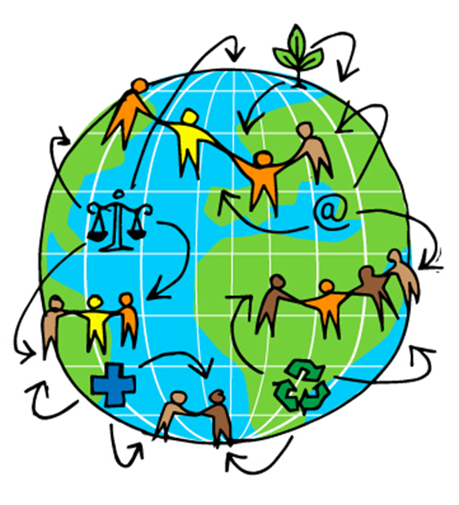
Global Citizenship
Being a global citizen is not clearly defined. As there is no global government there are no clear rules and regulations and globally, we do not have democratically-elected representatives to speak for us.
Global citizenship is more a moral understanding of our responsibilities and our rights in a global context. Being a true global citizen means that we recognise that all people have equal rights and that we value diversity.
It means we should value the earth as our common home which we all have a need and indeed a responsibility, to look after.

Slide 7





The Global Environment

Slide 8
The Global Environment
The term environment means surroundings; natural world. However, it can be narrowly defined, for example our immediate surroundings as in the classroom environment or very broadly, in relation to the global environment.
One thing that is certain is that ‘humankind’ has had a huge impact on the environment. Today, many of us have acquired so many things that we have a very comfortable life. But at what cost?
The more that people take from the environment, the more they change the pattern of nature. If we take too much, we risk upsetting this balance.
The balance of nature changes slowly over time but in recent years we have wanted more and more for ourselves and we are upsetting the balance at a faster rate, without even realising it.

Slide 9
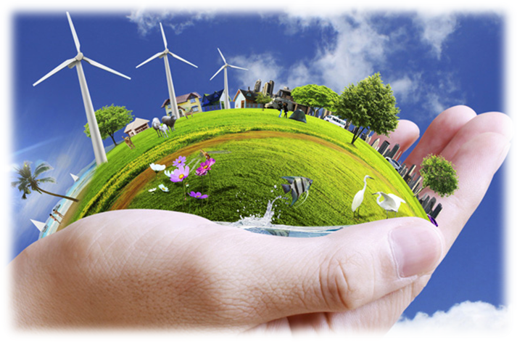
The Global Environment
We are part of the natural environment and must look after it. If we upset the pattern too much, we may even destroy ourselves and the lives of future generations.
Trócaire’s focus is on ensuring that our global resources are shared equitably and those in power act for the common good of all.

Slide 10



Global Food

Slide 11
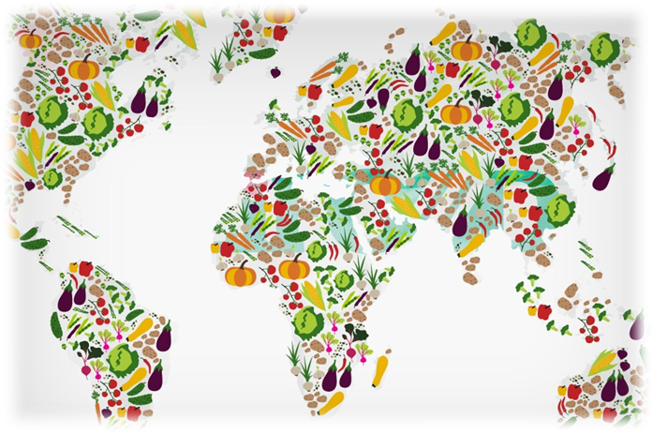
Global Food
There is plenty of food in the world to feed everybody.
The problem is how this food is distributed and shared.
In fact, more than one and a half times the amount of food needed to feed everybody in the world is produced each year.
Yet over 821 million, 1 in 9 people, are hungry.
If there’s really enough food in the world, why do some people still go hungry?
Hunger is caused by many factors and must be solved with many approaches. Factors include lack of investment in small farmers, particular women, unfair international trade policies and climate change.

Slide 12

Global Population

Slide 13

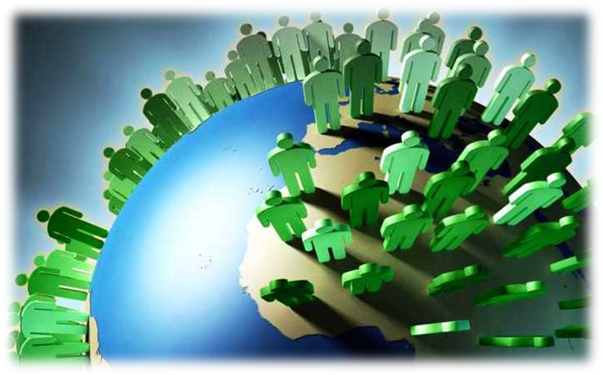
Global Population
Our precious finite world is currently home to over 7.8 billion people. Numbers this big are difficult to understand but what if we imagined the whole population of the world as a village of just 100 people? In this imaginary village, each person would represent about 78 million people from the real world. One hundred people would fit nicely into a small village. By learning about the villagers – who they are and how they live – perhaps we can find out more about our neighbours in the real world and the problems our planet may face in the future.
Imagining the world as a village also makes it easier for us to start thinking about all the human and environmental problems in the world and what we can do about them. It makes it easier for children to grasp the concept that the world is a large place; and many people in the world live lives much different from our own.

Slide 14

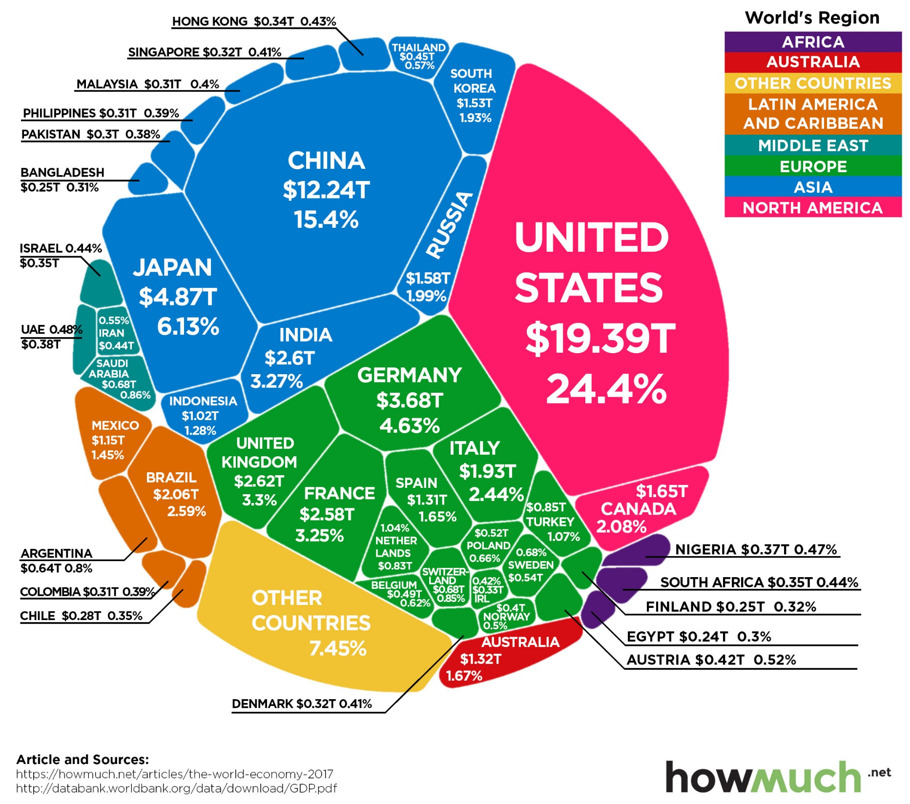
The
Global
Economy

Slide 15
Social Responsibility
Social responsibility is an ethical framework and suggests that an individual has an obligation to work and cooperate with other individuals and organizations for the benefit of society at large.
Social responsibility is a duty every individual has to perform so as to maintain a balance between the economy and the ecosystems. A trade-off may exist between economic development, in the material sense, and the welfare of the society and environment, though this has been challenged by many reports over the past decade.
Social responsibility means sustaining the equilibrium between the two. It pertains not only to business organizations but also to everyone whose any action impacts the environment. It is a concept that aims to ensure secure healthcare for the people living in rural areas and eliminate all barriers like distance, financial condition, etc. This responsibility can be passive, by avoiding engaging in socially harmful acts, or active, by performing activities that directly advance social goals.
Social responsibility must be intergenerational since the actions of one generation have consequences on those following.

Slide 16



Slide 17
Lack of Water = Poor Health
Safe water supplies and good hygiene are fundamental to global health. Areas which lack clean and safe water often have poor health because:
The water they drink is unclean and full of disease. This can result in poor health, such as diarrhea, malaria or stomach aches.
Illness or fetching water tasks can prevent children from attending school, therefore, they are not taught basic hygiene and ways to avoid potential diseases
A lack of water, impacts the ability to grow food. This has resulted in extreme malnutrition, especially among children
70% of our bodies are water, therefore, it is vital for our survival
Drinking water can flush out germs which may live within our bodies
Illness can form, when there is a lack of water to clean bodies and clothing

Slide 18
Lack of Water = Lack of Education
Student academic performance is severely Affected but a lack of clean water, some reasons for this include:
Missing school to fetch water
Dealing with stomach pains and diarrhea from disease and hunger
Taking care of sick parents or siblings
Becoming orphans, dropping out of school to care for younger siblings
Teacher becomes sick which results in the class being cancelled for everyone
Having no toilets in the school, typically results in girls dropping out once they reach puberty

Slide 19
Ways in which you can be more socially and environmentally responsible.
Recycle at home
Conserve energy through switching of lights and devices
Support Green vendors
Use reusables e.g. coffee cup, water bottle, lunchbox. Make your plastic promise on the KNIB website - reduce your use of single use plastic
Invest in plants at home
Try to stay healthy and eat organic fruit and veg
Use alternative modes of transport or share where possible
Get outside and volunteer
Conserve Water are – take short showers, fix leaking pipes, keep the running tap close while you brush your teeth, recycle water in your home, use water-saving appliances, collect rainwater in a rain barrel to water your garden.
Go meat free 2-3 days a week
Get involved in your school eco-committee
Be kind to everyone
Don’t buy things you don’t really need – always question yourself before purchase

