Slide 2
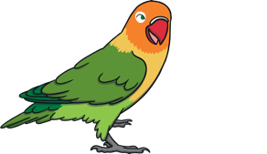
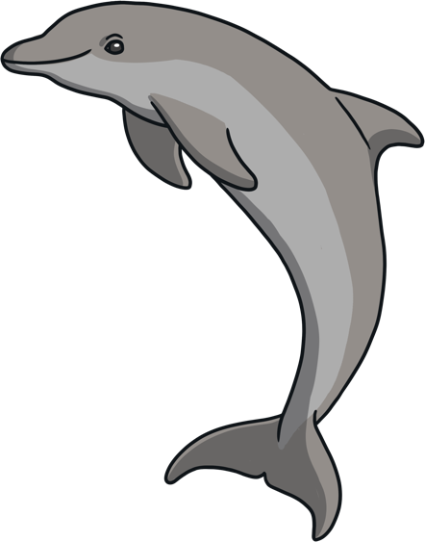
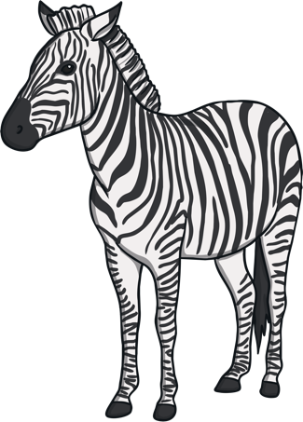
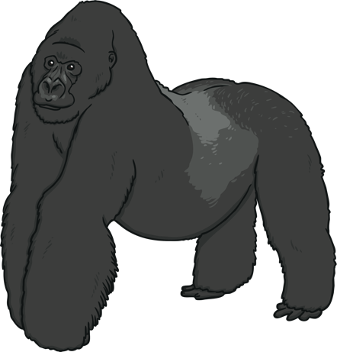
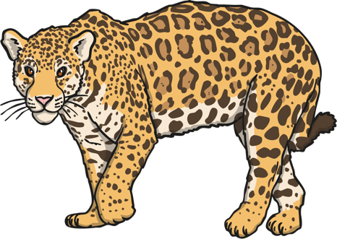
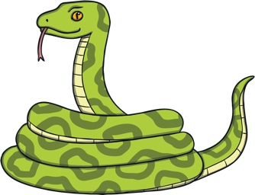
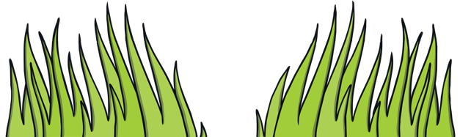
What is Biodiversity?
BIO means LIFE
DIVERSITY means RANGE OF DIFFERENT THINGS
Biodiversity is all of the plant and animal species that are living.

Slide 3
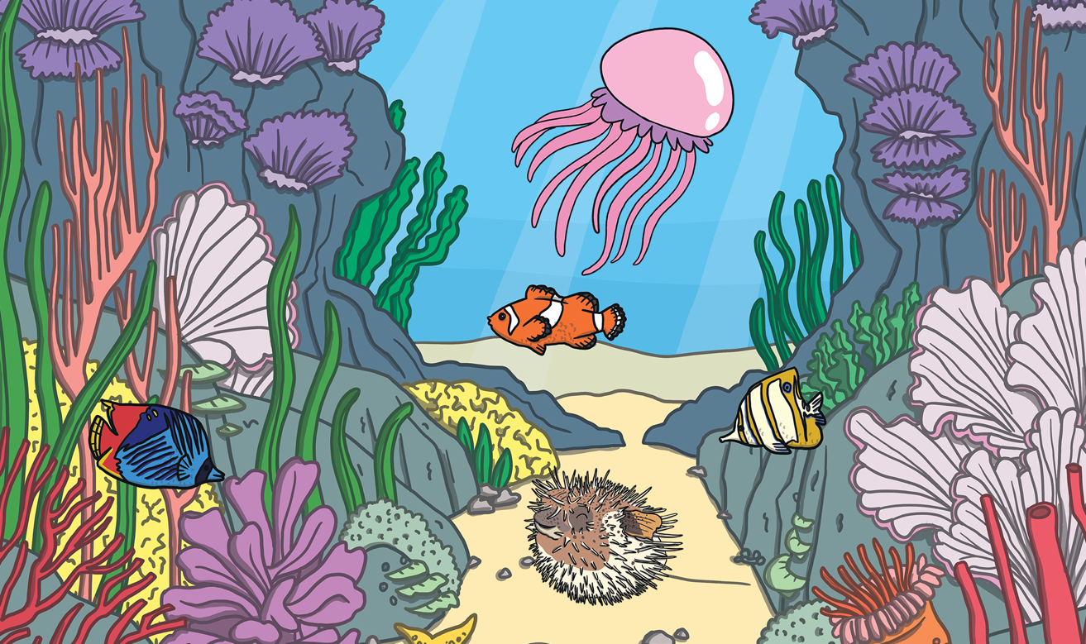
High Biodiversity
High biodiversity means many species of animals and plants.

Slide 4
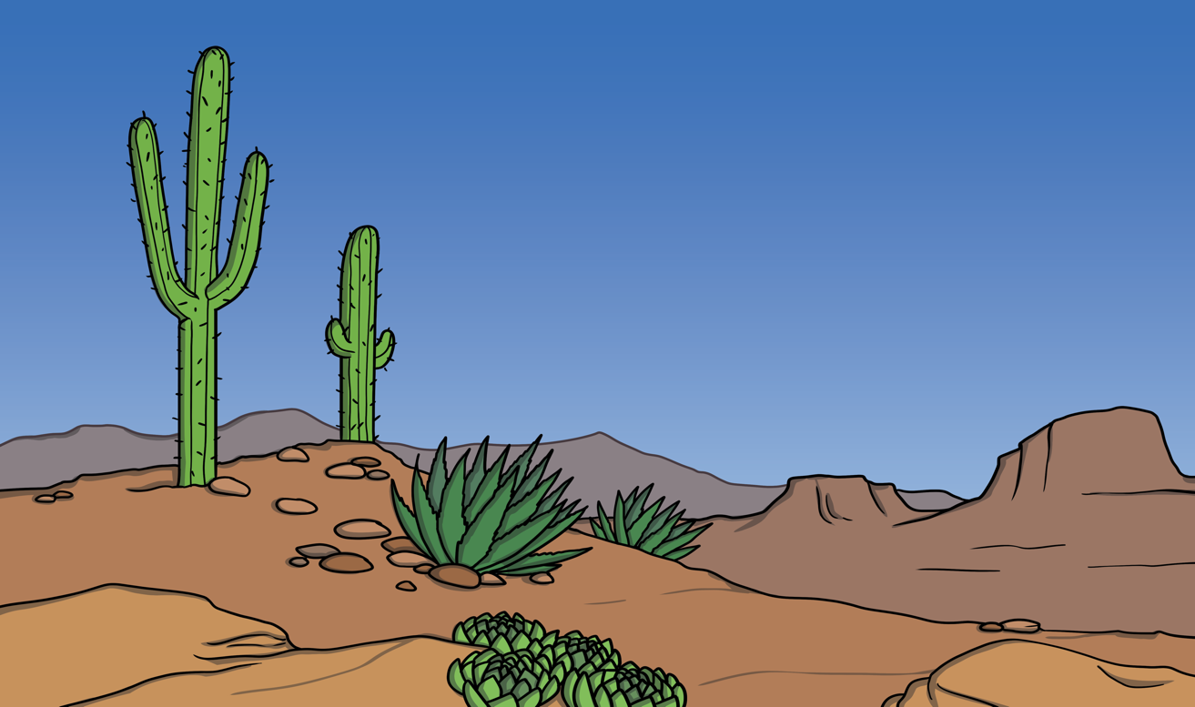
Low Biodiversity
Low biodiversity means very few species of animals and plants.

Slide 5
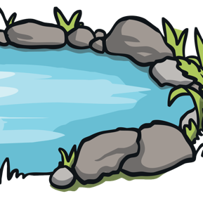
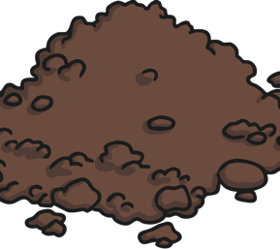
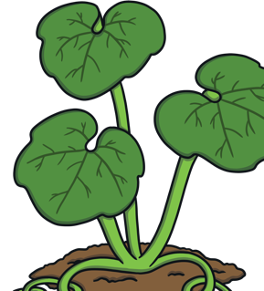
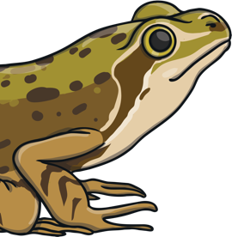
What is an Ecosystem?
An ecosystem is a way that living things work together in their surroundings.
They need water, soil, plants and animals.
They all work together. If you take one thing away, they won't work as well.

Slide 6
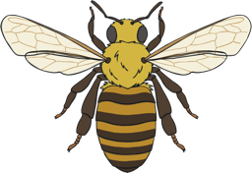
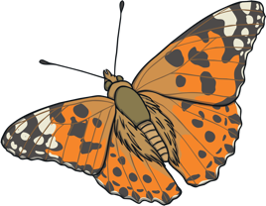
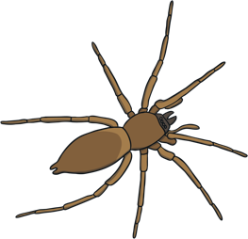
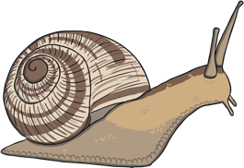
What is a Minibeast?
A minibeast is a 'creepy crawly'.
They are the little bugs that crawl and fly around the garden.
They provide food, pollinate flowers, spread seeds and help break down waste.

Slide 7
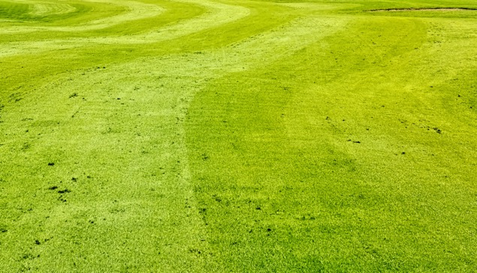
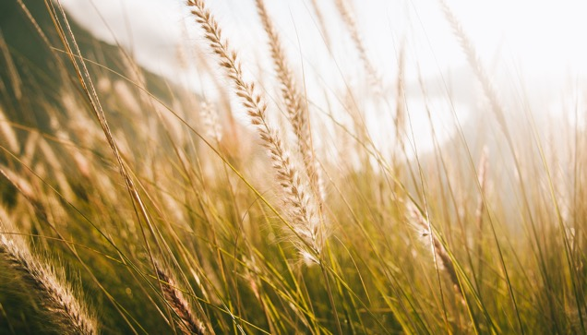
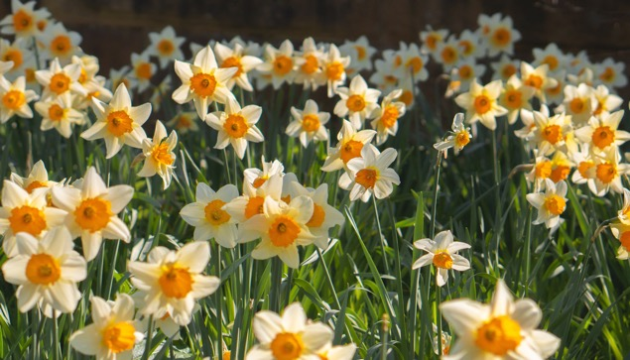
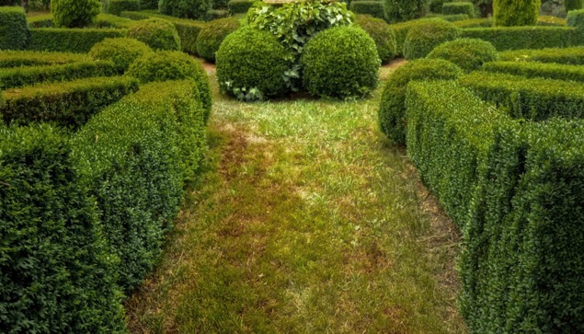
Types of Plants
Short grass
Long grass
Flowers
Hedges

Slide 8
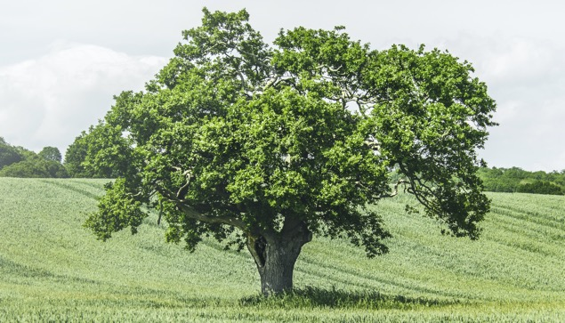
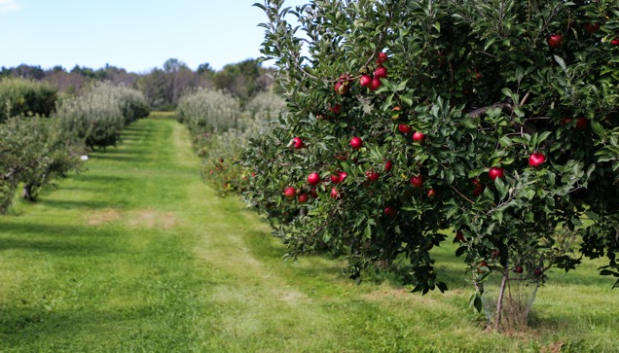
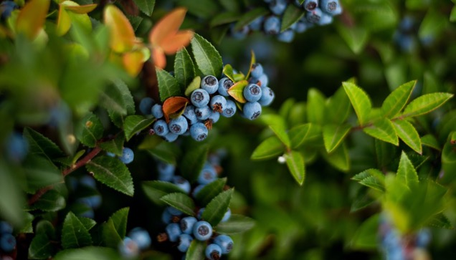
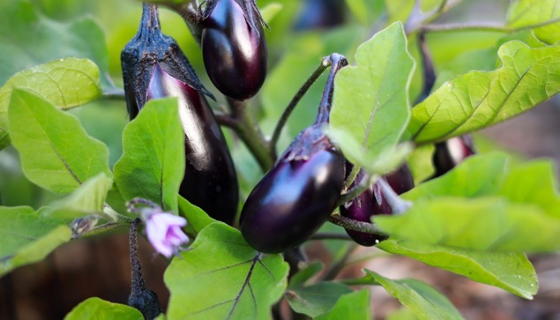
Types of Plants
Trees
Fruit tree
Fruit bush
Vegetables

Slide 9
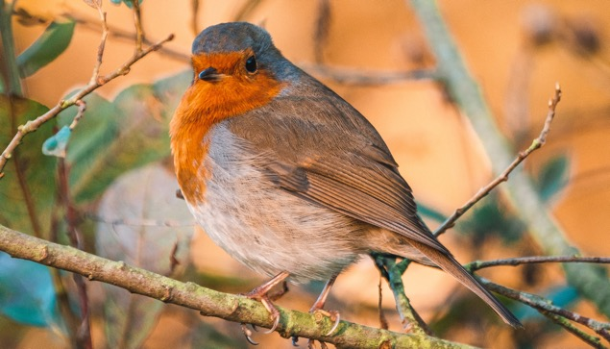
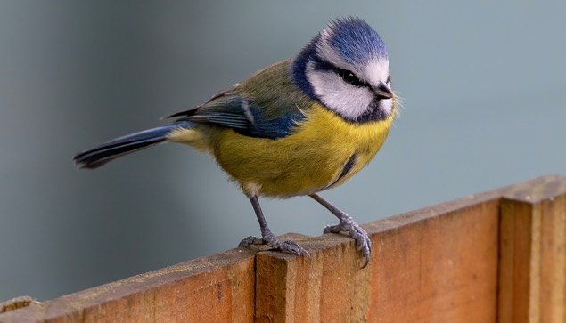
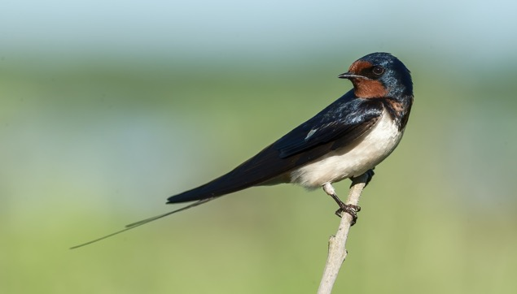
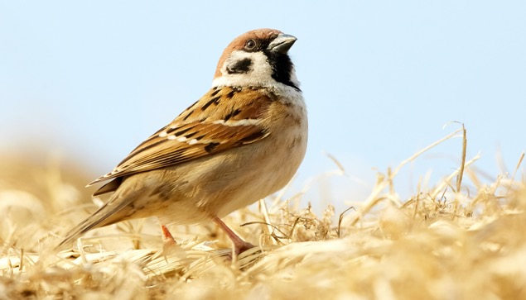
Types of Birds
Robin
Blue tit
Swallow
Sparrow

Slide 10
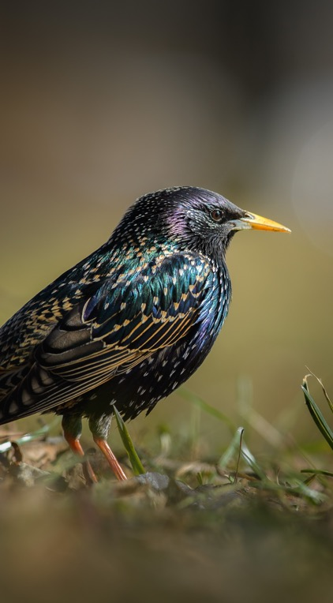
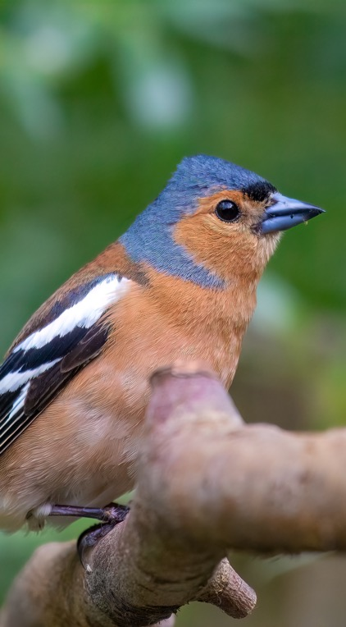
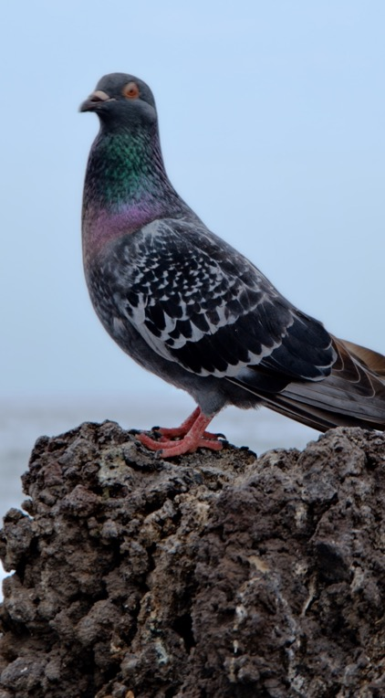
Types of Birds
Starling
Chaffinch
Pigeon

Slide 11
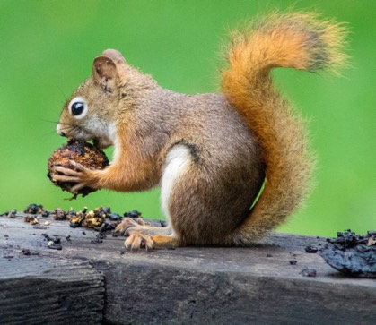
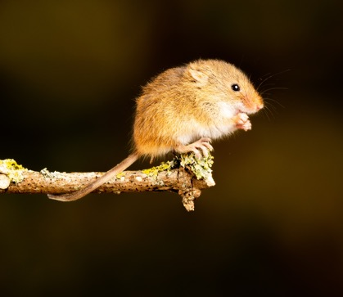
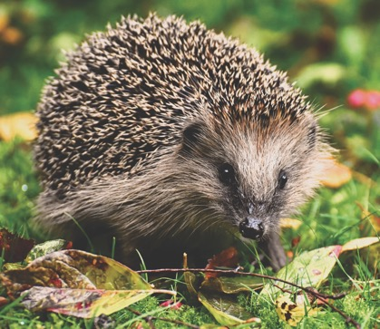
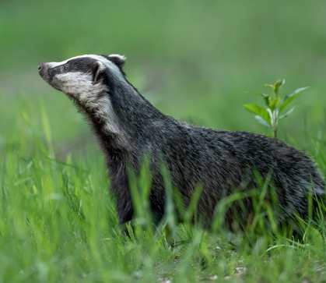
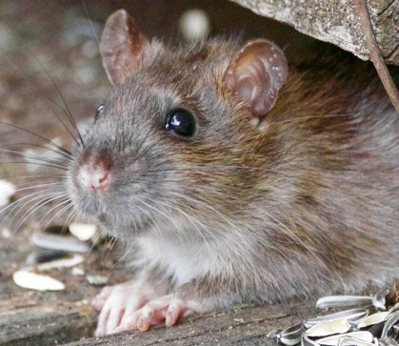
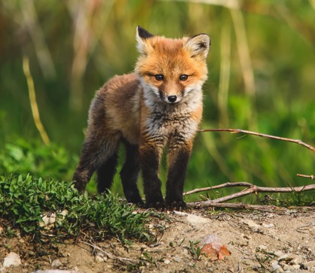
Types of Animals
Squirrel
Mouse
Hedgehog
Badger
Rat
Fox

Slide 12
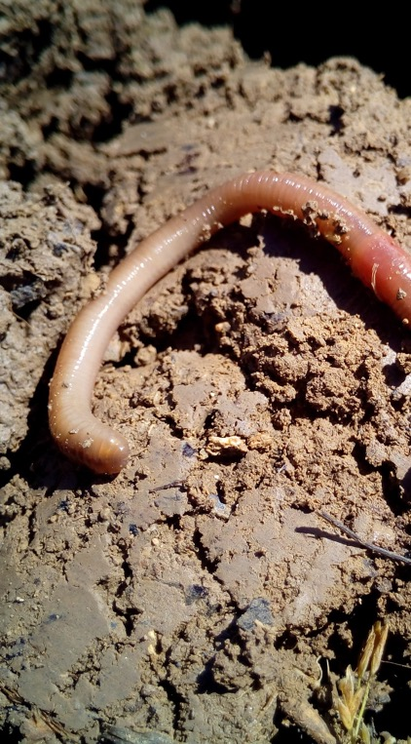
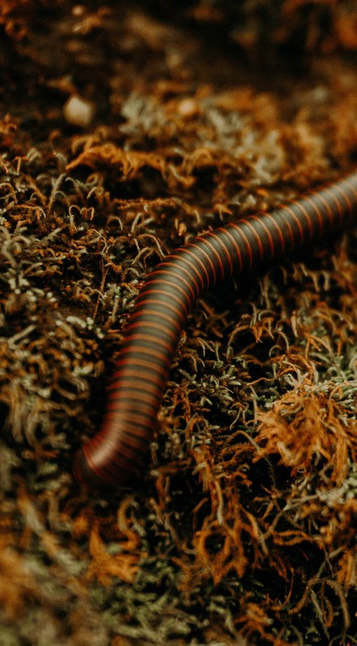
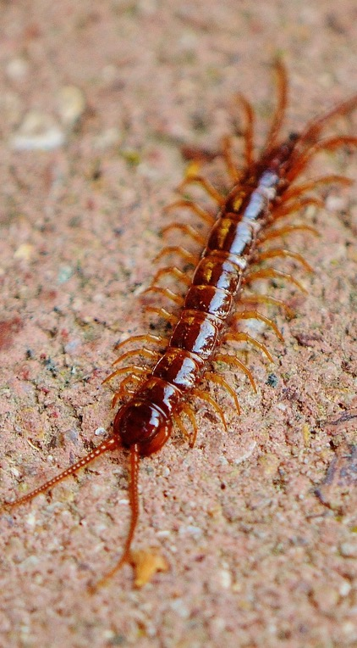
Soil Dwellers
Worm
Millipede
Centipede

Slide 13
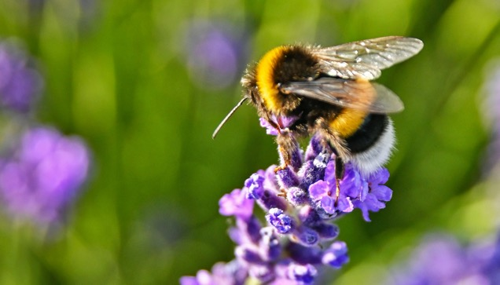
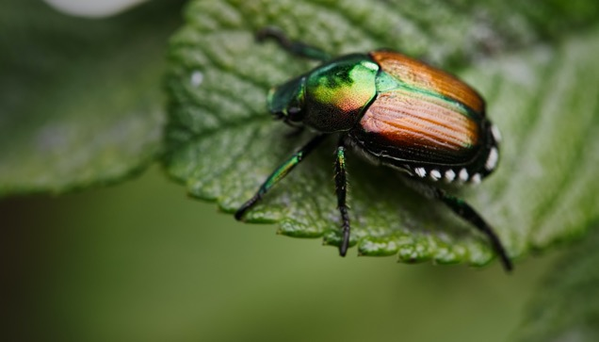
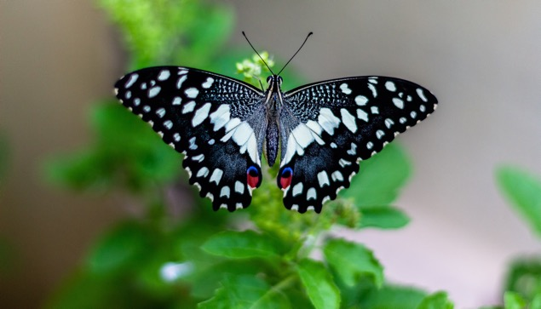
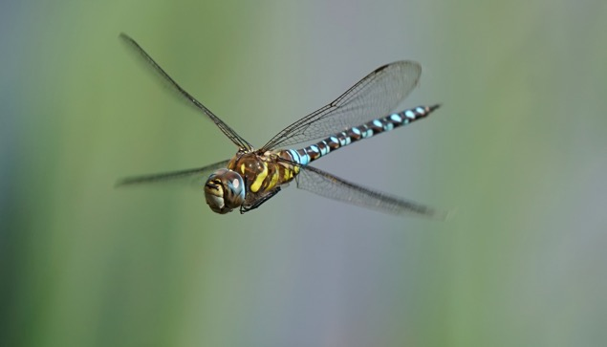
Types of Insects
Bumblebee
Beetle
Butterfly
Dragonfly

Slide 14
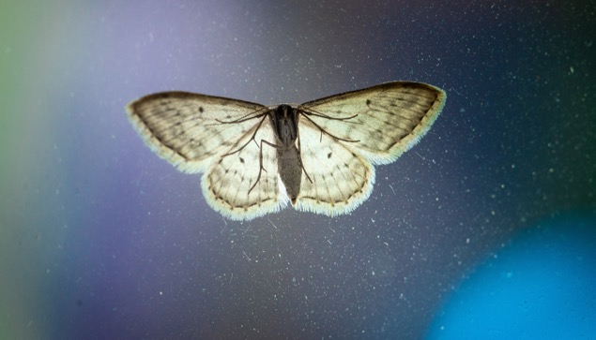
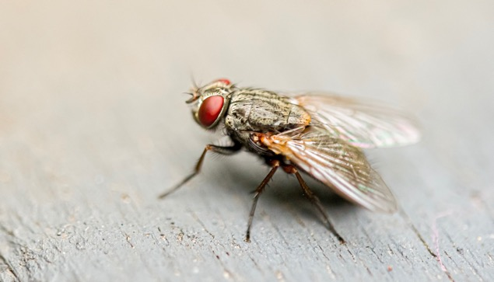
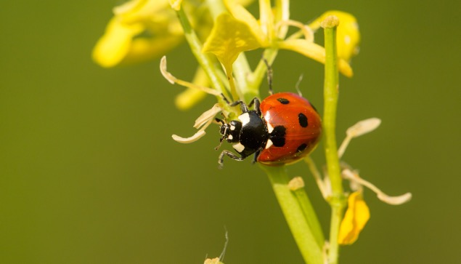
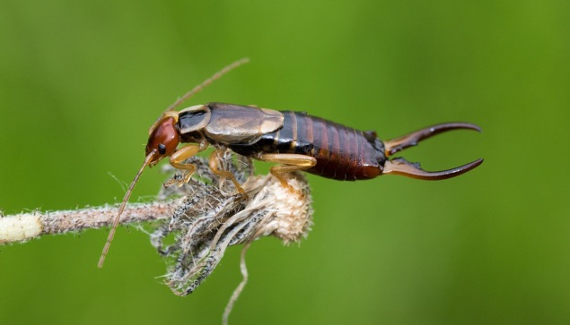
Types of Insects
Moth
Fly
Ladybird
Earwig

Slide 15
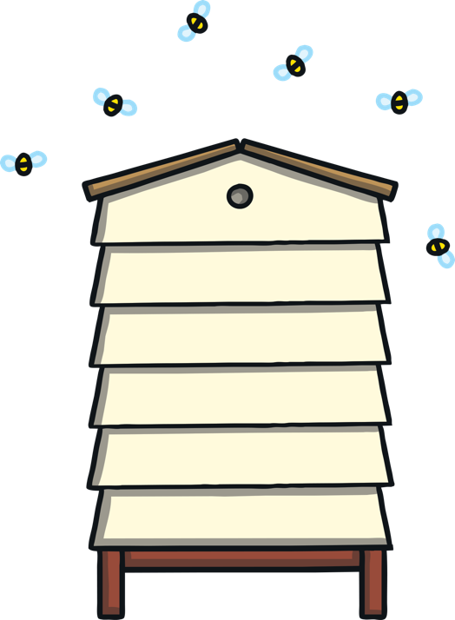
Types of Bees
There are 99 different species of bees in Ireland.
1 honeybee
21 different bumblebees
77 solitary bees
Bumblebees and solitary bees are known as wild pollinators.

Slide 16

Types of Bees
Honeybees live in hives and are managed and cared for by beekeepers.
Bumblebees have fat, furry bodies. They make their nests on the ground, hidden in long grass or other vegetation.
Solitary bees nest in tiny holes in wood or hollow
stems or make burrows in bare soil.

Slide 17

Bees are important for our environment!
As bees visit plants seeking food, pollen catches on their bodies and passes between plants, fertilising them – that's pollination.
Many plants would not be able to fertilise without bees and other pollinators.

Slide 18










There are around 70 crops in the UK that depend on or benefit from bee pollination.

Slide 19



3 Reasons Honey Bees Are Important
They Pollinate Food Crops
Honeybees always travel a long way to look for nectar. As a result, we have many foods like cucumbers, cherries, apples, limes and lemons.
They Pollinate Wild Plants
Wild plants provide food for lots of insects, birds and animals. Without wild plants, these would disappear. There would be no milk, meat and other important foods we get from animals and birds.

Slide 20

3 Reasons Honey Bees Are Important
They Produce Honey
It is only bees who can produce honey for us. Natural honey is an important food that
has immense benefits for our health.
Honey also reduces coughs, increases
athletic performance, heals wounds
and fights bacteria.

Slide 21




Bees are not the world's only pollinators.
Flies, wasps, moths, beetles, butterflies and even some birds all pollinate.
Estimates suggest we have over 1500 pollinating insect species in UK.

Slide 22

Bees Are Important For Our Environment
Bees are a fantastic symbol of nature.
By keeping the cycle of life turning, bees boost the colour and beauty of our countryside.
Some 80% of European wildflowers require insect pollination.
Pollinators allow plants to fruit, set seed and
breed. This in turn provides food and
habitat for a range of other creatures.
So the health of our natural
ecosystems is linked to the health
of our bees and other pollinators.

Slide 23

Bees Are in Danger of Dying Out!
Pollution and disease
Climate change
Pesticides and herbicides
Habitat loss
Invasive species

Slide 24

Habitat loss
Habitat loss means less forage and shelter for
bees. It’s vital for bees to have enough flowers
to forage and safe places to use for nesting
among vegetation, soil, and hedges.
Climate change
Changes in climate may be disrupting
bee nesting behaviour. It may also affect
the timing of flowering plants that bees
rely on for food. For example, apple trees
could be in blossom at a different time from
when the bees are active.

Slide 25
Invasive species
Some species that are not naturally found in the UK can be disruptive - or worse - for native bees. For example, the Asian hornet recently arrived in the UK and could devastate British bee species.
Pesticides and herbicides
These can have negative effects on bees by reducing their breeding success and resistance to disease. Scientists have found that exposure to pesticides can impair honeybees' ability to navigate and bumblebees' ability to reproduce.

Slide 26

Habitat Protection
First, and most important, is to protect existing natural habitats.
Native hedgerows are vital for pollinators and wildlife.
It is important to stop mowing grassy areas. This allows common wildflowers to naturally grow among the grass.

Slide 27

Habitat Protection
Next comes restoration of existing areas to encourage plants to grow.
Trees, shrubs, verges and parks need to be allowed to flower and fruit. Bees need the nectar that flowers provide, while birds need the seeds.
Bees need to survive the winter and safe spaces to rear the next generation. Leaving rough uncut areas in parks or around hedgerow bottoms are
perfect places for this.

Slide 28

Habitat Protection
Last but not least comes the creation of new habitat.
Higher quality green spaces bring us closer to nature.

Slide 29

Why Do We Need to Protect Our Pollinators?
Farmers need pollinators to ensure good yields of high quality produce. Without pollinators, the livelihood of farmers would be impacted.
Gardeners rely on pollinators for growing their own fruit and vegetables to feed their families.
Environment 78% of wild plants need insect pollination. Without these, the landscape would be a much less beautiful place. These plants provide shelter for our native wildlife.

Slide 30

What Can We Do To Help?
Plant for pollinators: Grow more nectar-rich flowers, shrubs and trees to provide for pollinators throughout the year.
Let your garden grow wild: Leaving
patches of land to grow wild lets
wildflowers grow and makes great nesting and feeding sites.
Put away the pesticide: They can harm pollinators and many other beneficial invertebrates. Consider alternatives and only use pesticides as a last resort.

Slide 31


What Can We Do To Help?
Leave the lawnmower: Cut your grass less often and remove cuttings to let plants flower.
Build a bee hotel and avoid disturbing or destroying nesting or hibernating insects in grass margins, bare soil, hedgerows, trees, dead wood or walls.

Slide 32

4 Things You Can Do To Save Our Bees
When planning your garden, plant flowers and shrubs that will flower in Spring or Autumn.
When gardening, consider leaving an area uncut to allow daisies, dandelions and other flowers to grow.
Have a little more space? Grow a fruit bush.
Don’t have a garden? You can grow flowers and
plants in plant pots.

Slide 33


Pollinator Plan for Your School
Draw a habitat map of your school.
Identify areas where you can take action to help pollinators.
Visit www.pollinators.ie and find out what they need to survive.
Protect wildlife spots you already have.
These include: areas of long grass with wildflowers; flowerbeds; and native trees.
Protect wildlife spots you already have.
Make your own 'Don't Mow' and 'Pesticide-Free Zone' signs for your school.

Slide 34





Plant pollinator-friendly trees.
The best native trees are:
Willow
Hawthorn
Wild cherry
Crab apple
Blackthorn

Slide 35




Plant pollinator-friendly flowers for every season of the year.
The best ones are:
Spring - Crocus
Summer - Monarda
Autumn - Perennial Wildflower
Winter - Snowdrop

Slide 36




Plant pollinator-friendly herbs for every season of the year.
The best ones are:
Spring - Marjoram
Summer - Chives
Autumn - Sage
Winter - Rosemary

Slide 37




Plant pollinator-friendly fruit and veg for every season of the year.
The best ones are:
Spring - Kale
Summer - Strawberry
Autumn – Runner beans
Winter – Raspberry

Slide 38

Reduce or eliminate pesticides in your school.
Find out from the school caretaker if they use pesticide and if they could reduce it.
Only use herbicides for health and safety reasons, for example, to stop areas becoming slippery.

Slide 39

Help Wildlife in Your School
Organic bird feed helps birds to thrive!
Wildflowers provide homes and food for bees and other insects.
Weeds are good for bees and insects too!
Why not start a gardening/vegetable club and help wildlife. Never use pesticides when gardening!
Make a bee hotel for bees to live in.
Keep paths and the playground
free of unwanted weeds by hand
weeding/brushing or hot foam.
Never use pesticides on paths or
the playground!
Don’t cut the grass too often and
never use pesticides on the grass!

