Slide 1

Translink Travel Challenge

Slide 2
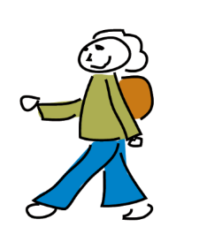
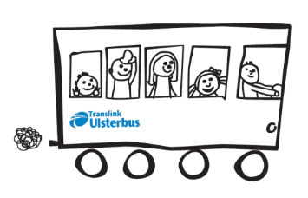
What is the Translink Travel Challenge?
The challenge is a competition where pupils in school try to change their transport habits for 2 weeks (or more!)
Pupils try to bus, bike, hike, train, scoot, even hop to school instead of just taking the car, and they record their results.
Pupils can, for example - walk in groups, take the bus/train or form a cycle group!

Slide 3
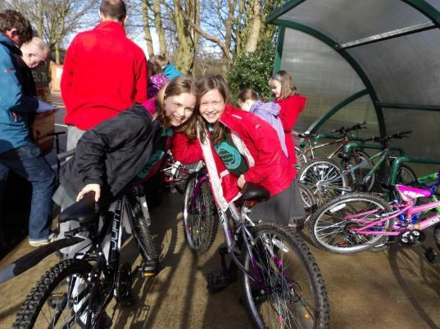

What’s good about it?
Positively changing your travelling habits reduces the amount of pollution and carbon in the atmosphere
It’s healthy
It’s more sociable
It’s fun
It wakes you up
You could win a prize!
It will help your school work
towards the Eco-Schools Green Flag award

Slide 4
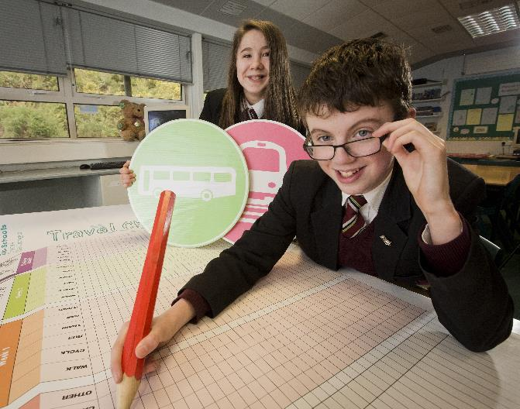
How to take part
Pupils record how they travel to and from school each day for the 2 week period on a personal tally sheet or class wall chart
Think of creative ways to promote your
Travel Challenge – have fun!!
Record your travel results for two weeks

Slide 5
Examples of how to get started
Walk to school with friends in your class or create a walking bus with your classroom bubble
Take on the challenge and do your best!
Take the bus with your parents or the friends in your class
Have a ‘Bike for Breakfast’ day – get your reward for being so committed
Work out how many eco-miles you could save.
Magherafelt Primary School set themselves a ‘Lap the Lough Challenge’. They saved 1183½ eco-miles as a school and ‘Lapped the Lough’ 14 times!

Slide 6
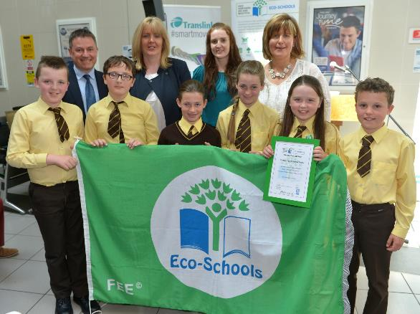
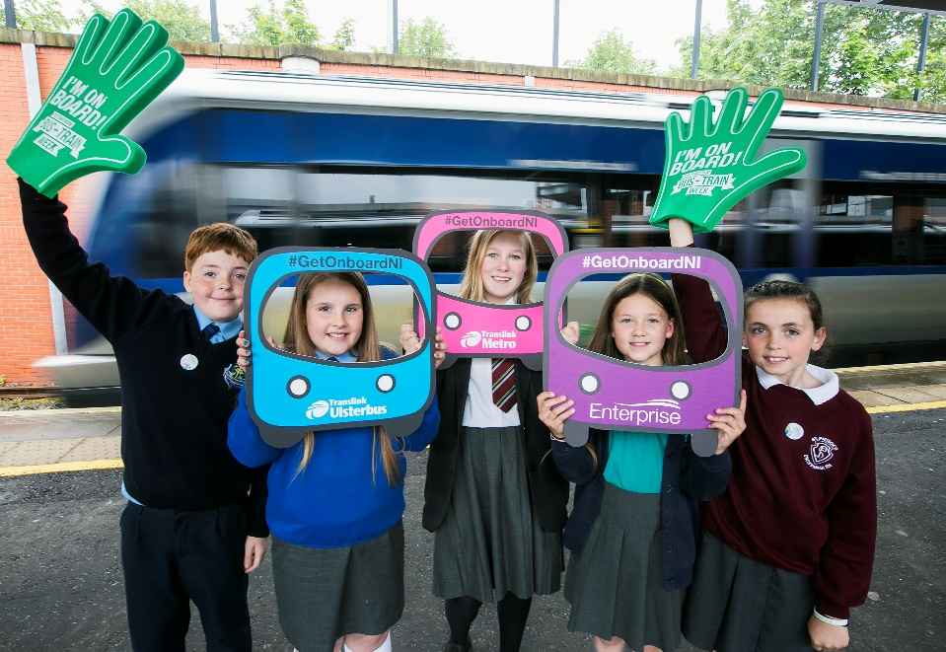
Submit your results
The Travel Challenge can be run any term. So you have more flexibility to take part in any 2 weeks which suit you. Do the challenge more than once if you wish!
Record your results on the wall chart or individual tally chart and submit via the Eco-Schools online Data Zone.
Good Luck!!

