Slide 1



















Slide 2






WELCOME,
STUDENTS!

Slide 3


Global Perspective
Water
Climate Change
Key Stage 3

Slide 4

Key Stage 3
A day in the life of – sorting activity based on country using headings such as type of home, buildings, food and water access, shopping, education, employment, health care, transport
Thinking, Problem Solving and Decision Making Example: Investigate living conditions in different countries. Where do they live? What type of buildings do they live in? How do people in other countries access water, electricity, health care? Make decisions on whether our lifestyle is preferable to that of another country.
100 people in the world
Self Management: Find out what personal decisions can be taken to make the planet a fairer society and improve the environmental impacts of our own lifestyles.
Biscuit activity but with money – Global economy/wealth
The world gave me my phone

Slide 5









GLOBAL CITIZENSHIP
Notes:
Being a global citizen is not clearly defined. As there is no global government there are no clear rules and regulations and globally, we do not have democratically-elected representatives to speak for us. Global citizenship is more a moral understanding of our responsibilities and our rights in a global context. Being a true global citizen means that we recognise that all people have equal rights and value diversity.
In addition, it means we should value the earth as our common home and one which we all have a need and indeed a responsibility, to look after.

Slide 6






Global Population

Slide 7


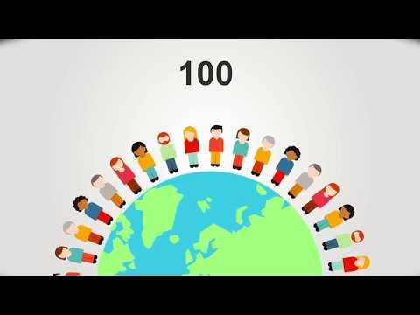
IF THE WORLD WERE 100 PEOPLE
Notes:
The world has 7,600,000,000 billion people
https://www.youtube.com/watch?v=A3nllBT9ACg

Slide 8

IF THE WORLD WERE 100 PEOPLE
Gender
50 would be female
50 would be male
Age
25 aged 0-14
66 aged 15-64
9 aged 65+
Continent
60 Asians
15 Africans
11 Europeans
9 South Americans
5 North Americans
Living Area
51 live in urban areas
49 live in rural areas
Language
12 Chinese
5 Spanish
3 Arabic
3 Hindi
3 Bengali
3 Portuguese
2 Russian
2 Japanese
62 Others
Housing
77 have access to shelter
23 do not
Nutrition
1 Starving
11 Undernourished
63 Adequate
22 Overweight
Poverty
48 live on less than $2 USD per day
Water
91 have safe water
9 do not
Phones
5 have no mobile phone network
Internet
47 have access to the internet
53 do not
College
66 go to highschool
Literacy
86 able to read & write
14 unable (2/3s are women)
Electricity
82 have electricity
18 do not
Religion
31 Christians
23 Muslims
15 Hindus
7 Buddhists
8 Others
16 Don’t identify with a particular religion

Slide 9





Global Food
Notes:
Global Food
There is plenty of food in the world to feed everybody. The problem is how this food is distributed and shared. In fact, more than one and a half times the amount of food needed to feed everybody in the world is produced each year yet over 1 billion people, 1 in 6 people are hungry.

Slide 10

How Far Did My Food Travel?
Food | Country imported from | Miles to Northern Ireland
Bananas | Ecuador | 5585
Green beans | Kenya | 6479
Coffee beans | Brazil | 5265
Tea | India | 6408
Lemons | Spain | 1554
Sweet potatoes | USA | 4148
Olives | Italy | 1475
Pineapples | China | 8453
Lamb | New Zealand | 11,703
Rice | Indonesia | 7427
Coconuts | Philippines | 6701
Garlic | South Korea | 10,566
Chilli Peppers | Mexico | 5113
Apples | Poland | 1434

Slide 11
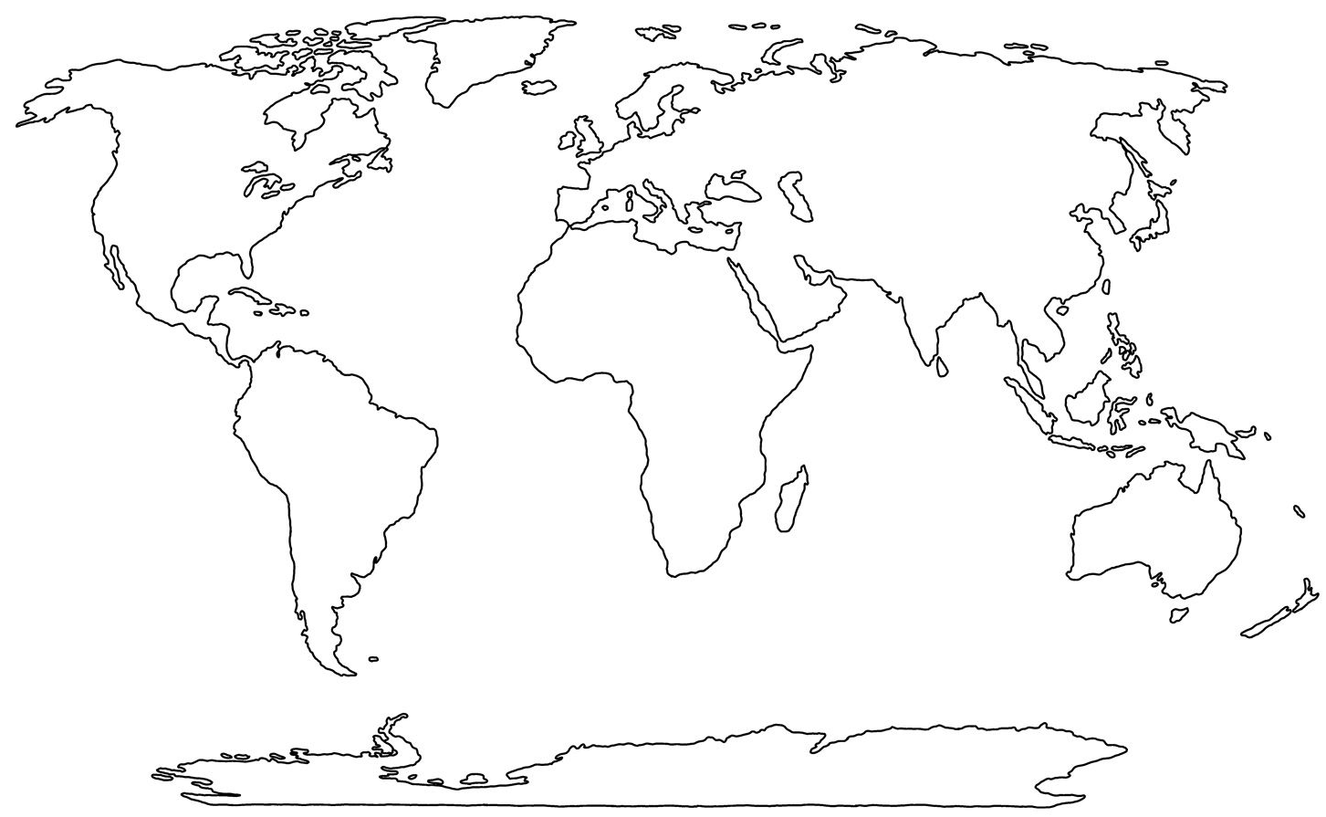













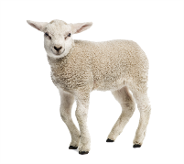

Slide 12



Trade: One of the causes of hunger is unfair trade rules. When we talk about trade we are referring to how countries buy and sell goods and services. By buying and selling goods and services countries receive an income. This income is used to improve a country’s standard of living by investing in public services such as roads, hospitals and schools. But who trades? Individuals, companies, governments… almost everyone, in some shape or form, is involved in buying and selling goods and services in order to satisfy their needs and wants.
FairTrade guarantees a better deal for developing world producers. By Buying FairTrade products, you can ensure that injustices to the producers are reduced. FairTrade is also about sustainable development: producer organisations are encouraged to continuously improve working conditions and product quality; to increase the environmental stability of their farming methods; and to invest in the development of their organisations and the welfare of their works. The Fairtrade logo is only awarded to producers that have a trade union, obey health and safety rules, protect the environment and do not allow children to work.
www.fairtrade.org

Slide 13

LOGO
LOOKOUT

Slide 14






Notes:
Forests for all forever - The Forest Stewardship Council is an international non-profit, multi-stakeholder organization established in 1993 that claims to promote responsible management of the world's forests
Reuse, Repair, Refuse, Reduce, Recycle – Universal recycling symbol
Fairtrade is an arrangement designed to help producers in developing countries achieve sustainable and equitable trade relationships. Members of the fairtrade movement add the payment of higher prices to exporters, as well as improved social and environmental standards.
Rugmark is a global, not-for-profit organisation dedicated to providing a better life for thousands of children working illegally in the rug industry across South Asia.
Traidcraft is a UK-based Fairtrade organisation, established in 1979. The organisation has two components: a public limited company called Traidcraft plc, which sells fairly-traded products in the United Kingdom; and a development charity called Traidcraft Exchange that works with poor producers in Africa and Asia
The Rainforest Alliance certification seal means that the product (or a specified ingredient) was produced by farmers, foresters, and/or companies working together to create a world where people and nature thrive in harmony

Slide 15

A pair of Nike trainers sells for $100.
How would you divide the money up?
There are 7 areas listed below which are all part of the journey a Nike trainer takes before you buy it.
Cost to Produce
Materials (famers, tanners and suppliers)
Factory worker’s salary
Factory Owner salary
Retailer Margin
How much the shop makes?
Marketing & Advertising
Insurance & Custom Duty
Taxes
Other Expenses & overheads
Shipment
Packaging etc.
Nike Profit

Slide 16
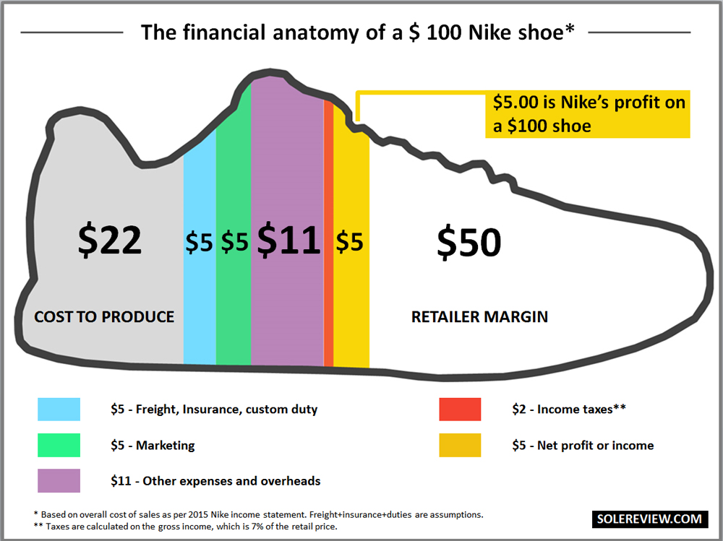

Slide 17


Possible Activities
Working with others: Organise a Fairtrade Breakfast, invite local shops and supermarkets to take part and supply Fairtrade goods. Any funds raised could be used to help support other environmental projects in the school or could be donated to charity.
Using Mathematics: Do a survey of awareness levels in school about global environmental issues. Collate the data and make graphs for the Eco-Schools noticeboard.

Slide 18



Slide 19

Water scarcity around the world
Water abundance: A more than adequate supply of water. Great in its quantity.
Physical water scarcity: There is not enough water to meet all its demands (human needs, industrial uses, agricultural use, recreational use, etc)
Economic water scarcity: There is a lack of investment in water infrastructures or poor management of water

Slide 20



Water Scarcity Activity
Each station has 3 cups, each labelled agriculture, human needs and recreational uses. Each group must divide the cotton balls into these 3 cups. Take notes along the way, describing your experience (challenges faced), identifying water quality and giving reasons for your actions.
Station 3 (Economic water scarcity):
3 cups (agriculture, human needs and recreational uses)
1 large jug of cotton balls (dyed blue) – marked with an X and must not be used
1 very small cup for collecting
1 small bucket of cotton balls (dyed brown located at the other side of the room
Station 1 (Water Abundance):
3 cups (agriculture, human needs and recreational uses)
1 big bowl
1 large jug of cotton balls (dyed blue)
Station 2 (Physical Water Scarcity):
3 cups (agriculture, human needs and recreational uses)
1 small cup for collecting ‘water’
1 small bucket containing very few cotton balls

Slide 21
Symbolism
Station 3 (Economic water scarcity):
Have to travel to collect water (time-consuming, tiring)
Water that is collected is poor in quality (very dirty)
The large jug of clean ‘water’ indicates that there is available water underground, however, they do not have the economic power to make use of it
Station 1 (Water Abundance):
Ability to fill all 3 cups
Large bowl indicates that there is even overflow
Blue clean, healthy water available
No feeling of worry about water shortage
Station 2 (Physical Water Scarcity):
Unable to fill all 3 cups
Simply not enough water
Have to decide on what to use the water on
May cause arguments

Slide 22

CLIMATE
CHANGE!
Notes:
Have you heard of climate change? What do you think it is? What is causing it?

Slide 23



What is ‘Carbon Footprint’?
Notes:
Begin by asking your class what ‘carbon footprint’ is.
And how we measure it.

Slide 24

Carbon Footprint
Carbon footprint is the amount of carbon a person uses on average
Every time we use Earth’s natural resources, carbon dioxide is released into the atmosphere, causing the Earth to heat up
Knowing a person’s carbon footprint and how it compares to the carbon footprint of others can help pupils to identify how the Earth is impacted by their actions and how they can reduce their carbon footprint

Slide 25
Key areas of ‘carbon footprint’
Electricity
Energy
Water
Recreation
Transportation
Dwelling
Food
Consumption
Waste

Slide 26
Ways to reduce your carbon footprint
Recycle at home
Conserve energy through switching of lights and devices
Support Green vendors
Use reusables e.g. coffee cup, water bottle, lunchbox
Invest in plants at home
Try to stay healthy and eat organic fruit and veg
Use alternative modes of transport or share where possible
Get outside and volunteer
Conserve Water are – take short showers, fix leaking pipes, keep the running tap close while you brush your teeth, recycle water in your home, use water-saving appliances, collect rainwater in a rain barrel to water your garden.
Go meat free 2-3 days a week
Make your plastic promise on the KNIB website - reduce your use of single use plastic
Get involved in your school eco-committee
Be kind to everyone
Don’t buy things you don’t really need – always question yourself before purchase

Slide 27





MATERIALS NEEDED FOR CLASS
List the things your students need to get ready before class. It can be a particular textbook, the accomplished homework due for the day, or any specific materials for the topic you're about to discuss. You can also match it with corresponding photos or icons.

Slide 28




CLASS OBJECTIVES AND RULES
Objectives inform students the learning outcomes of the class. What will they know? What will they be able to do? Why is this important to know? It's an effective way to assess their learning progress.
Rules provide the structure necessary for an engaging and productive class. Keep it simple and easy to follow. It can be general to cover different situations or very specific to your students.

Slide 29



LESSON FOR THE DAY
KEY STAGE 3

Slide 30







CONCEPTS AND DEFINITIONS
Get the ball rolling by introducing the lesson's key concepts and its corresponding definitions. Duplicate this page as many times as needed to give you more space for discussion. Pair the concepts and definitions with relevant images too for a more visualized presentation of the lesson.

Slide 31
EXAMPLES AND ILLUSTRATIONS
Example 1
Example 2
Example 3

Slide 32


EXERCISE
Add instructions or guidelines here.
You can also put in the amount of time allotted for this.
Individual exercises extend a student’s grasp of the lesson. It allows them to synthesize on their own and think of ways they can apply their new learnings in real life. Duplicate this page as many times as needed to give you more space for discussion.

Slide 33
Question 2: Write the question you want to ask your students and allot space for the answers.
WORKSHEET
Answer 2:
Add instructions or guidelines here. You can also put in the amount of time allotted for this.
Question 1: Write the question you want to ask your students and allot space for the answers.
Question 3: Write the question you want to ask your students and allot space for the answers.
Answer 1:
Answer 3:

Slide 34

ACTIVITY TIME
Add instructions or guidelines here.
You can also put in the amount of time allotted for this.
Like seatworks, student-led activities that can be done by pairs or by group widen their grasp and interpretation of the lesson. Be creative with the activity. Duplicate this page as many times as needed to give you more space for discussion.

Slide 35

SUPPLEMENTAL VIDEO
Let your students watch relevant educational videos that help reinforce the lesson for the day. It’s no secret that it helps students stay interested and engaged. Duplicate this page as many times as needed.

Slide 36

ADDITIONAL RESOURCES
Duplicate this page as many times as needed to give you more space for discussion.
Photos or screenshots of relevant articles are also effective in reinforcing a class lesson.
Maximize this space for additional resources you want to share with your students.
It's something they can easily look back on or search online in case they need a refresher.

Slide 37

CLASS RECAP
Discussion Point
Discussion Point
Discussion Point
Discussion Point
Discussion Point
Cap off a productive class with key summary points students can easily remember.
You can provide this for the class as a way of wrapping up everything you've discussed.
You can provide this for the class as a way of wrapping up everything you've discussed.
You can provide this for the class as a way of wrapping up everything you've discussed.
Recaps can also be led by students for a more enriching experience.

Slide 38


HOMEWORK
Add instructions or guidelines here. You can also put additional details on when and how to submit.

Slide 39


















FREE ICONS
Use these free recolorable icons and illustrations in your Canva design.

Slide 40














FREE RESOURCES
Use these free recolorable icons and illustrations in your Canva design.

