Slide 1




















Slide 2









WELCOME,
STUDENTS!

Slide 3






Global Perspective
Water
Climate Change
Foundation Stage
Global Perspective
Water
Climate Change
Key Stage 1

Slide 4
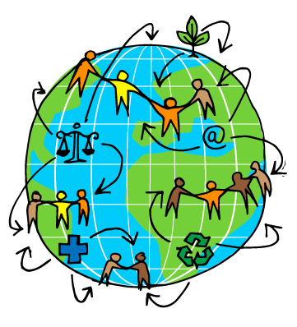

GLOBAL CITIZENSHIP
Notes:
Being a global citizen is not clearly defined. As there is no global government there are no clear rules and regulations and globally, we do not have democratically-elected representatives to speak for us. Global citizenship is more a moral understanding of our responsibilities and our rights in a global context. Being a true global citizen means that we recognise that all people have equal rights and value diversity.
In addition it means we should value the earth as our common home and one which we all have a need and indeed a responsibility, to look after.

Slide 5

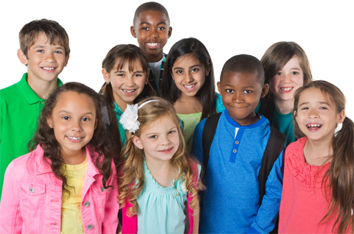
Li: I know that everyone
is special and unique

Slide 6
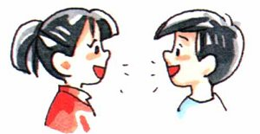
Look at the photographs of these children
What is the SAME about them?
What is DIFFERENT about them?
Talk to your partner
about what you notice.

Slide 7
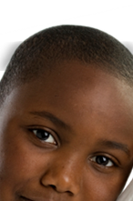
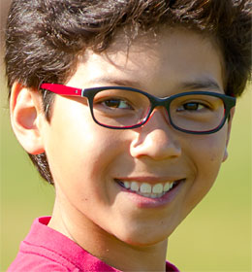
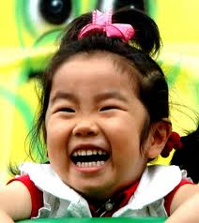
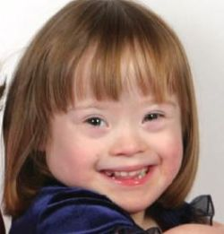
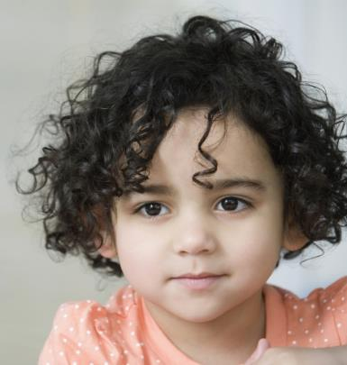
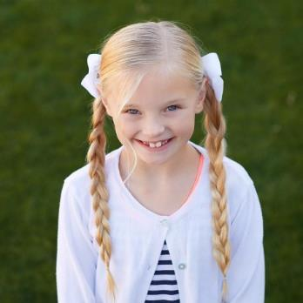
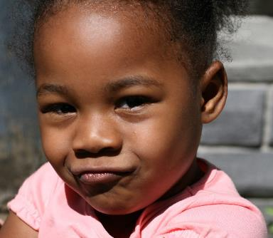
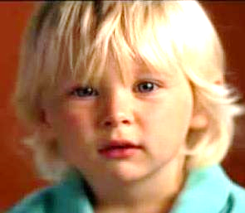
Notes:
May print some images for children to walk around the room and discuss

Slide 8

We all have different likes and dislikes around the world and even in this classroom.

Slide 9
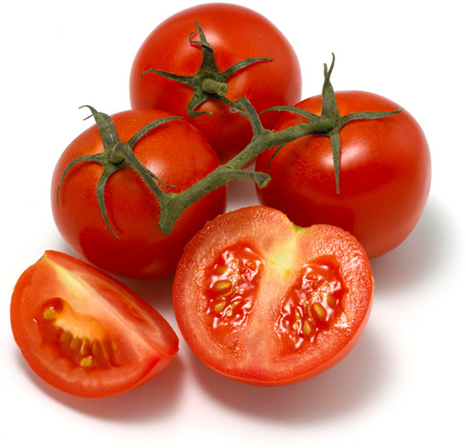


Like
Don’t like

Slide 10

GREEN
Like
Don’t like

Slide 11
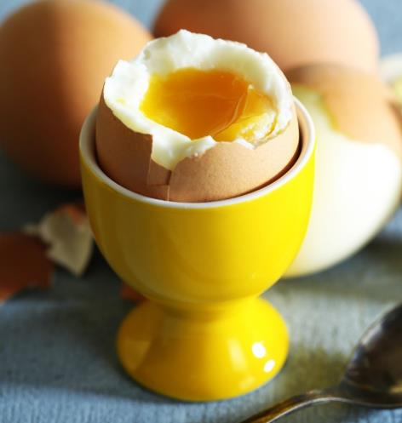
Like
Don’t like

Slide 12

Like
Don’t like

Slide 13
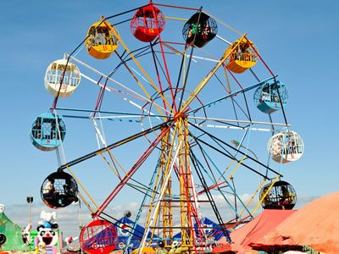
Like
Don’t like

Slide 14
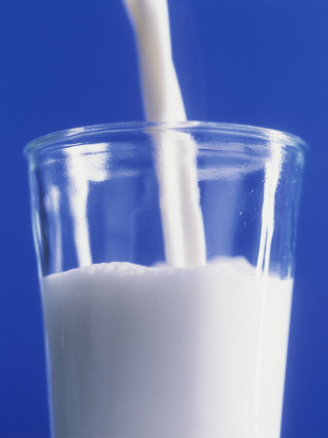
Like
Don’t like

Slide 15
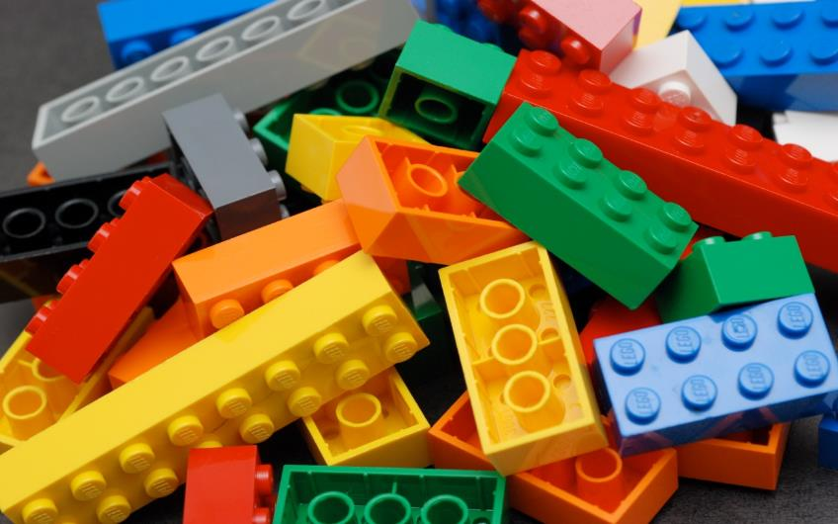
Like
Don’t like

Slide 16
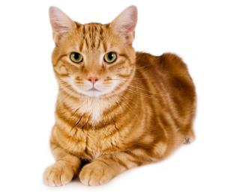
Like
Don’t like

Slide 17
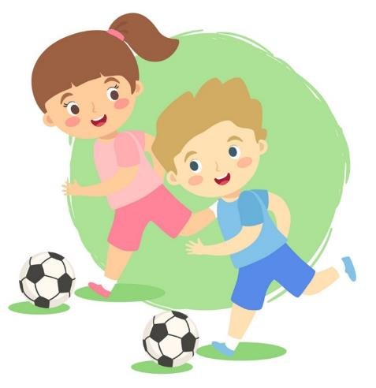
Like
Don’t like

Slide 18
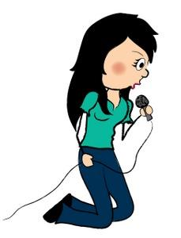
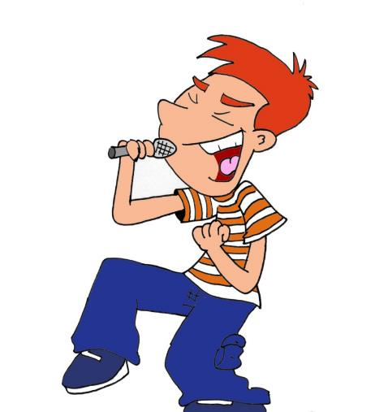
Like
Don’t like

Slide 19
Nobody in the WORLD
looks the same
thinks the same
feels the same
believes the same
or behaves exactly the same way
as............YOU!
YOU are UNIQUE!

Slide 20
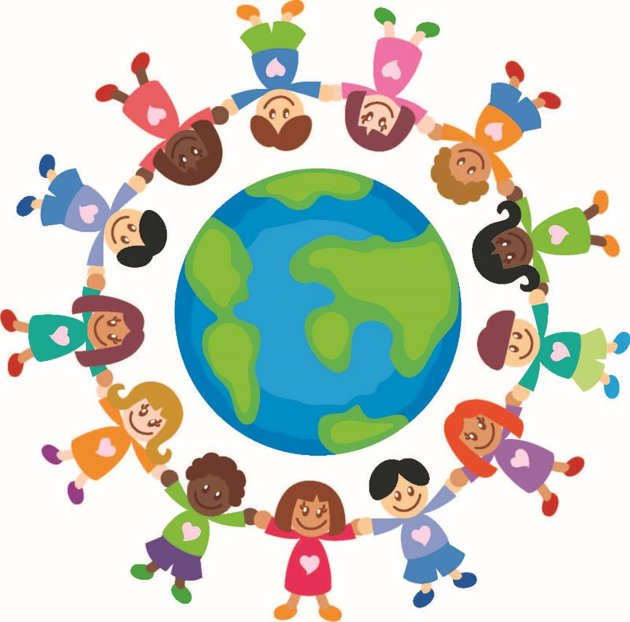
We are all different. We are all special. We are all unique.

Slide 21

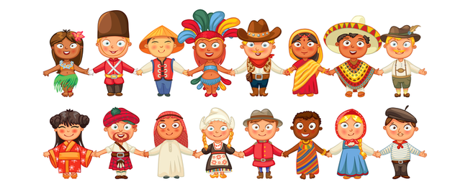

Traditional Clothing from around the World.
Notes:
People around the world dress differently and have traditional clothing

Slide 22
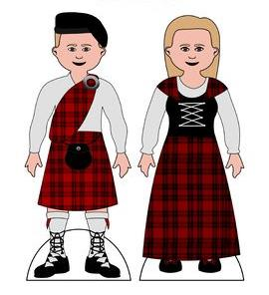
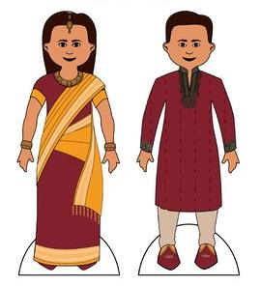
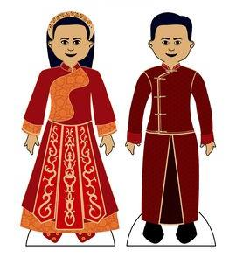
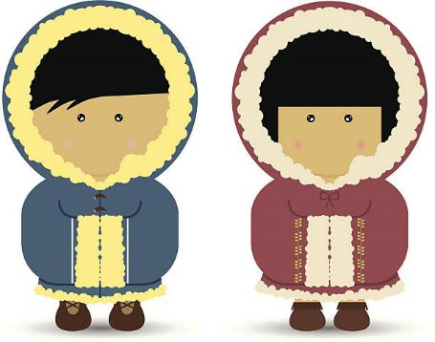
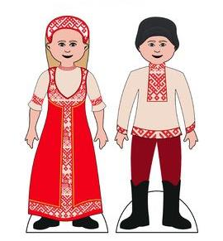
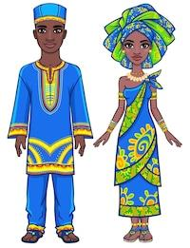
Scotland
India
China
Alaska
Russia
East Africa
Notes:
Tartan is a criss-crossed pattern of horizontal and vertical bands in lots of colours. The tartan is Scotland’s national dress!
2. In India cotton fabric is used to make clothes that is lightweight. This material is a favourite because it keeps the wearer cool and is easily washed. Girl – Sari and male Sherwani
3. The Chinese believe that the colour red is lucky. They believe that the colour red can bring good luck and riches. Cheongsam for girls and Tang suit for men
4. The Eskimos make their clothing out of the natural resources they have around them. They make most of their clothes out of animal skin. Yup'ik clothing and Cup'ik clothing
5. Russia is known for its fur hats called, "ushanka," which keep Russians warm during the cold, snowy days. The sarafan and the poneva
6. In East Africa, the kanzu is the traditional dress worn by Swahili-speaking men. Women wear the kanga and the gomesi. These colourful patterns are printed onto locally sourced materials.
Worksheet to colour in and show how people dress differently and have different cultures
Also mention the different colours of their skin.
Unfortunately people can be mean to one another when someone looks or dresses differently but we are here today to remember to celebrate what is different. We must respect how different people around the world look or choose to dress.

Slide 23
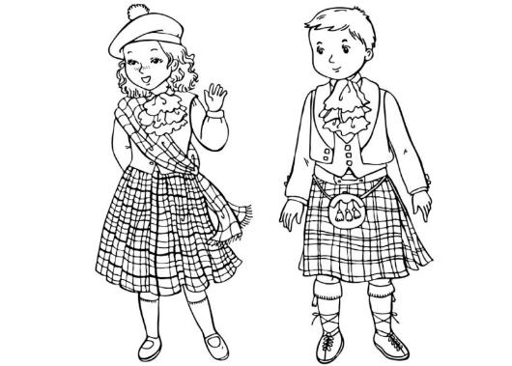
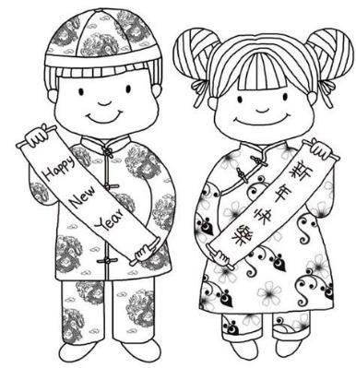
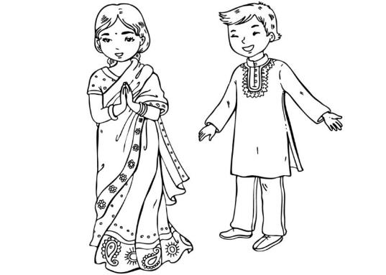
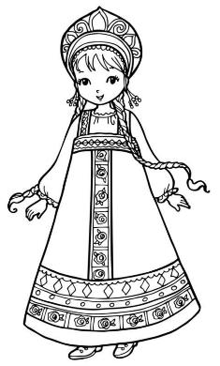
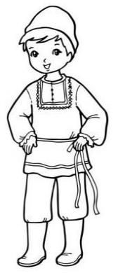
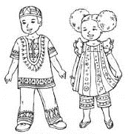
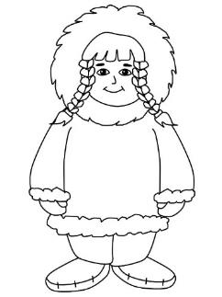
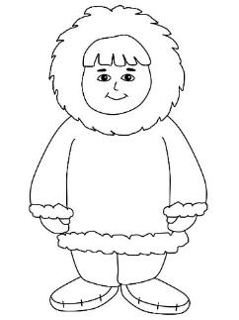
Can you colour and match these traditional pictures to their countries?
Worksheet 2
1
2
3
4
5
6
Notes:
Tartan is a criss-crossed pattern of horizontal and vertical bands in lots of colours. The tartan is Scotland’s national dress!
2. In India cotton fabric is used to make clothes that is lightweight. This material is a favourite because it keeps the wearer cool and is easily washed. Girl – Sari and male Sherwani
3. The Chinese believe that the colour red is lucky. They believe that the colour red can bring good luck and riches. Cheongsam for girls and Tang suit for men
4. The Eskimos make their clothing out of the natural resources they have around them. They make most of their clothes out of animal skin. Yup'ik clothing and Cup'ik clothing
5. Russia is known for its fur hats called, "ushanka," which keep Russians warm during the cold, snowy days. The sarafan and the poneva
6. In East Africa, the kanzu is the traditional dress worn by Swahili-speaking men. Women wear the kanga and the gomesi. These colourful patterns are printed onto locally sourced materials.

Slide 24
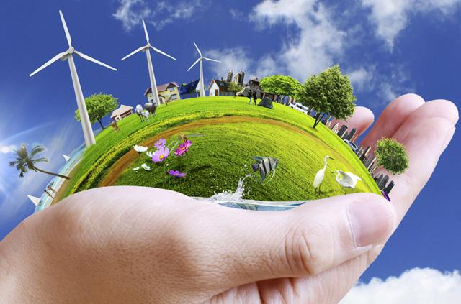
GLOBAL ENVIRONMENT

Slide 25
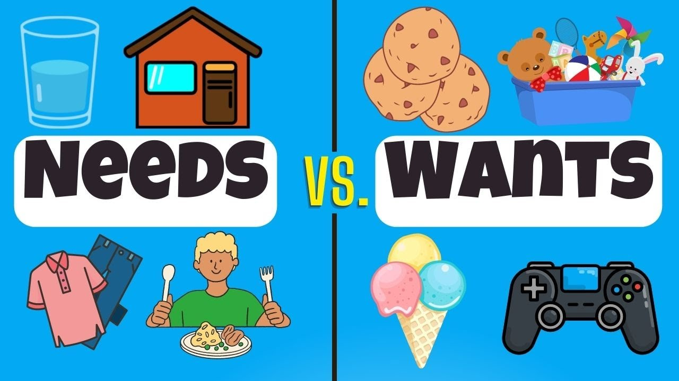

Notes:
Watch the video to allow class to understand the difference between needs and wants
Check understanding by looking at pictures and seeing if they can identify if they are needs or wants

Slide 26

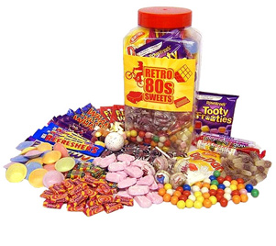
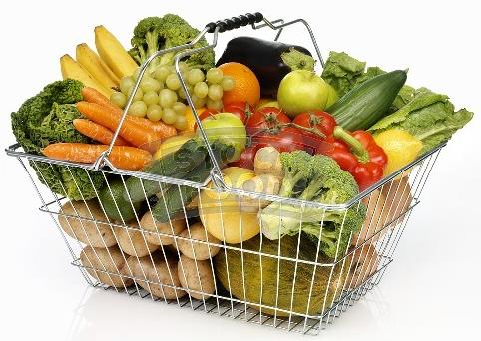
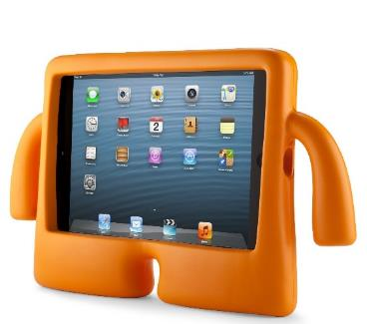
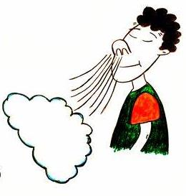
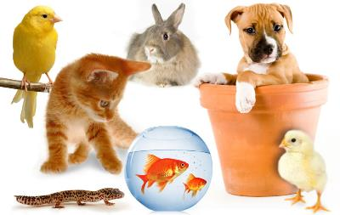
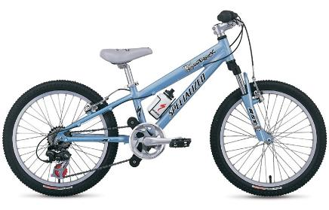
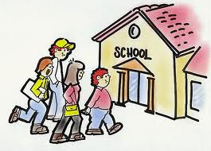

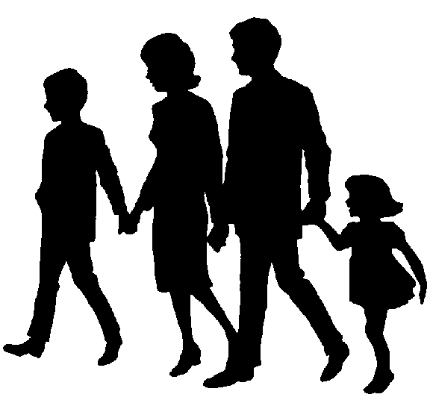


Notes:
Thumbs up thumbs down or one side of the room is a want and the other is a need.
Explain many children/people get to have all these things (both their needs and wants however some children even here in this classroom may not get all these things.
Is it fair one person should get it and another should not? why do you think it is or isn’t?
Family and love should be discussed – these are things we need to look after our emotional health.

Slide 27
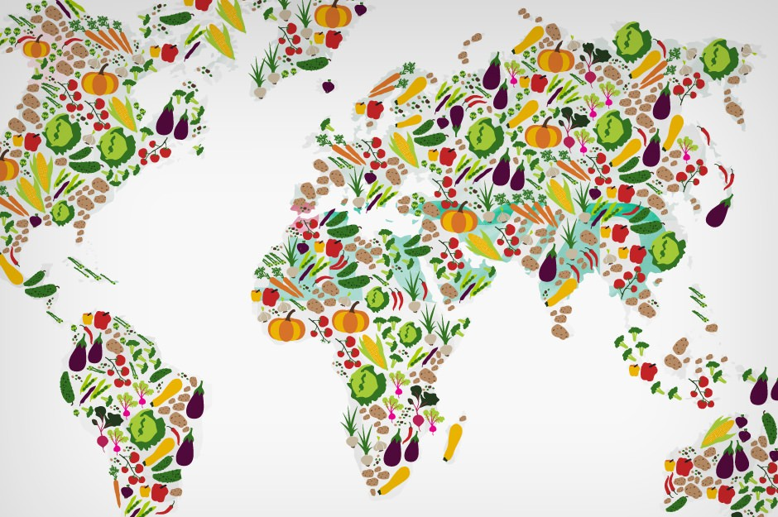
Global Food
Notes:
Global Food
There is plenty of food in the world to feed everybody. The problem is how this food is distributed and shared. In fact, more than one and a half times the amount of food needed to feed everybody in the world is produced each year yet over 1 billion people, 1 in 6 people are hungry.

Slide 28
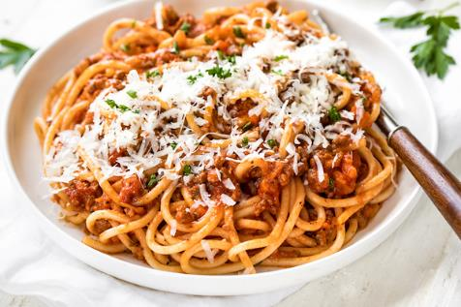
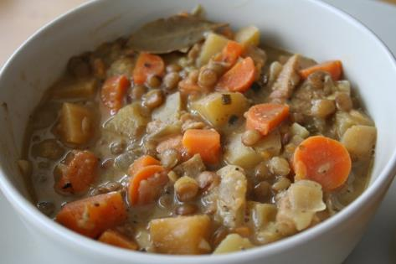
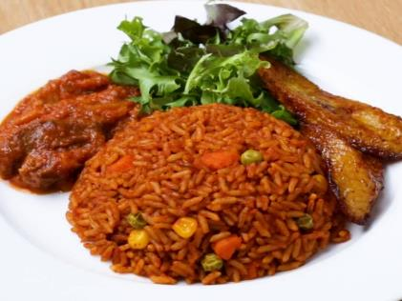







Notes:
Italy is famous for its pasta dishes, sauces and wines. Italians use a few fresh ingredients to make their meals. Such as Lasagna and Spaghetti Bolognese made often with Tomatoes, meat, pasta, olive oil, herbs…
Irish Stew – mince, beef onion, carrot
English breakfast - This a big hearty breakfast! Beans, bacon, Eggs, sausages, tomatoes, toast, cup of tea…
Malawian cuisine can be very diverse with locals enjoying tea and fish like bream, salmon and sardines sourced from nearby Lake Malawi.
India is famous for it’s yummy spicy food. Indian cooking uses lots of spices to make the food smell, taste and look delicious.
Thalis are a selection of several small portions of different things, e.g. chutney, rice, yogurt, curry… they are one of the most popular foods in the UK.
Paella is a famous Spanish dish and it is made using sea food and vegetables and lots of rice! Omelets are made using lots of eggs, potatoes, herbs, meat, vegetables.
Jerk Chicken refers to the way it has been cooked. After the meat has been thoroughly cleaned it is smoked in a deep pit or on a BBQ and it is covered a sauce full of many spices. Curried Goat is also a favourite Caribbean dish. Have you ever eaten it at home?
Turkish and Greek people eat lots of different types of olives especially at breakfast time.
Mezze and Kebabs are famous dishes from both countries. Mezze are lots of little plates of food like, humus, olives, stuffed peppers, feta cheese, fried aubergine, vine stuffed leaves. Spicy rice.
Turkey and Greece are both famous for making Kebabs as well as pastry dishes.
Turkey is also known for making Baklava, a sweet filo pastry dessert.

Slide 29

Share the sweets out among the class
I got a sweet
I didn’t get a sweet
Notes:
Ask one pupil to share the sweets out among the class – going seat by seat or desk by desk (not individually choosing their friends)
You should ensure they have less sweets than there are pupils
Those who get sweets ask them how it makes them feel.
Some may be able to say they felt sadness when their friend didn’t get a sweet.
Explain unfortunately the things we need in life are not always shared out fairly. It is important to be kind to everyone.

Slide 30








Possible class or whole school activities
Example 1
Example 2
Example 3
Example 4
Themed days/hours in nursery to teach about different cultures. Pupils could host themed events (dress up day/local cuisines).
Example 3
Walk around the school to decide which things are needs and which are wants.
Discuss the journey some food, clothes or items make to get to where we are.
Possibility of introducing which things are natural and which are human made.
Possibility of introducing which things are natural and which are manmade.

Slide 31





Slide 32
Which of these items uses water?

Slide 33
Which of these items uses the most water?

Slide 34
Which of these items uses the least water?

Slide 35

Ways to save water
Re-use your bath water for plants
Check for leaks in taps
Help FILL the dishwater and washing machine
Fill your cup halfway
Collect rainwater for your plants

Slide 36

CLIMATE
CHANGE!

Slide 37




Feeling unwell?
Notes:
Ask the children what happens when they eat too much bad food – they end up feeling sick
How do you feel when you’re unwell? Happy/Sad?
Does your temperature increase? Do you feel warmer?
Can you have fun when your sick or do you stay in bed?
Who cares for you when your sick? Your parents, siblings, grandparents?
Explain that this is similar to the Earth, when we use too much of the things on Earth is also begins to feel sick. We can help Earth feel better again.

Slide 38






What is good for the Earth?
Notes:
Good – reduce, reuse, recycle, walking, planting a tree
Bad – leaving lights on, driving the car everywhere, wasting water by leaving the tap running

Slide 39





CLASS RECAP
Nobody in the WORLD
looks the same
thinks the same
feels the same
believes the same
or behaves exactly
the same way
as............YOU!
YOU are UNIQUE!
A need is something that is necessary for you to survive as a person.
A want is something that a person wishes or desires to have.
We must not waste water and it is important to understand which human activities are good for the environment and which are not.

