Slide 1













YOUNG REPORTERS FOR THE ENVIRONMENT
YRE CLINIC 2024
Overview of the Programme &
how to apply
for this year’s competition
DEADLINE: 26 APRIL

Slide 2




TODAY’S
OBJECTIVES
INTRODUCTION
YRE METHODOLOGY
COMPETITION CATEGORIES
HOW TO APPLY
Q&A

Slide 3


PROUDLY SPONSORED BY;
About Young Reporters
for the Environment
Est. 1991
& absorbed by FEE in 1994
44 countries
& counting
19,000
photos, articles, & videos submitted each year
The YRE Programme empowers young people to engage with and report on local environmental issues.
450,000+
students

Slide 4


OPEN NOW!
Young Reporters for the Environment
NATIONAL
COMPETITION
26 APRIL 2024
IF YOU ARE AGED 11-25,
PASSIONATE ABOUT ENVIRONMENT
AND FULL OF CREATIVITY,
THIS IS FOR YOU!
Monetary Prize of £100
& opportunity to win a free trip to the YRE Conference in
South Korea March 2025

Slide 5





1
2
COMPETITION CATEGORIES
Single Reportage Photo
Article
3
4
5
Single Environmental Campaign Photo
Photo Story
3-5 Photos
Video

Slide 6









METHODOLOGY
The YRE Programme provides a simple set of steps for young reporters to follow as they produce their articles, photos, or documentary videos.
RESEARCH
SOLUTIONS
INVESTIGATE
Investigate a local issue, using primary & secondary sources, key stakeholders, original research, and links to relevant context and global issues.
Identify possible solutions from experts’ and stakeholders’ perspectives, exploring pros and cons.
REPORT
DISSEMINATE
Identify target audience and create a journalistic piece: article, photo or short video.
Disseminate to educate. Use your social media, school platforms, national operator organisation, or local/national media.

Slide 7
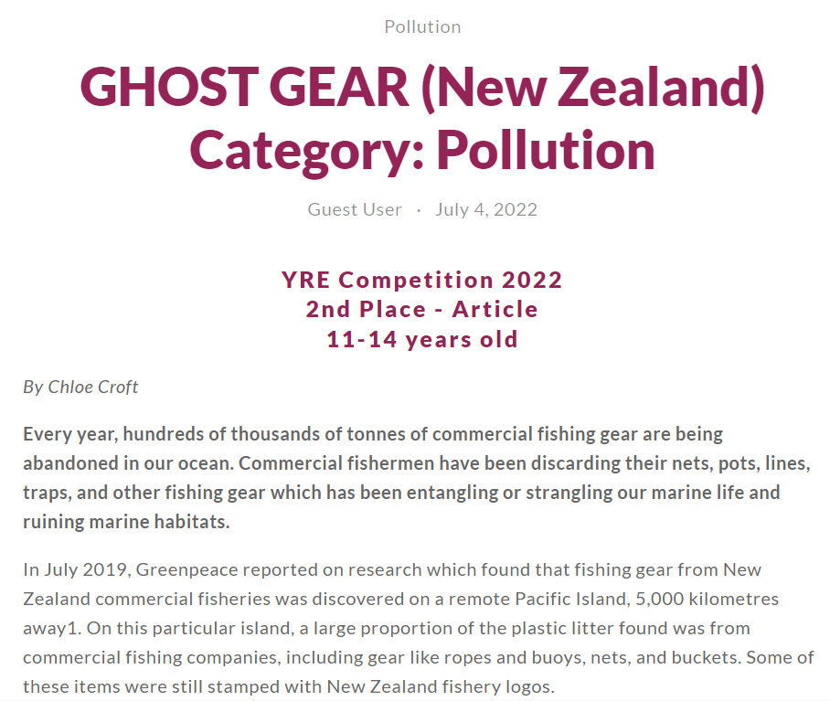
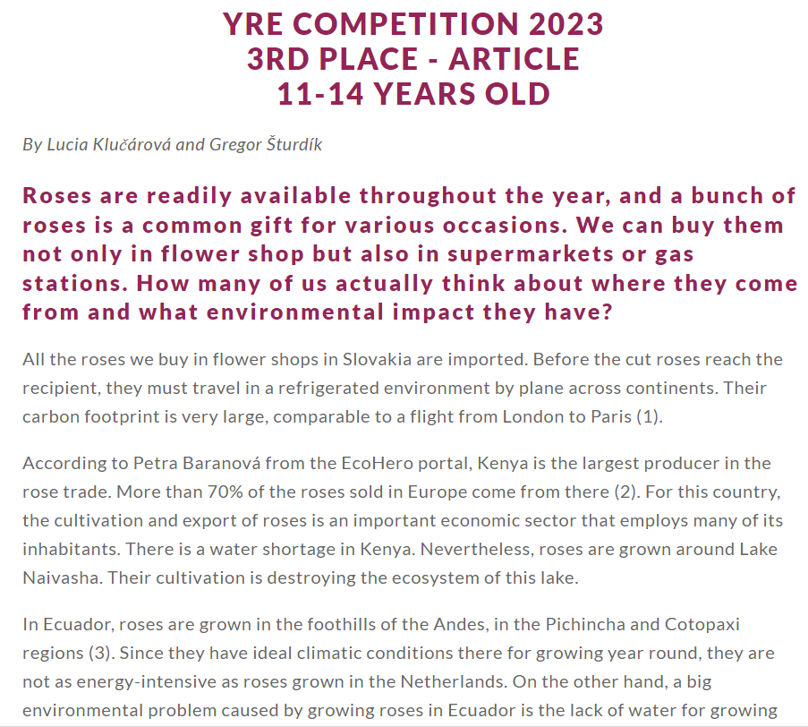

Article
Young reporters choose an engaging and relevant environmental topic that is supported with impactful data and examples.
Requirements:
  1000 words maximum
  must include 1-3 images (photos, diagrams, etc.)
  follows typical structure of a news article (introduction, body, conclusion, answering 5 Ws & H)
  incorporate strong evidence and variety of perspectives
  academic honesty - original, independent work, MLA
  dissemination
Think local! Find a topic that is important to YOUR community!

Slide 8
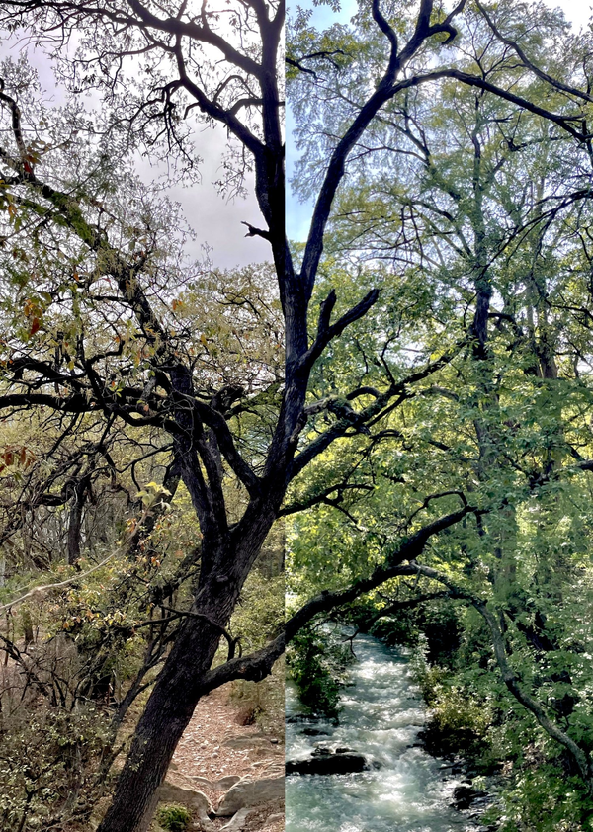
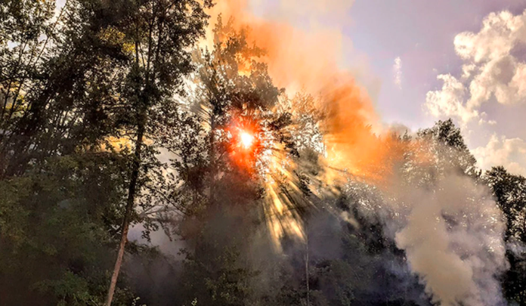
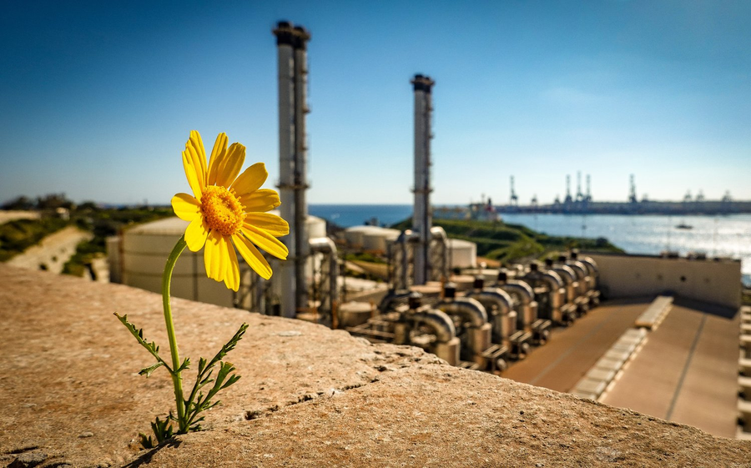
Single Photo Reportage
“Terrifying Light” by Arijana Adrović, Montenegro 2022
“Nature Finds a Way, But at What Cost?”
by Elizabeth Jade Pace and Zoe Zammit, Malta 2023
“The Northern Drought” by Victoria Margarita Andrade Morell, Mexico 2023
Requirements
  True and fair representation, not significantly altered
  Link local and global events or issues
  Description of 120 words max (or 100 words and 20 word caption)
  Description should explain the environmental link and solutions to issue presented
  Technically and artistically of good quality
Report on a Live Here Love Here campaign, beach clean up, or local environmental event!

Slide 9

Single Photo Campaign
The purpose of the Environmental Campaign Photo is to raise awareness of an issue, promote certain values, and/or inspire positive action through a photograph. The photograph can be staged, and the subject can be posed with the intention of sending a message to the viewers. An environmental lens or perspective is required.
Requirements
  Original photo and research
  Minimal photoshopping permissible, but should not alter the reality of the photo
  Address the historical, economic, social, and/or political implications through an environmental lens
  Clear link between local and global issues
  Description should include relevant and feasible solutions to environmental issues identified in photo

Slide 10
Single Photo Campaign
The purpose of the Environmental Campaign Photo is to raise awareness of an issue, promote certain values, and/or inspire positive action through a photograph. The photograph can be staged, and the subject can be posed with the intention of sending a message to the viewers. An environmental lens or perspective is required.
Requirements
  Original photo and research
  Minimal photoshopping permissible, but should not alter the reality of the photo
  Address the historical, economic, social, and/or political implications through an environmental lens
  Clear link between local and global issues
  Description should include relevant and feasible solutions to environmental issues identified in photo

Slide 11
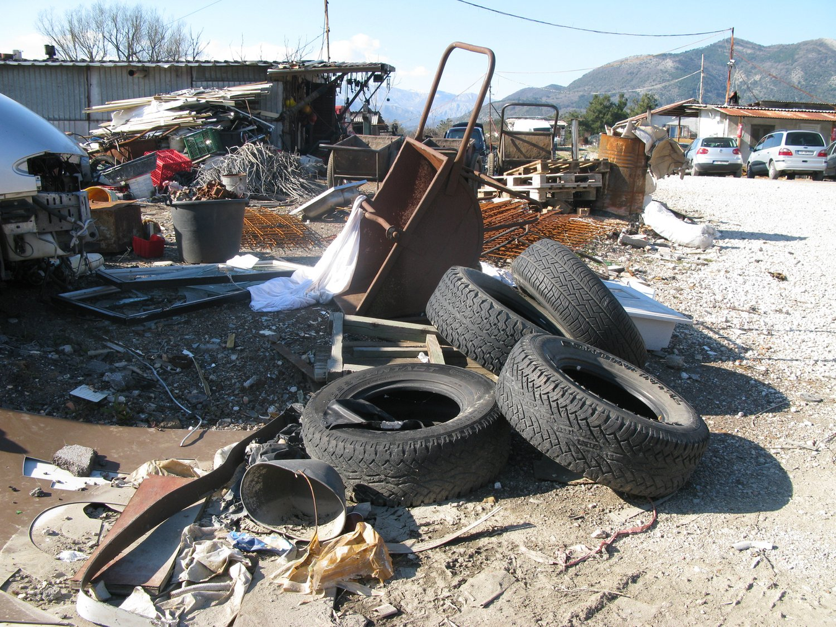
“Recycling Embrace, No Disgrace” (Montenegro)
By Nikola Kovač
Photo Story
(3-5 photos)
The purpose of a Photo Story (3-5 Photographs) is to tell a story through a series of photographs to help the viewer better understand environmental issues, events, or phenomena. Like photo reportage, a photo story aims to tell a truthful and accurate story through a series of candid photographs.

Slide 12
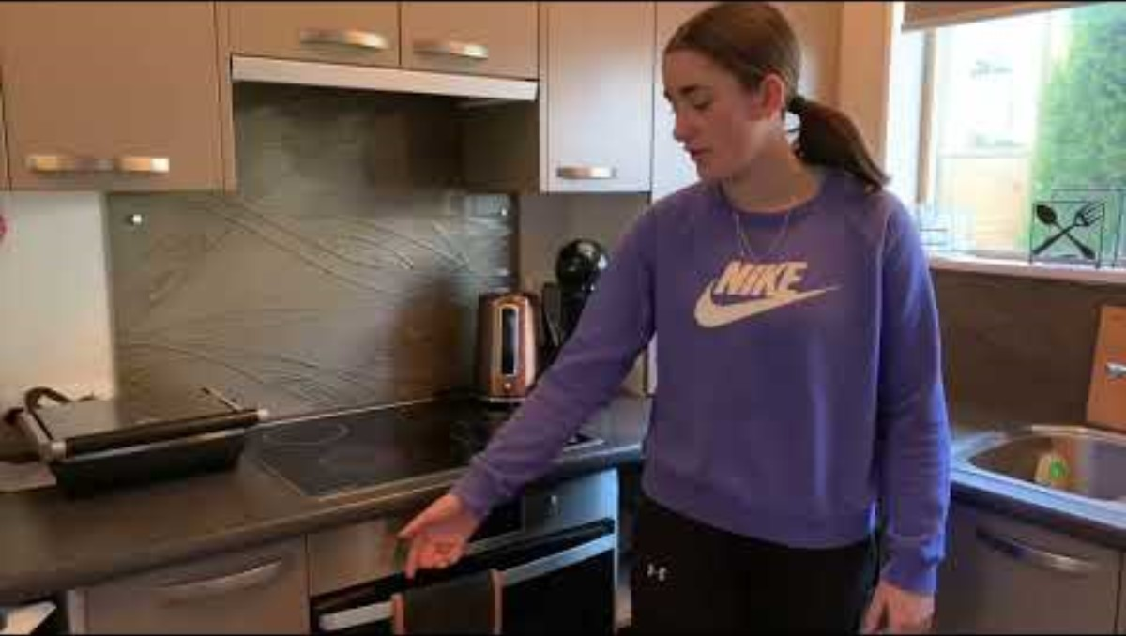
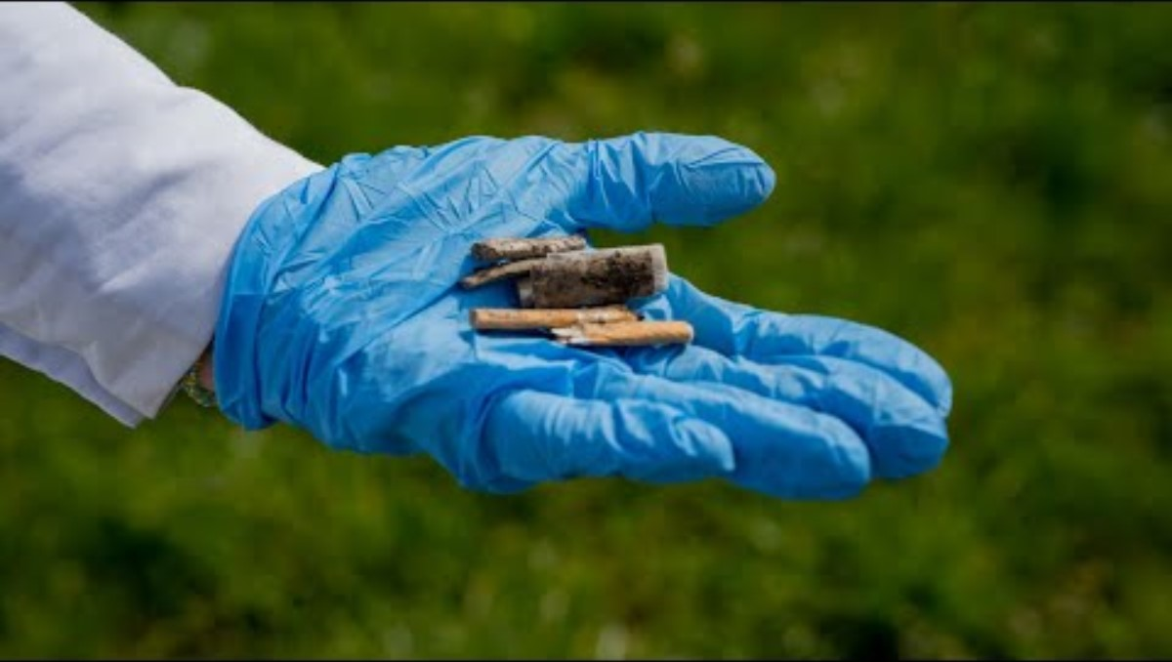
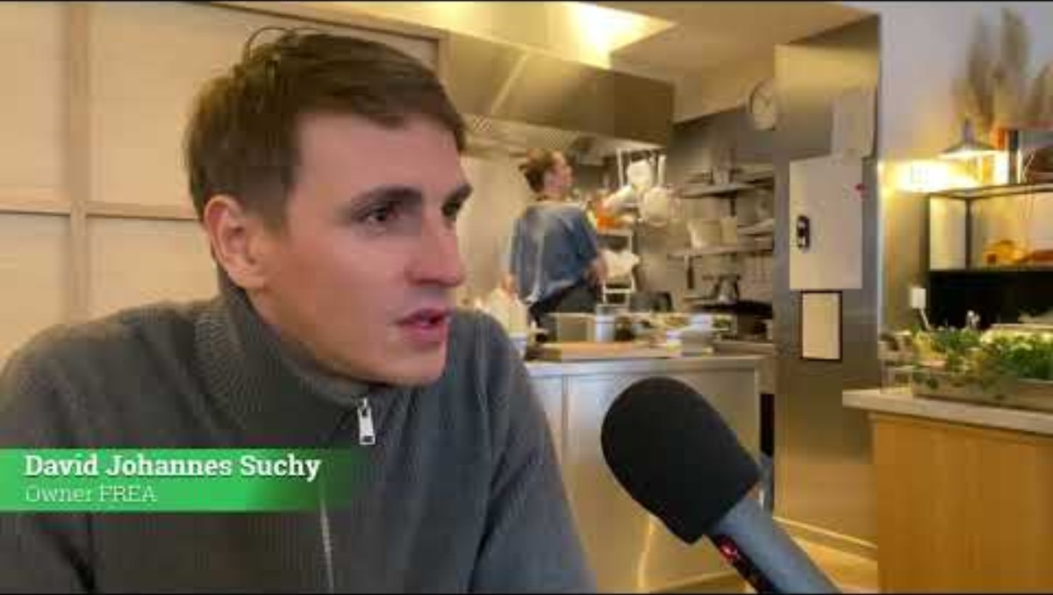
Video
Reportage Videos are like mini documentaries. They are based on news, events, history, facts etc., and use elements of direct observation, research, interviews and documentation

Slide 13

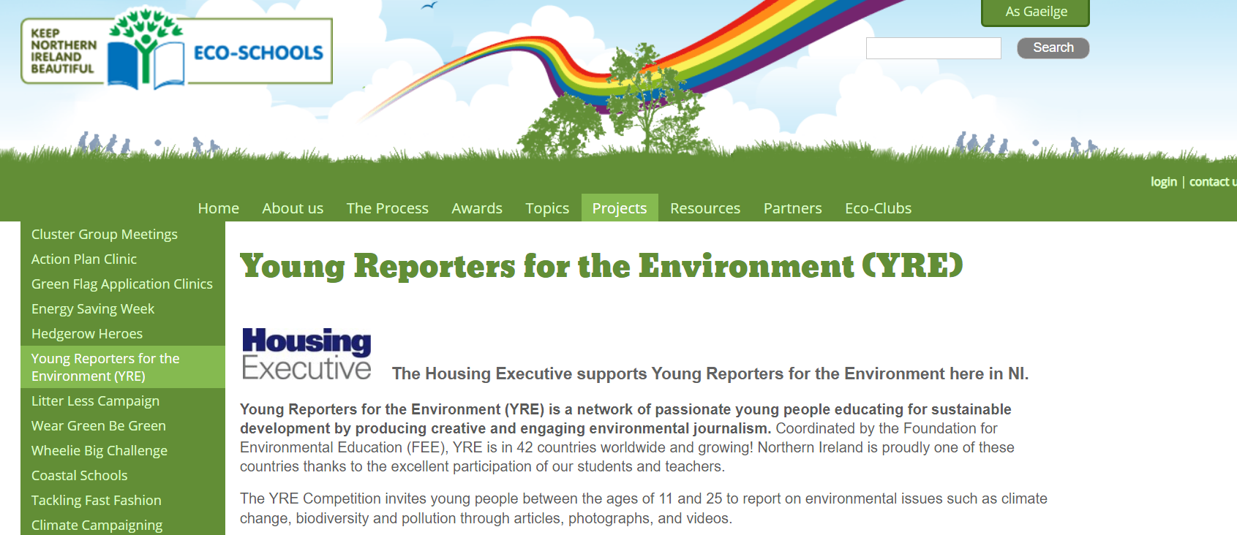
How to Apply
Go to eco-schoolsni.org
  Register using the online form on the Eco-Schools NI website
  Report on a local issue & disseminate
  Read through the awarding criteria for your category
  Complete the relevant form for your category
  Email your final work + your completed form to
eco-schools@
keepnorthernirelandbeautiful.org

Slide 14



Questions?
CONTACT US
eco-schools@keepnorthernirelandbeautiful.org
Michelle Gallagher
Environmental Education Coordinator
michelle.gallagher@keepnorthernirelandbeautiful.org

