Slide 1


YOUNG REPORTERS FOR THE ENVIRONMENT
Giving our environment a voice​!

Slide 2
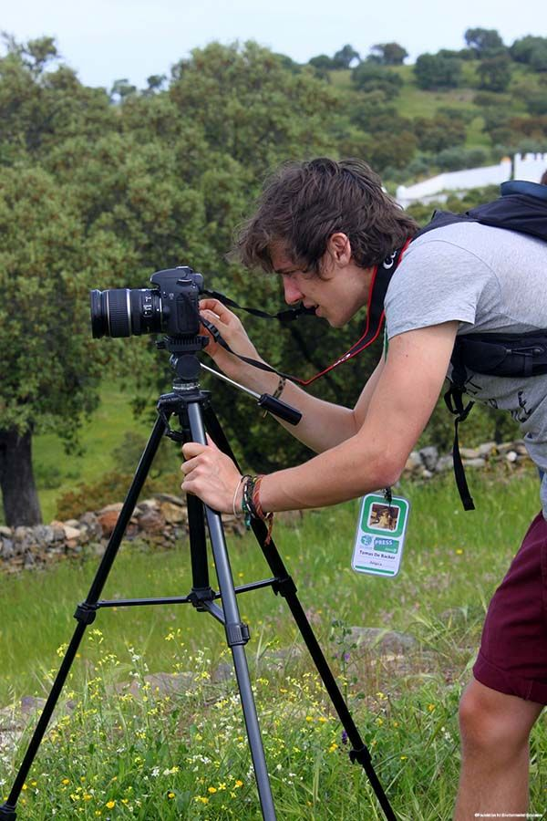
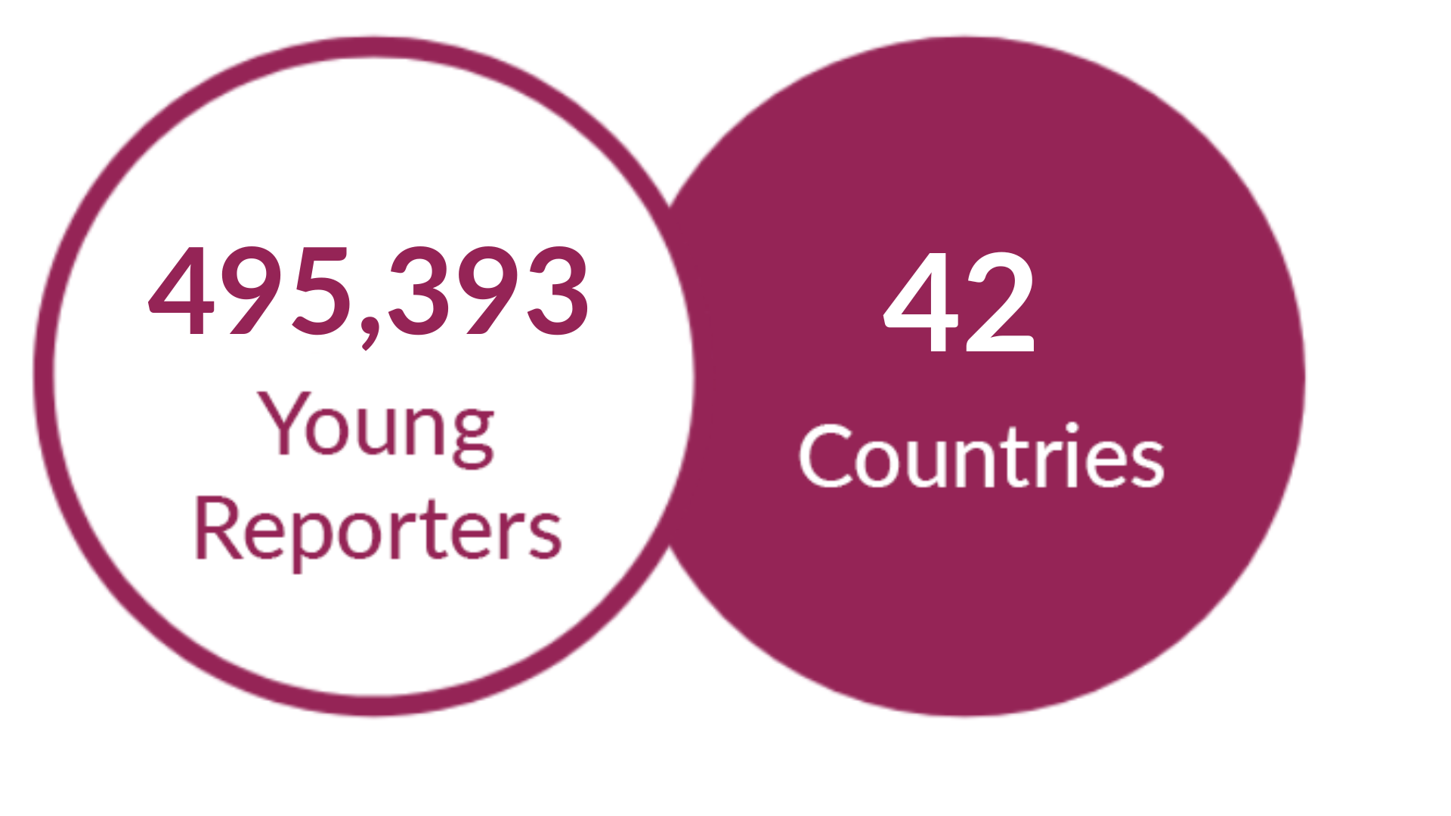
YRE gives young people a platform to research environmental issues and promote
solutions through investigative reporting, photography, and video journalism.​
YRE is a leadership programme for youth!​

Slide 3






FOUNDATION FOR ENVIRONMENTAL EDUCATION
A non-profit, nongovernmental organisation​
Promoting Sustainable Development through ​
Environmental Education worldwide​
An umbrella organisation with one member ​organisation in each country​​
4 member organisations in 4 countries in 1981
Member organisations in 77 countries in 2021
5 environmental education programmes​

Slide 4
DEVELOPMENT OF THE PROGRAMME
1990
YRE introduced in France​
1994
YRE spreads throughout Europe ​
1998
National programmes and competitions introduced​
2007-2009
YRE spreads outside Europe (Brazil, Canada, Chile, China, Kazakhstan and New Zealand)​
2011
YRE introduces age categories, video, a new website, Facebook Page, YouTube channel
2014
the 20th anniversary of YRE​
2019
YRE is active in 42 countries as it celebrates its 25th anniversary
2022
FEE was awarded with WSIS Prize for the #yrestayhome challenge
2024
we will celebrate 30 years of YRE

Slide 5
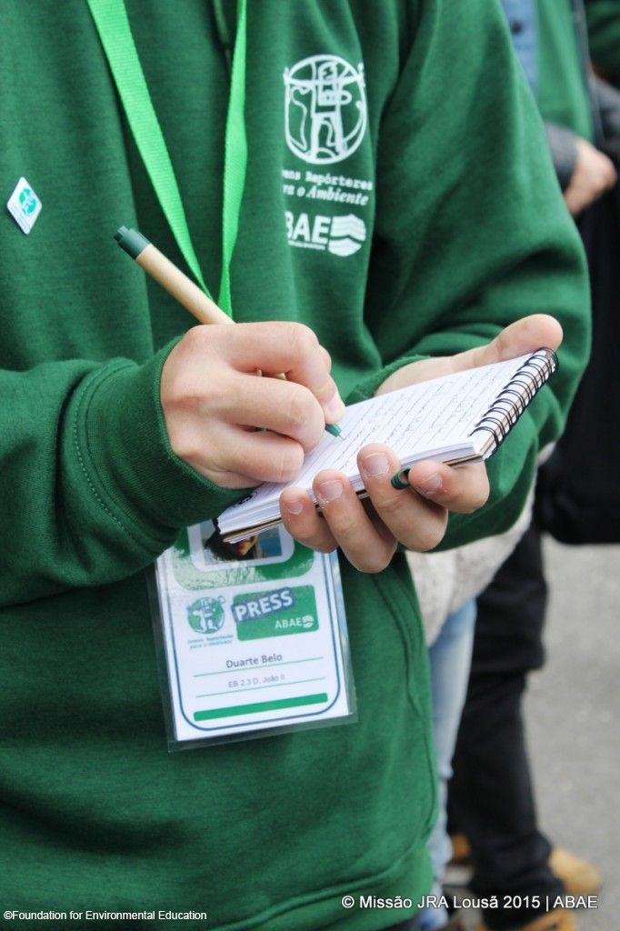
THE YRE PROGRAMME
Active in 42 countries, the YRE programme empowers young people to report on local environmental issues, giving them a sense that they can really make a difference in the world.​
YRE is a network of passionate young people educating for sustainable development by producing, engaging, creative, critical-thinking environmental journalism.​
A competition is held annually to encourage young people from all over the world to push themselves to their limits in the search for a story that will ultimately bring a real and current local environmental issue to the fore.

Slide 6
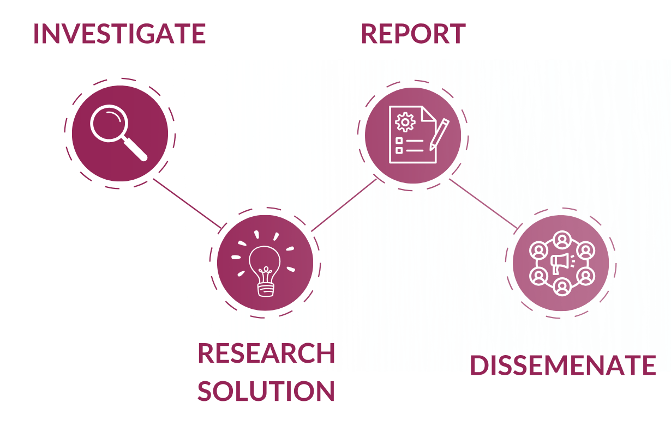
YRE METHODOLOGY
Investigate a local issue following set criteria​
Research solution
Create a journalistic piece: article, photo or short video​
Disseminate to educate

Slide 7
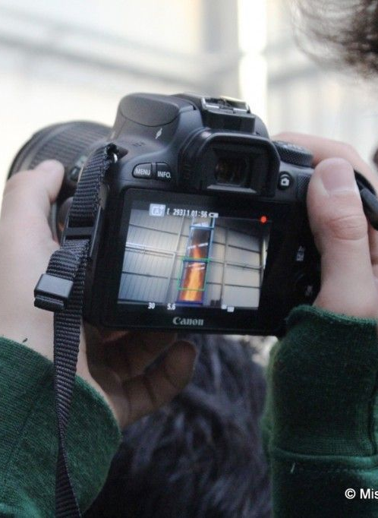
YRE INTERNATIONAL COMPETITION
National winning entries compete in the YRE International Competition​
Participants: aged 11- 25 (participating alone or through their school, college, university or youth group)​
Three categories: articles, videos and photographs.

Slide 8
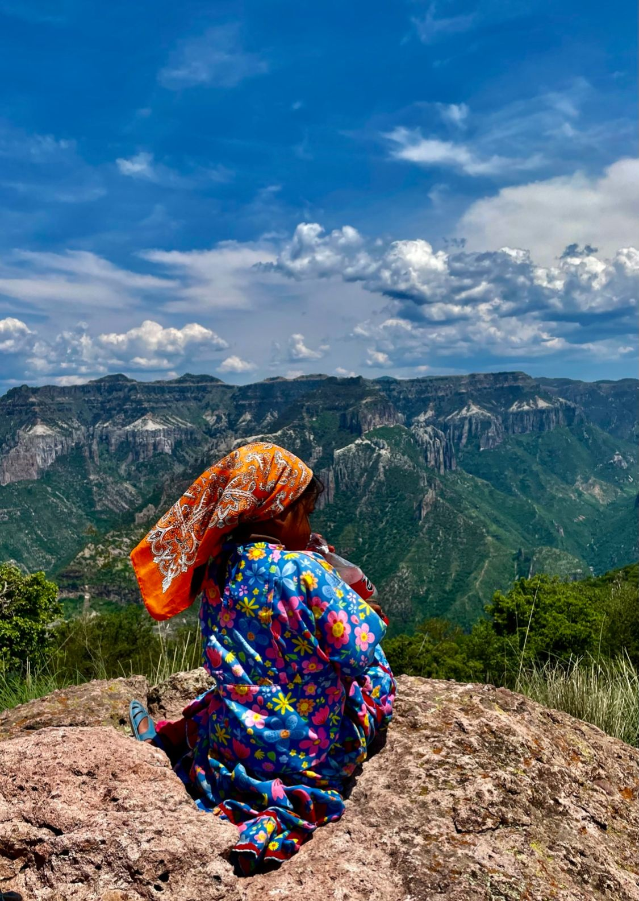
Mexico, Single Photo Reportage Raramuri
INTERNATIONAL COMPETITION
YRE competition 2022 – Summary ​
Number of participating countries: 37​
Number of entries on National level: 20,775 (6,972 in Article; 12,315 in Photo; 2,087 in Video category)​
Number of submissions for 2023 International Competition: 236 (62 in Article, 77 in Photo, 63 in Video, 35 International Collaboration)​
Jury was composed of stakeholders in the fields of environmental journalism and Education for Sustainable Development, including representatives from: ​
- UNESCO​
- UNEP​
- Youth Climate Report
- We don’t have time
- Mars Wrigley Foundation​
- journalists, filmmakers and photographers
​
Winners were published on Exposure and yre.global​

Slide 9
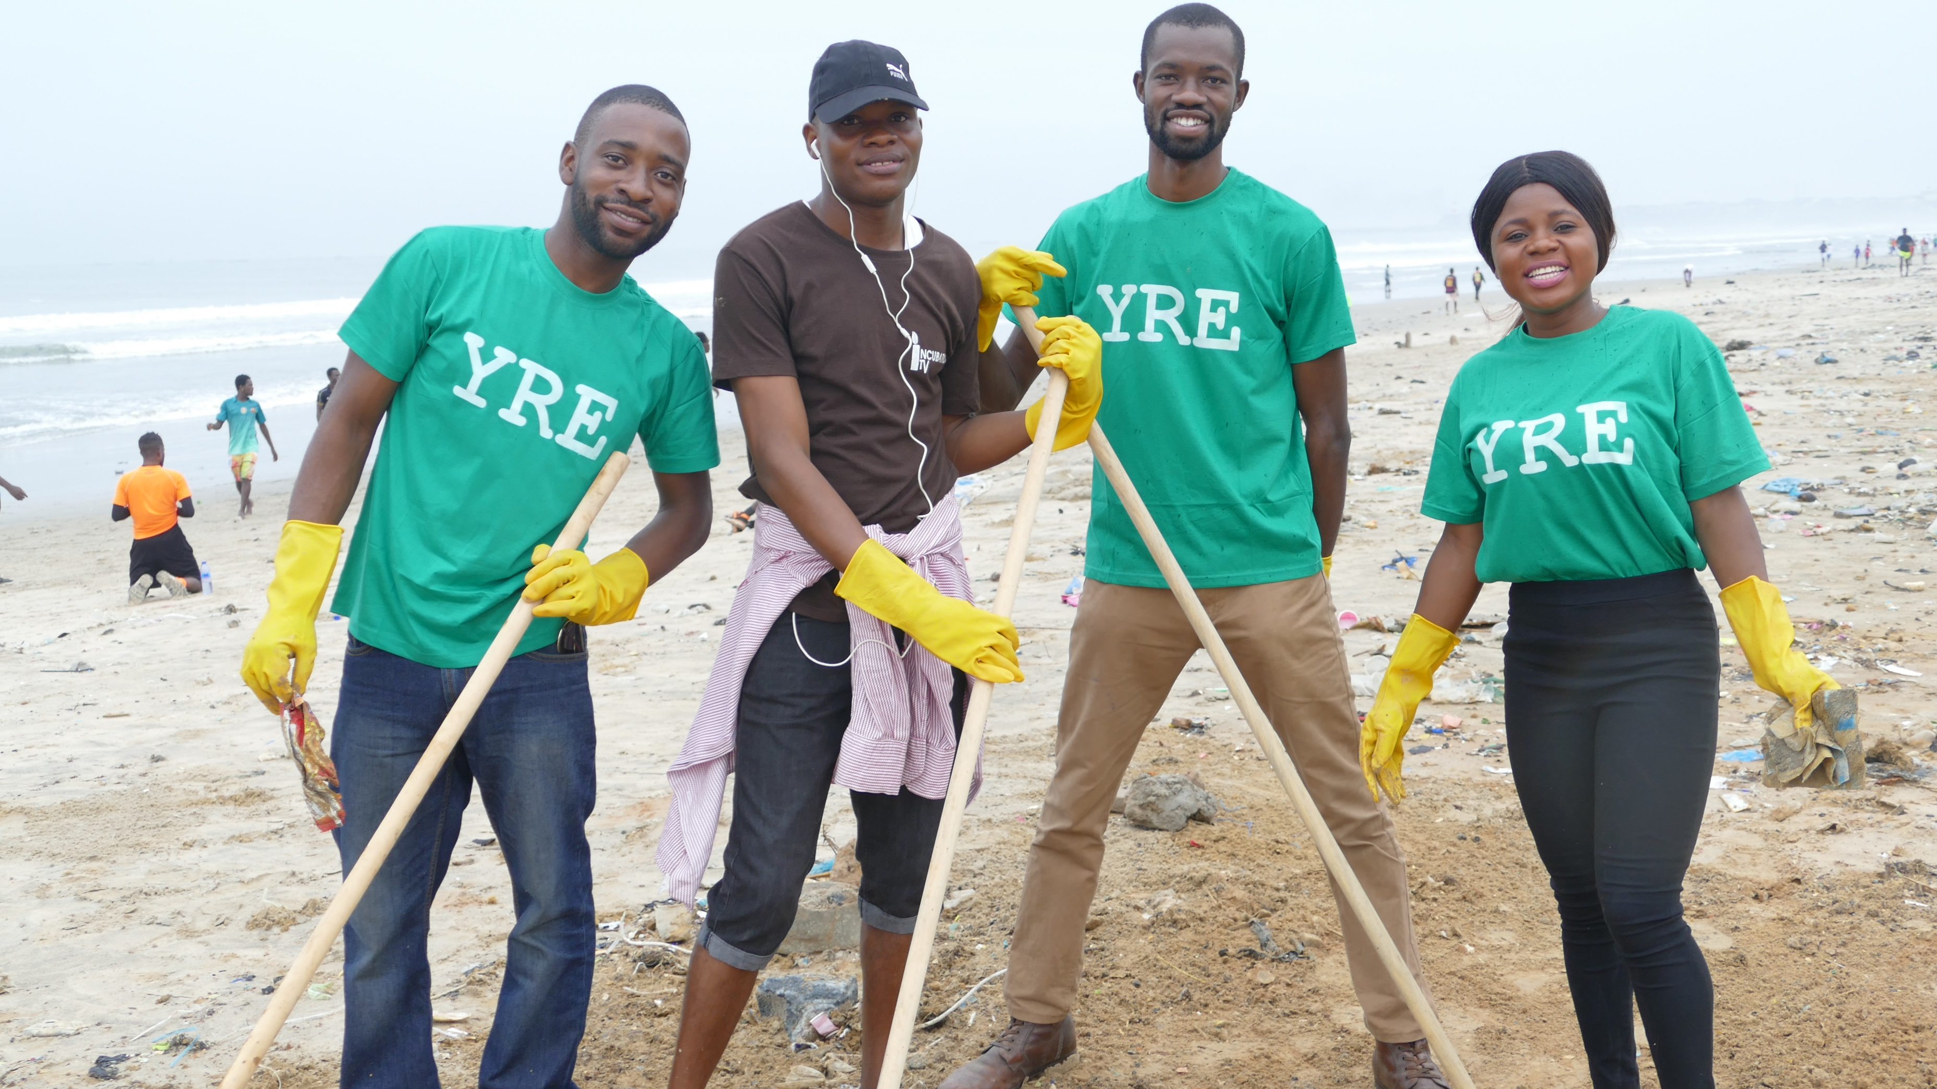
EDUCATION FOR SUSTAINABLE DEVELOPMENT THROUGH YRE

Slide 10
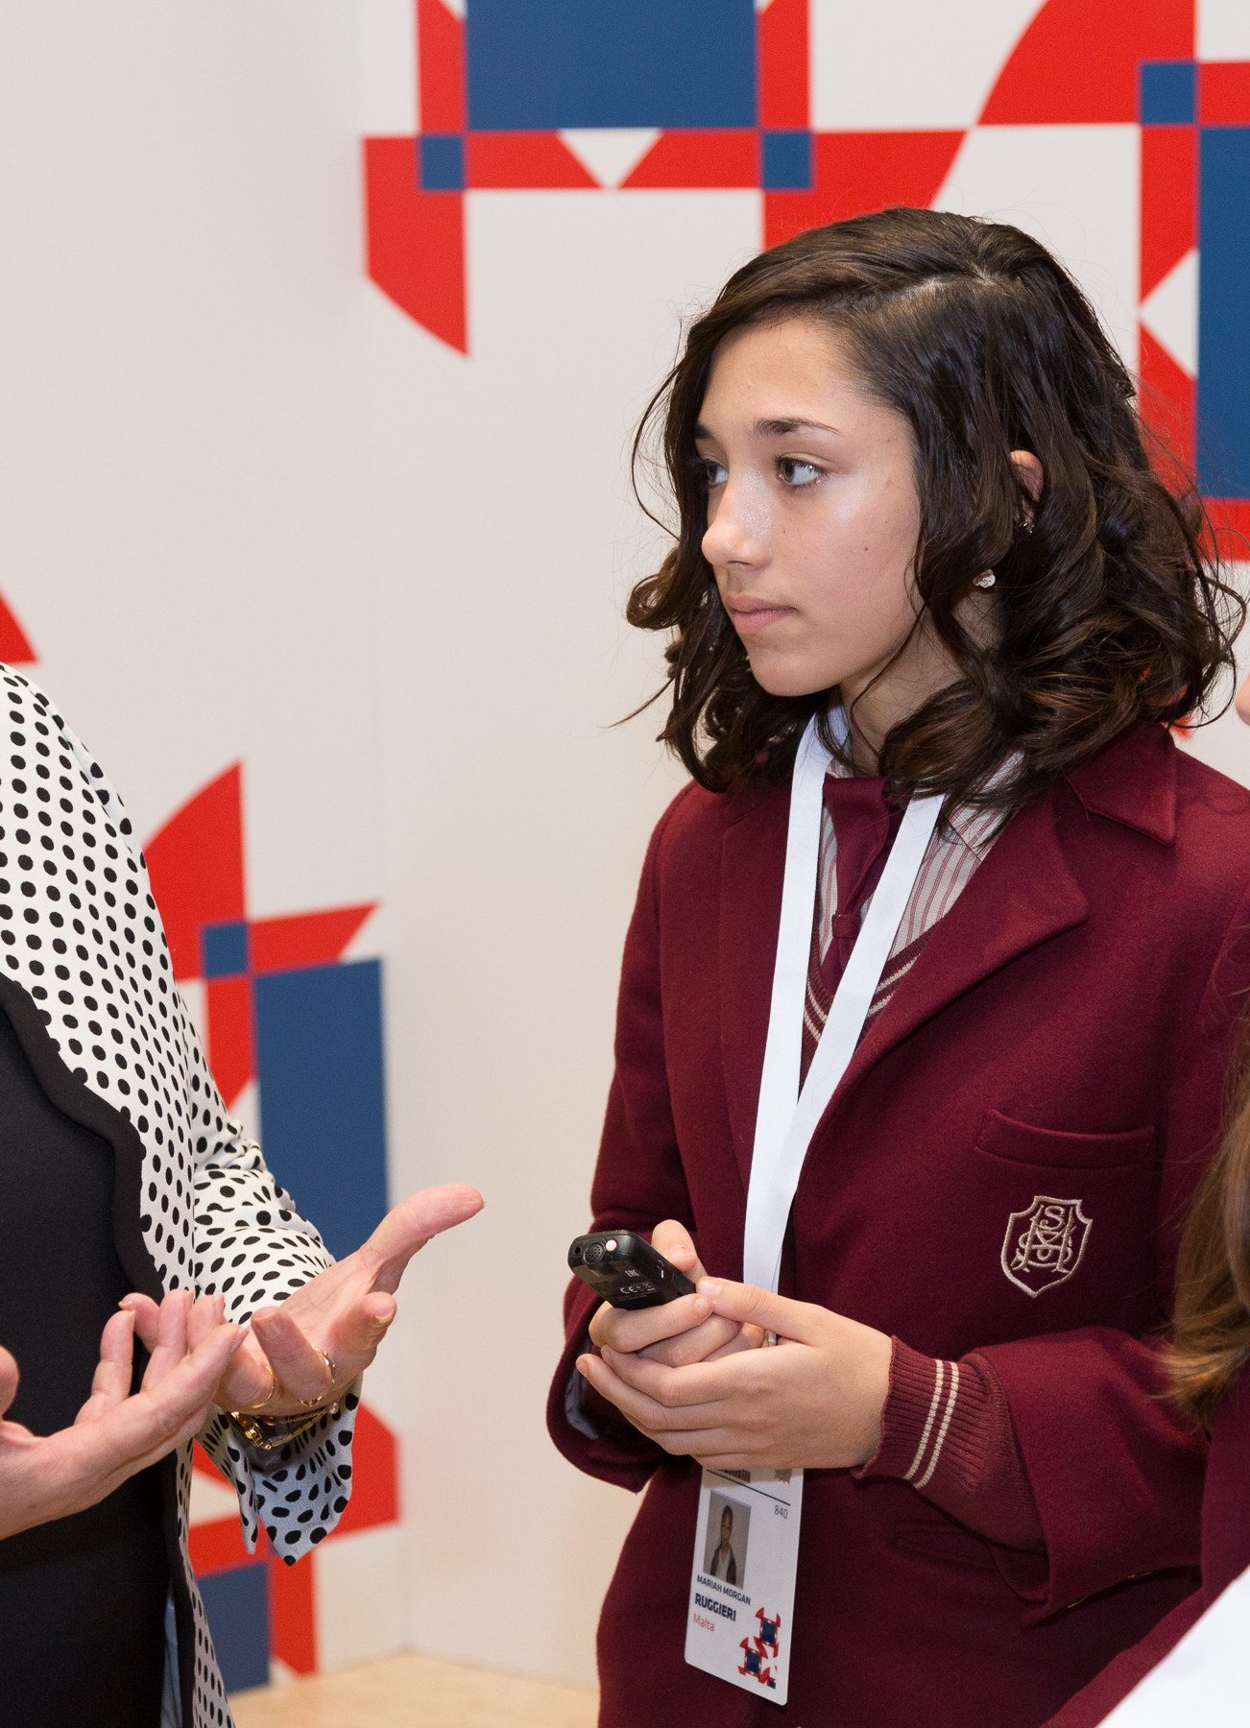
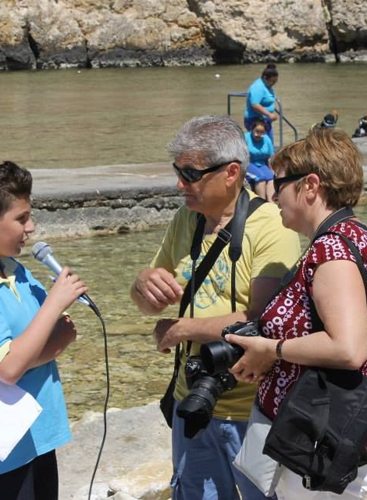
YRE IN THE CLASSROOM
Incorporating ESD in your classroom through the YRE programme.
Understanding sustainable development.
Connecting to concrete societal problems and issues.​
Cross-curricula investigations.​
Active solution-orientated learning​.
Developing not only knowledge but life skills: critical thinking, journalistic skills etc.

Slide 11
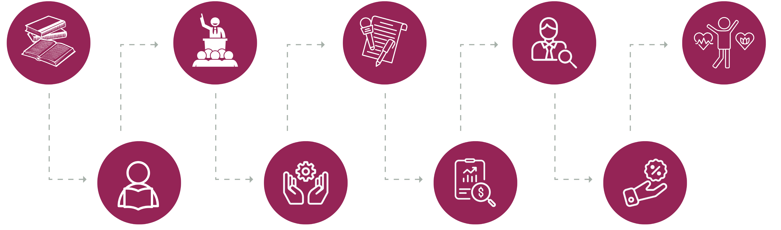
WHAT ARE THE BENEFITS FOR STUDENTS?
Education for Sustainable Development​
Leaders of change​
Journalistic skills – critical thinking​
Young, responsible leaders​
Mental and physical well-being​
Inspired and empowered students
Environmental knowledge​
Inspired and empowered students
Influencing communities​

Slide 12


YRE SUPPORTS PILLAR 4 OF THE GREENING EDUCATION PARTNERSHIP (GEP)
Vision
Engage the entire community by integrating climate education in life-long learning, in particular through community learning centres and learning cities.
Goal
All countries will be able to report at least 3 different ways learning opportunities are made available for adults outside the formal education system to develop the skills, attitudes, and actions that will foster community resilience to tackle climate change.
#greeningeducation

Slide 13
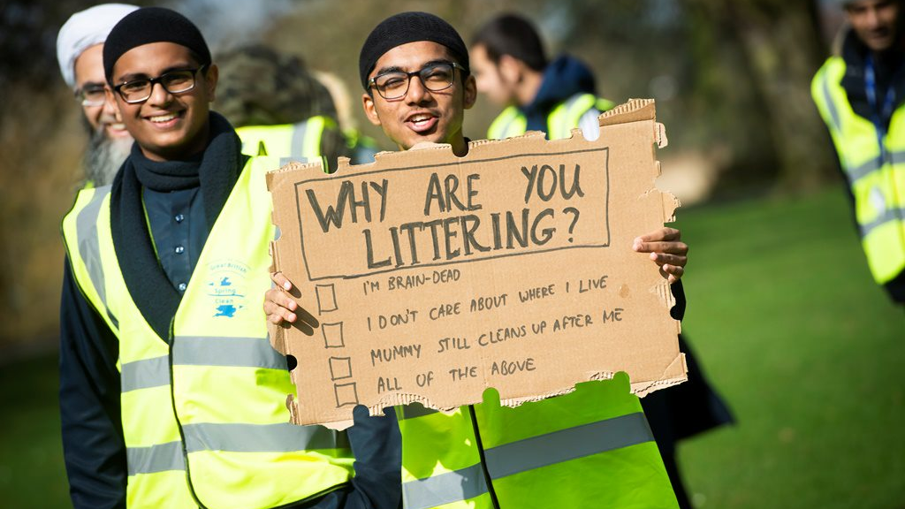
OUR CAMPAIGNS

Slide 14
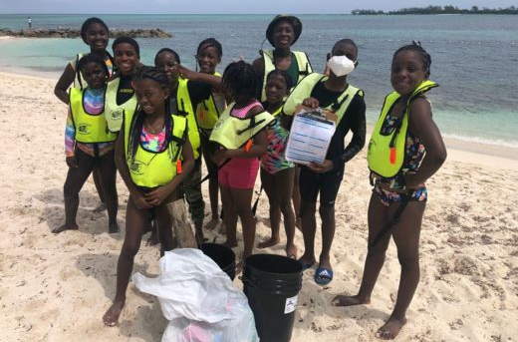
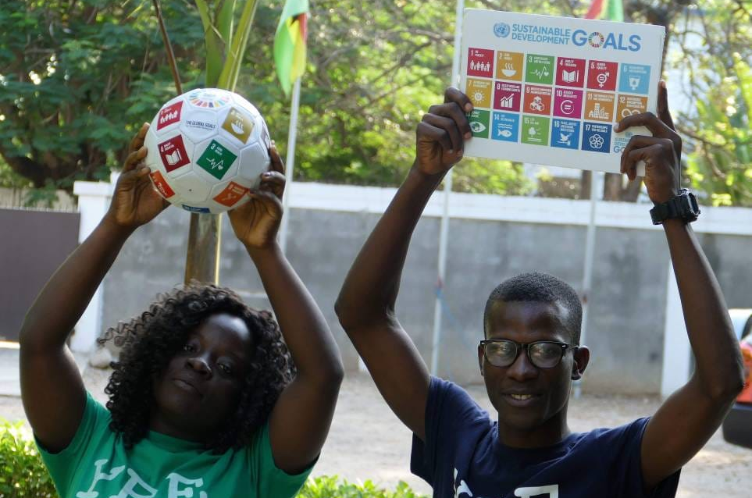
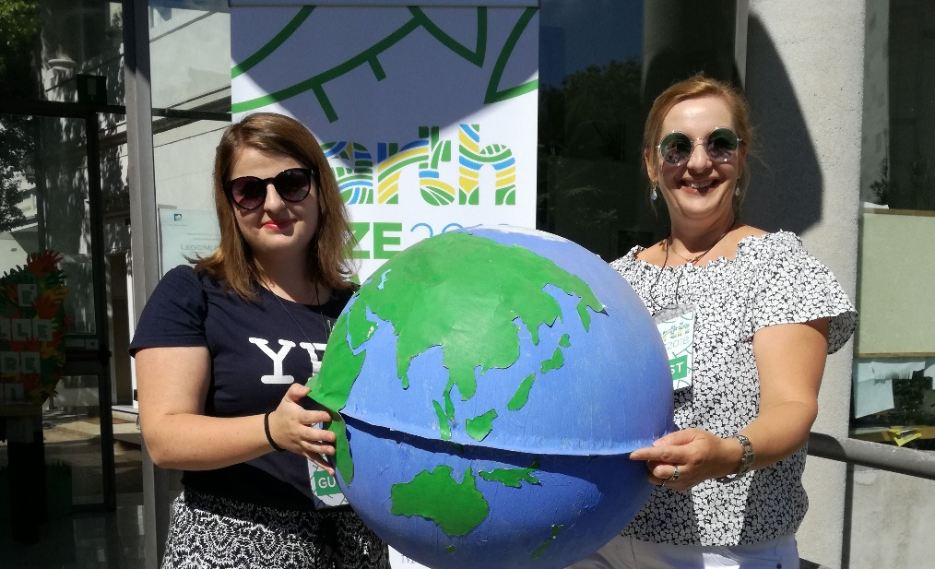
ACTIVITIES
Litter Less Plus focus on reducing litter, waste and invisible pollutants by encouraging more responsible consumption (and production) of things and taking a more circular approach (this is a circular economy approach) to the way our homes, schools, businesses and communities work.
The Litter Less Campaign is an environmental literacy project that can be run in both formal and non-formal educational settings. Due to its visibility and wide-spread nature, litter is a simple way to introduce children and youth to environmental issues and topics.
Biodiversity Campaign encompasses a set of activities targeted at different stakeholders to emphasise the importance of protecting global biodiversity and ecosystems.

Slide 15
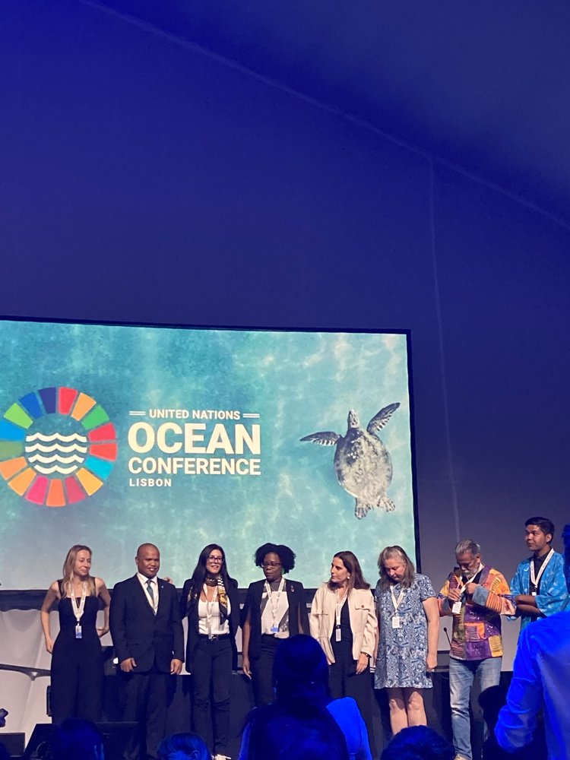
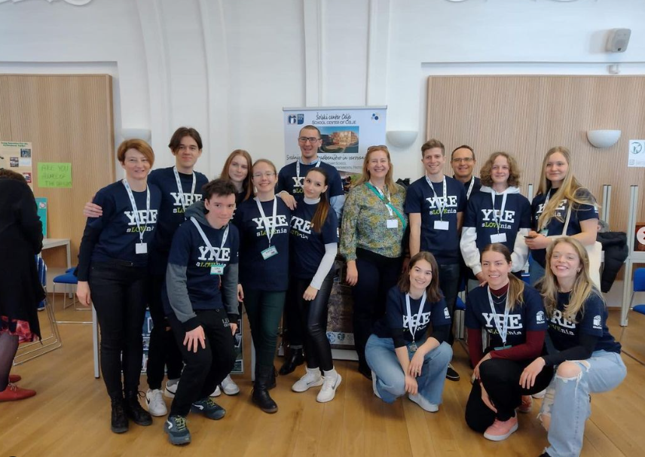
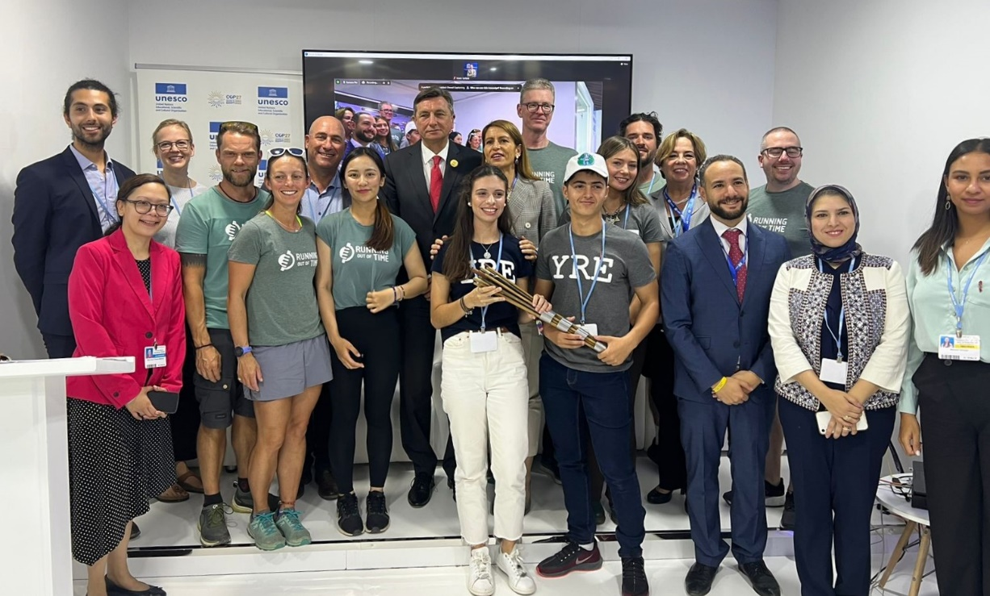
STUDENT ENGAGEMENT AND TRAINING:
CONFERENCES AND MISSIONS​ for YRE AMBASSADORS
YRE students at the Youth Environment Education Congress in Prague in 2022
3 YRE students Covered COP 27 in Sharm el-Sheikh, Egypt in 2022
UN Ocean Conference in Lisbon, 2022

Slide 16
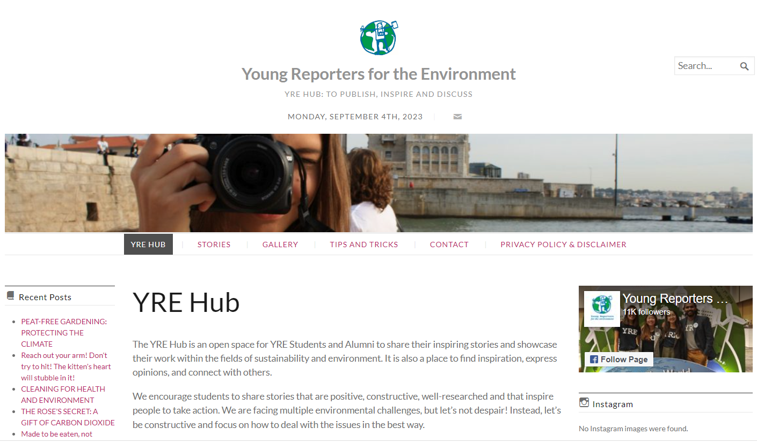
YRE HUB - A place for students to share their stories.

Slide 17
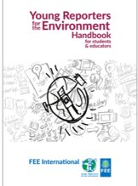



YRE MATERIALS​
Handbook​
Checklists​
Video tutorials about writing, photography and video​
Tips from YRE International Jury​
Lesson plans
Competition Criteria​
Webinars
FEE Academy

Slide 18







PARTNERS AND SPONSORS
Institutional partners:
Corporate sponsor:

Slide 19
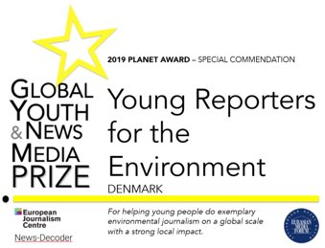


AWARDS

Slide 20
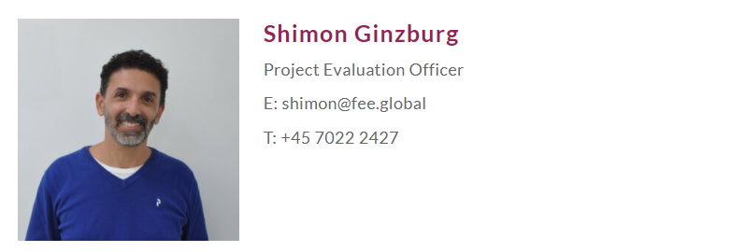
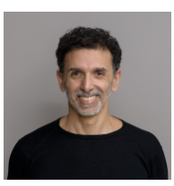
CONTACT US!
More information at: www.yre.global
Notes:
Add ROoT logo

