Slide 1



















Slide 2







WELCOME,
STUDENTS!

Slide 3
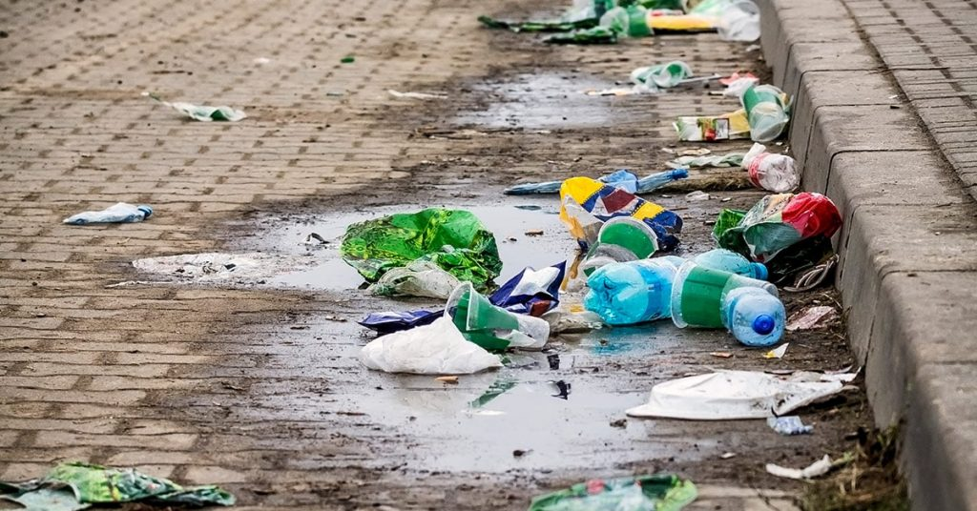
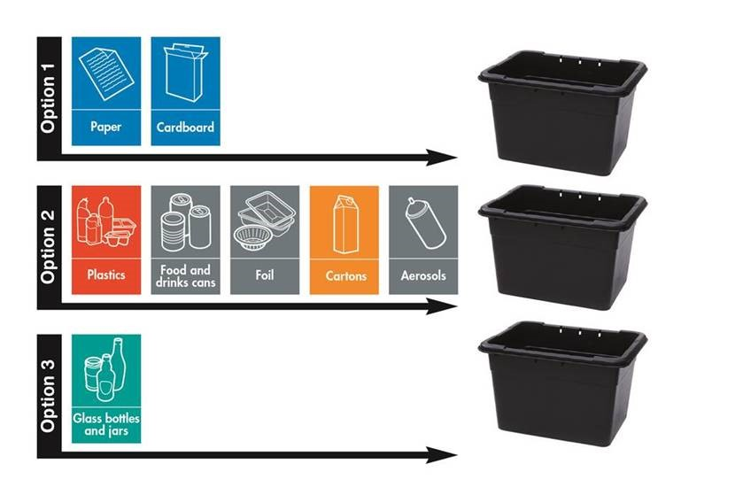
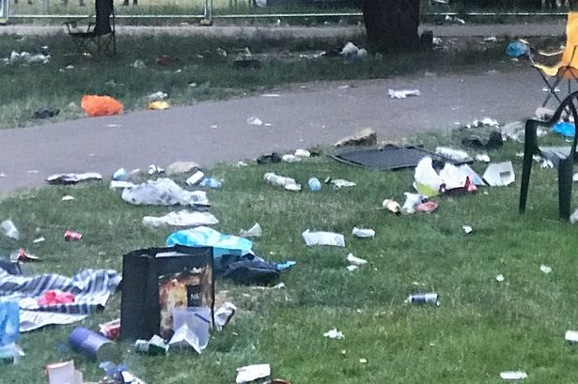

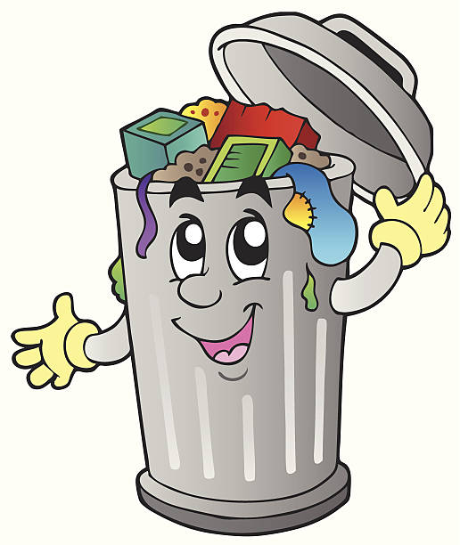
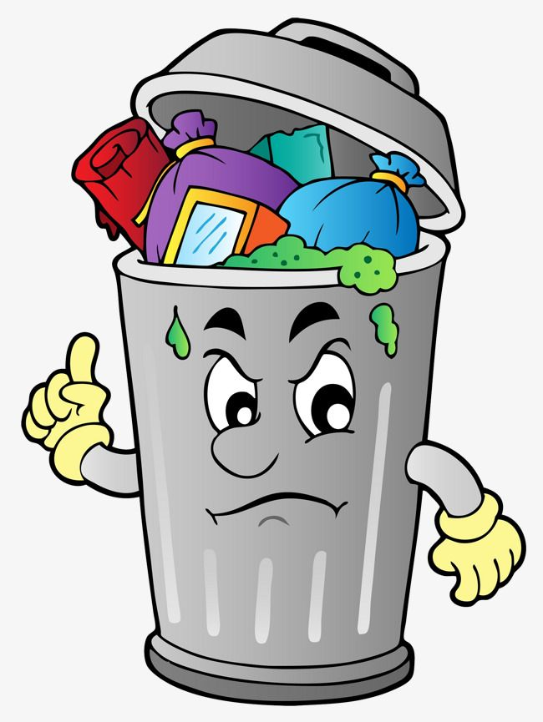


What is litter?
Key stage 1

Slide 4
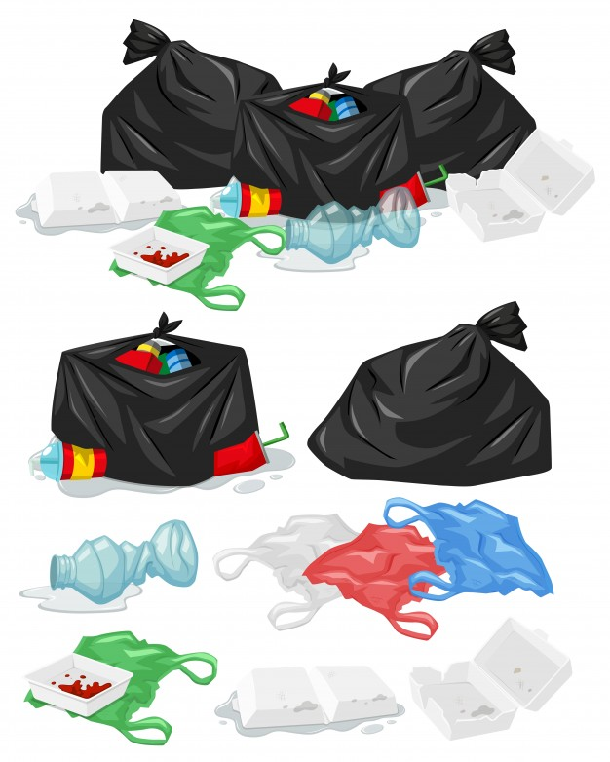
CLASS OBJECTIVES
Different types of litter?
Litter in school
Litter effects on environment
What should we do with litter?

Slide 5



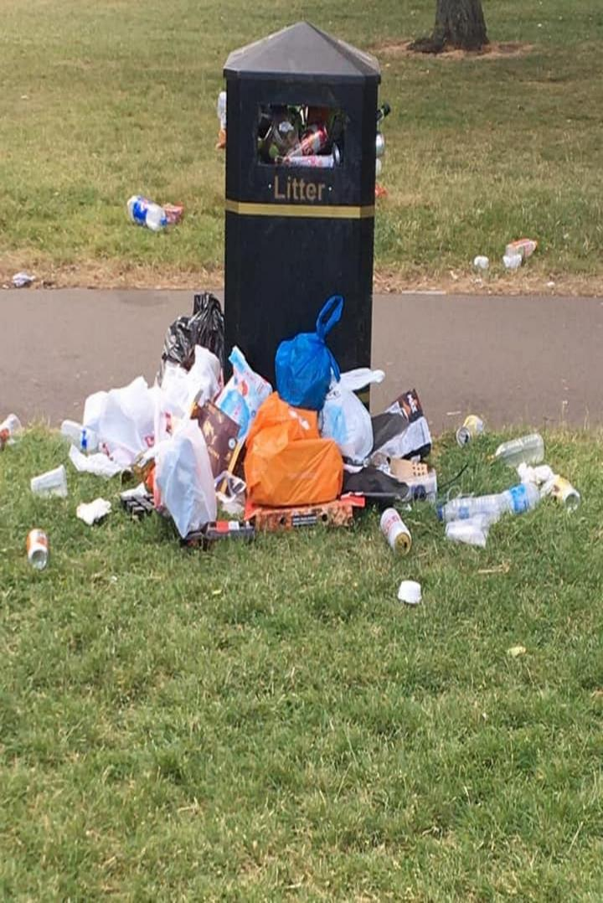



What is litter?
Rubbish like paper
cans
bottles
bags left lying in an open place.
Litter consists of waste products that have not been thrown away properly.
.
Notes:
Litter consists of waste products that have been discarded incorrectly, without consent, at an unsuitable location. Litter can also be used as a verb; to litter means to drop and leave objects, often man-made, such as aluminum cans, paper cups, fast food wrappers, cardboard boxes or plastic bottles on the ground, and leave them there indefinitely or for other people to dispose of as opposed to disposing of them correctly.
Litter can remain visible for extended periods of time before it eventually biodegrades, with some items made of condensed glass, styrofoam or plastic possibly remaining in the environment for over a million years

Slide 6
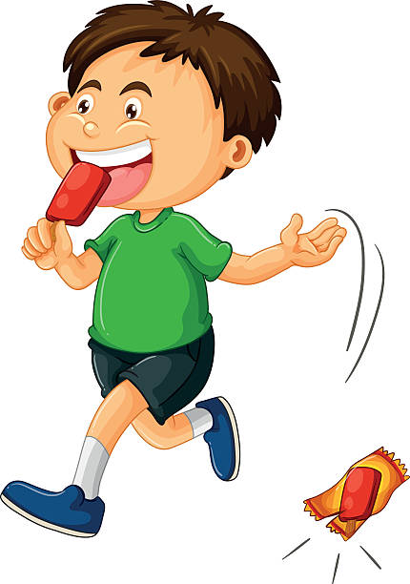
Why do people litter?
Sometimes people are just careless.
Sometimes dirty spaces prompt them to throw more rubbish.
Sometimes they are just lazy or forgetful.
Bins may not be available at many places which could also be a reason for people to litter.
.

Slide 7
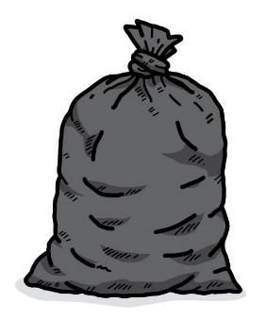



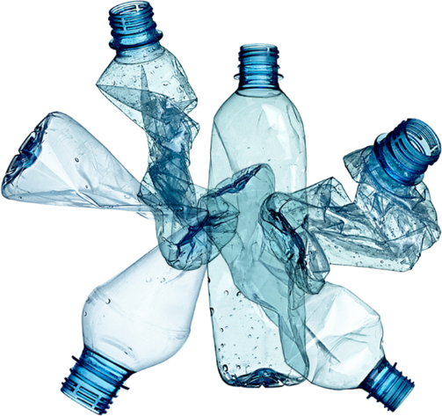
What is most common litter in your school?
different types of litter in school
Plastic bottles
Glass bottles
Sweet, chocolate, crisp wrappers
Paper and card
Food waste

Slide 8
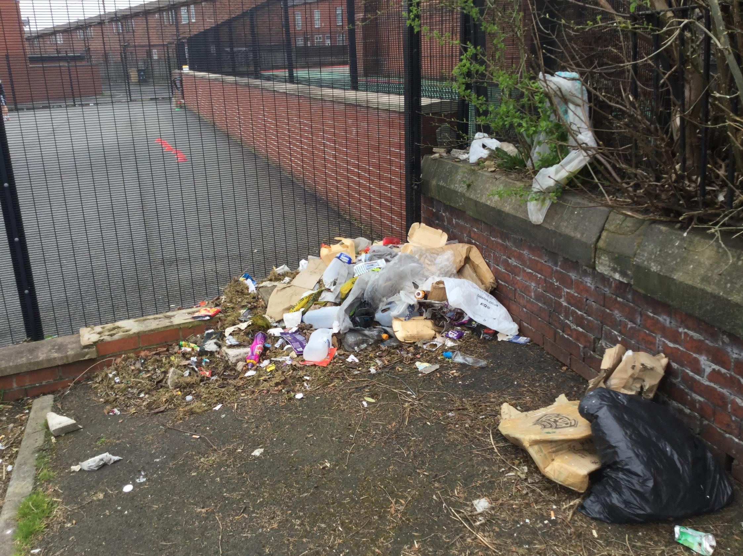
Notes:
Questions. Why is the rubbish on the ground? who put the rubbish there? Why leave it on the ground?
Can you think of other rubbish you have seen?

Slide 9
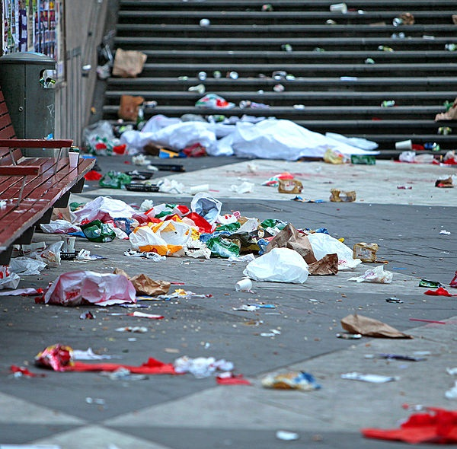
Notes:
Questions. Do you like this picture? Why/why not? Would you like to see this every day? How does this make you feel? Happy/sad, annoyed, angry.
Who is responsible for this? Who should tidy it up?

Slide 10
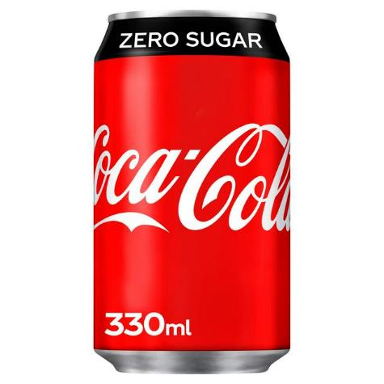
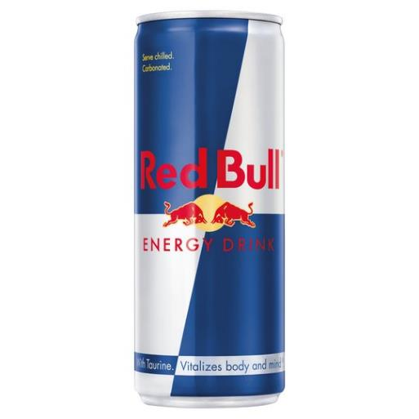

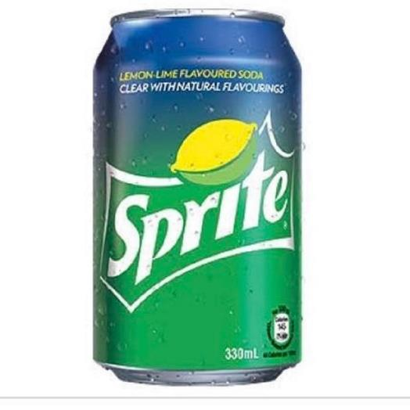
What are these made of?

Slide 11
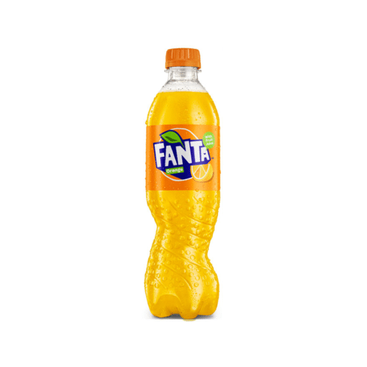
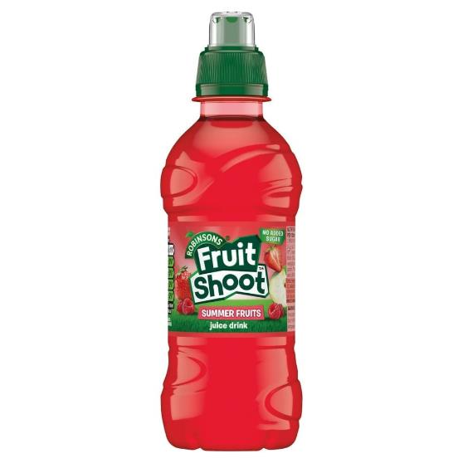
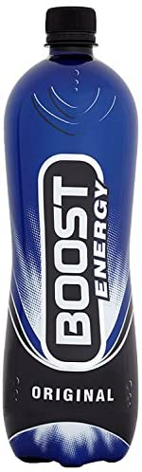
What are these made of?

Slide 12
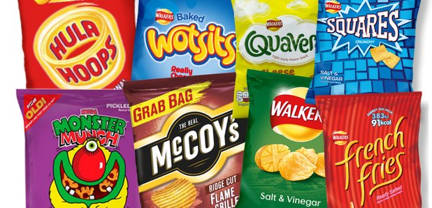
What are these made of?
What are these made of?

Slide 13
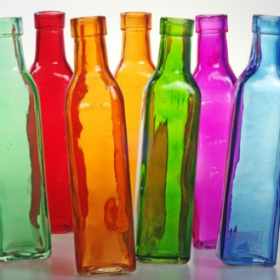
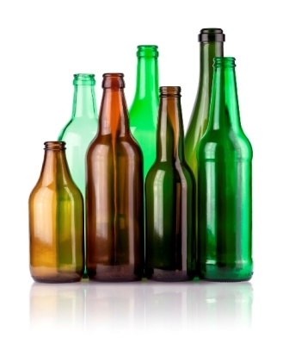
What are these made of?
What are these made of?

Slide 14
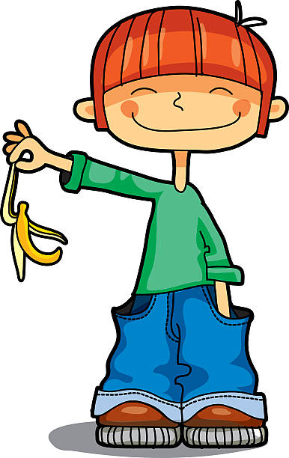
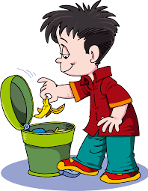
Where should we put our rubbish?

Slide 15
plastic
food
Not all rubbish can be put in together.
We have to separate it into different types.
Some re can recycle……use again.
We can recycle
glass
wood
paper

Slide 16
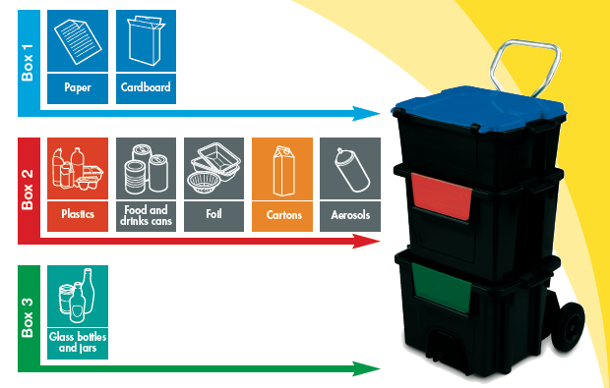
These are the most common recycling bins.

Slide 17
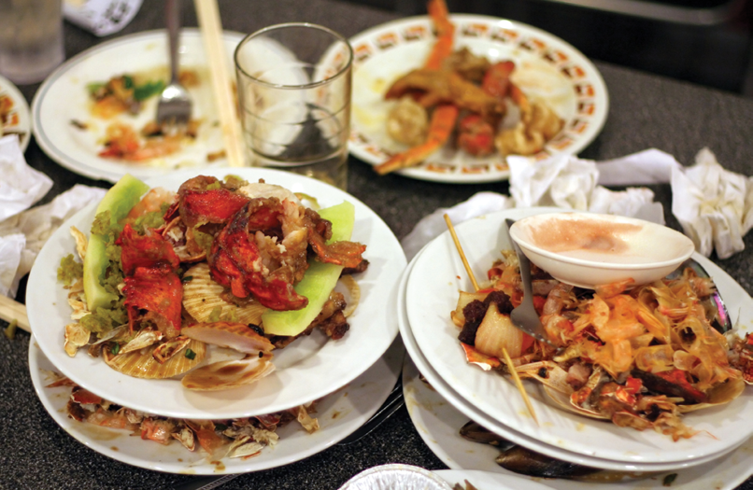
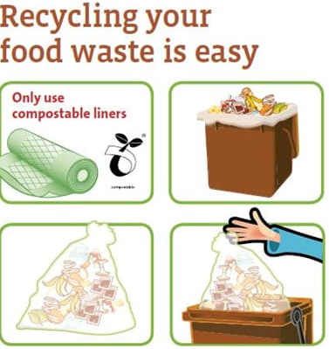
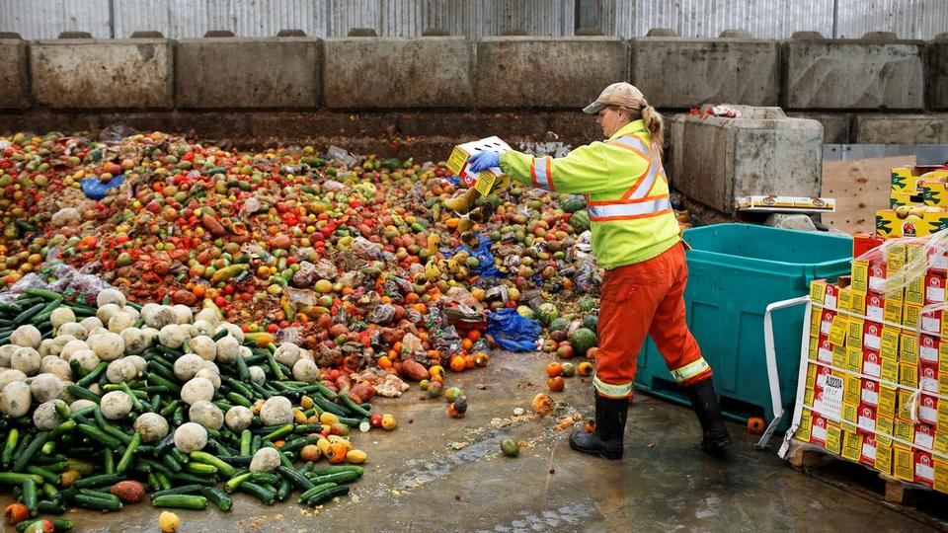

Slide 18
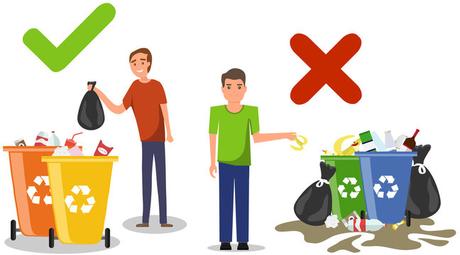
Where do you put plastic after you are finished with it?
paper
glass
food

Slide 19
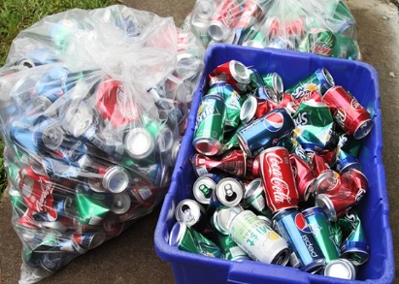

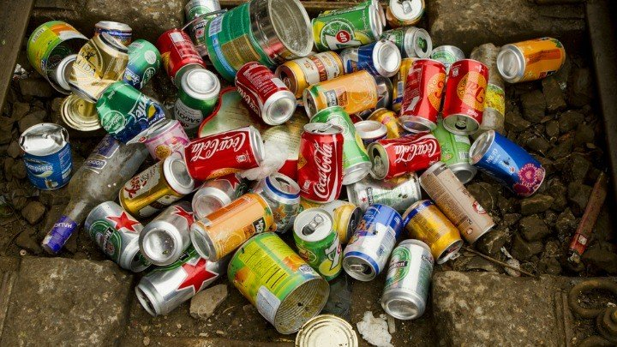

Put your aluminium cans in recycling boxes.
Don’t throw aluminium cans on the ground.

Slide 20
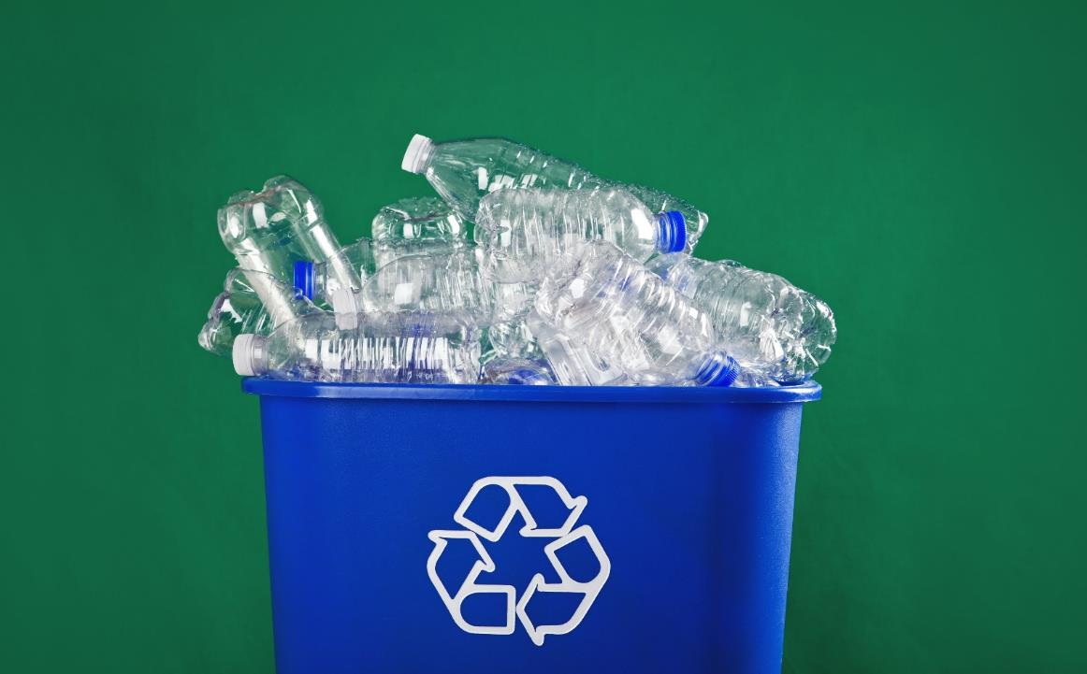
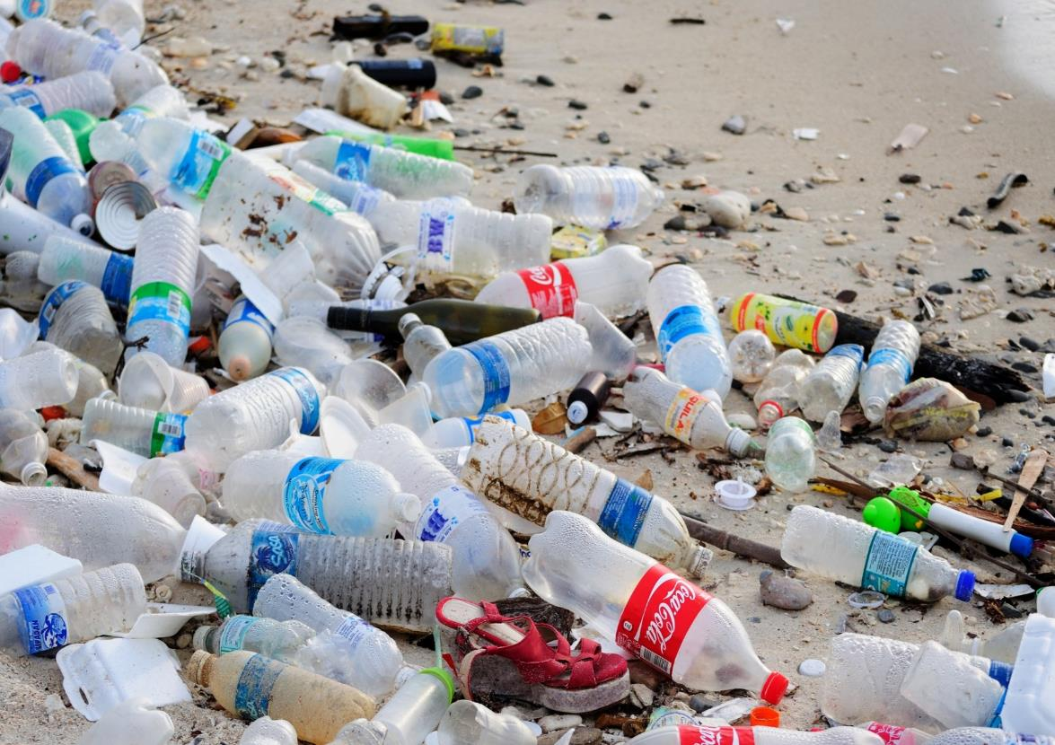

Put your plastic bottles in recycling boxes.
Don’t throw plastic bottles on the ground.

Slide 21
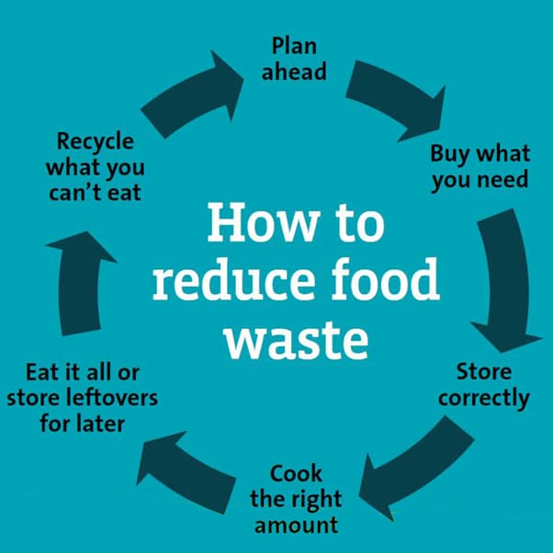
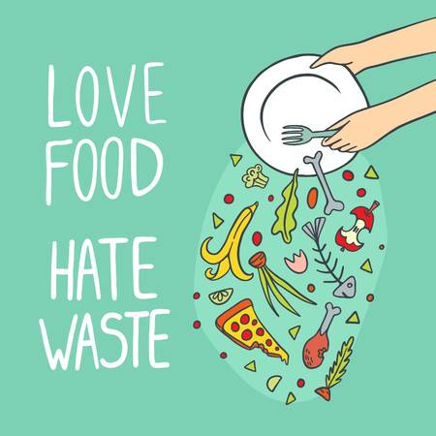

Slide 22
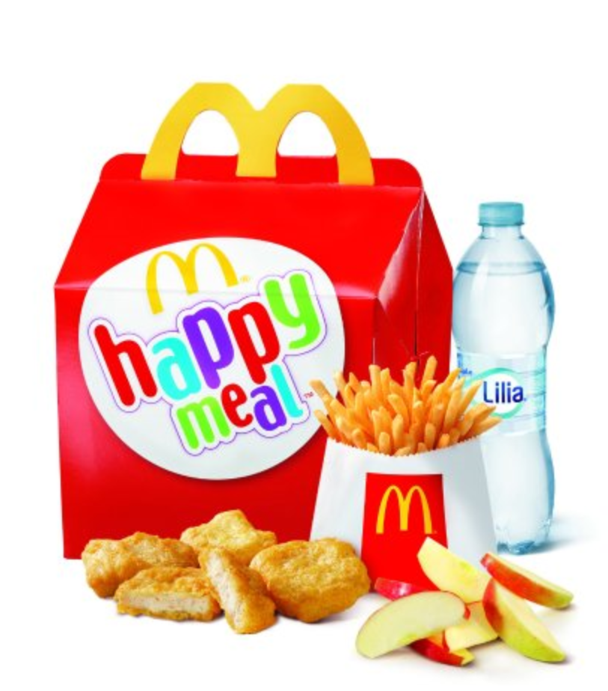
cardboard
plastic
paper
food
Remember that you can’t put food rubbish in bin that has food on it!!!

Slide 23
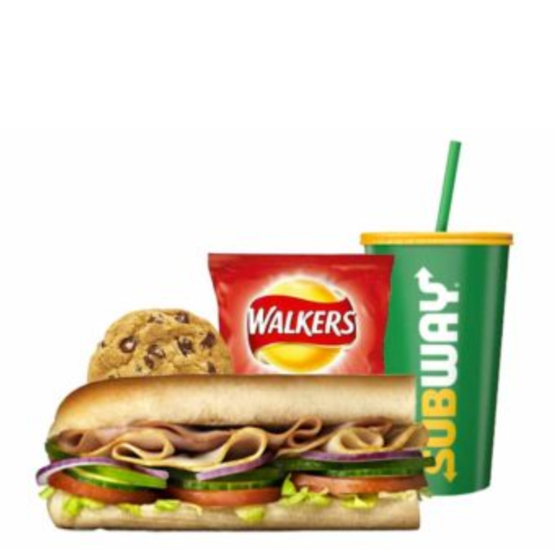
plastic
cardboard
food
Remember that you can’t put food rubbish in bin that has food on it!!!

Slide 24
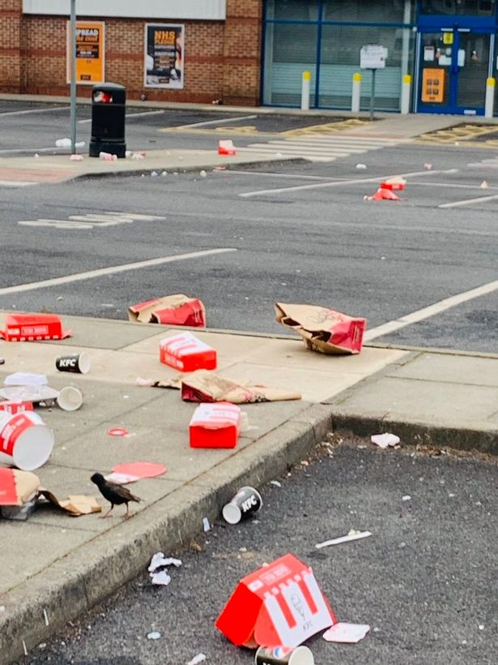
cardboard
paper
plastic
food
Remember that you can’t put food rubbish in bin that has food on it!!!

Slide 25
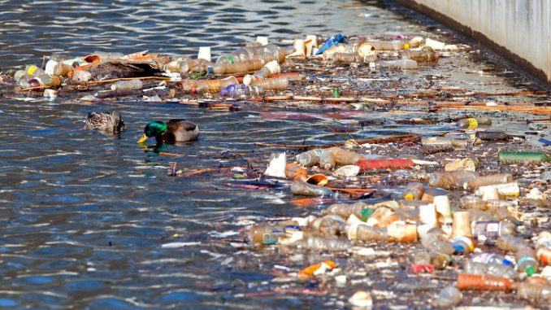
effects of litter
Litter creates visual pollution.
It makes a place look unclean and unpleasant to the eyes.
Litter causes damage to marine life, sea and rivers.
Litter in water supply creates a toxic environment. The toxic water can kill plant life. If humans drink the water they can also become sick

Slide 26
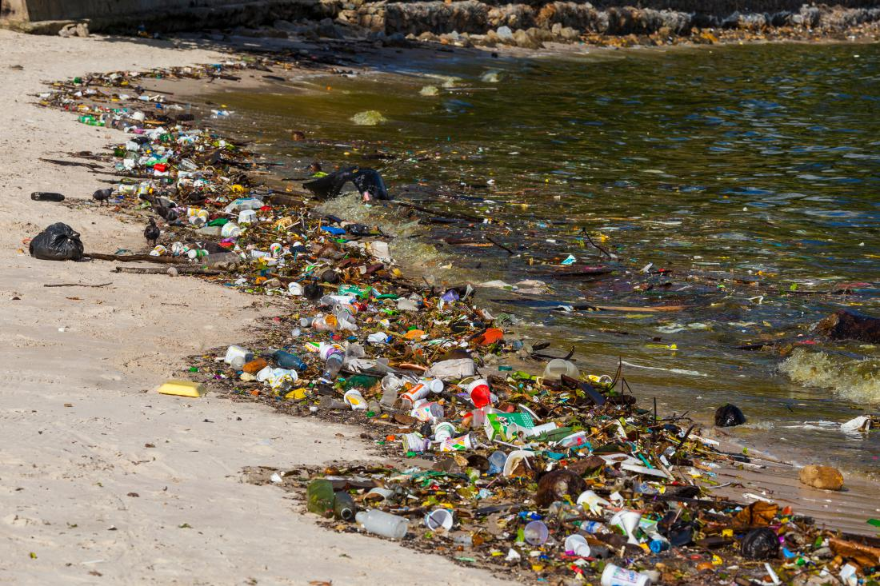

Slide 27
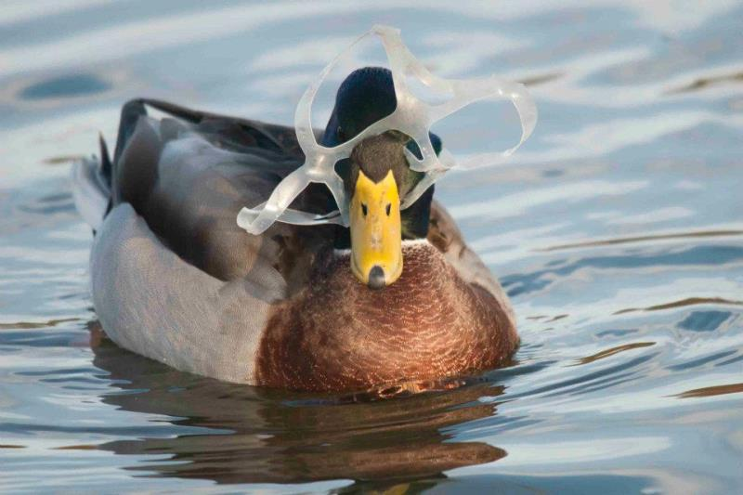
Effects of litter
Litter is responsible for the death of millions of animals.
Animals can get entangled in litter and die a slow painful death.
Animals eat litter and they can’t digest it – this can cause injury or death.

Slide 28
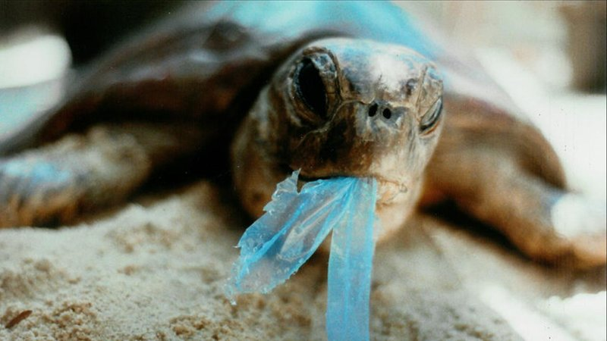
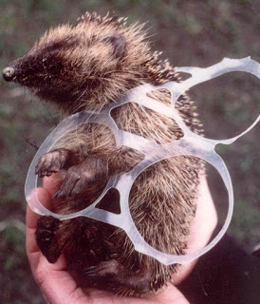
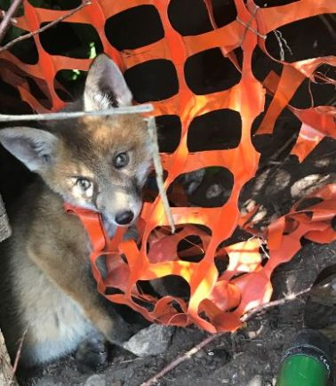
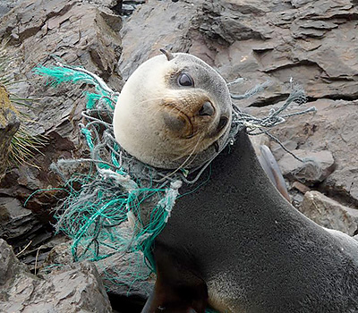
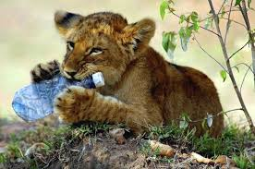
Notes:
Questions: What is happening in each of these pictures? Is it the animal’s fault? Whose fault is it?
Is it us, humans? Is it big companies?
What do you think will happen to these animals? Are they in pain? Could they die?

Slide 29
There’s litter all around us
There’s litter at our feet
There’s litter in the bushes
There’s litter in the street
There’s litter all around us
And it’s a filthy sin
When at your feet just yards away
There lies an empty bin

Slide 30

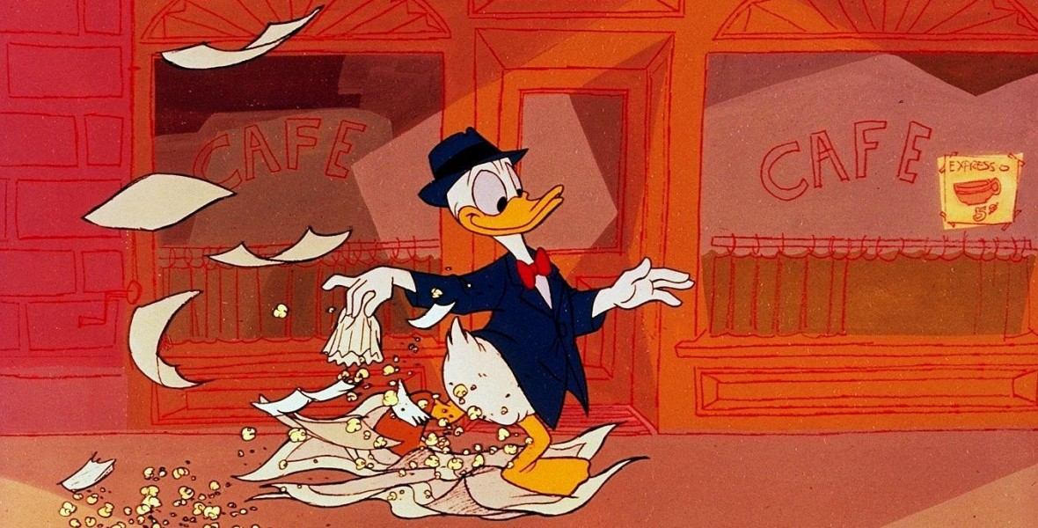
The litter bug
Design your own litterbug!!
Describe what does it do to the environment?
Notes:
Discuss with children the term “litterbug”
Who are litterbugs?
What do they do?
What characteristics do they have?
How does it change our environment?
What can we do to change people’s attitudes to littering?
How do you feel when you see people littering?

Slide 31
Don’t Litter/ Moral Stories For Kids/ English Moral Stories/ English Moral Stories Ted And Zoe
https://youtu.be/4at5ZU9Z2ig

Slide 32



SUPPLEMENTAL VIDEO
Let your students watch relevant educational videos that help reinforce the lesson for the day. It’s no secret that it helps students stay interested and engaged. Duplicate this page as many times as needed.

Slide 33







LESSON FOR THE DAY
KEY STAGE 1

Slide 34
EXAMPLES AND ILLUSTRATIONS
Example 1
Example 2
Example 3

Slide 35




MATERIALS NEEDED FOR CLASS
List the things your students need to get ready before class. It can be a particular textbook, the accomplished homework due for the day, or any specific materials for the topic you're about to discuss. You can also match it with corresponding photos or icons.

Slide 36





CONCEPTS AND DEFINITIONS
Get the ball rolling by introducing the lesson's key concepts and its corresponding definitions. Duplicate this page as many times as needed to give you more space for discussion. Pair the concepts and definitions with relevant images too for a more visualized presentation of the lesson.

Slide 37


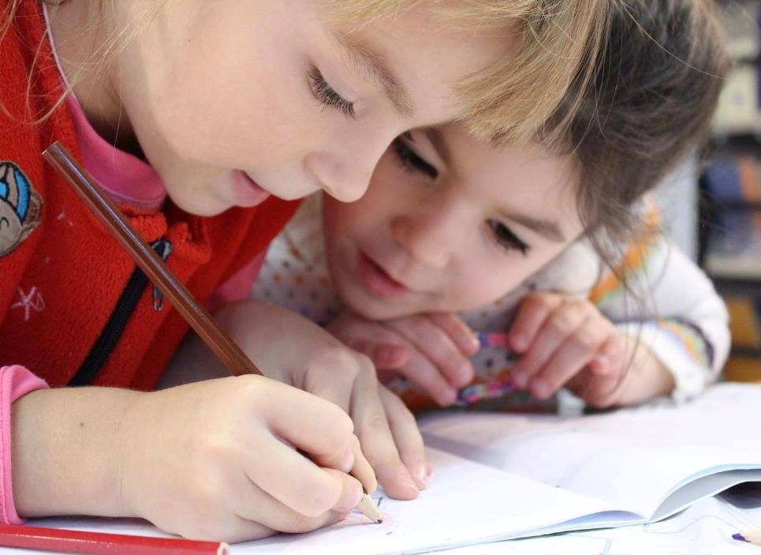
EXERCISE
Add instructions or guidelines here.
You can also put in the amount of time allotted for this.
Individual exercises extend a student’s grasp of the lesson. It allows them to synthesize on their own and think of ways they can apply their new learnings in real life. Duplicate this page as many times as needed to give you more space for discussion.

Slide 38

Question 2: Write the question you want to ask your students and allot space for the answers.
WORKSHEET
Answer 2:
Add instructions or guidelines here. You can also put in the amount of time allotted for this.
Question 1: Write the question you want to ask your students and allot space for the answers.
Question 3: Write the question you want to ask your students and allot space for the answers.
Answer 1:
Answer 3:

Slide 39

ACTIVITY TIME
Add instructions or guidelines here.
You can also put in the amount of time allotted for this.
Like seatworks, student-led activities that can be done by pairs or by group widen their grasp and interpretation of the lesson. Be creative with the activity. Duplicate this page as many times as needed to give you more space for discussion.

Slide 40


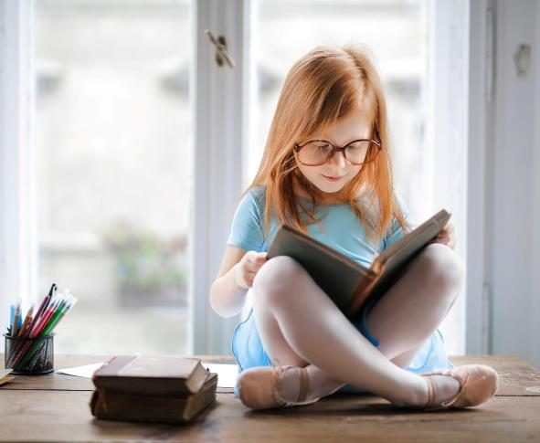
ADDITIONAL RESOURCES
Duplicate this page as many times as needed to give you more space for discussion.
Photos or screenshots of relevant articles are also effective in reinforcing a class lesson.
Maximize this space for additional resources you want to share with your students.
It's something they can easily look back on or search online in case they need a refresher.

Slide 41



CLASS RECAP
Discussion Point
Discussion Point
Discussion Point
Discussion Point
Discussion Point
Cap off a productive class with key summary points students can easily remember.
You can provide this for the class as a way of wrapping up everything you've discussed.
You can provide this for the class as a way of wrapping up everything you've discussed.
You can provide this for the class as a way of wrapping up everything you've discussed.
Recaps can also be led by students for a more enriching experience.

Slide 42

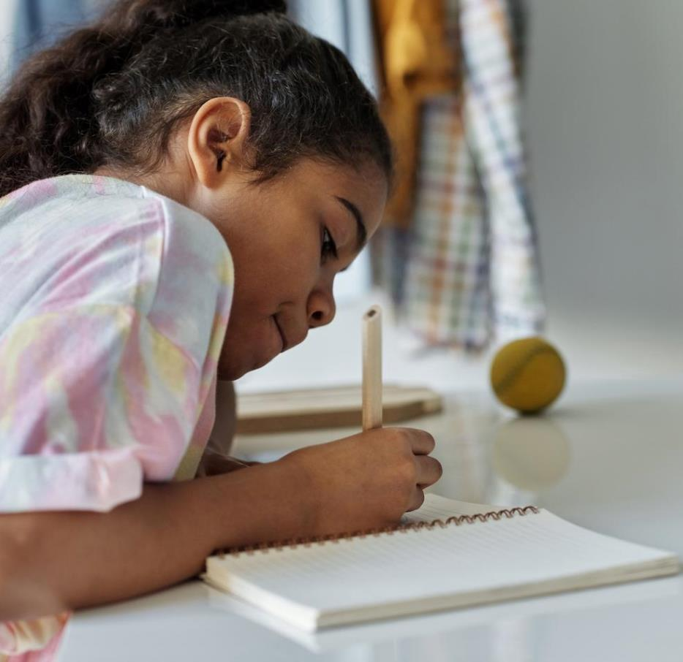
HOMEWORK
Add instructions or guidelines here. You can also put additional details on when and how to submit.

Slide 43


























FREE ICONS
Use these free recolorable icons and illustrations in your Canva design.

Slide 44





















FREE RESOURCES
Use these free recolorable icons and illustrations in your Canva design.

