Slide 1



















Slide 2







WELCOME,
STUDENTS!

Slide 3

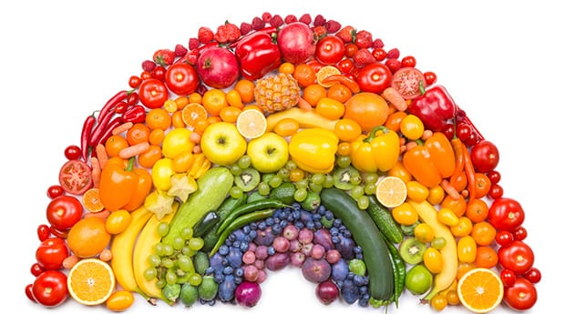




Healthy eating
KEY STAGE 3

Slide 4
Avoid eating too many fatty foods
Drinking lots of water every day
Eating food that is good for us
What is Healthy Living?
Getting some form of exercise every day
Getting plenty of sleep every night

Slide 5



What are the main food groups?
There are 5 main food groups.
Fruit and vegetables
Carbohydrates
Proteins
Dairy
Fats

Slide 6
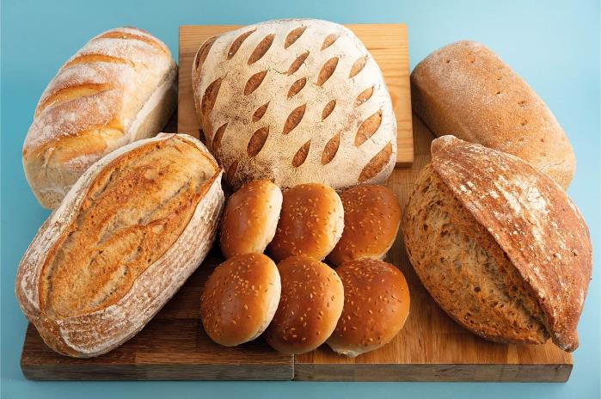
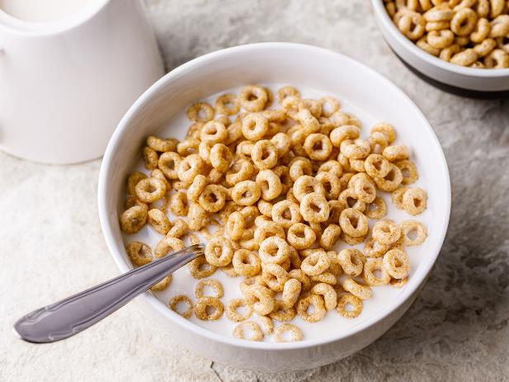
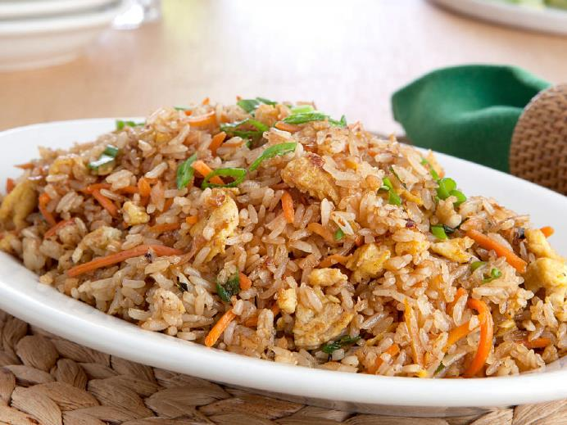

carbohydrates
Bread, rice cereal and pasta are healthy.
They give us energy.

Slide 7

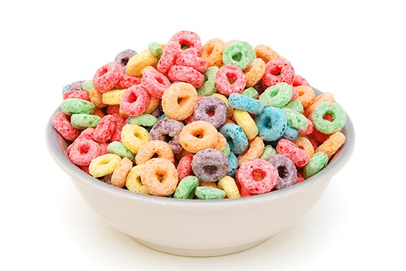
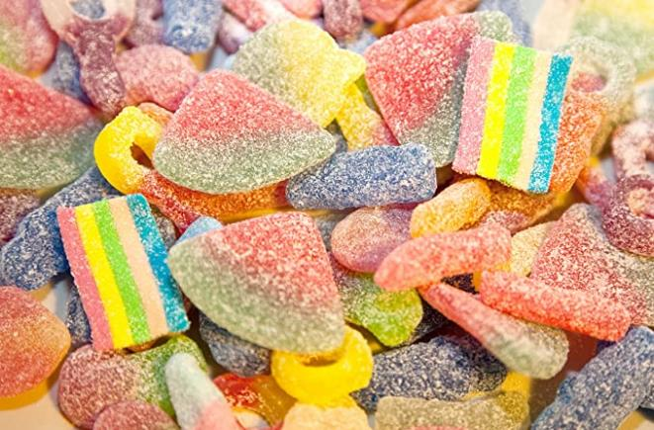
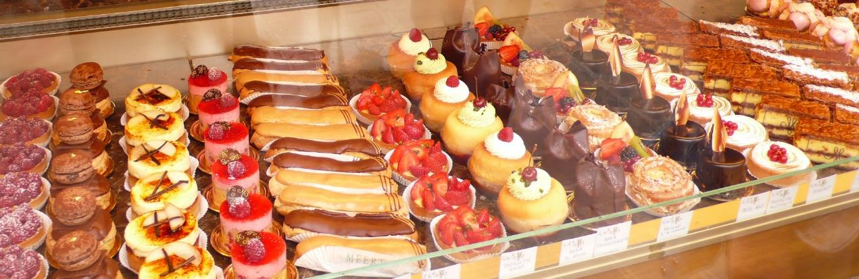
carbohydrates
Sweets, sugary drinks, pastries, sugary cereals are “bad” carbohydrates.
They also give us energy but should only be eaten as a treat!!.

Slide 8


Slide 9
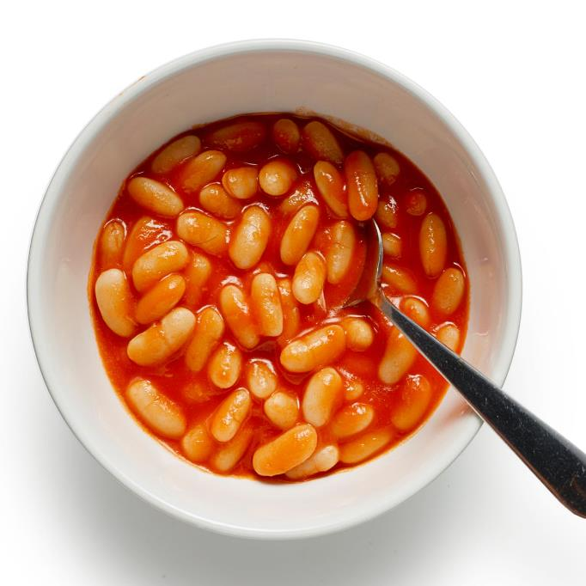

protein
Meat - beef, chicken
Fish – Tuna, Salmon, Cod
Beans
Eggs
These help muscles to grow and repair

Slide 10

dairy
Dairy products include food items such as yogurt, cheese and butter.
These contain Calcium for healthy teeth and bones.

Slide 11
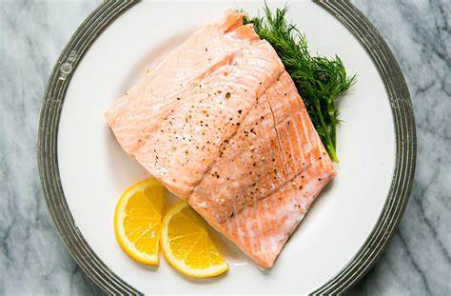
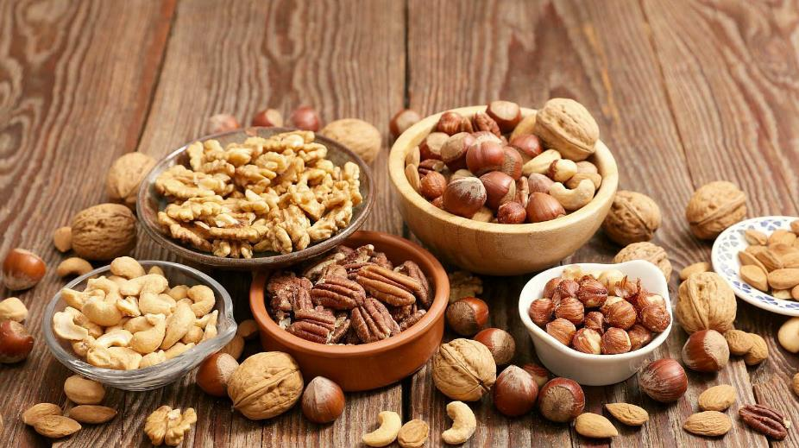
fats
There are good fats like seeds and nuts. Fish like salmon is also a healthy fat.
Fats give us energy

Slide 12
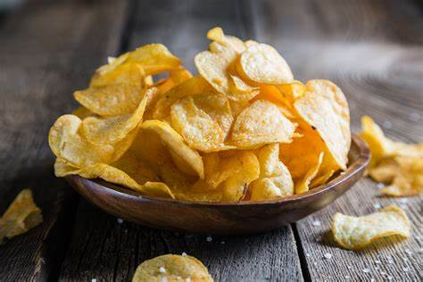
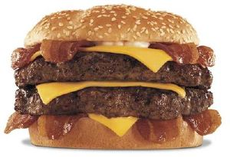

fats
There are “bad” fats. These come from processed foods and animal products.
You can eat these but not every day!!!

Slide 13
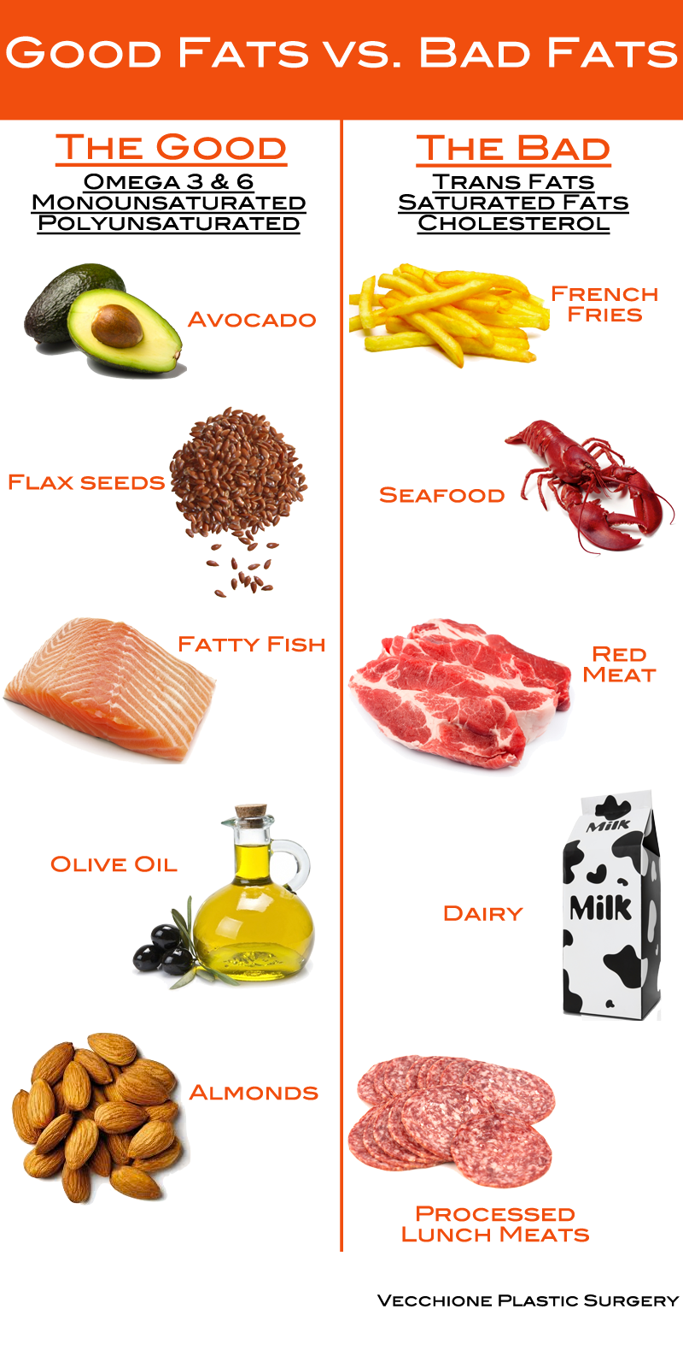
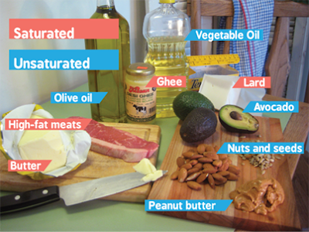

Slide 14
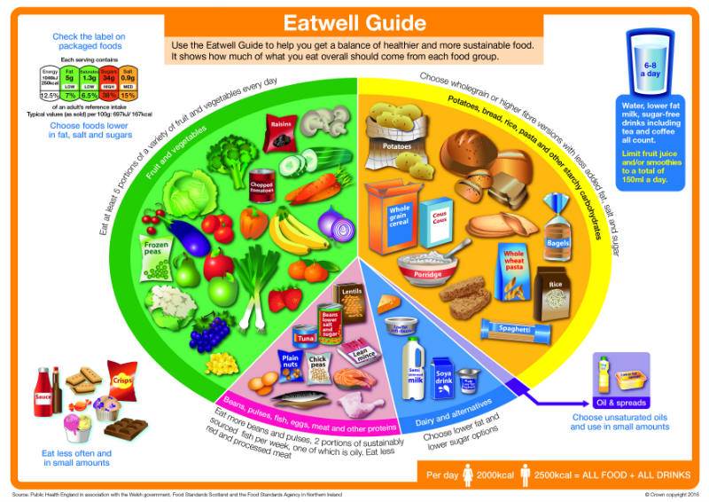

Slide 15
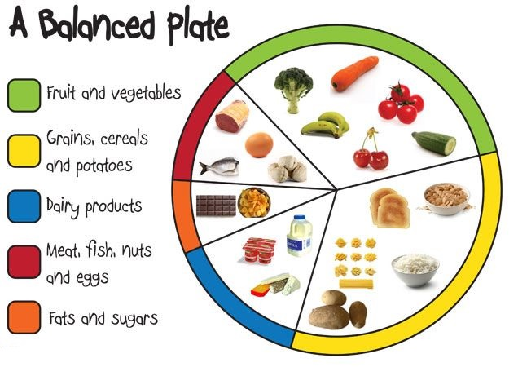

Slide 16
Our body needs a balanced diet. This should include:
At least five portions of fruit and vegetables per day
Starchy foods such as bread, rice, potatoes and pasta. Choose wholegrain varieties wherever possible
Milk and dairy products such as cheese and yogurts
Meat, fish, eggs, beans and other non-dairy sources of protein
Only a small amount of foods and drinks high in fats and/or sugar

Slide 17

We should drink 6-8 glasses of water a day. – around 1.2 to 1.5 litres.
Water, lower fat milk and sugar-free drinks, including tea and coffee, all count.
WATER IS THE BEST!!!

Slide 18
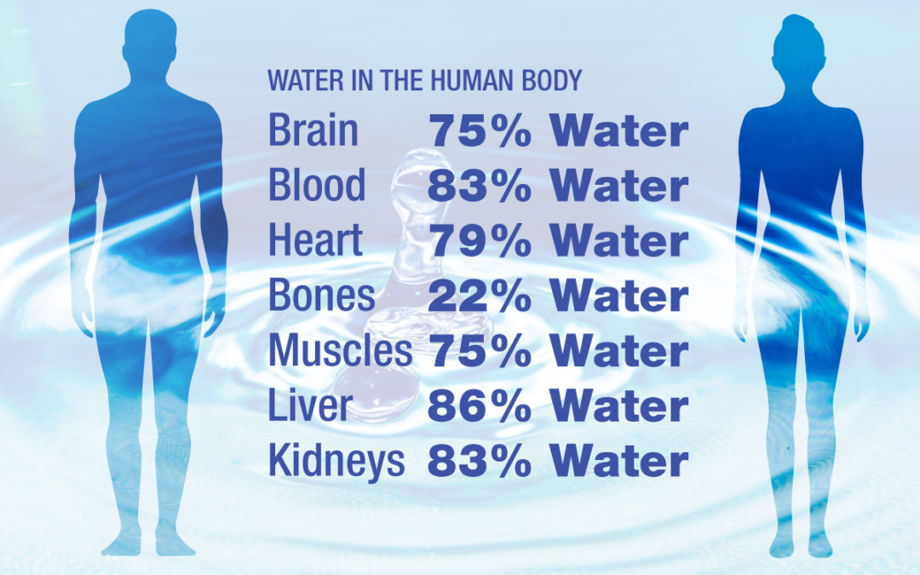
Water is essential for humans to survive. We need it to make sure our body functions properly.

Slide 19

Can you eat healthily and save money?
Write a shopping list
Draw up a weekly meal plan using up ingredients you already have and make a shopping list of any missing items.
Try not to shop when hungry. People who shop when hungry are more likely to spend more.
Waste nothing
The average family with children throws away almost £60 of good food every month.
Plan your meals so all the ingredients on your list get used.
Freeze any unused food. Food storage bags and boxes will come in handy.

Slide 20
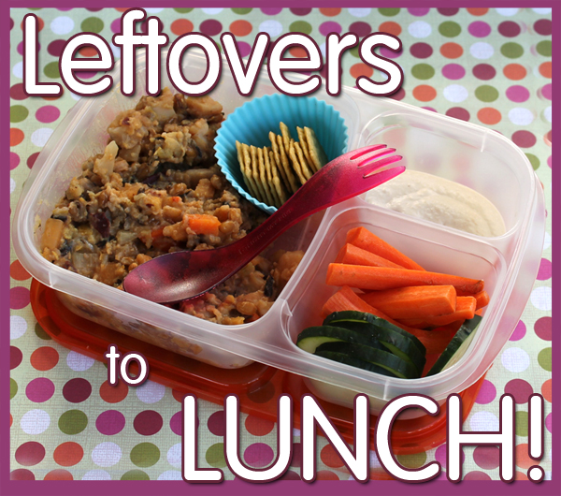
Eat leftovers for lunch
Cook extra portions for your evening meal so you can have the leftovers for lunch the next day.
Buy frozen
Frozen fruit and vegetables are underrated. They are just as good for you and are often cheaper than fresh varieties.
Frozen vegetables are picked at the peak of freshness and then frozen to seal in their nutrients.

Slide 21



.
Try cheaper brands
You could save money by buying cheaper brands than you normally do.
Eat more veg
Meat and fish are typically the most expensive food ingredients on a shopping list
Try a few vegetarian meals during the week to keep costs down.

Slide 22
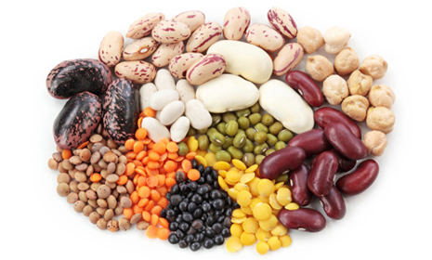
Cook with pulses
Pulses, such as beans, lentils and peas, are some of the cheapest foods on the supermarket shelf.
These pulses are low in calories and fat but packed with fibre, vitamins and minerals, and also count towards your 5 A Day.
Use them in dishes to replace some of the chicken or meat, such as a chilli con carne with kidney beans or a chicken curry with chickpeas.

Slide 23

Freeze leftover bread
Bread is one of the most wasted household foods. Reduce waste by freezing bread.
Know your kitchen
Plan your week's meals to include ingredients you have already got in and avoid buying items you already have.
Check use-by dates to make sure you use up ingredients before they go off.

Slide 24
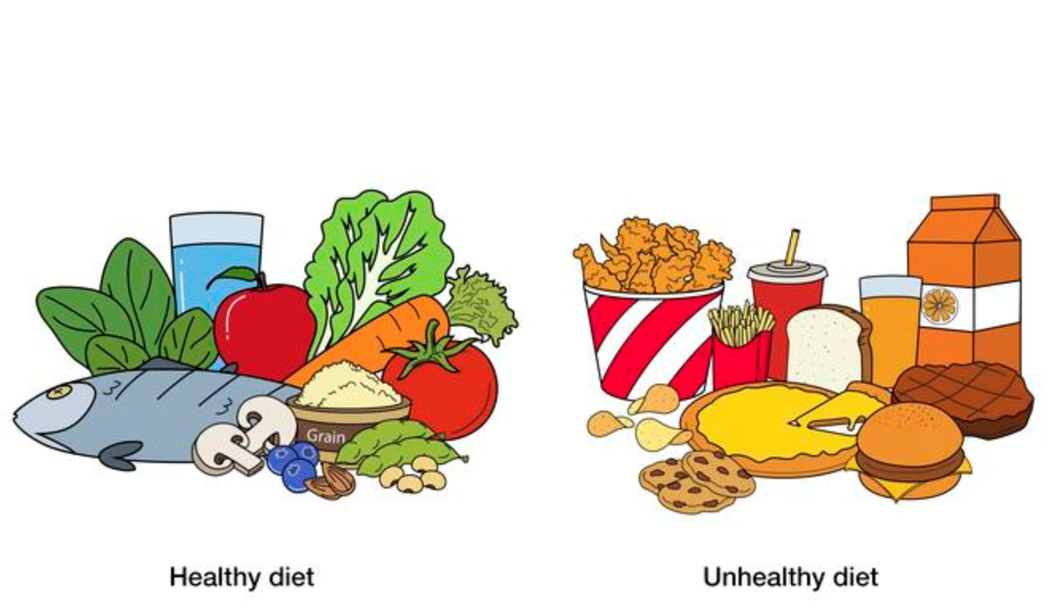
Is it cheaper to eat healthy or unhealthy food?
Design 2 meal plans for 2 adults and 2 children. One is healthy, one is unhealthy.
Research which one is the cheapest!!!

Slide 25
Food waste
Food waste causes just as much damage to our planet as plastic waste. Think about all the energy and resources it takes to produce, process and transport food.
What’s most concerning is that 5m tonnes of this is edible and equates to £15bn of food each year. This works out as £70 a month or £840 a year for a family of four.
Hospitality and the food service (catering) is responsible for 1.85m tonnes
Food manufacturing 1m tonne
Retail, 0.25m tonnes.
Notes:
Read more: https://www.which.co.uk/news/2019/06/three-food-waste-facts-everyone-needs-to-know/ - Which?
Read more: https://www.which.co.uk/news/2019/06/three-food-waste-facts-everyone-needs-to-know/ - Which?

Slide 26
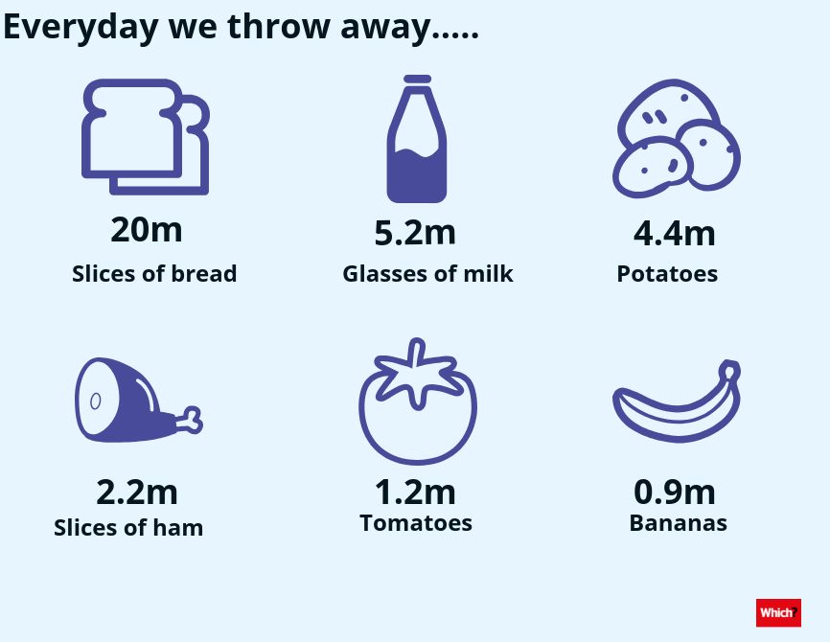
Food waste
Research shows that even people who think they don’t create any food waste actually create around 2.9kg a week – think about those tea bags, coffee grounds, veg peelings, bones and egg shells.
If your council offers a food waste collection service, use it. If people don’t use food waste collections they can become financially unviable and your council might stop them.
If your council doesn’t offer a food waste collection, compost it at home to prevent your food waste going to landfill.
Notes:
Read more: https://www.which.co.uk/news/2019/06/three-food-waste-facts-everyone-needs-to-know/ - Which?
Read more: https://www.which.co.uk/news/2019/06/three-food-waste-facts-everyone-needs-to-know/ - Which?

Slide 27
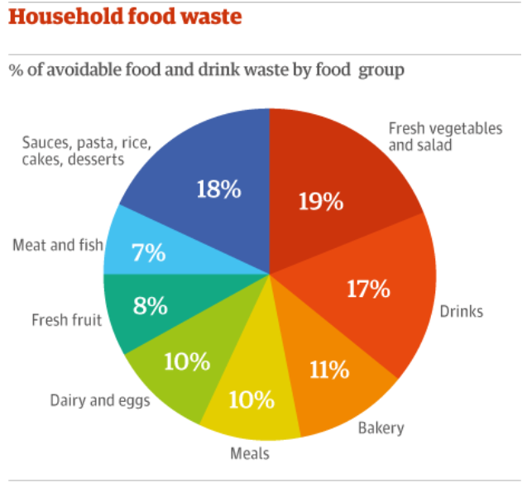

Slide 28
Sustainable consumption
Sustainable consumption is the use of material products, energy and immaterial services so that their use minimizes harm to the environment.
Human needs can be met not only in the present but also for future generations
Consumption refers not only to individuals and households, but also to governments, business, and other institutions.
In 1994 the Oslo symposium defined Sustainable Consumption
“The consumption of goods and services that enhance quality of life while limiting the use of natural resources and noxious materials”
Notes:
Read more: https://www.which.co.uk/news/2019/06/three-food-waste-facts-everyone-needs-to-know/ - Which?
Read more: https://www.which.co.uk/news/2019/06/three-food-waste-facts-everyone-needs-to-know/ - Which?

Slide 29
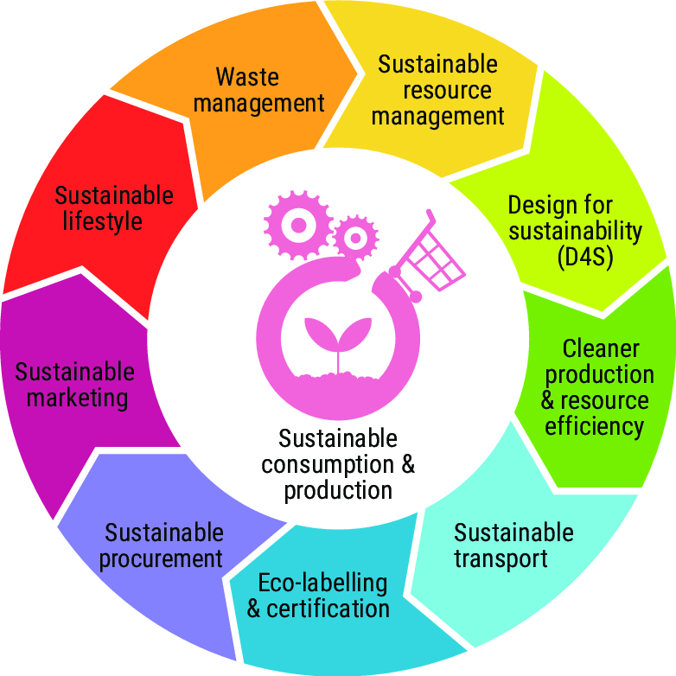

Slide 30
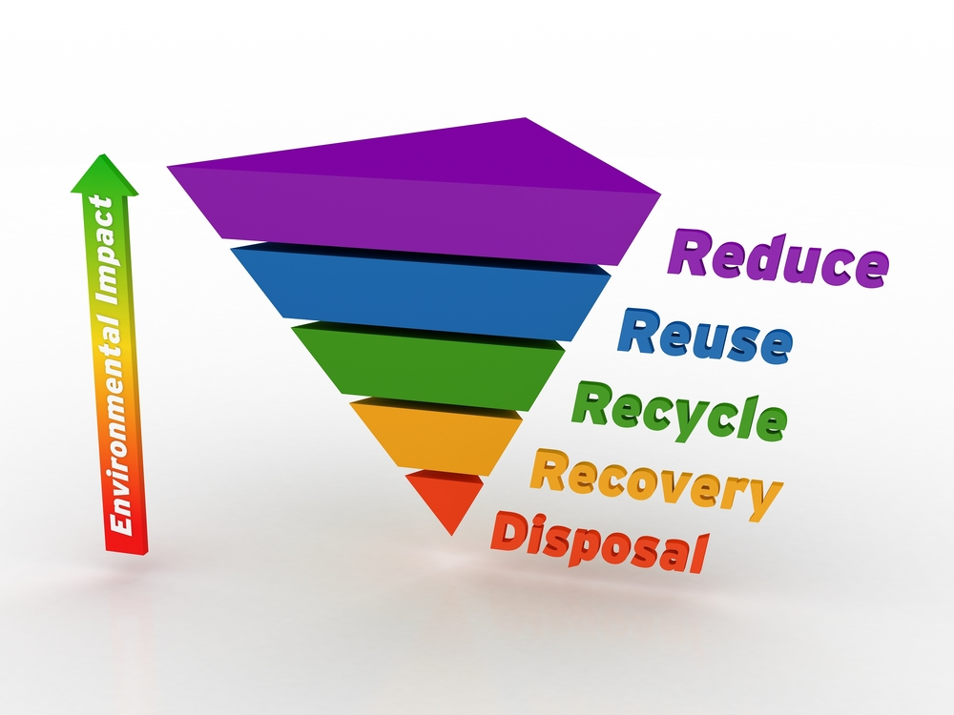

Slide 31
How can consumers be sustainable?
Here are five tips to help you on your journey to becoming a more mindful consumer.
Find sustainable alternatives. Sustainability begins at home! ...
Buy organic fruits and veggies. ...
B.Y.O.B.: Bring your own bags. ...
Make your own DIY beauty products. ...
Buy already loved clothing and household items.
Notes:
Read more: https://www.which.co.uk/news/2019/06/three-food-waste-facts-everyone-needs-to-know/ - Which?
Read more: https://www.which.co.uk/news/2019/06/three-food-waste-facts-everyone-needs-to-know/ - Which?

Slide 32
Food poverty
A quarter of Northern Ireland’s children are living in absolute poverty when their family housing costs are deducted.
New figures from the Department for Communities show that deprivation rose 3% in 2018-19 with a total of 350,000 children, pensioners and adults affected.
The bleak statistics also indicate the number of people in absolute poverty is up for the first time in five years, with children by far the worst affected.
That’s a rise of 16% to 21% of children in one year - and means 92,000 children now live in the worst off homes.
Notes:
Read more: https://www.which.co.uk/news/2019/06/three-food-waste-facts-everyone-needs-to-know/ - Which?
Read more: https://www.which.co.uk/news/2019/06/three-food-waste-facts-everyone-needs-to-know/ - Which?

Slide 33
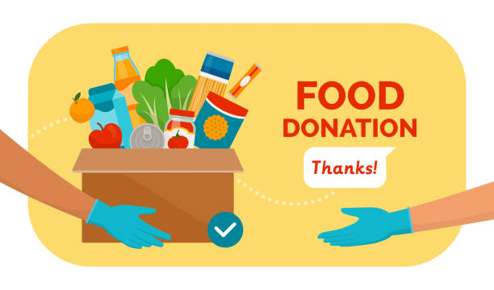
Food poverty
How do food banks help Northern Ireland?
Food banks fulfil a vital role as they help to support people who find themselves or their families without food.
Over the last few years particularly as a result of the economic downturn there has been a rapid growth of food banks providing emergency help and assistance to people across Northern Ireland
Notes:
Read more: https://www.which.co.uk/news/2019/06/three-food-waste-facts-everyone-needs-to-know/ - Which?
Read more: https://www.which.co.uk/news/2019/06/three-food-waste-facts-everyone-needs-to-know/ - Which?

Slide 34
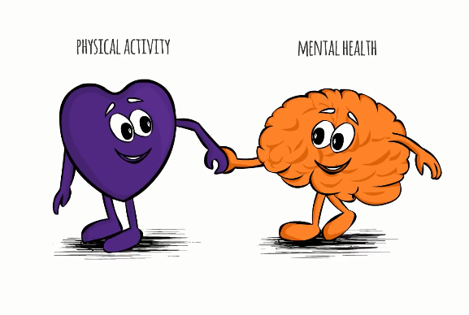
Benefits of healthy diet
There is research to suggest that what we eat may affect not just our physical health, but also our mental health and wellbeing.
Improving your diet may help to:
improve your mood
give you more energy
help you think more clearly.
Notes:
Read more: https://www.which.co.uk/news/2019/06/three-food-waste-facts-everyone-needs-to-know/ - Which?
Read more: https://www.which.co.uk/news/2019/06/three-food-waste-facts-everyone-needs-to-know/ - Which?

Slide 35
Exercise and healthy mind
Exercise can have an enormous impact on your mood. In fact, it is thought that exercise can be just as effective as anti-depressants in treating mild-to-moderate depression.
Exercise can:
increase your energy levels
help you get a good night's sleep
distract you from your worries
help you get out and be with people if you're feeling lonely
help you feel more in control, and improve your self-esteem,
increase your confidence as you meet challenges and reach goals, no matter how small, as well as helping you to feel good about your body
Notes:
Read more: https://www.which.co.uk/news/2019/06/three-food-waste-facts-everyone-needs-to-know/ - Which?
Read more: https://www.which.co.uk/news/2019/06/three-food-waste-facts-everyone-needs-to-know/ - Which?

Slide 36
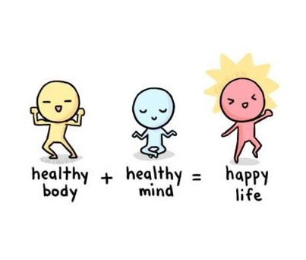
Exercise and healthy mind
For even greater benefits, try exercising outdoors
Some recent studies have found people report a higher level of vitality, enthusiasm, pleasure and self-esteem, and a lower level of tension, depression and fatigue, after they have walked outside
Research shows that vitamin D can help us to fight disease. Vitamin D is known as the sunshine vitamin because we can get our daily dose just by spending some time in the sunshine.
Notes:
Read more: https://www.which.co.uk/news/2019/06/three-food-waste-facts-everyone-needs-to-know/ - Which?
Read more: https://www.which.co.uk/news/2019/06/three-food-waste-facts-everyone-needs-to-know/ - Which?

Slide 37

Exercise and healthy mind
The good news is that your body can make all the vitamin D you need if you expose your arms and legs to sunshine for 10 to 15 minutes a few times a week.
Natural light is known to help lift people's moods, so heading outside can help you to feel better.
Researchers in Britain have been working on the idea that exercising in nature has added benefits for mental health. They call this 'green exercise'.
These researchers have found that even five minutes exercising in nature can lift your mood.
.
Notes:
Read more: https://www.which.co.uk/news/2019/06/three-food-waste-facts-everyone-needs-to-know/ - Which?
Read more: https://www.which.co.uk/news/2019/06/three-food-waste-facts-everyone-needs-to-know/ - Which?

Slide 38
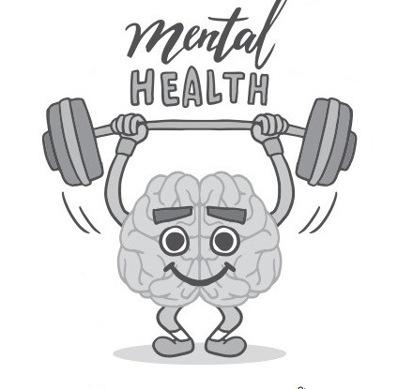
Exercise and healthy mind
Children and young people need to do 2 types of physical activity every week.
Aerobic exercise
Exercises to build their muscles and bones.
Aim for 60 minutes of activity spread throughout the day.
Walking to school
Playground activities
Skateboarding
Rollerblading
Walking the dog
Cycling
Notes:
Read more: https://www.which.co.uk/news/2019/06/three-food-waste-facts-everyone-needs-to-know/ - Which?
Read more: https://www.which.co.uk/news/2019/06/three-food-waste-facts-everyone-needs-to-know/ - Which?

Slide 39

Exercise and healthy mind
Activities to strengthen muscles and bones
Walking
Running
Gymnastics
Basketball
Football
Rugby
Tennis
Sits ups or press ups
Notes:
Read more: https://www.which.co.uk/news/2019/06/three-food-waste-facts-everyone-needs-to-know/ - Which?
Read more: https://www.which.co.uk/news/2019/06/three-food-waste-facts-everyone-needs-to-know/ - Which?

Slide 40
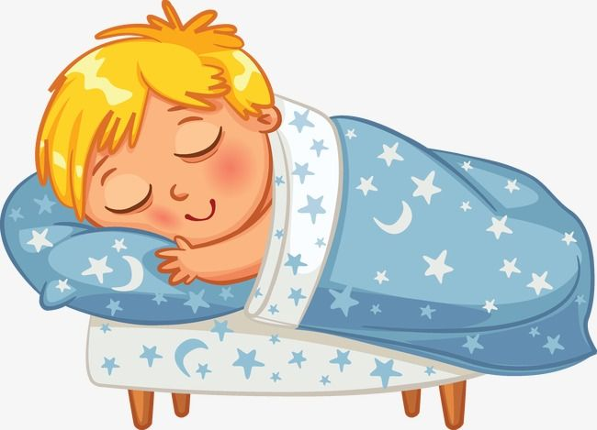
Exercise and healthy mind
Improve you sleep pattern by establishing a routine.
Stick to same sleep schedule every day.
Make sure your mattress is supportive and comfortable and ensure you have comfortable pillows.
Minimise disruptions from light and sound.
Disconnect from electronic devices for half hour or more before bed.
Carefully monitor your caffeine intake and try to avoid it in the evenings before bed.
Notes:
Read more: https://www.which.co.uk/news/2019/06/three-food-waste-facts-everyone-needs-to-know/ - Which?
Read more: https://www.which.co.uk/news/2019/06/three-food-waste-facts-everyone-needs-to-know/ - Which?

Slide 41
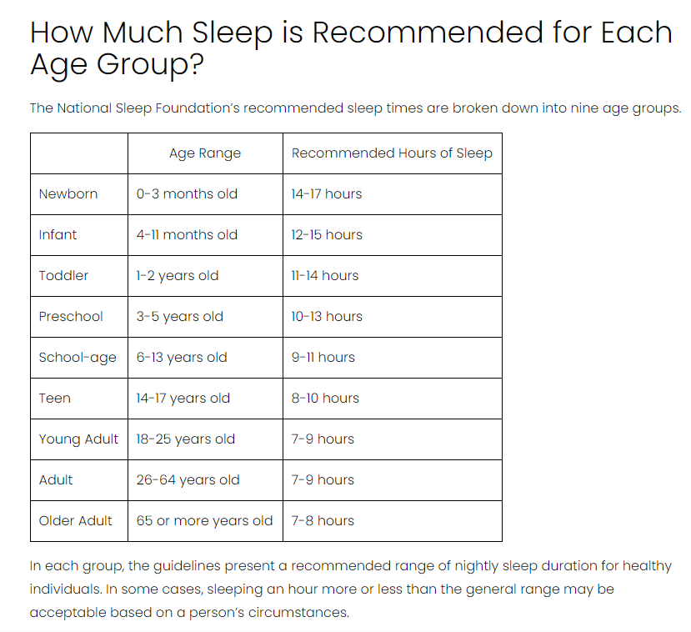


Slide 42
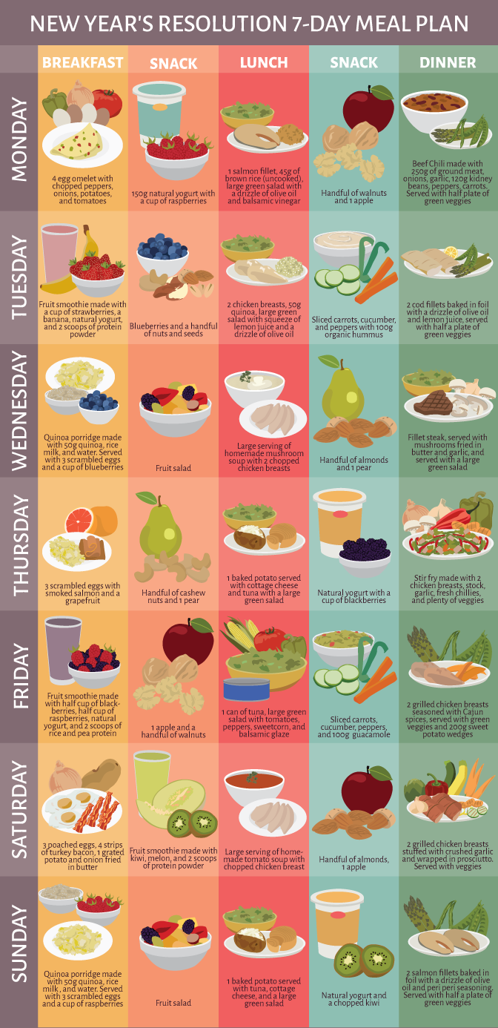
Plan a healthy meal plan
BREAKFAST
SNACK
LUNCH
SNACK
DINNER
SNACK
Notes:
Plan a healthy meal plan for 1 day.
Design your own healthy lunchbox on the template in KS2 LUNCHBOX

Slide 43
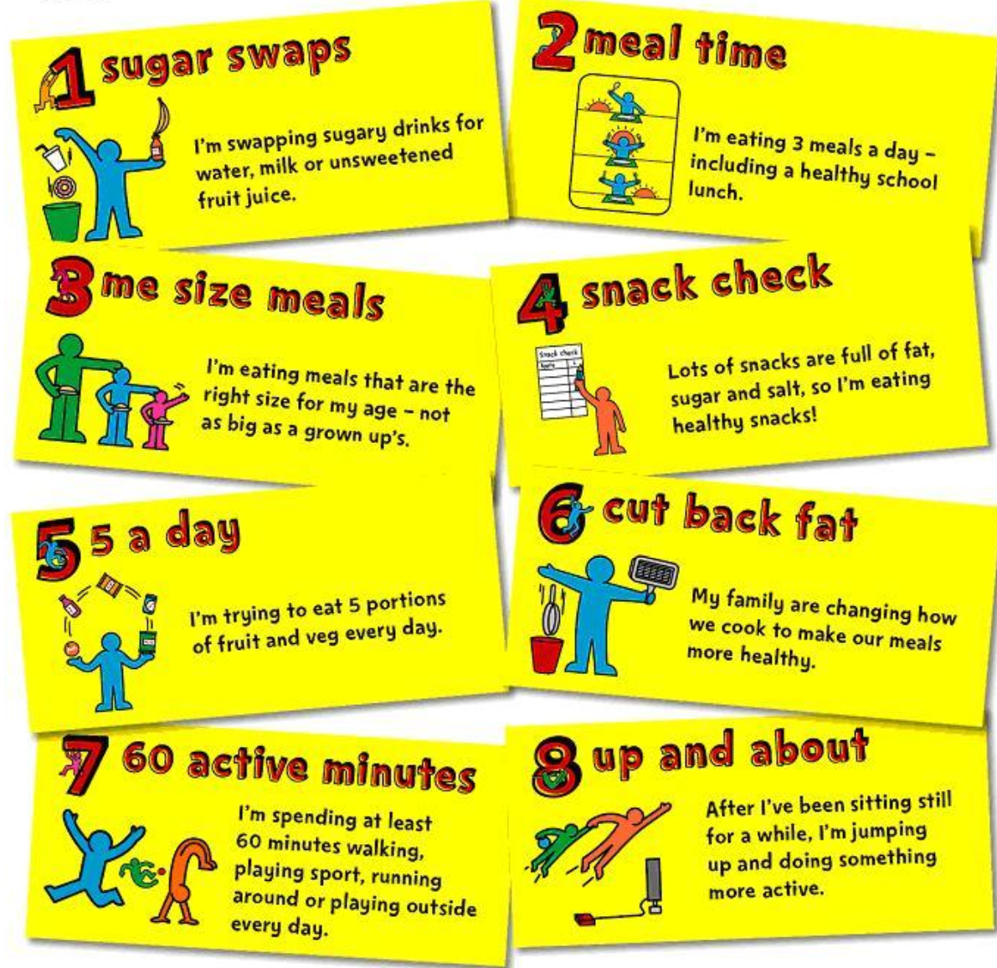
Notes:
Create a poster with at least 5 things you should do to make sure you lead a healthy life.

Slide 44
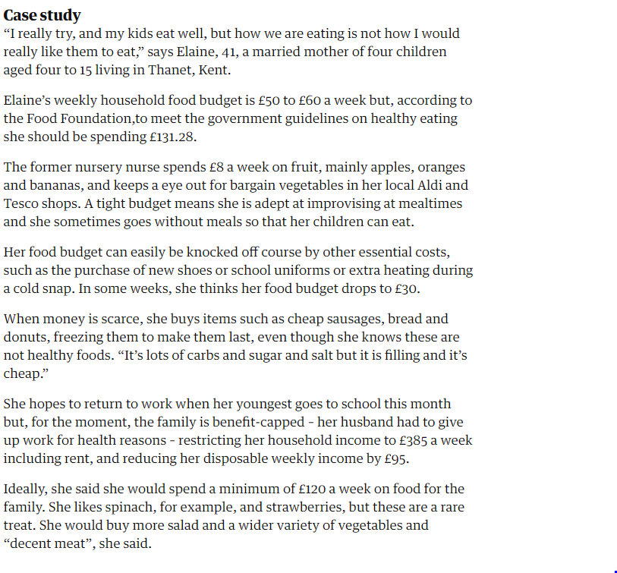

Slide 45
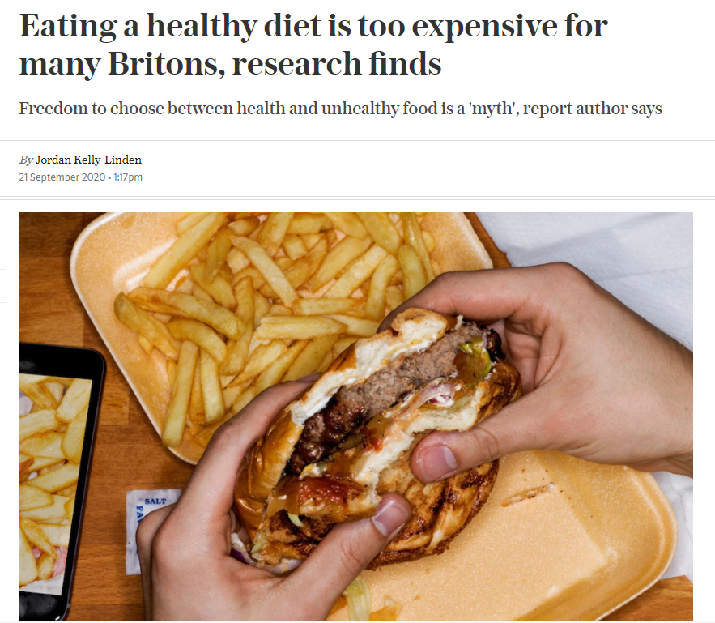
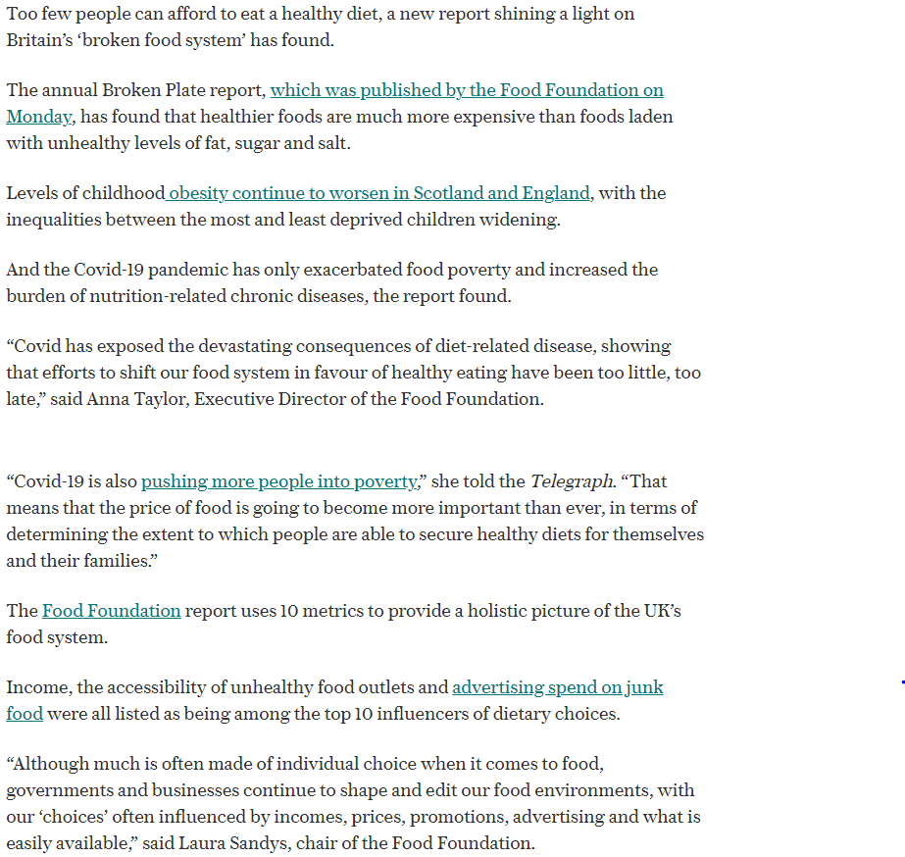

Slide 46
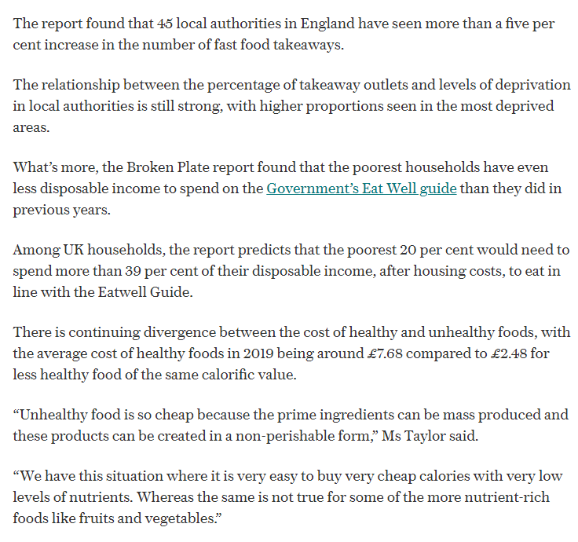
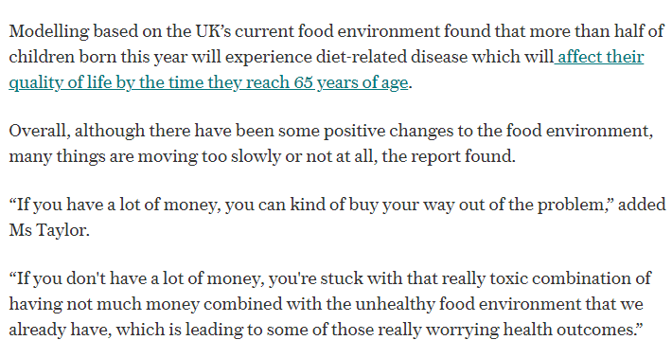

Slide 47





CLASS OBJECTIVES AND RULES
Objectives inform students the learning outcomes of the class. What will they know? What will they be able to do? Why is this important to know? It's an effective way to assess their learning progress.
Rules provide the structure necessary for an engaging and productive class. Keep it simple and easy to follow. It can be general to cover different situations or very specific to your students.

Slide 48


EXAMPLES AND ILLUSTRATIONS
Example 1
Example 2
Example 3

Slide 49




EXERCISE
Add instructions or guidelines here.
You can also put in the amount of time allotted for this.
Individual exercises extend a student’s grasp of the lesson. It allows them to synthesize on their own and think of ways they can apply their new learnings in real life. Duplicate this page as many times as needed to give you more space for discussion.

Slide 50

Question 2: Write the question you want to ask your students and allot space for the answers.
WORKSHEET
Answer 2:
Add instructions or guidelines here. You can also put in the amount of time allotted for this.
Question 1: Write the question you want to ask your students and allot space for the answers.
Question 3: Write the question you want to ask your students and allot space for the answers.
Answer 1:
Answer 3:

Slide 51

ACTIVITY TIME
Add instructions or guidelines here.
You can also put in the amount of time allotted for this.
Like seatworks, student-led activities that can be done by pairs or by group widen their grasp and interpretation of the lesson. Be creative with the activity. Duplicate this page as many times as needed to give you more space for discussion.

Slide 52


SUPPLEMENTAL VIDEO
Let your students watch relevant educational videos that help reinforce the lesson for the day. It’s no secret that it helps students stay interested and engaged. Duplicate this page as many times as needed.

Slide 53



ADDITIONAL RESOURCES
Duplicate this page as many times as needed to give you more space for discussion.
Photos or screenshots of relevant articles are also effective in reinforcing a class lesson.
Maximize this space for additional resources you want to share with your students.
It's something they can easily look back on or search online in case they need a refresher.

Slide 54





CLASS RECAP
Discussion Point
Discussion Point
Discussion Point
Discussion Point
Discussion Point
Cap off a productive class with key summary points students can easily remember.
You can provide this for the class as a way of wrapping up everything you've discussed.
You can provide this for the class as a way of wrapping up everything you've discussed.
You can provide this for the class as a way of wrapping up everything you've discussed.
Recaps can also be led by students for a more enriching experience.

Slide 55



HOMEWORK
Add instructions or guidelines here. You can also put additional details on when and how to submit.

Slide 56


























FREE ICONS
Use these free recolorable icons and illustrations in your Canva design.

Slide 57





















FREE RESOURCES
Use these free recolorable icons and illustrations in your Canva design.

