Slide 1

















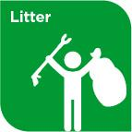


Slide 2








WELCOME,
STUDENTS!

Slide 3
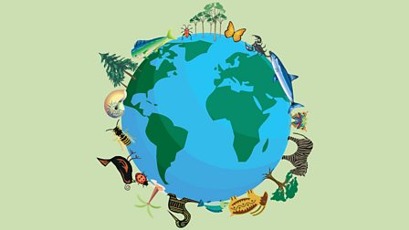

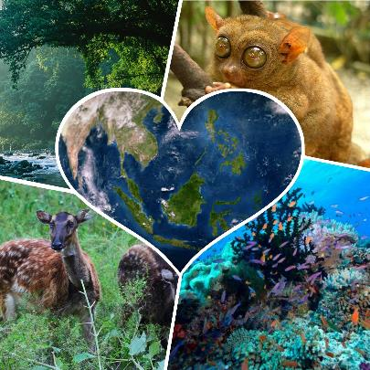
BIODIVERSITY
FOUNDATION STAGE

Slide 4
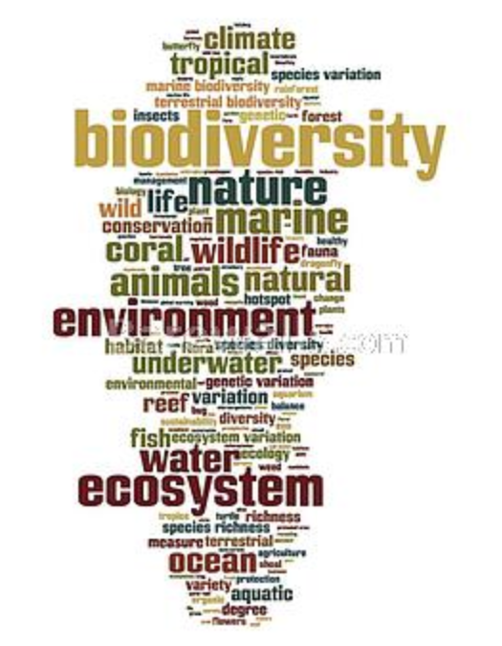
WHAT IS BIODIVERSITY?
BIO means LIFE
DIVERSITY means RANGE OF DIFFERENT THINGS
Biodiversity is all of the plants and animals species that are living.

Slide 5
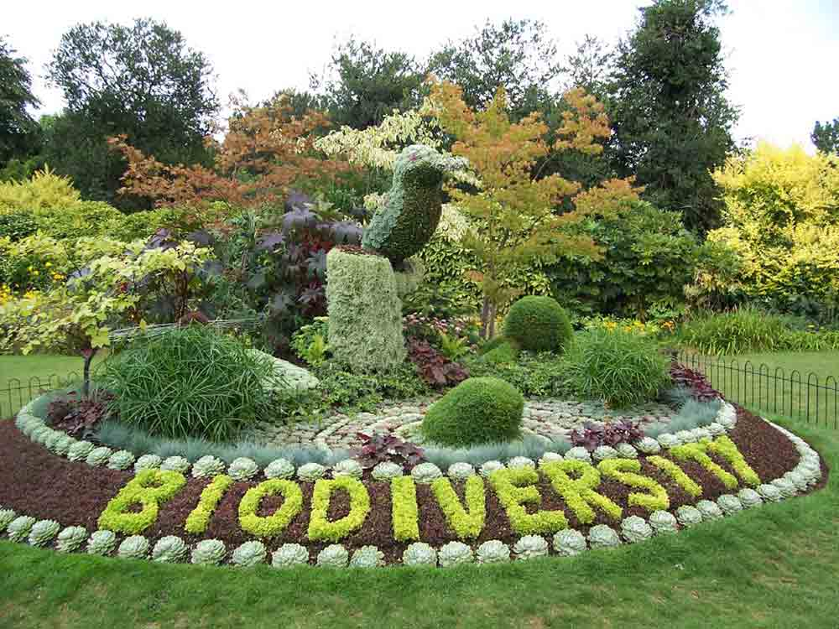

Slide 6
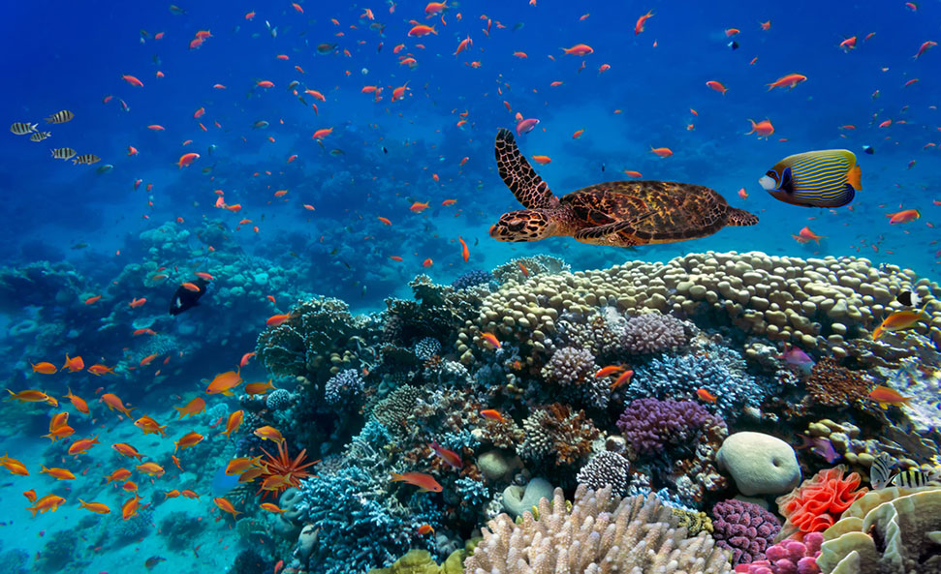
High biodiversity means many species of animal and plants.
High biodiversity

Slide 7
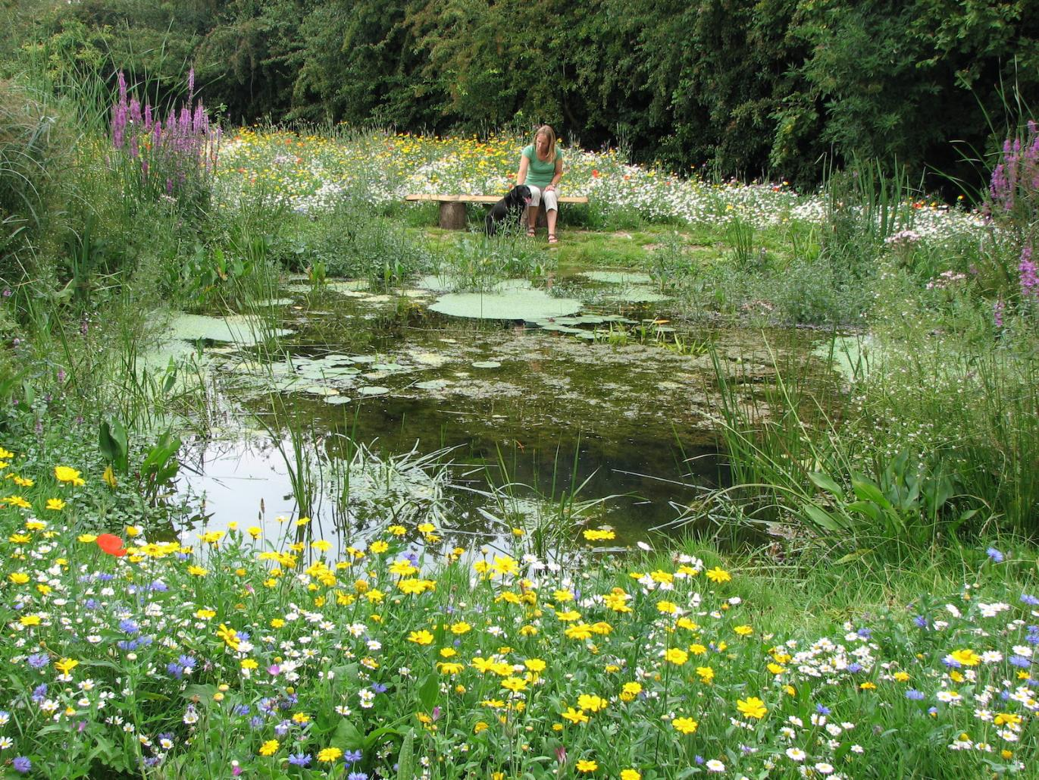

Slide 8
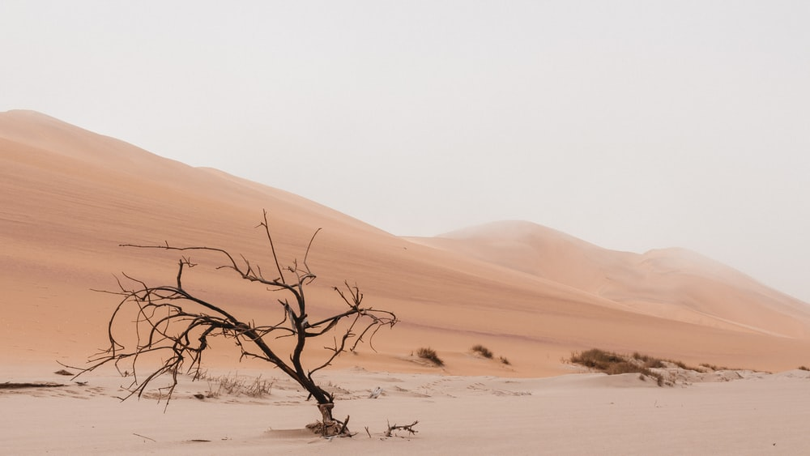
Low biodiversity means very few species of animals and plants.
low biodiversity

Slide 9
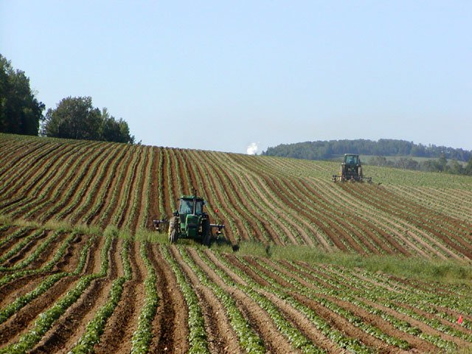

Slide 10

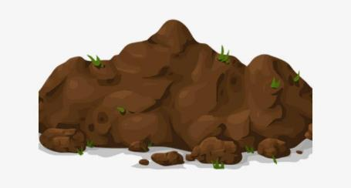
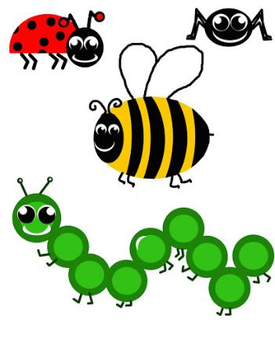
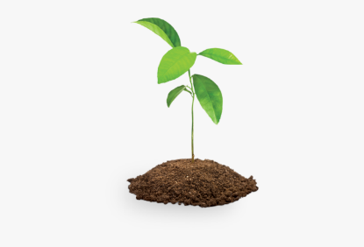
What is an ecosystem?
An ecosystem is a way that living things work together in their surroundings.
They need water, soil, plants, animals.
They all work together so if you take 1 thing away they wont work as well.

Slide 11
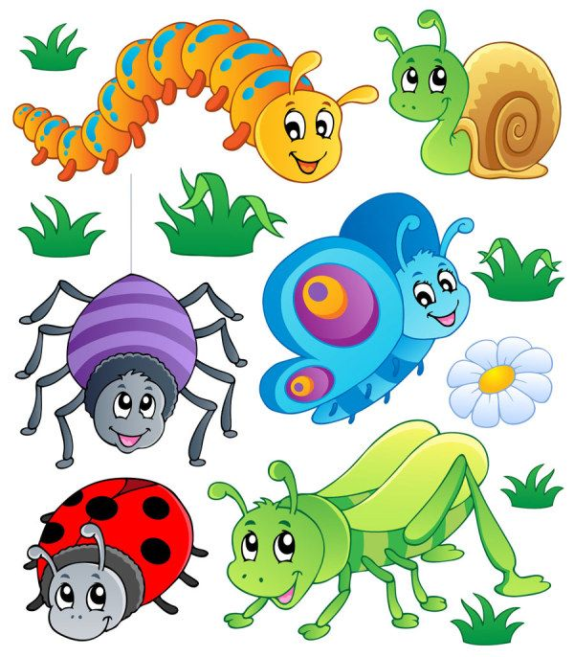
What is a minibeast?
A minibeast is a creepy crawly
They are the little bugs that crawl around the garden.
They provide food
pollinate flowers
spread seeds
help break down waste

Slide 12
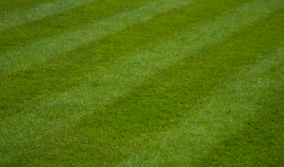
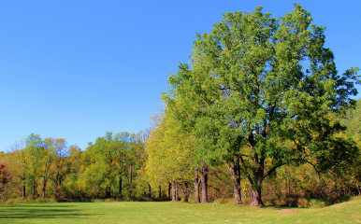
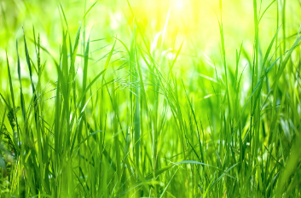


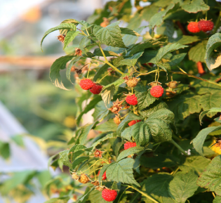
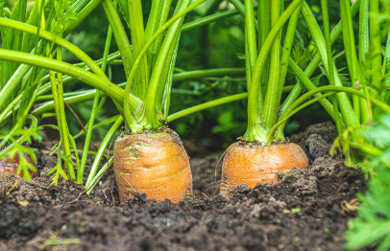



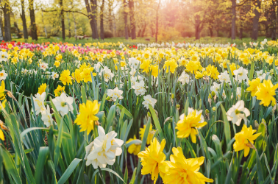
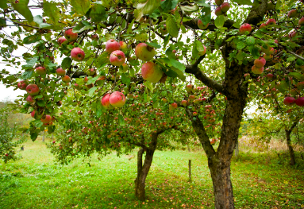
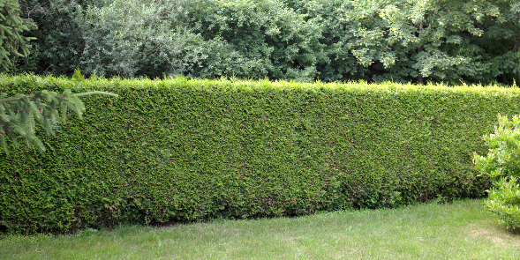


Types of plants

Slide 13
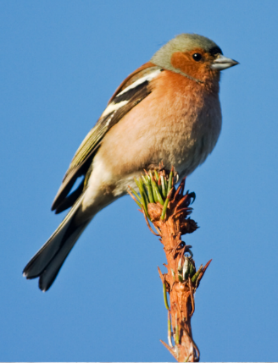
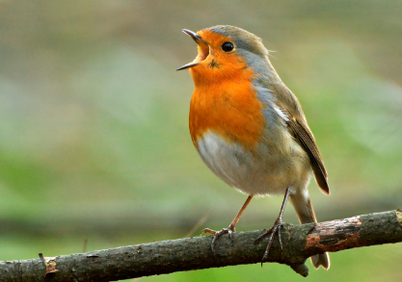
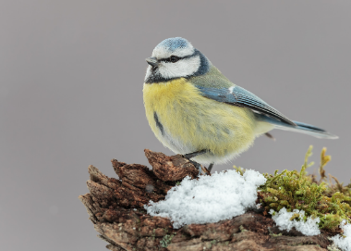



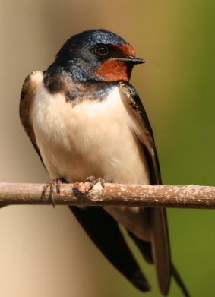
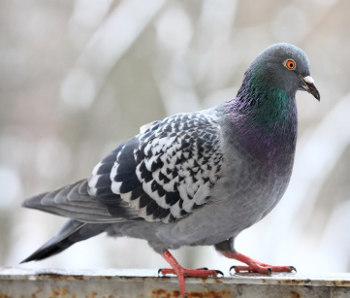
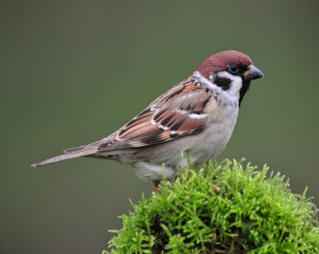
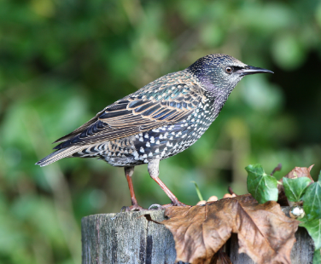




Types of birds

Slide 14
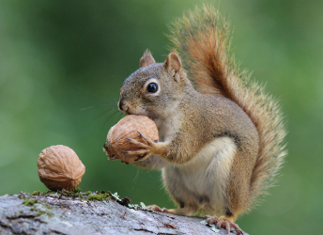
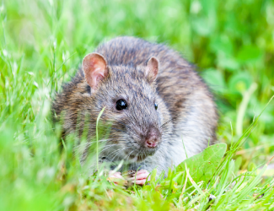

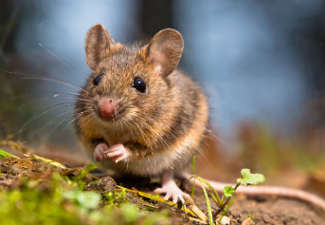
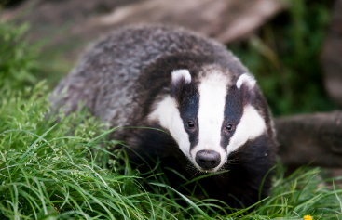

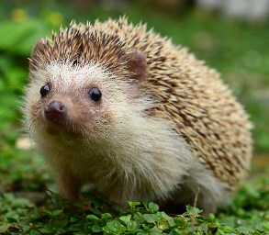


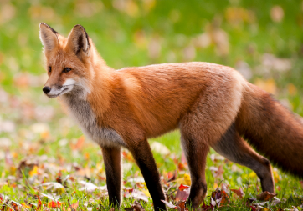


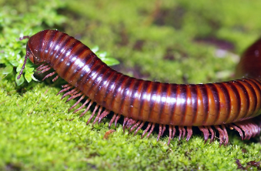
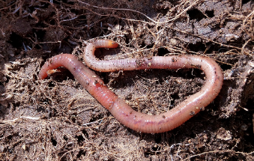
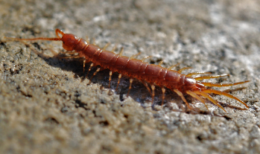



Types of animals
soil dwellers

Slide 15
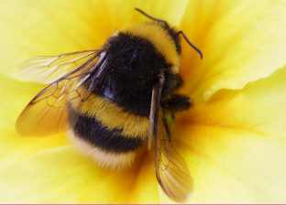
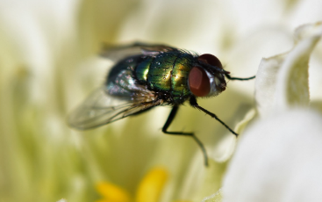
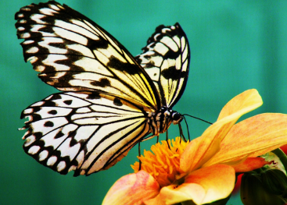
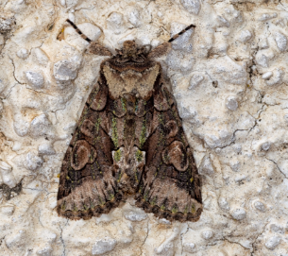


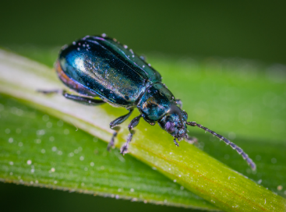

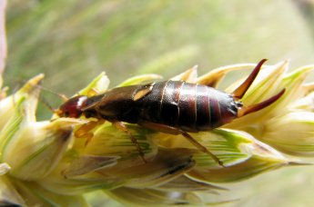
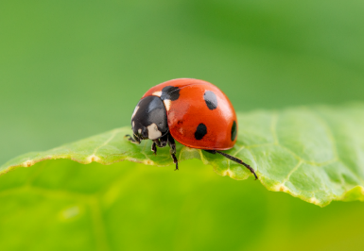


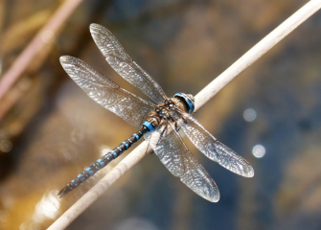
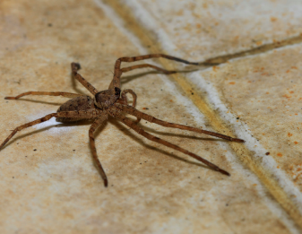

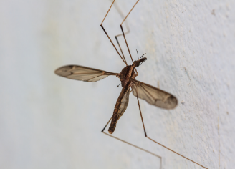


Types of insects

Slide 16
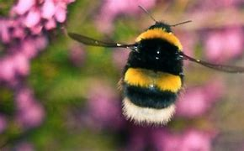
Types of bees
There are 99 different species of bees in Ireland.
1 honeybee
21 different bumblebees
77 solitary bees.
Bumblebees and solitary bees are known as wild pollinators.

Slide 17
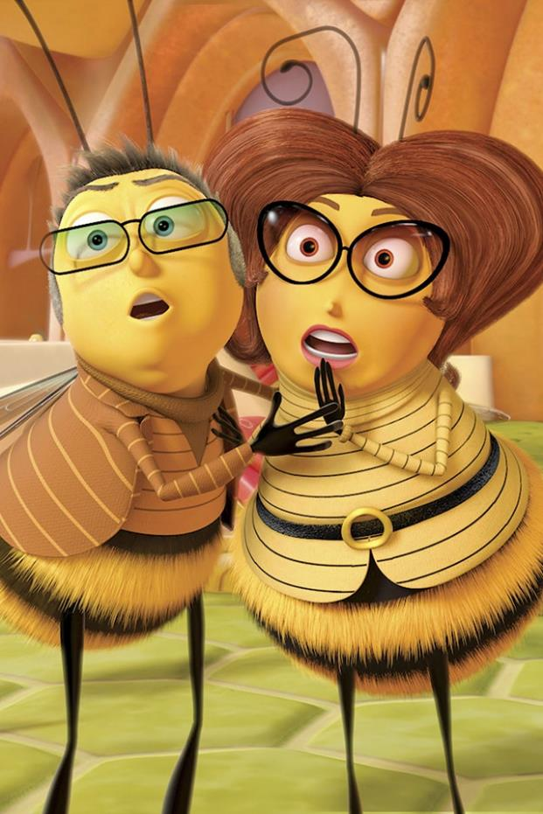
Types of bees
Honeybees live in hives and are managed and cared for by beekeepers.
Bumblebees have fat furry bodies. They make their nests on the ground, hidden in long grass or other vegetation.
Solitary bees nest in tiny holes in wood or hollow stems or make burrows in bare soil.

Slide 18
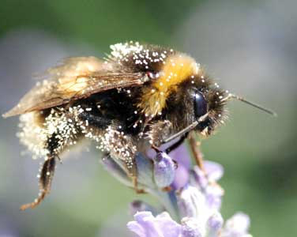

Bees are IMPORTANT FOR OUR ENVIRONMENT
As bees visit plants seeking food, pollen catches on their bodies and passes between plants, fertilising them – that's pollination.
Many plants would not be able to fertilise without bees and other pollinators.

Slide 19

There are around 70 crops in the UK that depend or benefit from bee pollination.

Slide 20


Slide 21





3 REASONS HONEY BEES ARE IMPORTANT
They Pollinate Food Crops
Honeybees always travel a long way to look for nectar.
As a result, we have many foods like cucumbers, cherries, apples, limes and lemons.

Slide 22


3 REASONS HONEY BEES aRE IMPORTANT
They Pollinate Wild Plants
Wild plants provide food for lots of insects, birds and animals.
Without wild plants, these would disappear.
There would be no milk, meat and other important foods we get from animals and birds.

Slide 23

3 REASONS HONEY BEES aRE IMPORTANT
They Produce Honey
It is only bees who can produce honey for us.
Natural honey is an important food that has immense benefits on our health.
Honey also reduces coughs, increases athletic performance, heals wounds and fight bacteria.

Slide 24






Bees are not the world's only pollinators. Flies, wasps, moths, beetles, butterfies and even some birds all pollinate.
Estimates suggest we have over 1500 pollinating insect species in UK.

Slide 25
Bees are in danger of dying out!!
Pollution and disease
Pesticides and herbicides
Climate change
Habitat loss
Invasive species
Notes:
HABITAT LOSS – less forage and shelter for bees. Its vitals for bees to have enough flowers to forage and safe places to use for nesting among vegetation, soil, and hedges.
Since WW2 we’ve lost 97% of wildflower meadows leaving bees with little natural habitat.
CLIMATE CHANGE – changes in climate may be disrupting bee nesting behaviour. It may also affect the timing of flowering plants that bees rely on for food. Eg apple trees could be in blossom at a different time from when the bees are active.
PESTICIDES – these can have adverse effects on bees by reducing their breeding success and resistance to disease. Scientists have found that exposure to pesticides can impair honeybees ability to navigate, bumblebees ability to reproduce.
PEST AND DISEASE – honeybee diseases can spread to wild bumblebees.
INVASIVE BEES – some species that are not naturally found in UK can be disruptive or worse for native bees. Eg Asian Hornet recently arrived in UK and could devastate British bee species.

Slide 26
Climate change
Habitat loss
changes in climate may be disrupting bee nesting behaviour. It may also affect the timing of flowering plants that bees rely on for food. Eg apple trees could be in blossom at a different time from when the bees are active.
less forage and shelter for bees. It’s vital for bees to have enough flowers to forage and safe places to use for nesting among vegetation, soil, and hedges.
Pesticides and herbicides
Invasive species
these can have negative effects on bees by reducing their breeding success and resistance to disease. Scientists have found that exposure to pesticides can impair honeybees ability to navigate and bumblebees ability to reproduce.
some species that are not naturally found in UK can be disruptive or worse for native bees. Eg Asian Hornet recently arrived in UK and could devastate British bee species.

Slide 27

HABITAT PROTECTION
First and most important is to protect existing natural habitats.
Native hedgerows are vital for pollinators and wildlife.
It is important to stop mowing grassy areas. This allows common wildflower to naturally grow among the grass

Slide 28
HABITAT PROTECTION
Next comes restoration of existing areas to encourage plants to grow again.
Trees and shrubs, verges and parks need to be allowed to flower and fruit. Bees need the pollen and nectar that flowers provide, while birds need the seeds.
Bees need to survive the winter and safe spaces to rear the next generation. Leaving rough uncut areas in parks or around hedgerow bottoms are perfect places for this.

Slide 29

HABITAT PROTECTION
Last but not least comes the creation of new habitat.
Higher quality green spaces bring us closer to nature.

Slide 30
Why do we need to protect our pollinators?
Farmers need pollinators to ensure good yields of high quality produce. Without pollinators the livelihood of farmers would be impacted.
Gardeners rely on pollinators for growing their own fruit and vegetables to feed their families.
Environment 78% of wild plants need insect pollination. Without these the landscape would be a much less beautiful place.

Slide 31
WHAT CAN WE DO TO HELP?
Plant for pollinators: Grow more nectar-rich flowers, shrubs and trees to provide for pollinators throughout the year.
Let your garden grow wild: Leaving patches of land to grow wild let wildflowers grow and make great nesting and feeding sites.
Put away the pesticide: They can harm pollinators and many other beneficial invertebrates. Consider alternatives and only use pesticides as a last resort.

Slide 32
WHAT CAN WE DO TO HELP?
Leave the lawnmower: Cut your grass less often, and remove cuttings to let plants flower.
Build a bee hotel and avoid disturbing or destroying nesting or hibernating insects in grass margins, bare soil, hedgerows, trees, dead wood or walls.

Slide 33
4 things you can do to save our bees!!
When planning you garden, plant flowers and shrubs that will flower in Spring or Autumn
Have a little more space? Grow a fruit bush
When gardening consider leaving an area uncut to allow daisies, dandelions and other flowers to grow
Don’t have a garden? You can grow flowers and plants in plant pots

Slide 34
Pollinator plan for your school
Draw a habitat map of your school.
Identify areas where you can take action to help pollinators.
www.pollinators.ie pollinating insects and what they need to survive.
Protect wildlife spots you already have.
Areas of long grass with wildflowers; flowerbeds; native trees.
Reduce mowing.
Make your own “Don’t Mow” “Pesticide free zone” sign for school.

Slide 35





Plant pollinator friendly flowers.
Plant pollinator friendly trees.
The best native trees are
hawthorn
willow
Blackthorn
Wild cherry
Crab apple

Slide 36




SUMMER
Plant pollinator friendly flowers for every season of the year.
The best ones are
AUTUMN
Monarda
SPRING
WINTER
Perennial Wildflower
Crocus
Snowdrop

Slide 37




SUMMER
Plant pollinator friendly herbs for every season of the year.
The best ones are
AUTUMN
Chives
Sage
SPRING
WINTER
Marjoram
Rosemary

Slide 38




SUMMER
Plant pollinator friendly fruit and veg for every season of the year.
The best ones are
AUTUMN
Strawberry
SPRING
WINTER
Runner beans
Kale
Raspberry

Slide 39


Reduce or eliminate pesticides in your school.
Find out from the school caretaker if they use pesticide and could they reduce it?
Only use herbicide for health and safety reasons. Eg to stop areas becoming slippy.

Slide 40


Slide 41





MATERIALS NEEDED FOR CLASS
List the things your students need to get ready before class. It can be a particular textbook, the accomplished homework due for the day, or any specific materials for the topic you're about to discuss. You can also match it with corresponding photos or icons.

Slide 42








CLASS OBJECTIVES AND RULES
Objectives inform students the learning outcomes of the class. What will they know? What will they be able to do? Why is this important to know? It's an effective way to assess their learning progress.
Rules provide the structure necessary for an engaging and productive class. Keep it simple and easy to follow. It can be general to cover different situations or very specific to your students.

Slide 43







LESSON FOR THE DAY
FOUNDATION STAGE

Slide 44







CONCEPTS AND DEFINITIONS
Get the ball rolling by introducing the lesson's key concepts and its corresponding definitions. Duplicate this page as many times as needed to give you more space for discussion. Pair the concepts and definitions with relevant images too for a more visualized presentation of the lesson.

Slide 45

EXAMPLES AND ILLUSTRATIONS
Example 1
Example 2
Example 3

Slide 46




EXERCISE
Add instructions or guidelines here.
You can also put in the amount of time allotted for this.
Individual exercises extend a student’s grasp of the lesson. It allows them to synthesize on their own and think of ways they can apply their new learnings in real life. Duplicate this page as many times as needed to give you more space for discussion.

Slide 47

Question 2: Write the question you want to ask your students and allot space for the answers.
WORKSHEET
Answer 2:
Add instructions or guidelines here. You can also put in the amount of time allotted for this.
Question 1: Write the question you want to ask your students and allot space for the answers.
Question 3: Write the question you want to ask your students and allot space for the answers.
Answer 1:
Answer 3:

Slide 48

ACTIVITY TIME
Add instructions or guidelines here.
You can also put in the amount of time allotted for this.
Like seatworks, student-led activities that can be done by pairs or by group widen their grasp and interpretation of the lesson. Be creative with the activity. Duplicate this page as many times as needed to give you more space for discussion.

Slide 49


SUPPLEMENTAL VIDEO
Let your students watch relevant educational videos that help reinforce the lesson for the day. It’s no secret that it helps students stay interested and engaged. Duplicate this page as many times as needed.

Slide 50





ADDITIONAL RESOURCES
Duplicate this page as many times as needed to give you more space for discussion.
Photos or screenshots of relevant articles are also effective in reinforcing a class lesson.
Maximize this space for additional resources you want to share with your students.
It's something they can easily look back on or search online in case they need a refresher.

Slide 51



CLASS RECAP
Discussion Point
Discussion Point
Discussion Point
Discussion Point
Discussion Point
Cap off a productive class with key summary points students can easily remember.
You can provide this for the class as a way of wrapping up everything you've discussed.
You can provide this for the class as a way of wrapping up everything you've discussed.
You can provide this for the class as a way of wrapping up everything you've discussed.
Recaps can also be led by students for a more enriching experience.

Slide 52




HOMEWORK
Add instructions or guidelines here. You can also put additional details on when and how to submit.

Slide 53


























FREE ICONS
Use these free recolorable icons and illustrations in your Canva design.

Slide 54





















FREE RESOURCES
Use these free recolorable icons and illustrations in your Canva design.

