Slide 1



















Slide 2




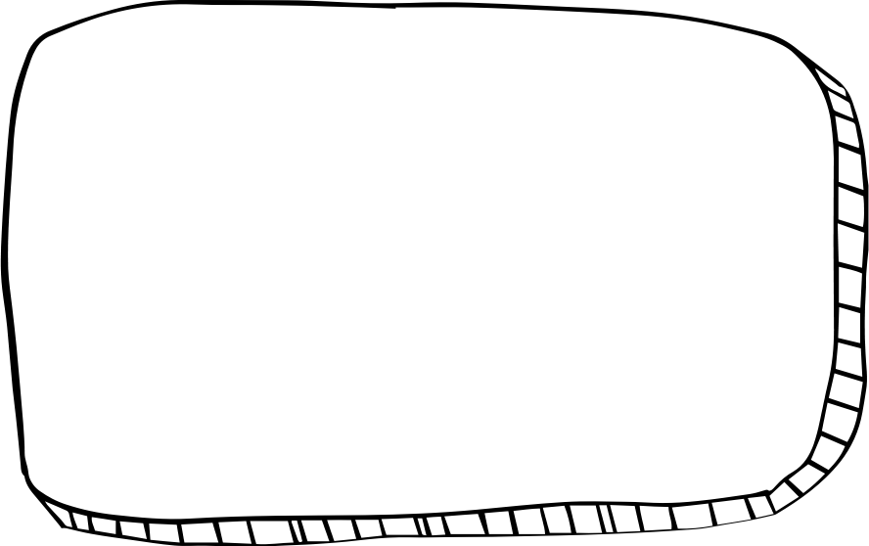


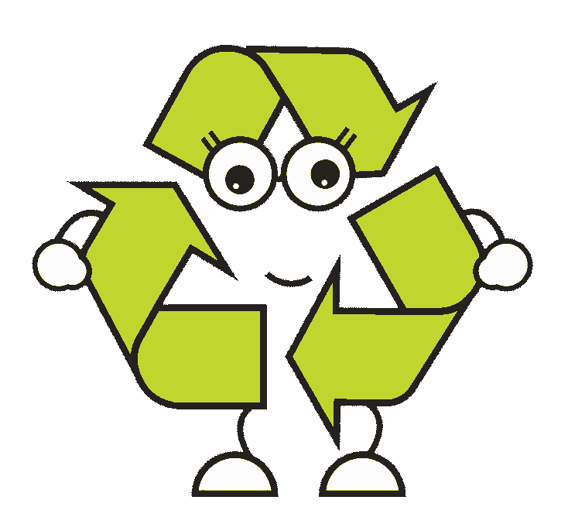



WELCOME,
STUDENTS!

Slide 3











LESSON FOR THE DAY
FOUNDATION STAGE

Slide 4








LANDFILL DEFINITION
A landfill is a place where we bury WASTE in the ground. We put WASTE in landfills because it's smelly and ugly. Imagine if you just threw your WASTE out into the street: gross, right? Nobody wants to look at that. So we take it somewhere people don't live, and we bury it in the ground. Then we don't have to smell it or look at it.
CONCEPTS AND DEFINITIONS
WHAT IS WASTE?
Waste is rubbish that goes to landfill
LANDFILL? WHAT IS THAT?
When you take out the trash, do you know where it goes?
On a truck!
But where does the truck go? Where is it taking all that waste and what happens to the waste afterwards?
That waste is probably going to a landfill.

Slide 5
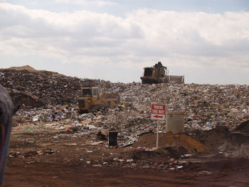
LANDFILL DEFINITION
A landfill is a place where we bury WASTE in the ground. We put WASTE in landfills because it's smelly and ugly.
Imagine if you just threw your WASTE out into the street: gross, right? Nobody wants to look at that.
So we take it somewhere people don't live, and we bury it in the ground.
Then we don't have to smell it or look at it!
CONCEPTS AND DEFINITIONS
Problems with Landfills
When waste is in a landfill, we don't have to look at it.
But there are big problems with landfills.

Slide 6

What’s wrong with landfills?
1
2
3
Landfills pollute the environment. The waste that we throw away includes a lot of dangerous chemicals. When rain falls on a landfill, it can wash the chemicals out into nearby lakes, rivers, and streams. This is bad for fish. It's also bad for people who drink the water.
Another problem is gas from landfills.
When waste rots in a landfill, it makes dangerous gasses.
These gasses are bad for the environment.
They can also cause health problems for people that live near the landfill.
Landfills are bad for animals. They aren't built where people live, but animals do live there.
We're basically dumping a bunch of waste all over those animals' homes.

Slide 7

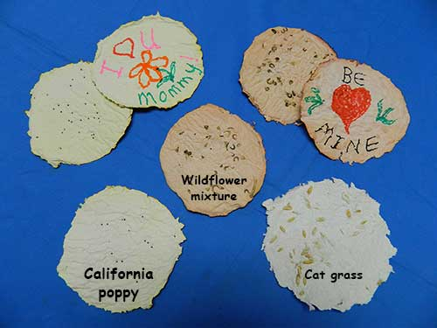
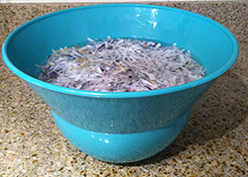
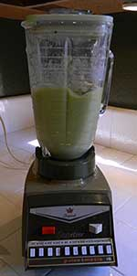
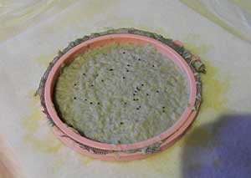
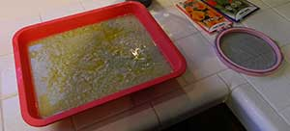
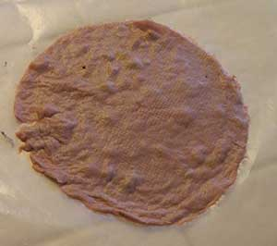
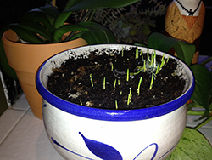
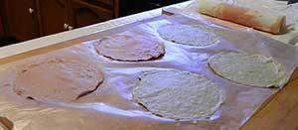
ACTIVITY TIME
Make seed paper
When is a recycled product better than the original? When it's paper that turns into flowers.
Here is a good way to recycle used paper and make a beautiful greeting card for someone special.
1. Soak paper in water
3. Pulp is ready to go. Mix in flower seeds.
4. Most of this is water, so use enough so the paper will not be too thin when it dries!
2. Fill the blender only half full
6. Making new paper from old is fun and easy!
7. Plant your paper and wait for your seeds to germinate
5. If it falls apart, use more pulp

Slide 8
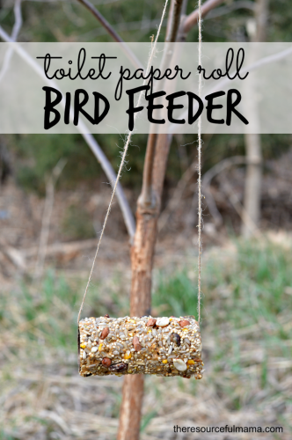
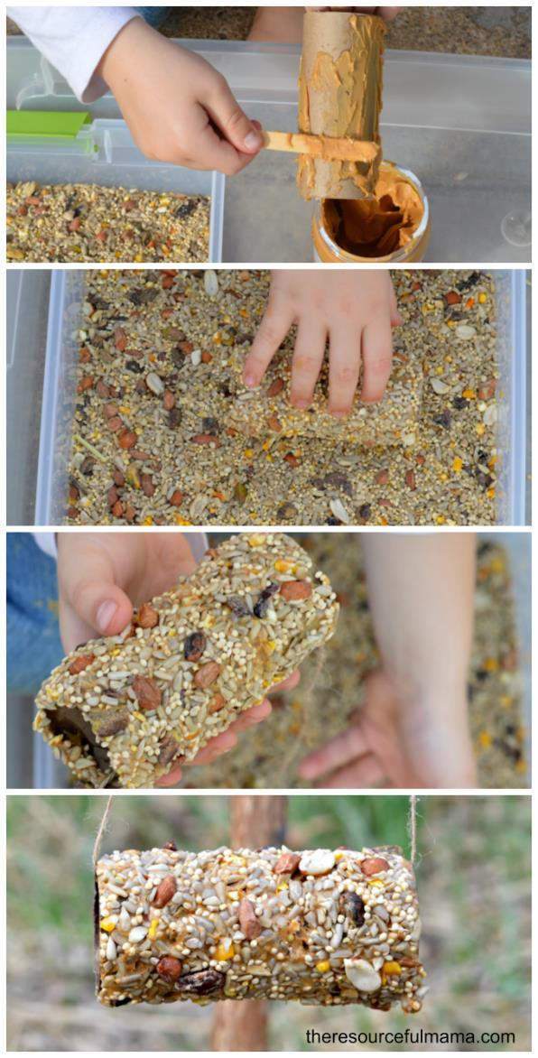
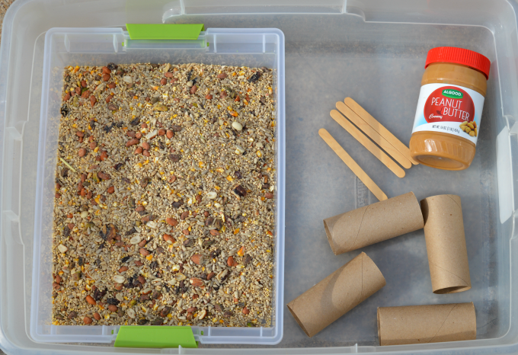
ACTIVITY TIME
EASY TOILET PAPER ROLL BIRD FEEDER CRAFT
When is a recycled product better than the original?
When it's turned into a bird feeder.
Enjoying the outdoors can happen in the garden, and lots of garden birds will pay you a visit with this recycled bird feeder
SUPPLIES:
Peanut Butter
Craft/Popsicle Sticks
Bird seed
Toilet paper rolls
Twine

Slide 9


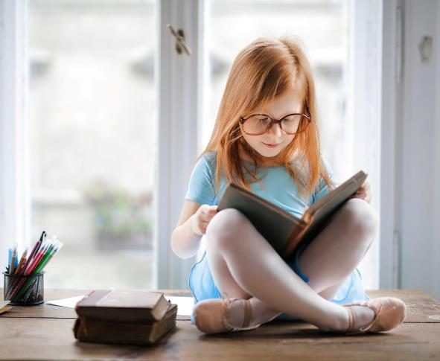



ADDITIONAL RESOURCES
Paper Seeds
To find out WHAT YOU NEED and WHAT TO DO visit this page https://climatekids.nasa.gov/seed-paper/
https://youtu.be/bcJILwxyj3Q
Birds Feeder Activity
To find out how to make it
https://www.theresourcefulmama.com/toilet-paper-roll-bird-feeders/
More fun activities
To learn how to REUSE ITEMS BEFORE BINNING THEM
https://www.theresourcefulmama.com/toilet-paper-roll-bird-feeders/

Slide 10
VIDEO TIME

Slide 11


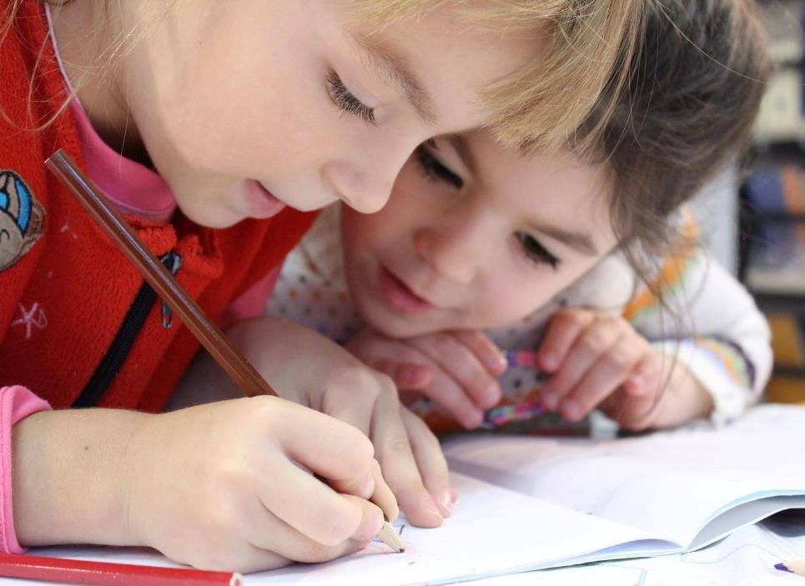
EXERCISE
Have a rubbish-free picnic
Challenge your children to create a zero waste picnic. Set a date for it with them and ask them to bring their ZERO WASTE PACKED LUNCH on that day.
Before that date help them to create a list of all the items they will need to have a proper zero waste packed lunch!
Each of them will suggest things that are necessary and things that can be left behind.
They could pack their own lunches with fresh fruits and sandwiches wrapped in beeswax wraps.
Make your own treats packed in reusable tubs and use a refillable water bottle.
Head out to the beach (if you are close to it) or simply in the outdoor space of your school, and let them know how enjoyable is knowing they won’t be leaving behind any litter when heading home.

Slide 12


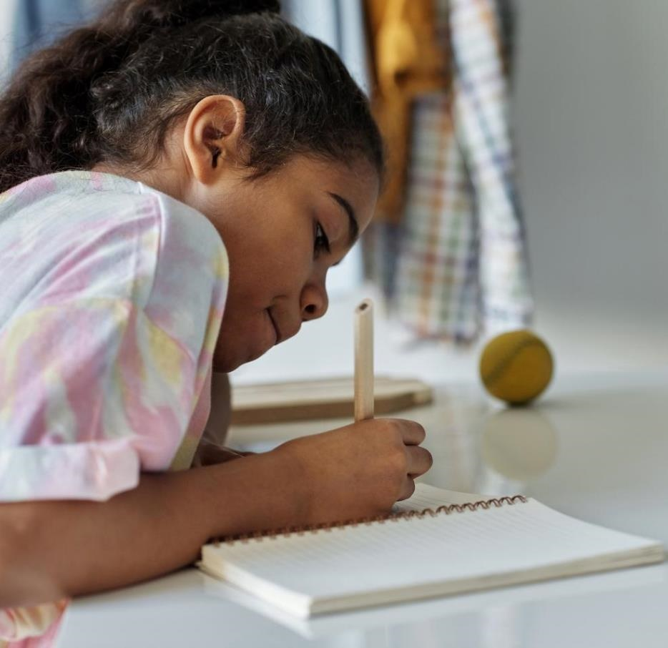

HOMEWORK
Go to the supermarket with your parents and help them to do the shopping, remembering what is necessary and what is not, and…what will produce less waste!
Help them preparing the shopping list asking:
Do we really need it?
Does it have a lot of plastic wrapped around?
Can I find a zero waste alternative to it?

