Slide 1



















Slide 2











WELCOME,
STUDENTS!

Slide 3











LESSON FOR THE DAY
KEY STAGE 5

Slide 4








DID YOU KNOW?
CONCEPTS AND DEFINITIONS
The term waste is also applicable to different types of materials including biomedical, hazardous, industrial, E-waste…
Waste, as we have come to understand, are materials that are unwanted or unusable that get discarded. Sometimes what is waste for one person, may not necessarily be the same for another.
Waste type, quantity of waste generated, how and where it is disposed, its nature sometimes makes it mandatory to be handled with care.
A number of laws and legislations are in place for correct waste management.

Slide 5
DID YOU KNOW?
CONCEPTS AND DEFINITIONS
The term waste is also applicable to different types of materials including biomedical, hazardous, industrial, E-waste…
Waste Management Laws look at minimising or controlling indiscriminate dispersal of waste; reduce ecological or biological harm.
Being aware of the laws is an important component of “Citizenship Education”. We have Rights but Responsibilities at once. With the waste becoming a global problem affecting our oceans, treating wildlife and impacting larges sources of food supply, it is essential knowing more about laws at both local and global level.
Waste type, quantity of waste generated, how and where it is disposed, its nature sometimes makes it mandatory to be handled with care.
A number of laws and legislations are in place for correct waste management.

Slide 6
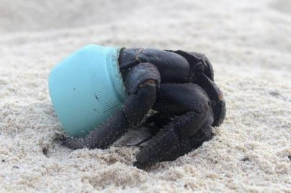
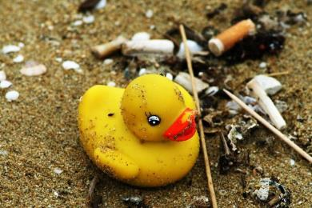
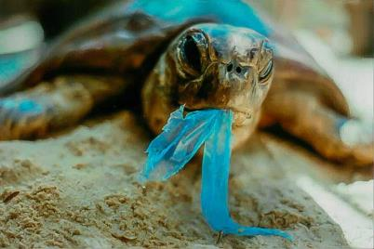

PLASTIC, NOT FANTASTIC
1
2
3
Plastic debris is found absolutely everywhere, from the Arctic to Antarctica. It clogs street drains in our cities; it litters campgrounds and national parks, and is even piling up on Mount Everest. There are an estimated 270,000 tons of plastic floating through the world’s seas where it threatens 700 marine species with its presence (ref). Further, there is growing evidence that plastics play a role in rising rates of species extinctions.
But more than floating around in the water column, plastic trash is found in the guts of more than 90% of the world’s sea birds (ref), in the stomachs of more than half of the world’s sea turtles (ref), and it’s even choking the life out of whales (ref). At the rate at which plastic is accumulating in the oceans of the planet, it’s predicted that, by 2050, the mass of plastic in the world’s oceans will exceed the mass of all the fish that live there (ref).
In 1992, a shipping container filled with 28,000 rubber duckies was lost after it fell into the sea somewhere between Hong Kong and the United States. Even today, those plastic bath toys still wash ashore from time to time, even in totally different oceans as far away as the eastern seaboard of the United States, as well as the coasts of Britain and Ireland.

Slide 7



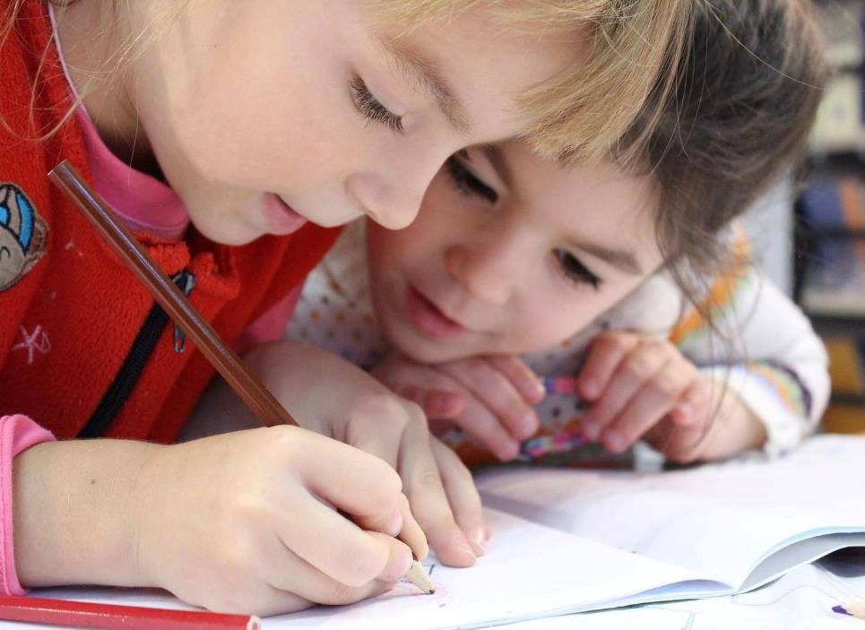
EXERCISE
Discuss with your students some concepts about waste and laws for waste management.
Divide the class into groups of 3-4 students.
Ask your students to undertake an internet-based research on different types of laws and legislations linked to waste (give a week).
Assign to different groups different aspects so to have a discussion in class on another day:
Laws about categories of waste
Laws about collection of waste
Laws about disposing of waste – how and where
Laws about behaviours (dog fouling, littering, fly-tipping and illegal waste dumping)

Slide 8


EXERCISE
Write an article or prepare a presentation about your findings.
Ask the groups to prepare a presentation or to write an article, just like a real reporter, about their findings.
Each group will present each week in front of the classroom informing the rest of the groups about their research and the key points of their work.
They will also propose solutions to the issue.
The rest of the classroom is invited to an open discussion about the topic presented.
Why not submit your article to the YRE Competition?
https://www.eco-schoolsni.org/cgi-bin/generic?instanceID=46

Slide 9

ACTIVITY TIME
Show the video about The Story of Stuff and ask your students to prepare a list of all the unused clothes, accessories and electronic gadgets they have and they could live without.
Could your students take the pledge to live for a week without one of the electronic gadgets?
Could your students take the pledge to live for a week wearing the same 2 or 3 jumpers?
Why not write about this experience or film it as a reportage/documentary?
The final work could enter the YRE Competition – find out more at https://www.eco-schoolsni.org/cgi-bin/generic?instanceID=46

Slide 10



VIDEO

Slide 11


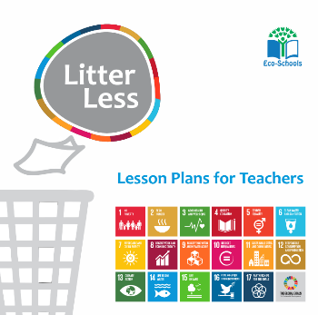
ADDITIONAL RESOURCES
How does recycling effect climate change?
Food Waste and Circular Economy
https://ypte.org.uk/lesson-plans/food-food-waste
http://www.bdronline.co.uk/downloads/file/119/how-does-recycling-affect-climate-change
http://www.bdronline.co.uk/downloads/download/14/key-stage-3-4-resources
https://www.ecoschools.global/lesson-plans-for-teachers
https://www.storyofstuff.org/

