Slide 1



















Slide 2










WELCOME,
STUDENTS!

Slide 3










LESSON FOR THE DAY
KEY STAGE 3

Slide 4








WHAT IS WASTE?
Waste is rubbish that goes to landfill
WASTE MANAGEMENT AND ITS IMPORTANCE
Eight million tons of plastic waste ends up in sea every year.
To put it in perspective, a blue whale weighs 120 tons:
8m tonnes = 66,000 blue whales.
Estimation of waste generation and understanding its composition is important information for management of waste as this information influences the designing of waste collection and handling facilities, understanding its management and safe disposal. The information also raises awareness of waste being produced at home and what individuals can do to minimize waste and adopt practices like segregation, reuse and composting to support the waste management systems in their towns and cities.

Slide 5
UNDERSTANDING WASTE
WHAT IS WASTE SURVEY?
Waste surveys in the school will help assess the type and quantity of waste produced/ generated in the school.
It will help understand the current system of collection, handling and disposal.
The survey will help plan appropriate actions.
REFUSE material or products like disposable plastic whenever and wherever possible.
RETHINK before creating waste or think of alternative products for reducing waste.
REDUCE to limit the amount of waste one creates in the first place. This includes buying products with less packaging.
REUSE something again that you would normally throw away (e.g. Glass jar for food or plastic bags for bin liners.)
RECYCLE products. This is only recommended when reducing and reusing are not possible.

Slide 6
UNDERSTANDING PLASTIC PACKAGING
DID YOU KNOW
Packaging sometimes has important symbols like the recycling symbol, ingredients source (vegetarian and non vegetarian), hazards etc.
The product packaging often has information about the content, price and quantity of the product, make it convenient to store and use the product and also tell us where the product was manufactured and how and by when it should be utilised.
Any plastic you throw in the trash today will sit in a landfill or float in the ocean for thousands of years. As brutal as it may seem, it’s true. We don’t know what the earth or humans will look like a thousand years from now, but plastic will remain the same. So, is there any solution? Well, recycling, reusing, refusing, reducing can offer an answer.

Slide 7
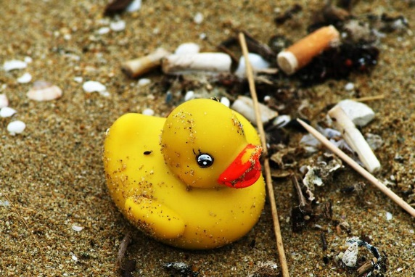
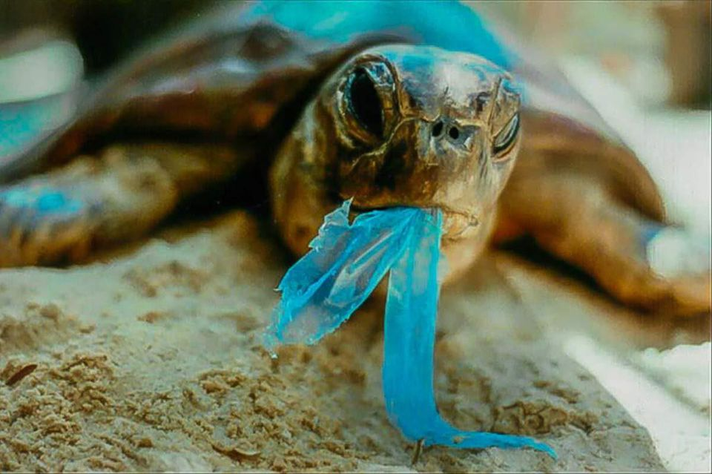
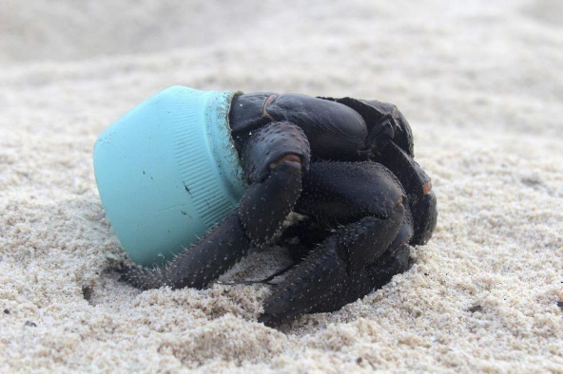

PLASTIC, NOT FANTASTIC
2
3
1
In 1992, a shipping container filled with 28,000 rubber duckies was lost after it fell into the sea somewhere between Hong Kong and the United States. Even today, those plastic bath toys still wash ashore from time to time, even in totally different oceans as far away as the eastern seaboard of the United States, as well as the coasts of Britain and Ireland.
But more than floating around in the water column, plastic trash is found in the guts of more than 90% of the world’s sea birds, in the stomachs of more than half of the world’s sea turtles, and it’s even choking the life out of whales. At the rate at which plastic is accumulating in the oceans of the planet, it’s predicted that by 2050 the weight of plastic in the world’s oceans will be more than the weight of all the fish that live there.
Plastic debris is found absolutely everywhere, from the Arctic to Antarctica. It clogs street drains in our cities; it litters campgrounds and national parks, and is even piling up on Mount Everest. There are an estimated 270,000 tons of plastic floating through the world’s seas where it threatens 700 marine species with its presence. Further, there is growing evidence that plastics play a role in rising rates of species extinctions.

Slide 8

WORKSHEET
Start with a discussion introducing students to packaging.
To get students to understand “packaging”, it will be useful to ask probing/leading questions to students and work further based on the response received.
Question 1: What packaging is?
Question 2: What is the importance of packaging?
Question 3: What are the problems caused by different types of packaging?

Slide 9



EXERCISE
Consider the case study of M&S and ask the students to read the examples of how one supermarket chain has started to reduce food packaging.
Discuss the strategies this supermarket chain using to reduce their environmental impact?
Suggested lines of questioning:
What simple changes has the supermarket made to reduce product packaging and packaging used for transporting products?
What argument does the supermarket give to continue to use plastic packaging with fresh fruit and vegetables?
This supermarket has made a very public commitment to reducing its environmental impact. What do you think are the benefits for the supermarket, for the consumer and for the producers?

Slide 10

ACTIVITY TIME
Understanding Packaging and Plastics
Discuss with your students the number of plastic bags they get when they are out shopping.
Ask them if they ever take old plastic bags out with them if they are going shopping, if not why not?
Ask them to design a reusable shopping bag that will be attractive to their age group.
They will design their bag and prepare a sales pitch to encourage people to use them instead of taking new plastic ones from the shops.
They should think of the most suitable material, create an eye-catching design or memorable message and add any additional ideas or features which might make the bag more useful or more attractive.
They should draw their designs and label any special features.
Students will then prepare a prototype and a pitch to encourage their peers to choose your bag.
Allow students time to pitch their designs to each other. They could vote to find the most popular design.
Ask the students what they could do to encourage more shops to reduce packaging or the number of plastic bags they use? Think about writing letters, joining campaigns and asking shops about their environmental policies.
Task the students to search the internet to find a local/ national campaign to encourage reduction in packaging and/or plastic bag usage (remember to suggest to sign the Plastic Promise https://www.liveherelovehere.org/cgi-bin/PlasticPromise)

Slide 11


VIDEO

Slide 12
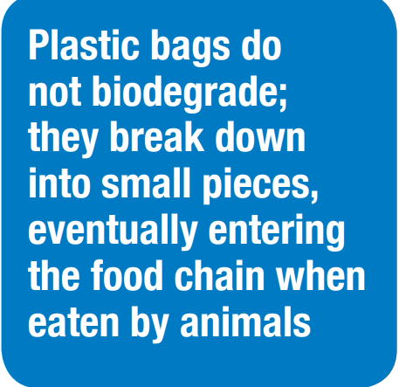

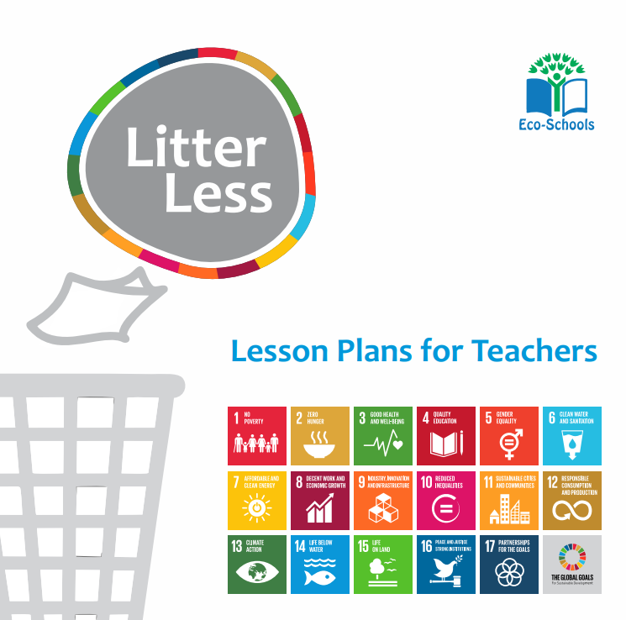
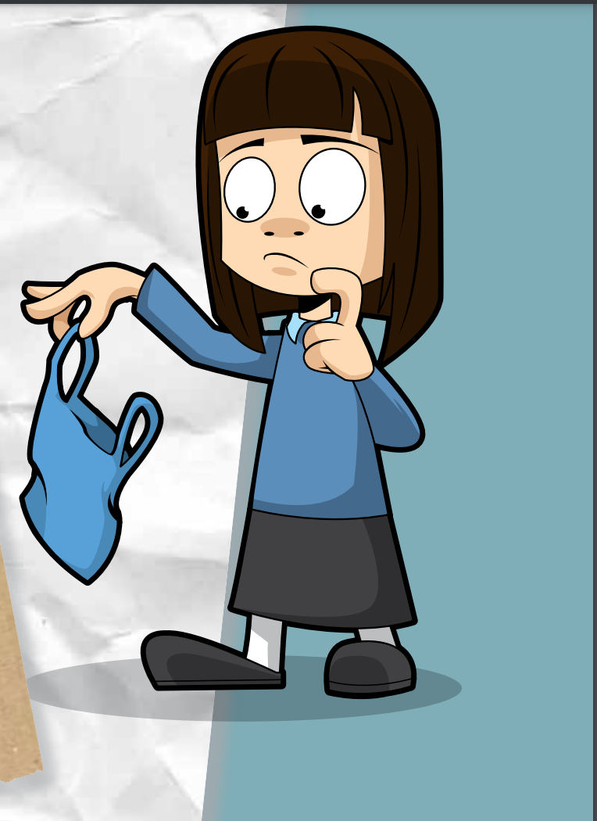
ADDITIONAL RESOURCES
https://www.eco-schoolsni.org/eco-schoolsni/documents/006513.pdf
https://www.eco-schoolsni.org/eco-schoolsni/documents/006500.pdf
https://www.ecoschools.global/lesson-plans-for-teachers

