Slide 1



















Slide 2










WELCOME,
STUDENTS!

Slide 3










LESSON FOR THE DAY
KEY STAGE 2

Slide 4








DEFINITIONS
LANDFILL DEFINITION
A landfill is a place where we bury WASTE in the ground. We put WASTE in landfills because it's smelly and ugly.
Imagine if you just threw your WASTE out into the street: gross, right? Nobody wants to look at that. So we take it somewhere people don't live, and we bury it in the ground.
Then we don't have to smell it or look at it.
CONCEPTS AND DEFINITIONS
WHAT IS WASTE?
Waste is rubbish that goes to landfill
LANDFILL? WHAT IS THAT?
When you take out the trash, do you know where it goes?
On a truck!
But where does the truck go? Where is it taking all that waste and what happens to the waste afterwards?
That waste is probably going to a landfill.

Slide 5
DEFINITIONS
CONCEPTS AND DEFINITIONS
Recycling means taking something old and turning it into something useful.
It’s important that we all recycle, reduce and refuse to save the earth’s natural resources, preserve the environment and keep the waste to a minimum.
Did you know, a plastic bottle you throw in the trash today will sit in a landfill or float in the ocean for thousands of years? Well, as brutal as it may seem, it’s true. We don’t know what the earth or humans will look like a thousand years from now, but the plastic bottle will remain the same. So, is there any solution? Well, recycling, reusing and refusing can offer an answer.

Slide 6
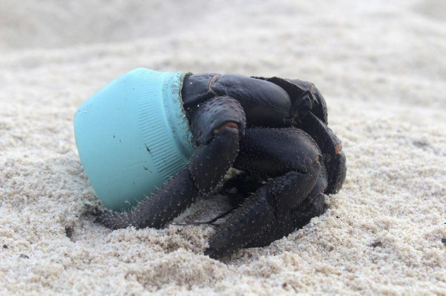
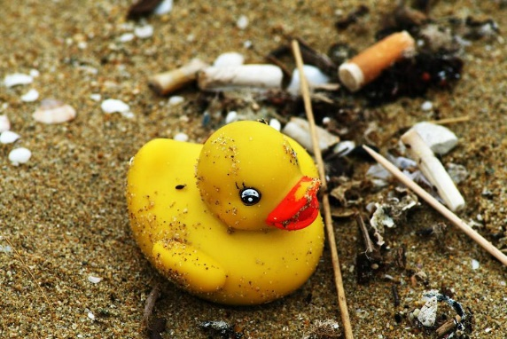
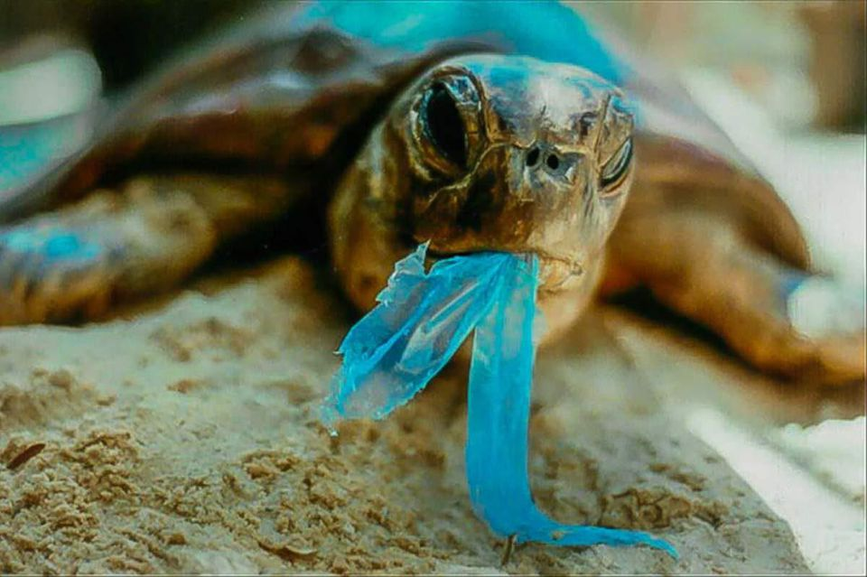

  PLASTIC, NOT FANTASTIC
1
2
3
Plastic debris is found absolutely everywhere, from the Arctic to Antarctica. It clogs street drains in our cities; it litters campgrounds and national parks, and is even piling up on Mount Everest. There are an estimated 270,000 tons of plastic floating through the world’s seas where it threatens 700 marine species with its presence. Further, there is growing evidence that plastics play a role in rising rates of species extinctions.
In 1992, a shipping container filled with 28,000 rubber duckies was lost after it fell into the sea somewhere between Hong Kong and the United States. Even today, those plastic bath toys still wash ashore from time to time, even in totally different oceans as far away as the eastern seaboard of the United States, as well as the coasts of Britain and Ireland.
But more than floating around in the water column, plastic trash is found in the guts of more than 90% of the world’s sea birds, in the stomachs of more than half of the world’s sea turtles, and it’s even choking the life out of whales. At the rate at which plastic is accumulating in the oceans of the planet, it’s predicted that by 2050 the weight of plastic in the world’s oceans will be more than the weight of all the fish that live there.

Slide 7

ACTIVITY TIME
Scavenger Hunt:
You Will Need:
Recyclable items like bottles, plastics, various paper items etc.
Pen
Paper

Slide 8
ACTIVITY TIME
How To:
This scavenger hunt requires children to find recyclable items. Make a list of all the recyclable items that the players have to find. You can even assign a time limit for the task. 30 minutes would be more than enough.
Alternatively, children can go through a pile of recyclable items and ask them to get one of each item. It won’t just educate them on the what can be recycled, but will also make them consider things that may not have actually been recyclable.
The player who manages to get the most number of recycled items will win.

Slide 9



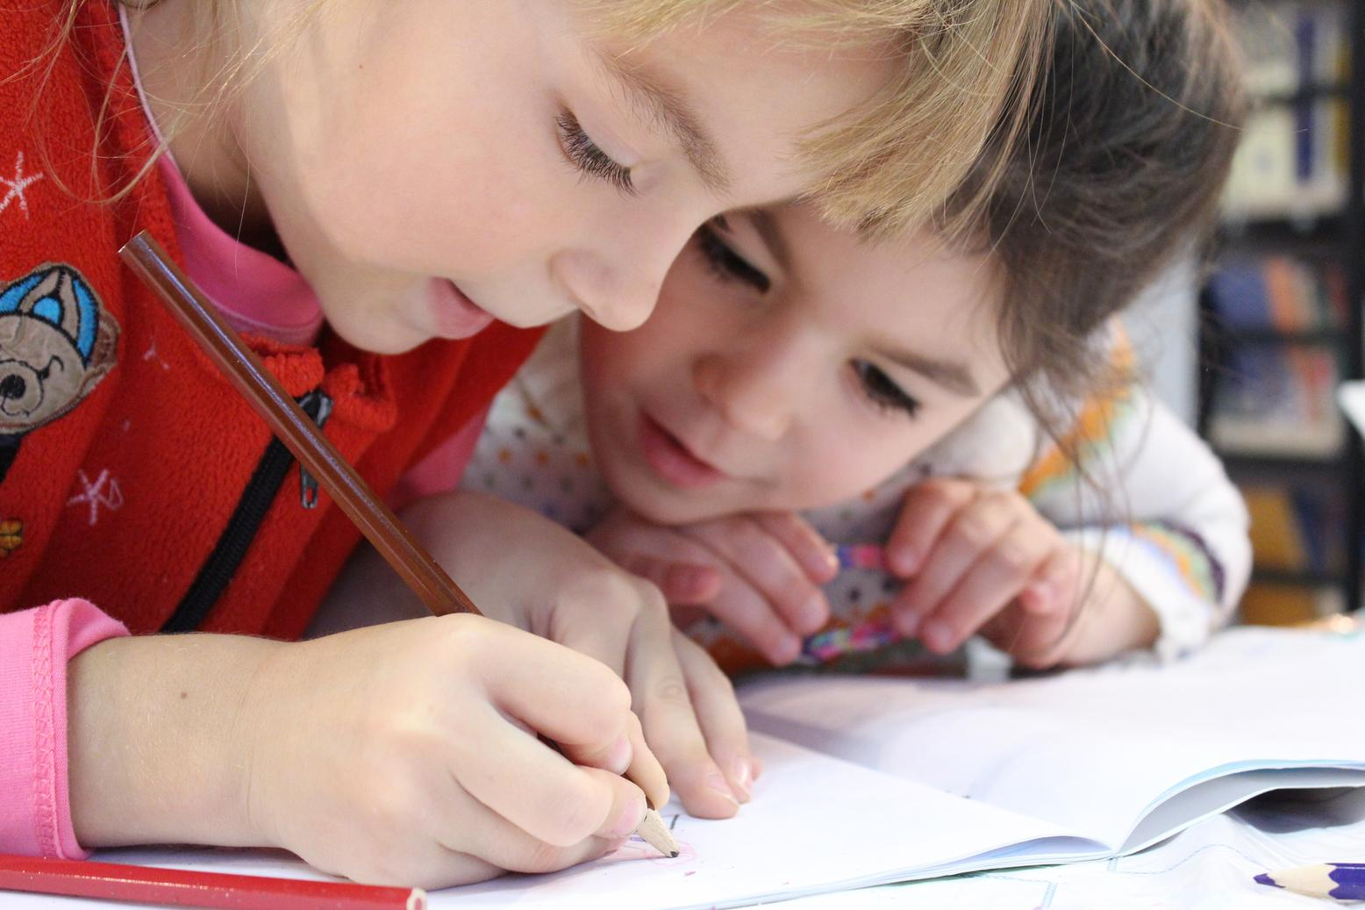
EXERCISE
This exercise can either be done in the classroom or at home!
Do you want to know how much waste goes to landfill and how you can do to reduce that?
Carry out a simple waste audit with the help of your teacher and/or your parents and count the number of bags of dry recyclable material, paper and non-recyclable material you and your friends collect.
Can you weigh them? How many Kilograms?
Remember to add this information to your Data Zone.
Tip
Do you want a fun way to do that?
Register for the Litter Less Campaign (LLC) - visit Eco-Schools NI (https://www.eco-schoolsni.org/cgi-bin/generic?instanceID=47)
Organise small groups of little waste heroes and assign a role to each group
The LLC toolkit to measure your data on dry recyclable material and paper will help you to keep track every month of what goes to landfill, what you can recycle and what you can reduce!
AND HOW MUCH YOUR SCHOOL CAN SAVE FROM LESS WASTE BEING SENT TO THE LANDFILL

Slide 10
WORKSHEET
Question 1: What do all the items have in common?
Pupils will work together in groups to guess how long some trash items might last in a landfill.
Learn about environmental consequences of not refusing, reusing, reducing and recycling.
Use a graph-making tool to create a graph. (Optional) (https://www.bbc.co.uk/bitesize/topics/z7rcwmn/articles/z8dp8mn)
If your students are too young to figure out the answer to the question, you can share with them that each of the items will likely end up in a landfill one day.
Question 2: What will happen to these items when they end up in the landfill? How long do you think they will last there?
aluminium can
banana
cigarette butt
cotton rag
glass bottle
leather boot
paper bag
plastic 6-pack rings
plastic jug
rubber sole of the leather boot (above)
Styrofoam cup
tin can (soup or vegetable can)
wool sock
Write the above list of items on a chalkboard or chart.
Question 3: Do they disappear/disintegrate/degrade immediately? Or will they continue to take up space in the landfill?
Arrange students into small groups.
(Groups of 4 to 5 students will work best.)
Let students share their lists and discuss what they believe to be the correct sequence. Ask each group to come to a decision about the correct order of the items.

Slide 11


VIDEO

Slide 12
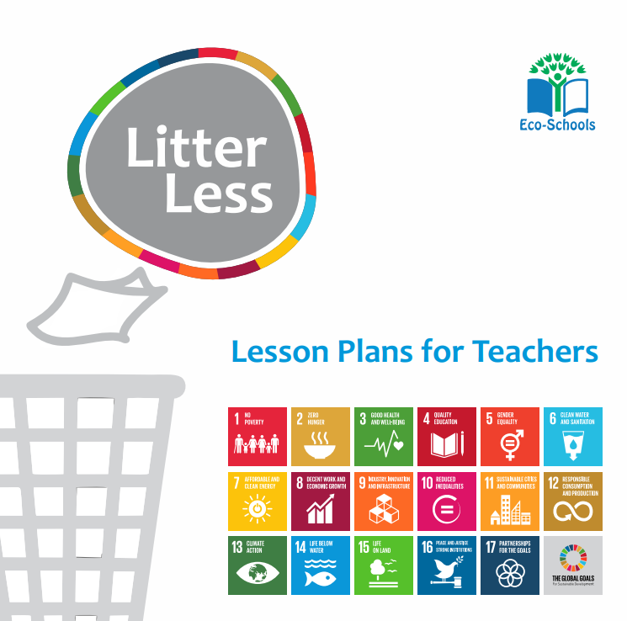


ADDITIONAL RESOURCES
Duplicate this page as many times as needed to give you more space for discussion.
Litter Less Eco-Schools Lesson Plans
Eco-Inspiration-Waste
https://www.eco-schoolsni.org/eco-schoolsni/documents/006534.pdf
KS2 Plastic Activity Sheets
https://www.eco-schoolsni.org/eco-schoolsni/documents/007474.pdf
https://www.eco-schoolsni.org/eco-schoolsni/documents/006492.pdf
https://www.eco-schoolsni.org/eco-schoolsni/documents/006511.pdf

