Slide 1



















Slide 2







WELCOME,
STUDENTS!

Slide 3
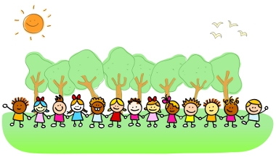




OUTDOOR LEARNING
KEY STAGE 2

Slide 4
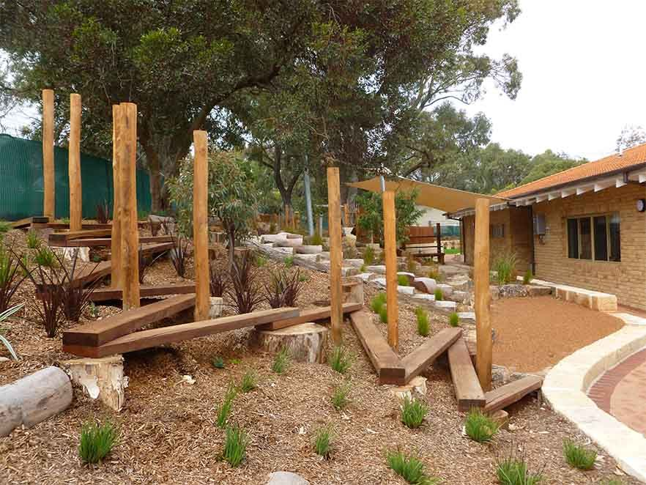

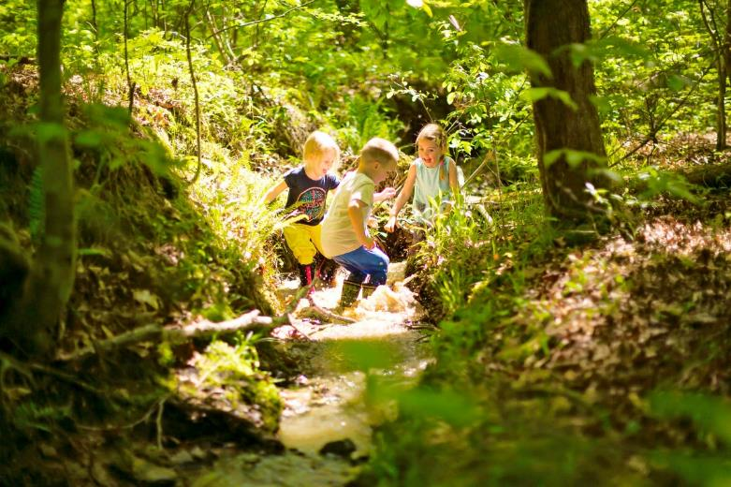
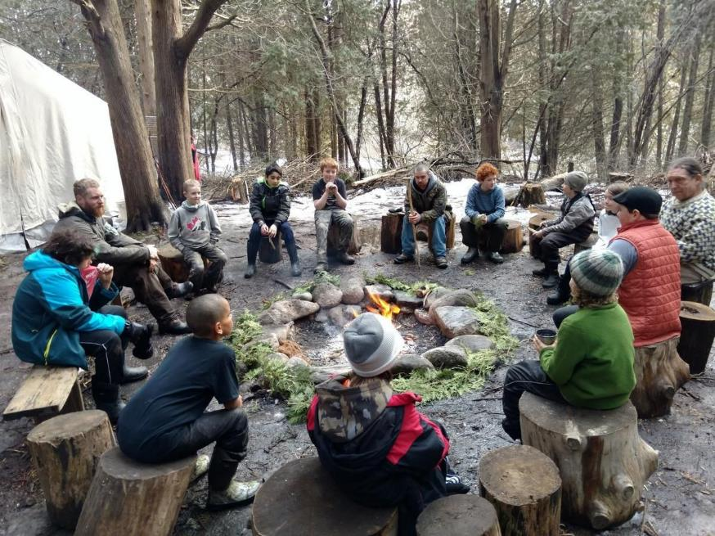
What is outdoor learning?
Outdoor Learning is a broad term that includes:
Discovery
Experimentation
Connecting to the natural world
Engaging in environmental activities

Slide 5

We are always learning!!
We learn both inside and outside the classroom.
We learn something new everyday.
We learn by seeing new things
hearing new sounds
smelling new things
touching new things
tasting new things.
We use all 5 of our senses when we learn outdoors.

Slide 6
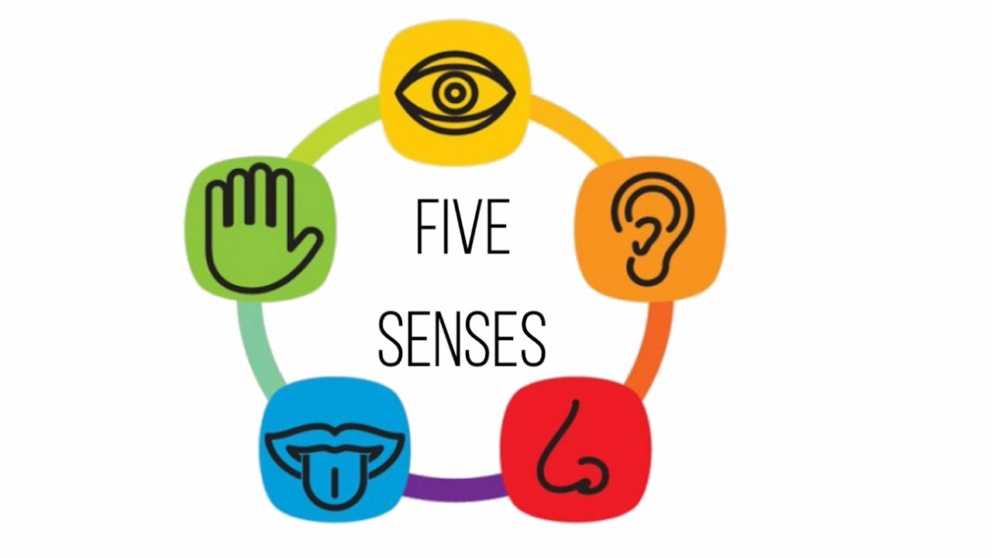
sight
touch
sound
taste
smell

Slide 7
Children will appreciate
colour
texture
smell
sound
shape

Slide 8


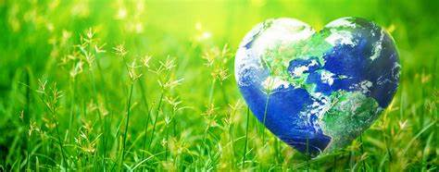
Benefits of outdoor learning
HEALTH
LEARNING
ENVIRONMENT

Slide 9

Benefits to learning
Playing outside helps children to develop physically, emotionally, cognitively, imaginatively and improve motor skills.
Develop creativity and problem solving skills.
Enhances enquiry skills and personal development.
They are able to interact with other children teaching them how to take turns, communicate and cooperate with each other.

Slide 10
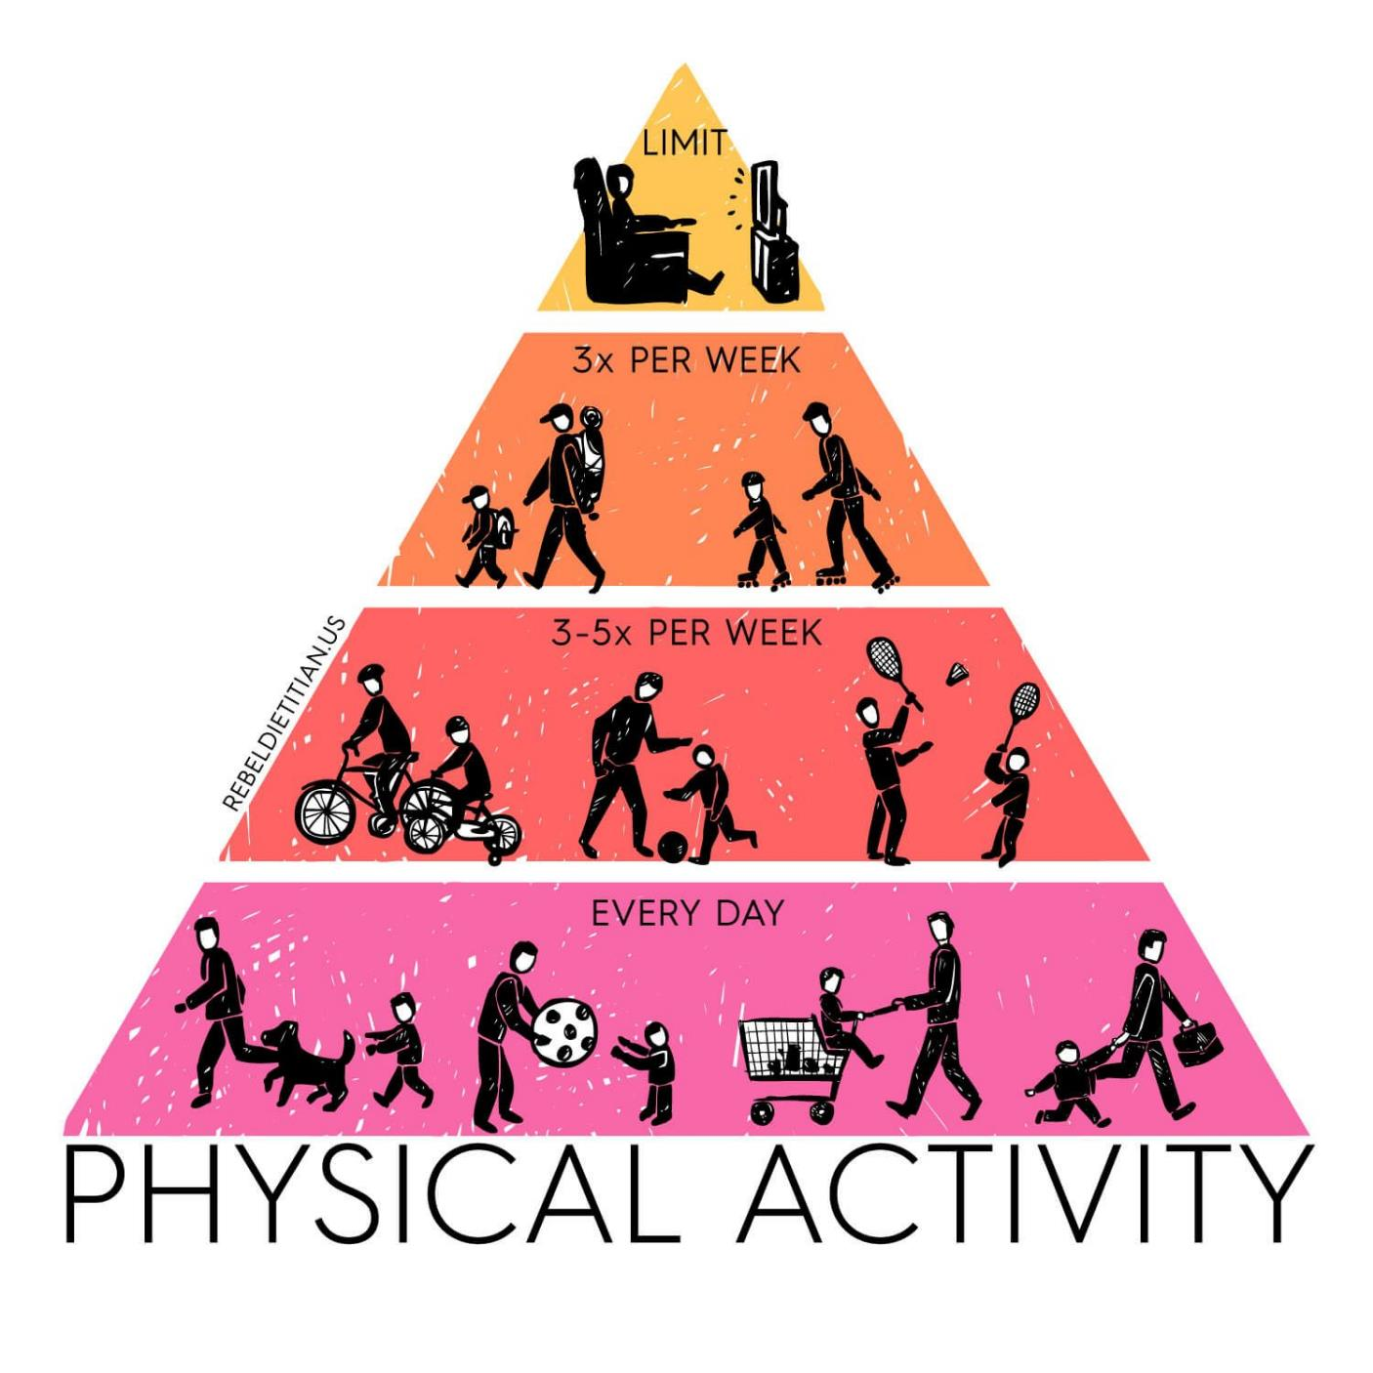
Benefits to health
Improves health and levels of physical activity in children.
Physical health can also influence a child’s ability to learn.
It is important for children who learn best through active movement. Different ways of moving improves coordination.
Burning off excess energy could help improve concentration levels.

Slide 11
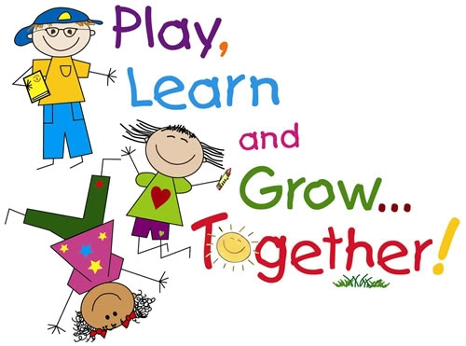
Benefits to health
Spending time in nature and the natural light can improve your mood and reduce stress and depression.
Time in green spaces significantly reduces your cortisol, which is a stress hormone. Nature also boosts endorphin levels and dopamine production, which promotes happiness.

Slide 12
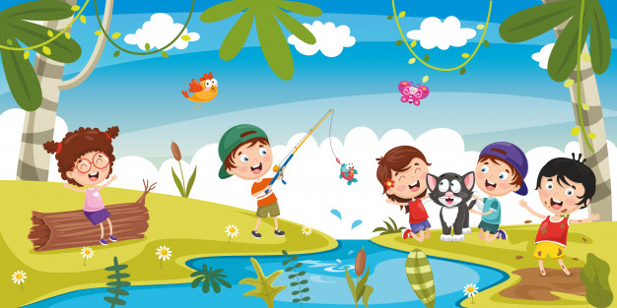
Benefits to ENVIRONMENT
Develop a love, appreciation and respect for nature and all that is living.
Develop a love and understanding of how we can look after the environment.
Develop a lifelong love of the outdoors.

Slide 13
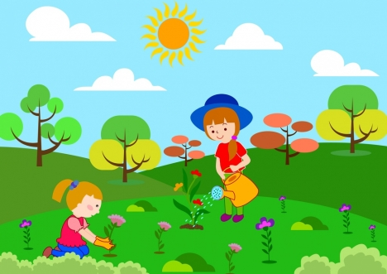
Benefits to ENVIRONMENT
Gives children contact with natural world and offers them experiences that are unique to outdoors, such as direct contact with weather and the seasons.
Helps children to understand and respect nature, the environment and the interdependence of humans, animals, plants and life cycles.

Slide 14
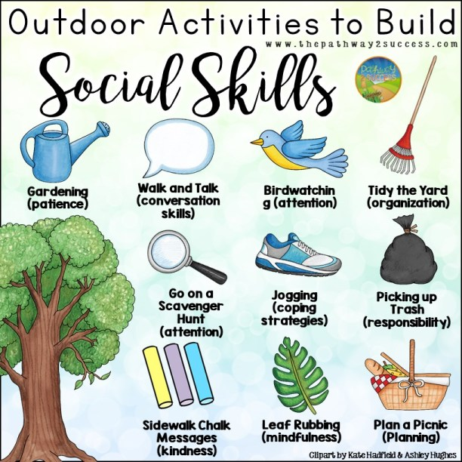


Slide 15
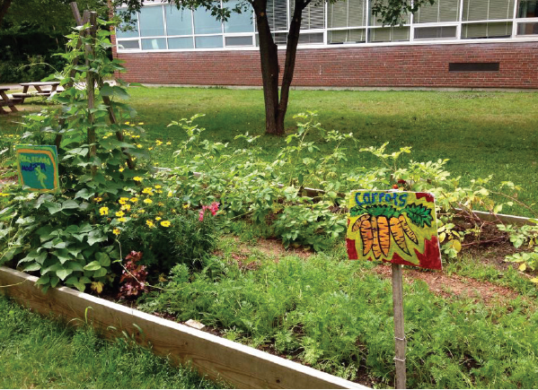
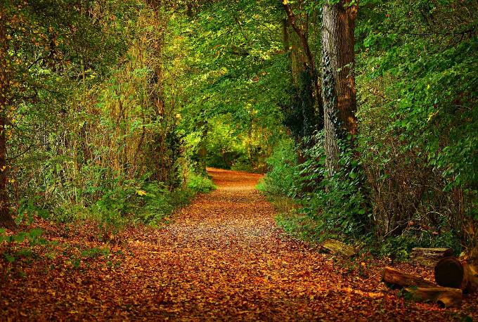
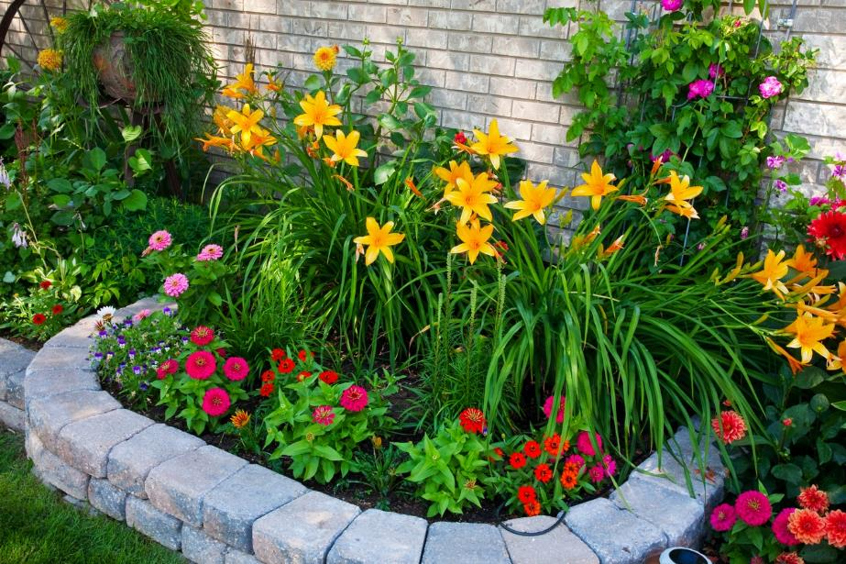
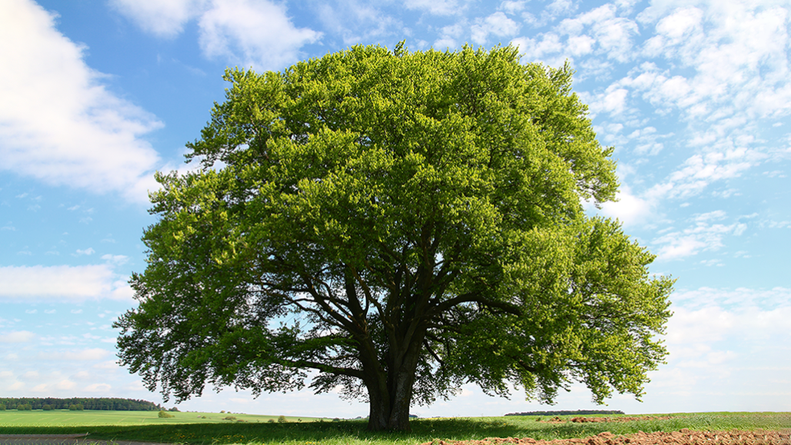
What do you see outside?

Slide 16
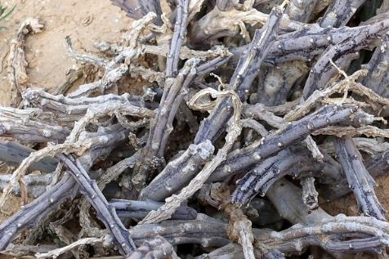

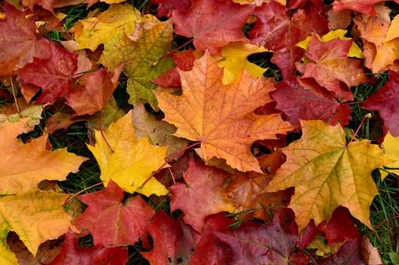
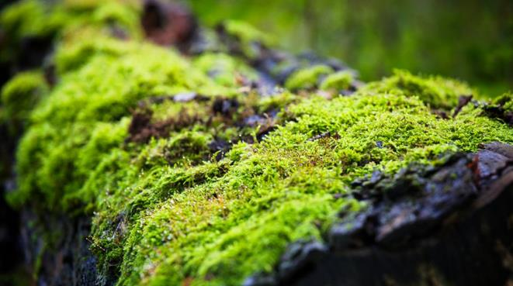
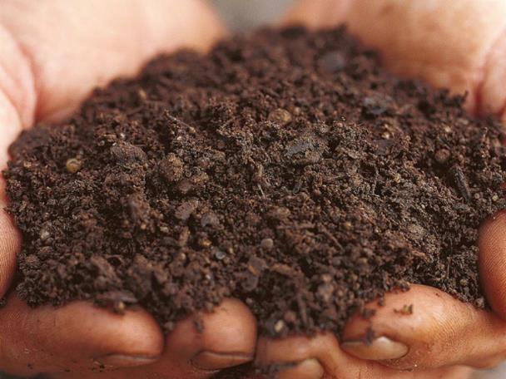
Equipment
A range of natural materials for example sticks, moss, feathers, mud, leaves, wool and grass.
All nests must have the same basic components –
• Well camouflaged in case of predators.
• Strong and sturdy to withstand the weather.
• Soft inside to protect eggs and young.

Slide 17
Gather together a range of natural materials to create your nest.
Look around your grounds and identify the best place to build your nest (make sure it is somewhere you can reach safely).
Why is this a good location?
Will your nest be safe from potential predators?
Use the materials you have gathered to create the nest structure.
Thinking about the location, the shape and the construction, how can you make sure your nest can withstand the wind and rain?
Once your nest is ready, can you make the inside of the nest a soft and safe place to support eggs and raise young birds?

Slide 18
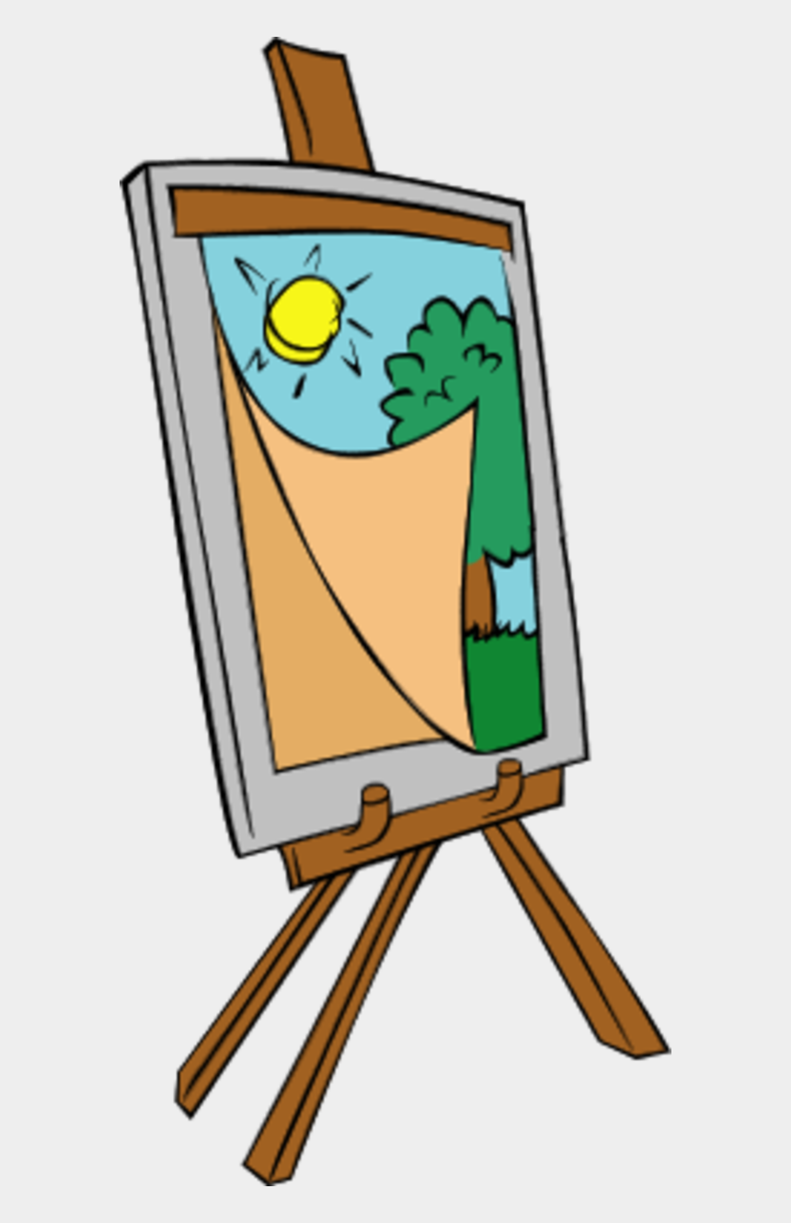
AL FRESCO ARTISTRY
Take your art lesson outdoors!!
What do you see?
A landscape
Plants
A tree
Birds
Draw what you see!!
Notes:
AL FRESCO ARTISTRY
The benefits of art for young children, where do we start? It promotes self-expression, confidence, creativity, accountability, attention to detail and the ability to accept feedback and criticism. And there’s nothing prouder than seeing one’s work adorning the classroom walls.
If weather permits, why bother confining your class to the indoors when it’s art time? Combine the benefits of art with the health effects of the outdoors. Challenge your learners to find something they find interesting - it might be a whole landscape, a simple plant, or perhaps a tree.

Slide 19
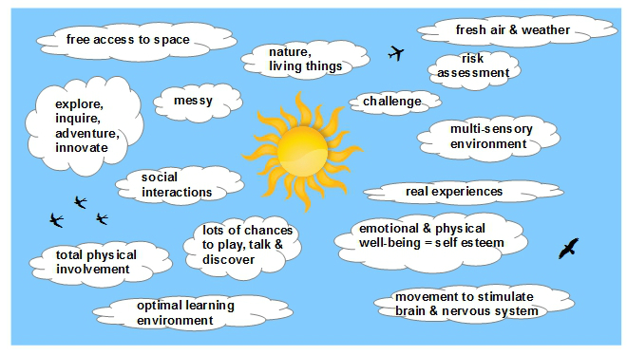

Slide 20
