Slide 1



















Slide 2







WELCOME,
STUDENTS!

Slide 3
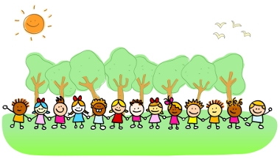




OUTDOOR LEARNING
KEY STAGE 3

Slide 4

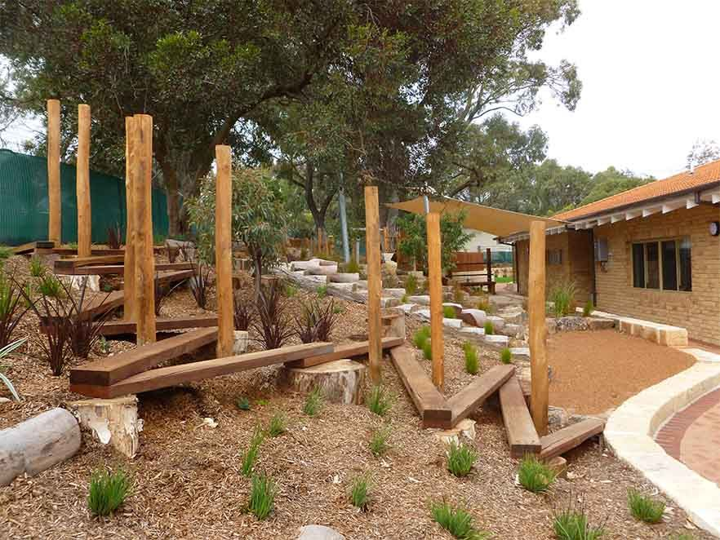

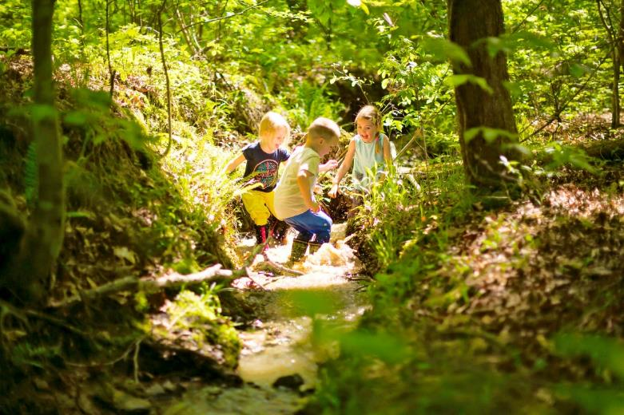
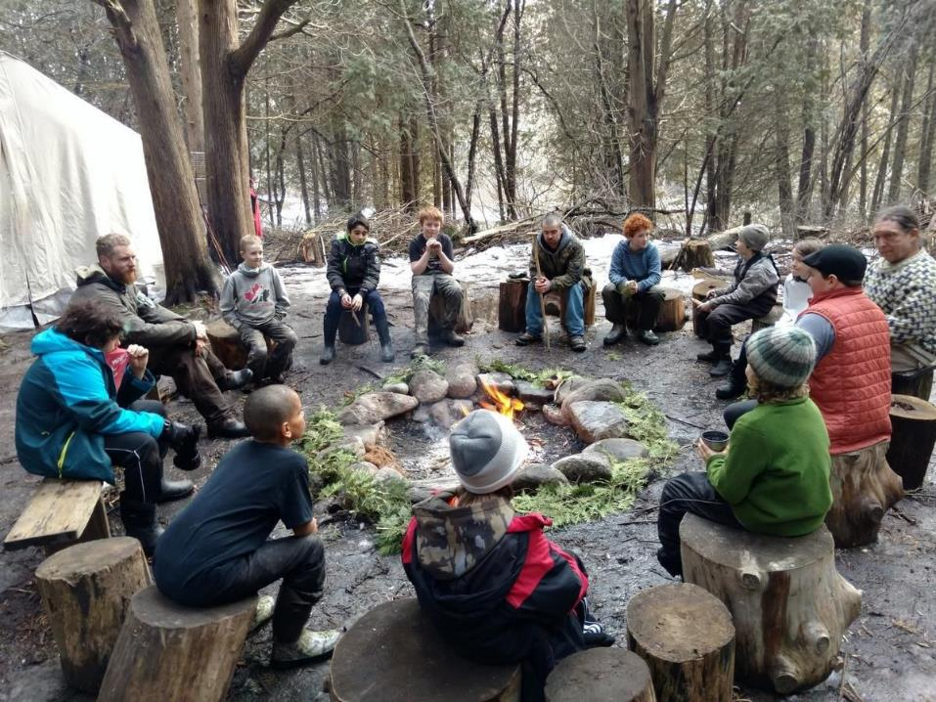
What is outdoor learning?
Outdoor Learning is a broad term that includes:
Discovery
Experimentation
Connecting to the natural world
Engaging in environmental activities

Slide 5

We are always learning!!
We learn both inside and outside the classroom.
We learn something new everyday.
We learn by seeing new things
hearing new sounds
smelling new things
touching new things
tasting new things.
We use all 5 of our senses when we learn outdoors.

Slide 6
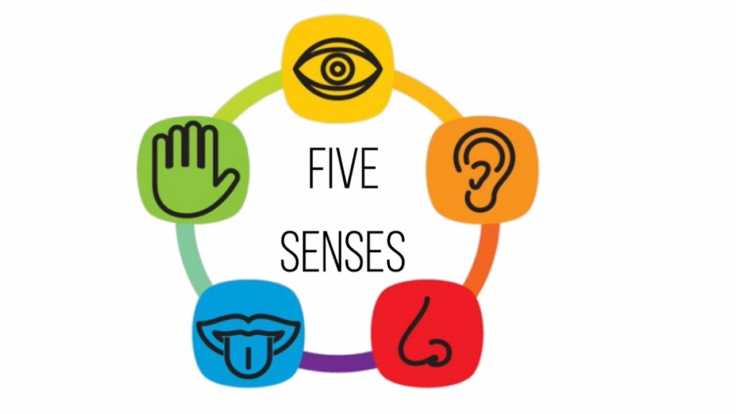
sight
touch
sound
taste
smell

Slide 7
Children will appreciate
colour
texture
smell
sound
shape

Slide 8



Benefits of outdoor learning
HEALTH
LEARNING
ENVIRONMENT

Slide 9

Benefits to learning
Playing outside helps children to develop physically, emotionally and imaginatively.
Develop creativity and problem solving skills.
Enhances enquiry skills and personal development.
They are able to interact with other children teaching them how to take turns, communicate and cooperate with each other.

Slide 10
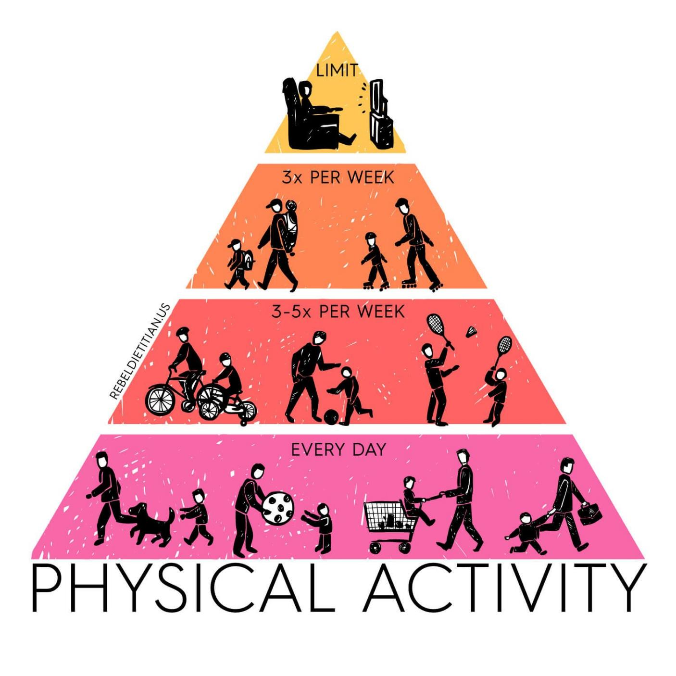
Benefits to health
Improves health and levels of physical activity in children.
Physical health can also influence a child’s ability to learn.
It is important for children who learn best through active movement. Different ways of moving improves coordination.
Burning off excess energy could help improve concentration levels.

Slide 11

Benefits to health
Spending time in nature and the natural light can improve your mood and reduce stress and depression.
Time in green spaces significantly reduces your cortisol, which is a stress hormone. Nature also boosts endorphin levels and dopamine production, which promotes happiness.

Slide 12
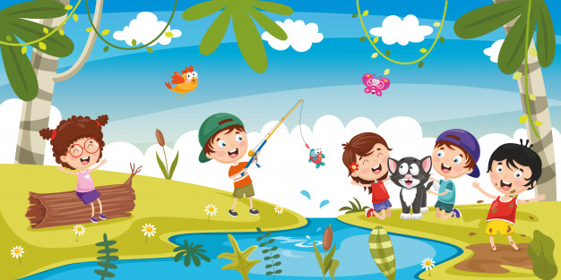
Benefits to ENVIRONMENT
Develop a love, appreciation and respect for nature and all that is living.
Develop a love and understanding of how we can look after the environment.
Develop a lifelong love of the outdoors.

Slide 13
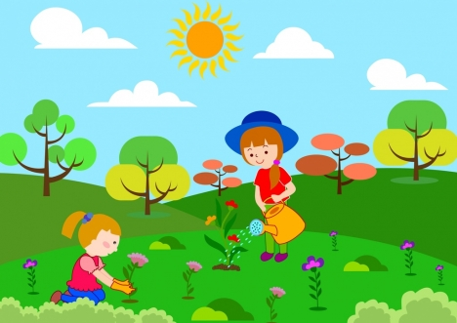
Benefits to ENVIRONMENT
Gives children contact with natural world and offers them experiences that are unique to outdoors, such as direct contact with weather and the seasons.
Helps children to understand and respect nature, the environment and the interdependence of humans, animals, plants and life cycles.

Slide 14
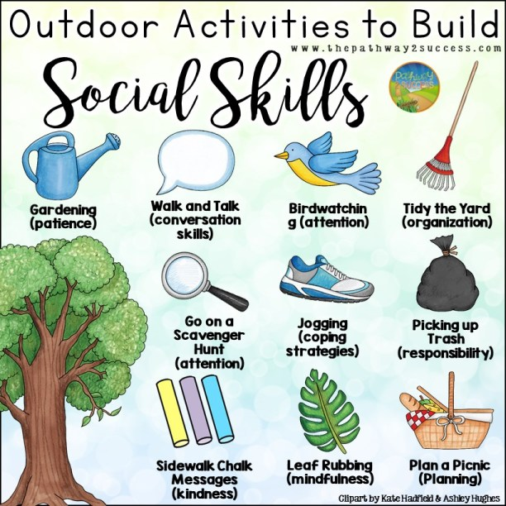


Slide 15
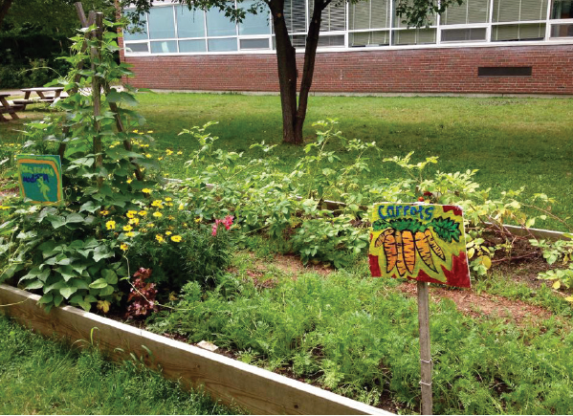
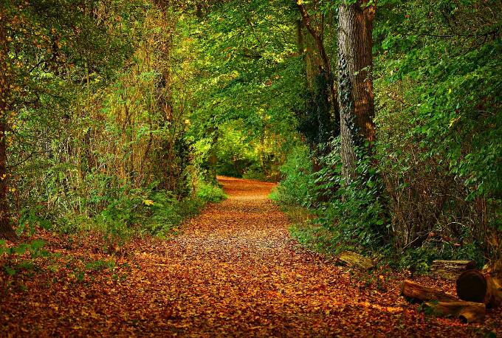
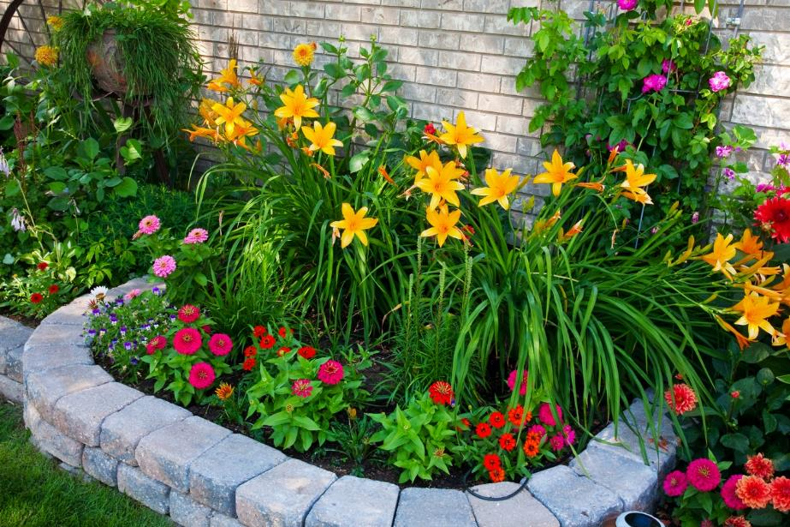
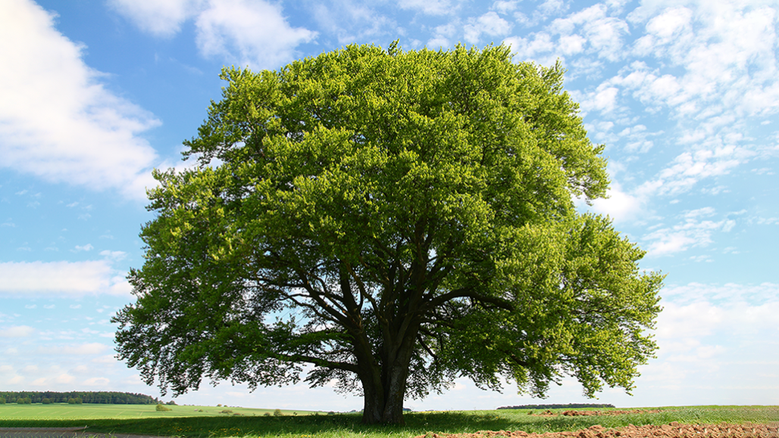
What do you see outside?

Slide 16
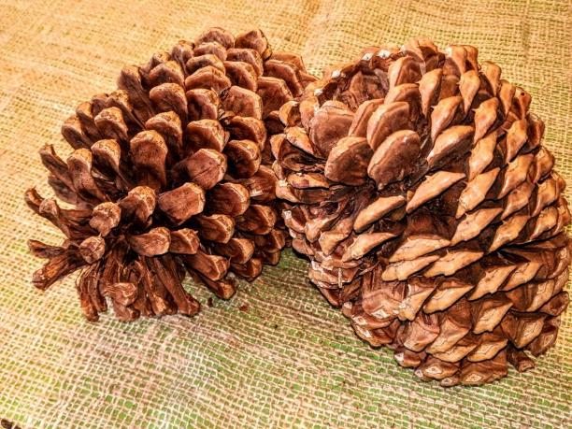
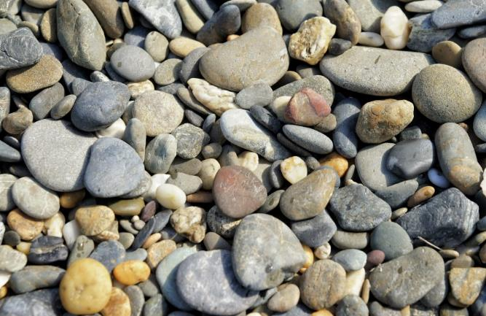

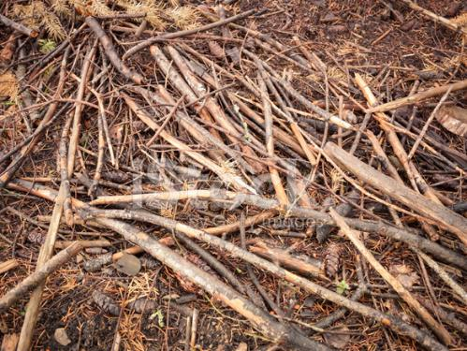
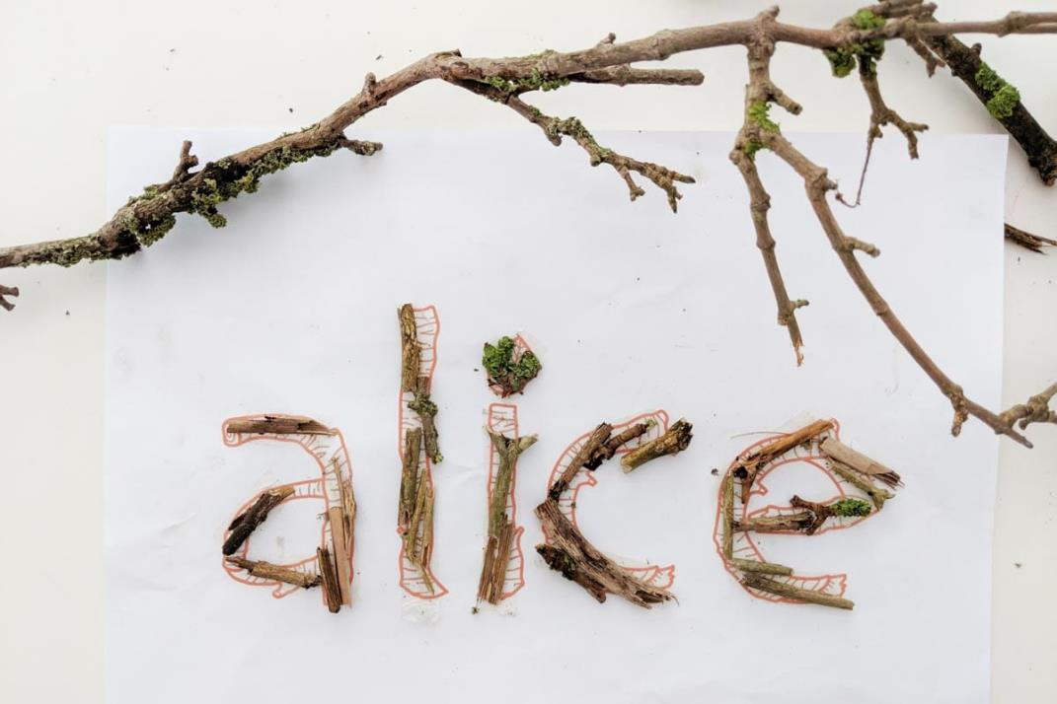
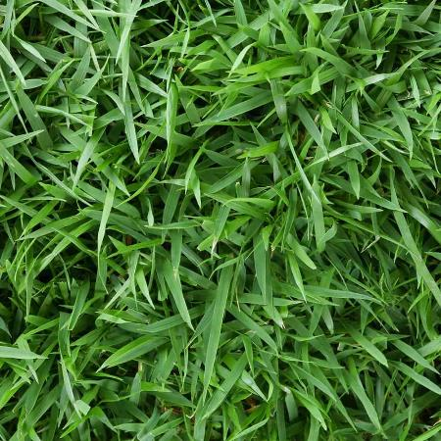
Alphabet activity
You will need the following.
Collect these and spell out your name.
Notes:
Trace the letters A – Z in the dirt/sand pit
Trace the numbers 1 – 20 in the dirt/sand pit
Draw the letters A – Z on the ground
Draw the numbers 1 - 20 on the ground
Give children a plastic cup and they fill them with things they find in nature
Pine cones
Twigs
Stones
Grass
sand

Slide 17
Shapes in nature
Can you find these shapes in nature?
Notes:
Pupils go outside and have a good look around them
Can they see any of these shapes in nature?

Slide 18
