Slide 1




















Slide 2








WELCOME,
STUDENTS!

Slide 3
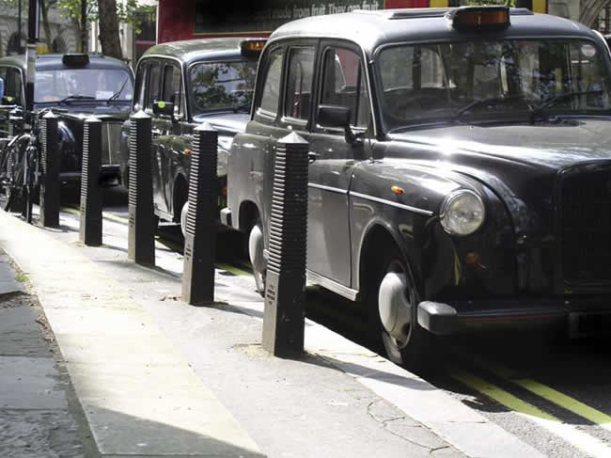
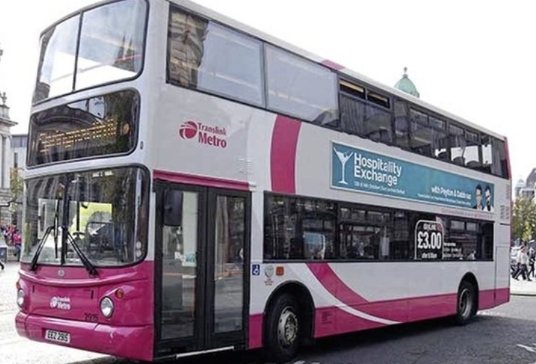
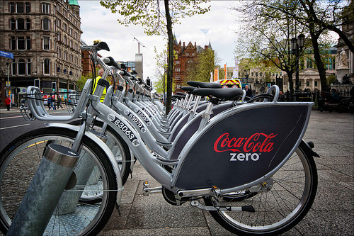


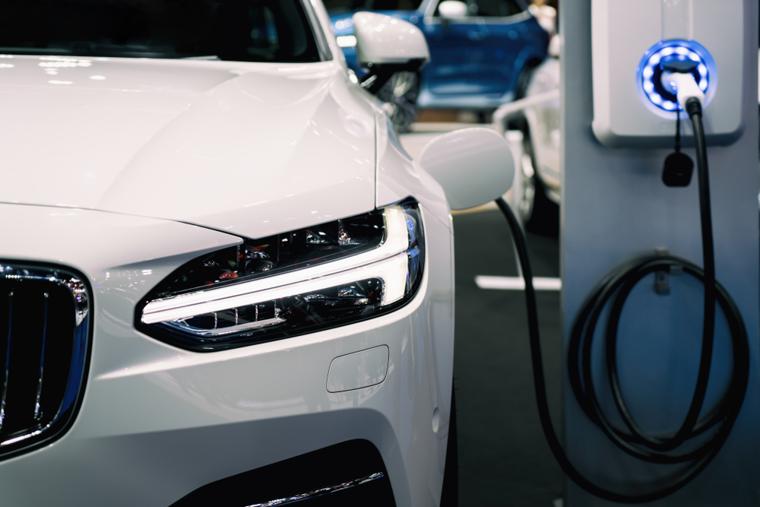
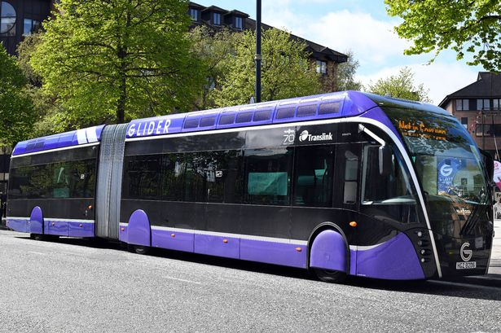
transport
KEY STAGE 5

Slide 4
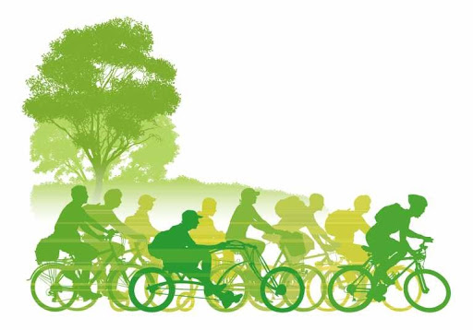
CLASS OBJECTIVES
What are the different types of transport?
How does transport affect the environment?
What is the most/least harmful form of transport?
What type of transport should I use to go to school?

Slide 5


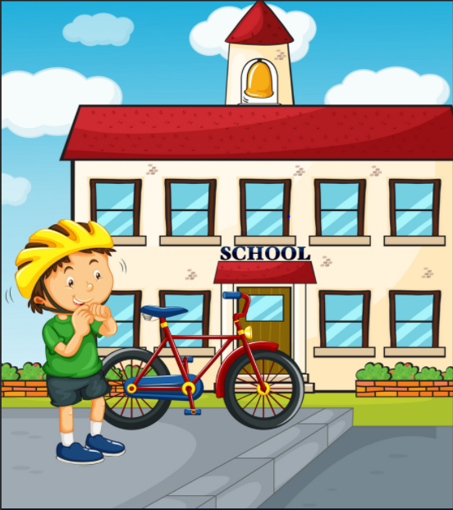

Different types of transport
The main forms of transport used for getting to school:
Car
Bus
Train
Bike
Our feet!!!!

Slide 6
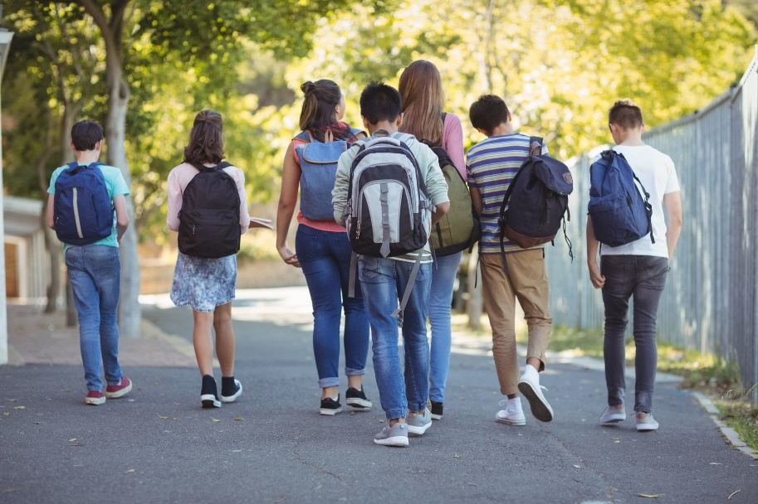
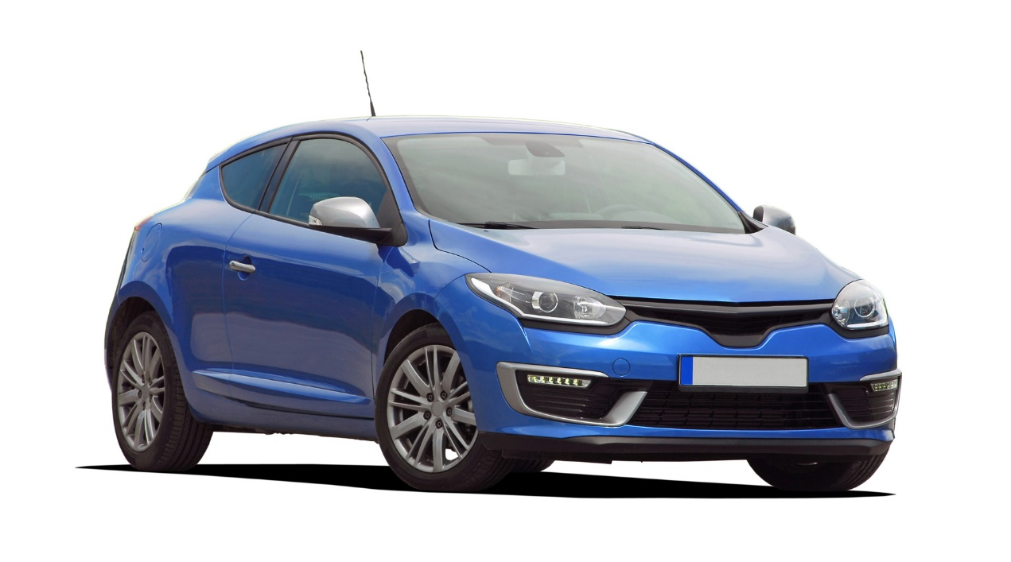
How do you get to school?
How many primary school children travel to school:
By car?
By train?
By bike?
On foot?

Slide 7
Most popular form of transport was car.
Why do you think this is the most common?
Survey of school pupils 2019
Notes:
Ask pupils before, which they think is the most common among Primary and Secondary pupils?
Is there a difference? If so, why?

Slide 8
Notes:
Ask pupils to look at both charts and see if they can work out why there is a difference
Why do more Primary school pupils go by car?
Why do more Secondary school pupils walk?

Slide 9

How do you get to school?
How many secondary school children travel to school:
By car?
By train?
By bike?
On foot?
Find out how everyone in your class go to school this morning.

Slide 10
Most popular form of transport was train.
Why do you think this is the most common?
Survey of school pupils 2019
Notes:
Ask pupils before, which they think is the most common among Primary and Secondary pupils?
Is there a difference? If so, why?

Slide 11
Notes:
Ask pupils to look at both charts and see if they can work out why there is a difference
Why do more Primary school pupils go by car?
Why do more Secondary school pupils walk?

Slide 12
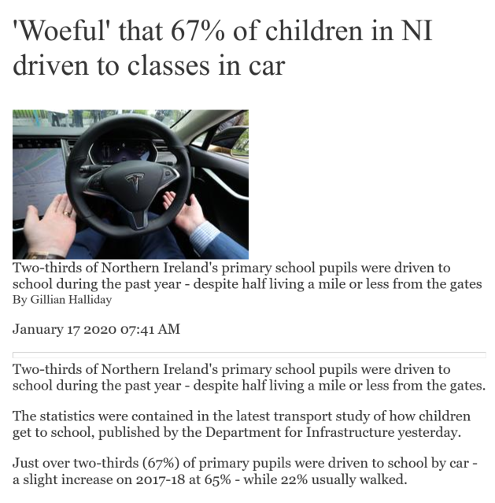
Why do you think that over two thirds of school pupils travelling by car is “woeful”?
Should primary school children walk to school?
Should secondary school children walk to school?

Slide 13
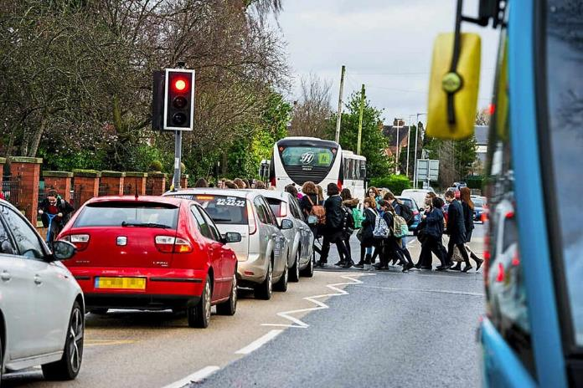
Too many cars at the school gates?
The traffic outside your school could be making the air in their playground and classroom dangerous to breathe.
Many parents take their children to school by car because it’s the most convenient option, but that could be contributing to the pollution outside the school gate and in the playground, especially if the engines are left on while the cars are parked.

Slide 14

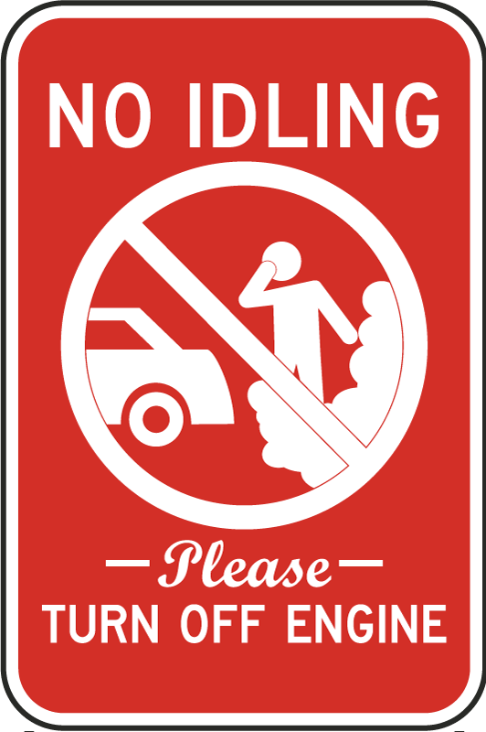
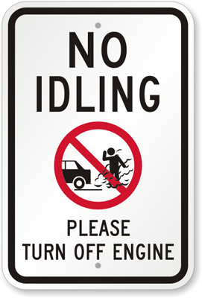
Are your parents guilty of leaving the car running when they are at school?

Slide 15
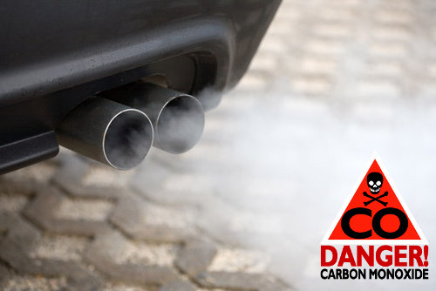
Transport and the Environment
In the UK the transport sector is now responsible for emitting more greenhouse gases than any other. Globally, transport accounts for around a quarter of CO2 emissions.
Road vehicles – cars, trucks, buses and motorbikes – account for nearly three quarters of the greenhouse gas emissions that come from transport.
A large car emits on average 85% more greenhouse gases per km than a small vehicle, according to figures from the UK government.
Electric cars are the lowest carbon – they emit around a third of the CO2 of a petrol car in the UK.

Slide 16
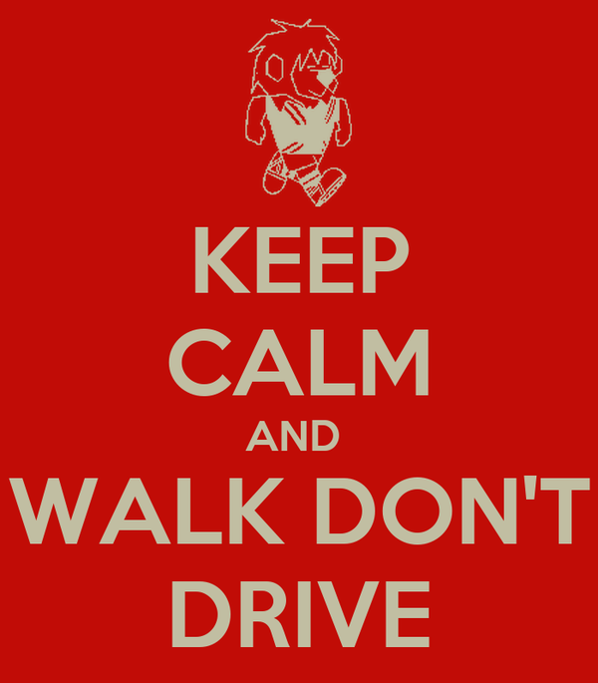
Transport and the Environment
In many countries even short journeys, which could often be made on foot or by bike, are usually made by car. In England, for instance, around 60% of 1-2 mile trips are made by car.
One thing that would be really good would be if people could just think, don't ever go in a car on your own, If you're going to do a journey by car, make sure you fill that car up with at least one other person who would also be making that journey.
Taking action to reduce the emissions from your daily transport can be tricky on an individual level, but even just cutting out one or two journeys could make a difference.
.

Slide 17
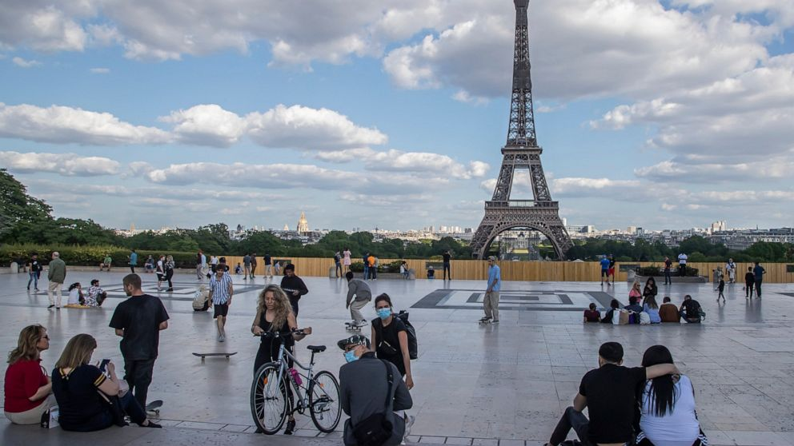
Transport IN OTHER COUNTRIES
Paris has embraced the idea of a 15-minute city, where all the services people need – including their workplaces – are situated in close proximity to where they live. It encourages people to substitute just one short car journey a day for a walk, and to experiment with incorporating walking into their daily routine.

Slide 18
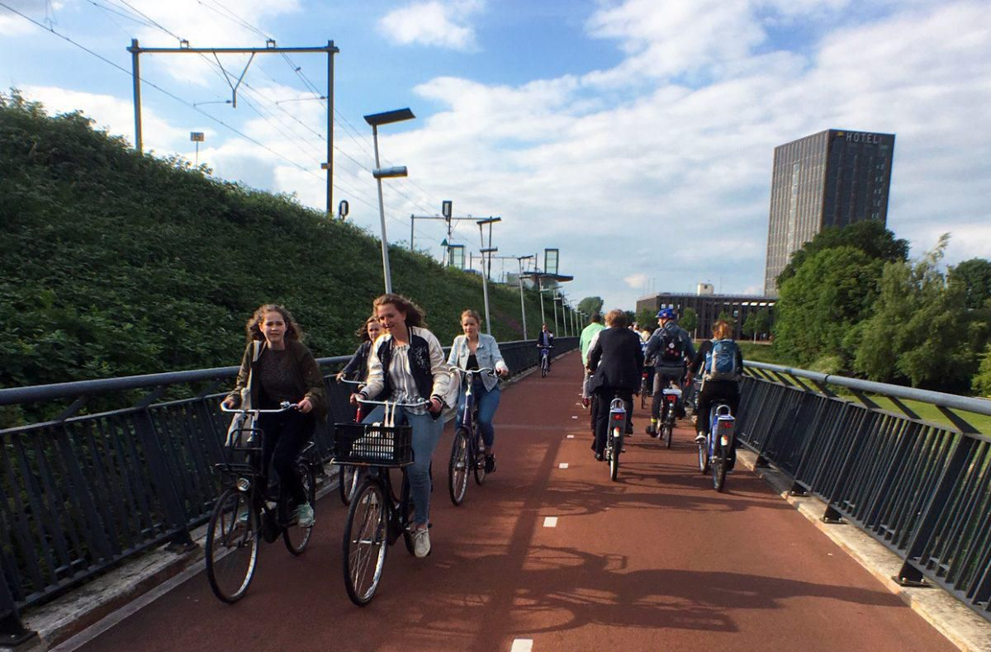
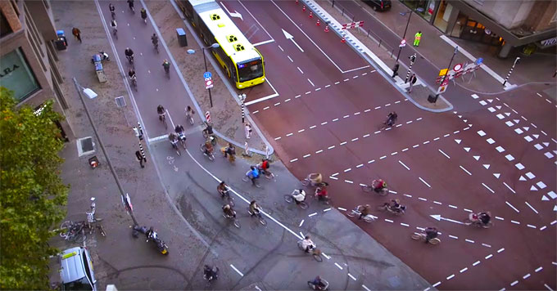
Transport IN OTHER COUNTRIES
Cycling, which shares many of the climate benefits of walking, is increasingly a viable alternative to car journeys.
In the Netherlands 26% of journeys are made by bike, followed by Denmark on 18% and 10% in Germany. All three countries had major policy changes in the 1970s and 1980s that led to a large increase in cycling, and all still continue to invest in cycling infrastructure.

Slide 19
How do cars harm the environment?
Car exhausts give off nasty fumes that are harmful and dangerous.
They can also cause acid rain which damages plants and water supply.
These fumes are 1 of the major causes of global warming.
.
Warmer global temperatures affect wildlife, sea levels and natural landscapes.
Fuel spills can be dangerous for other road users.

Slide 20
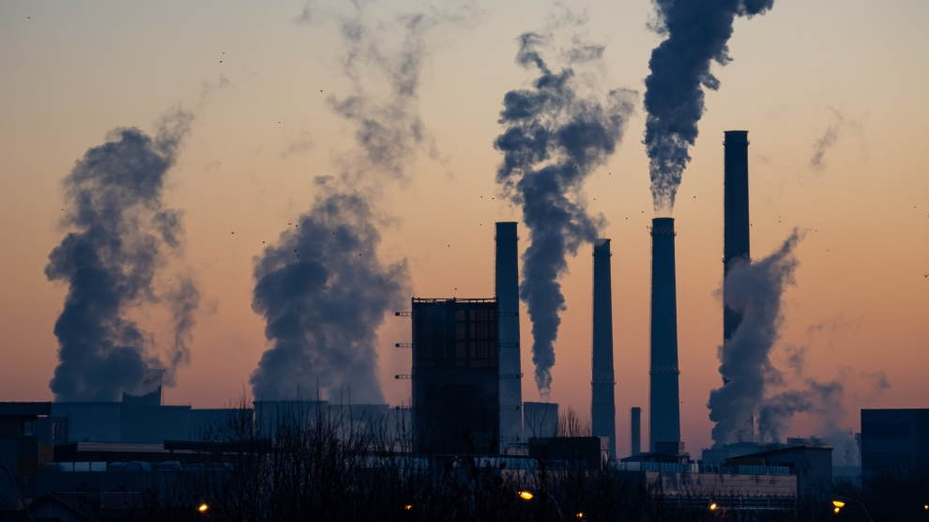
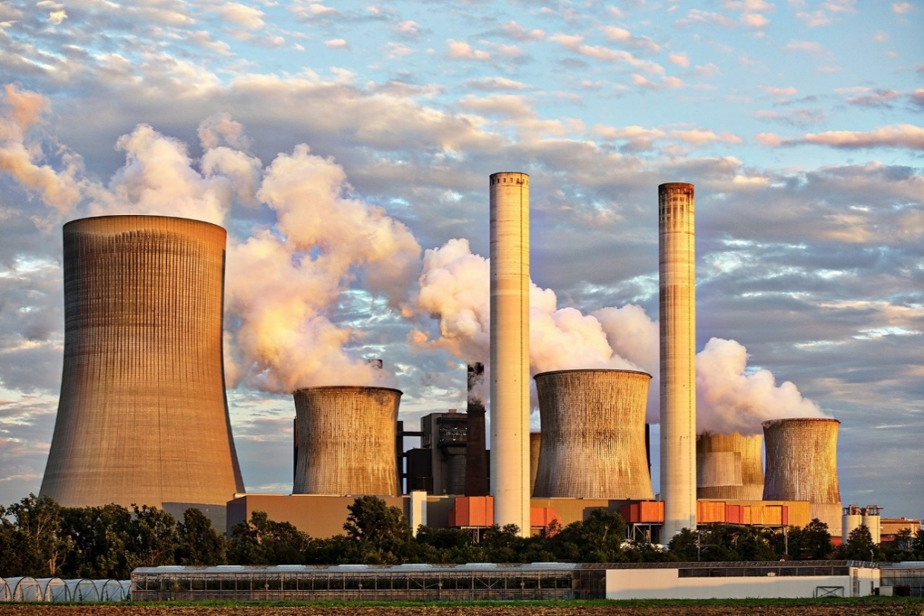
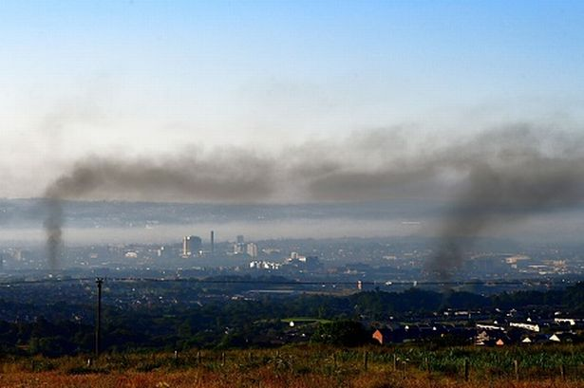
What is air pollution?
Air pollution is the term given to the small particles, chemicals and gases that are released into the air.
These air pollutants can have a harmful impact on the environment and our health if they are breathed in.
However, most of the time air pollution can’t be seen. Like oxygen, the particles can be invisible, but that doesn’t stop them from being very harmful.

Slide 21
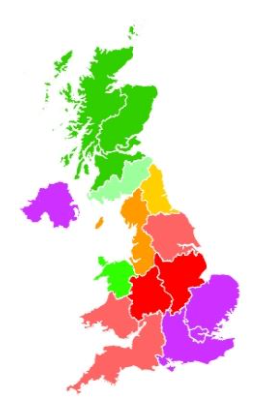

These were the levels of air pollution in 2017.
Look at the purple areas. Why do you think air pollution is highest in these areas?

Slide 22
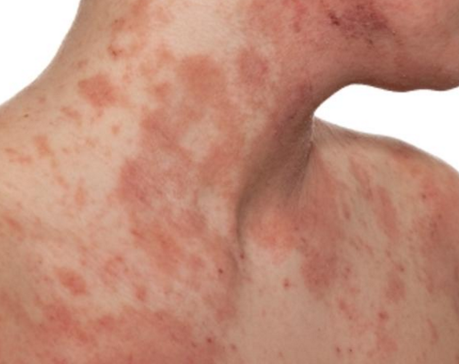
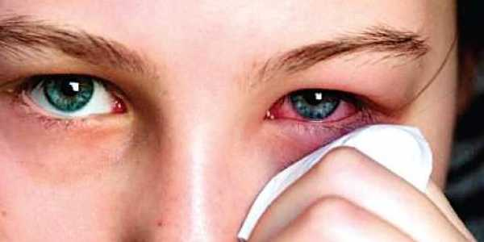
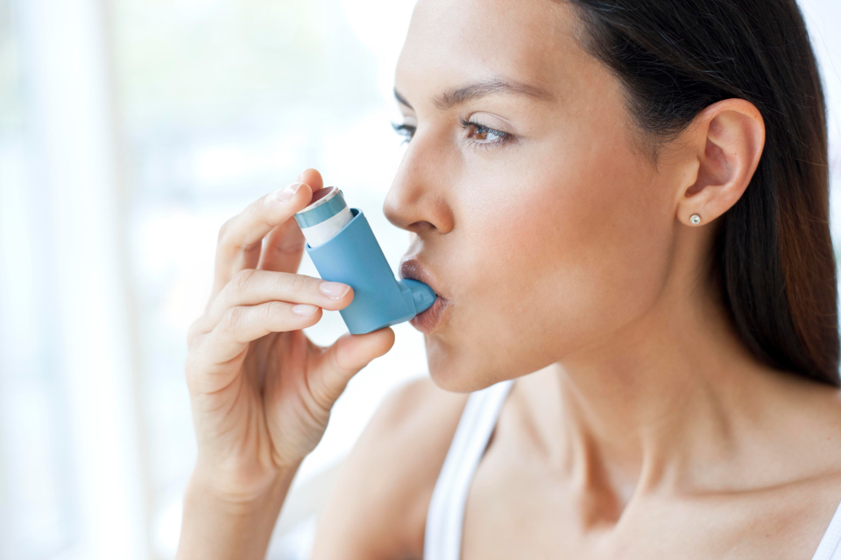
We suffer as well!!
Car pollutants harm human health. Diesel engines emit high levels of particulate matter, which is airborne particles of soot and metal.
These cause skin and eye irritation and allergies, and very fine particles lodge deep in lungs, where they cause respiratory problems.
Air pollution has been linked to cancer, asthma, stroke and heart disease, diabetes, obesity and dementia either as a cause or as a complicating factor contributing towards premature death.

Slide 23
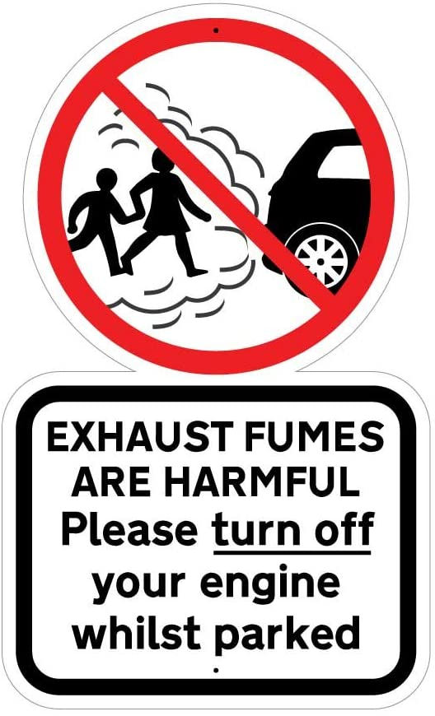
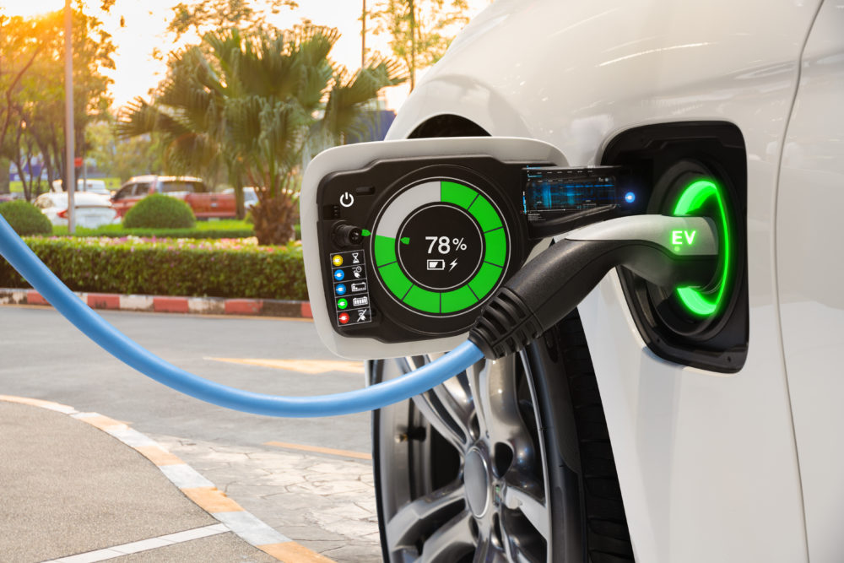
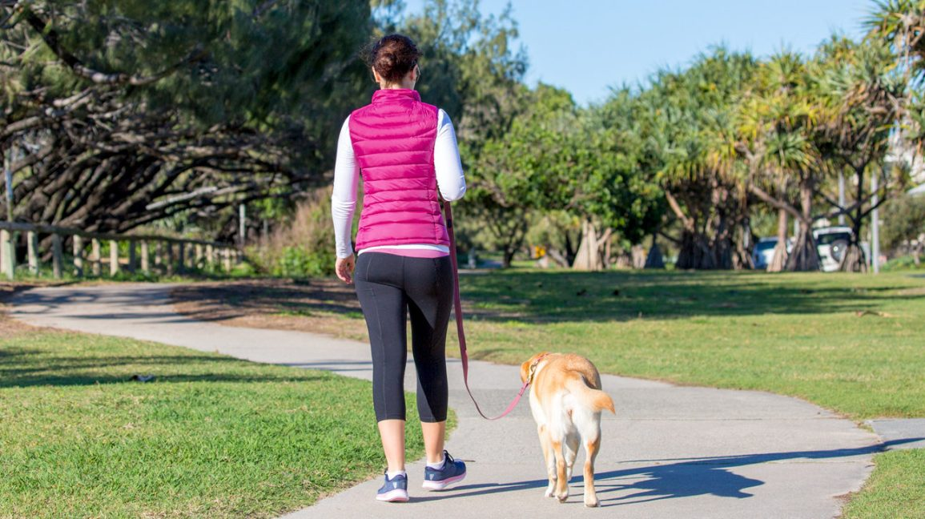

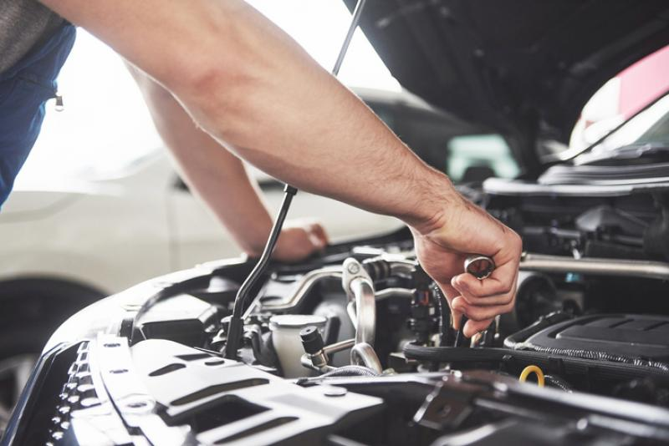
Reducing car pollution
.
Notes:
Switch your engine off if you’re going to be parked for a while. This will also help you to use less fuel, saving money.
Slower, steadier driving will help save fuel and reduce emissions.
Get your car serviced regularly, this should keep everything working as efficiently as it should.
Drive an electric or a hybrid car
If it’s a short journey, walk instead

Slide 24
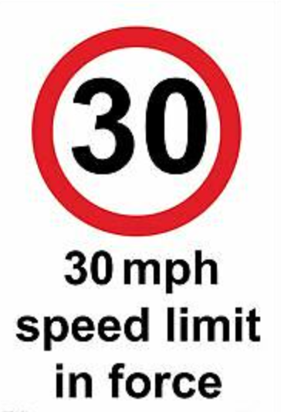
Reducing car pollution
Avoid idling. Switch your engine off if you’re going to be parked for a while. This will also help you to use less fuel, saving money.
Drop your speed. Slower, steadier driving will help save fuel and reduce emissions.
Avoid short journeys. Try combining several shorter trips or consider walking or cycling. Both of which will help keep you active, reduce air pollution and reduce wear and tear on your car.
Get your car serviced regularly, this should keep everything working as efficiently as it should.
Keep your tyres pumped up. Under-inflated tyres mean your car has to work harder and use more fuel.

Slide 25
Reducing car pollution
Older models will use more fuel and produce more toxic emissions than newer models.
Hybrid vehicles and electric vehicles are even greener alternatives.
Electric vehicles produce no exhaust emissions when being driven, meaning no impact on local air pollution.
When buying a new car, check the fuel economy and environment label. High ratings mean low pollution levels.

Slide 26
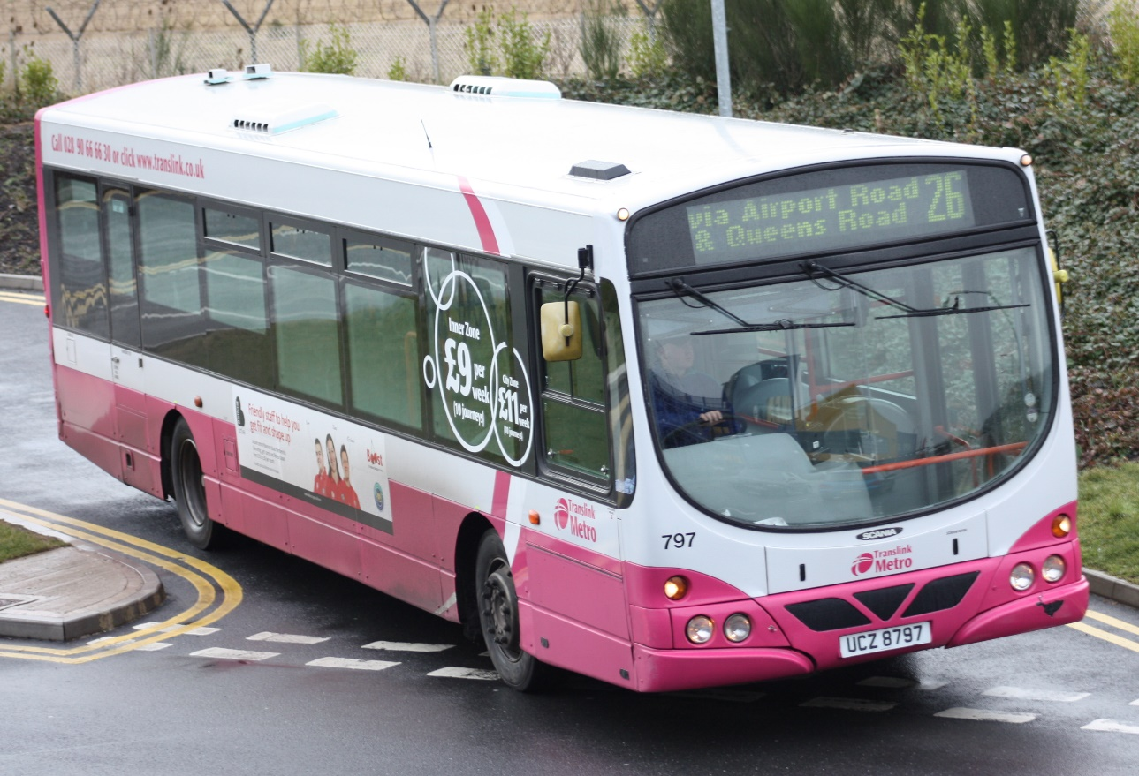
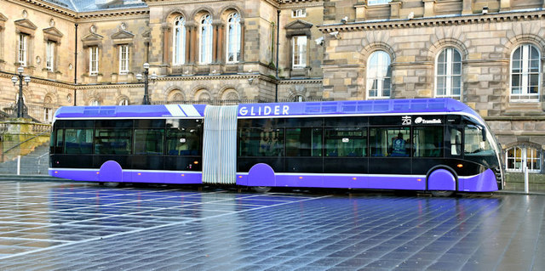
What is the least harmful form of transport?
Public transport overall is generally considered to be one of the better options when it comes to reducing the negative environmental impact of urban mobility.
Taking a bus, even if it runs on diesel, as the majority do, is still better than taking an electric car or taxi.
Why do you think this is better form of transport?

Slide 27
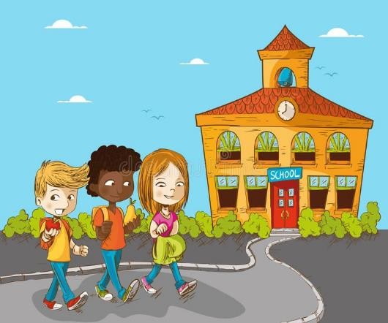
What is the least harmful form of transport?
Walking is undoubtedly the best way to get to school if you want to help the environment.
Children who walk to school have been found to have higher:
academic performance in terms of attention, concentration and alertness
degree of pleasantness and lower levels of stress during the school day
levels of happiness, excitement and relaxation on the journey to school.

Slide 28
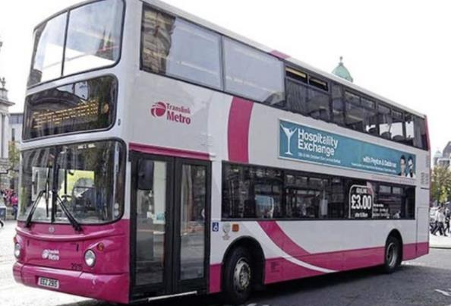
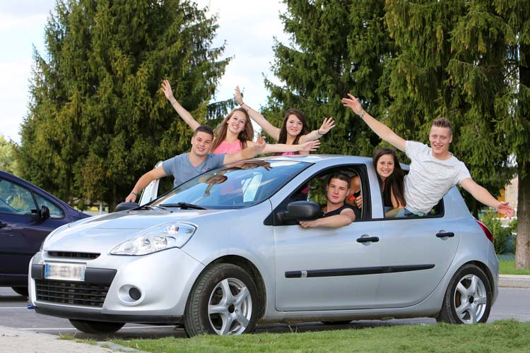
Are you up for a challenge?
Could you swap the car for the bus?
Could you car share with a friend?
Could you walk instead of taking the bus?
Could you cycle instead of using the car?

Slide 29

Contact Francesca.dipalo@keepnorthernirelandbeautiful.org
Can you do the Translink Travel Challenge?
The Translink Travel Challenge is a 2 week challenge that runs all year long.
You can complete your Challenge in any 2 week period you chose.
The Challenge can be done by one class, lots of classes, the whole school, a group of enthusiasts – whichever works best for your school – obviously the more the merrier.
The Challenge will help your school, pupils and parents to consider more environmentally friendly and healthy ways to travel to school sustainably – walk, bike, bus, train, scoot – it’s all good!
The Challenge will help you work towards your Eco-Schools Green Flag Award.

Slide 30


In order to make a good before and after comparison of your pupils’ efforts in the Travel Challenge you will need to provide 2 surveys:
Before - ‘My Old Travel’ an estimate by the pupils of how they have travelled in the 2 weeks prior to the challenge.
After - ‘My New Travel’ a tally and total of their journeys during the challenge which will hopefully show an increase in sustainable journeys.

Slide 31
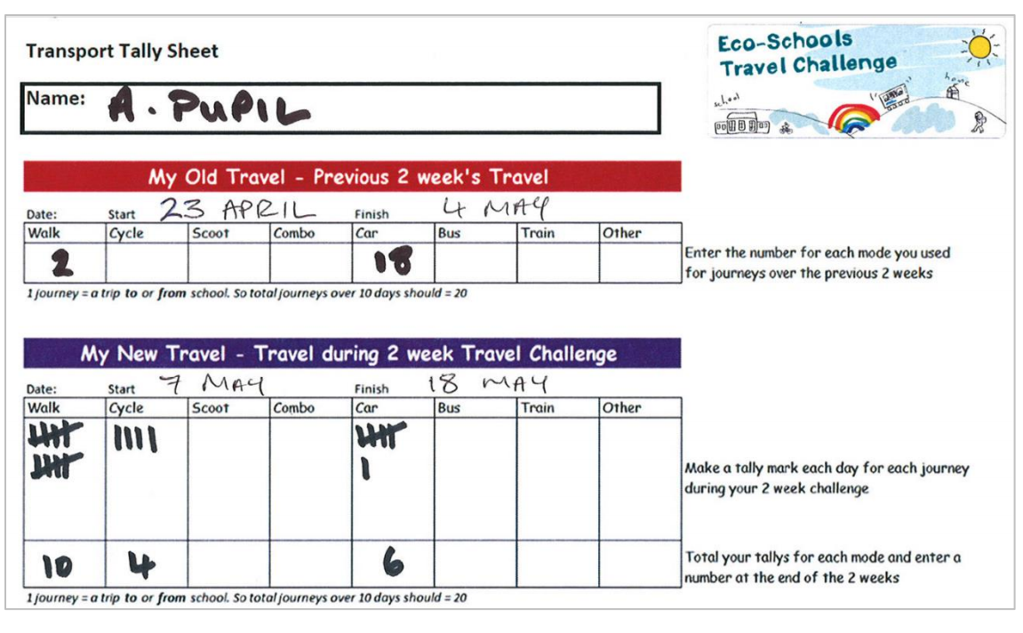

Slide 32

SCOOT
SKATEBOARD
ROLLERBLADE
.
WALK
CYCLE

Slide 33
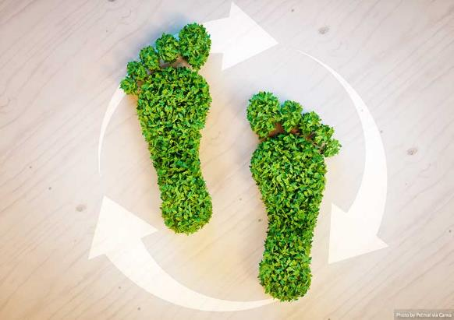
What is sustainable travel?
Sustainable Transport refers to any means of transportation that is 'green' and has low impact on the environment.
Sustainable travel is about valuing the environment and looking after our natural resources.
Sustainable transportation is also about balancing our current and future needs.

Slide 34


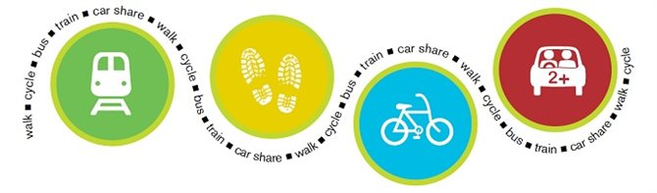
What is sustainable travel?
Examples of sustainable transportation include walking, cycling, carpooling, car sharing, and green vehicles.

Slide 35
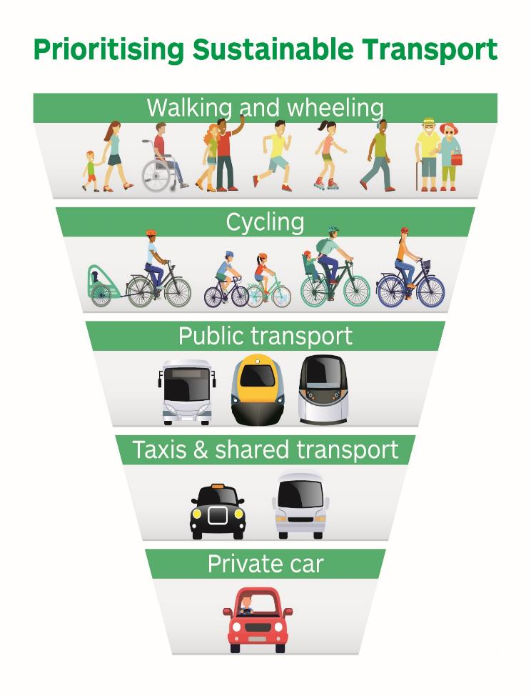


Slide 36
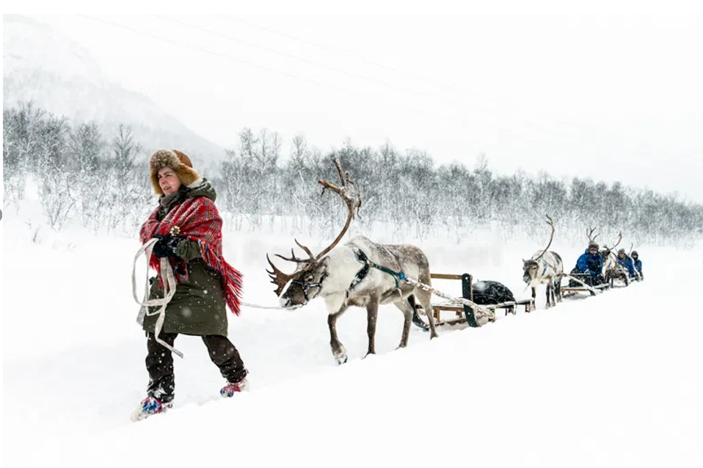
Sustainable travel around the world
Reindeer sledding in Finland is the oldest form of transport!!

Slide 37
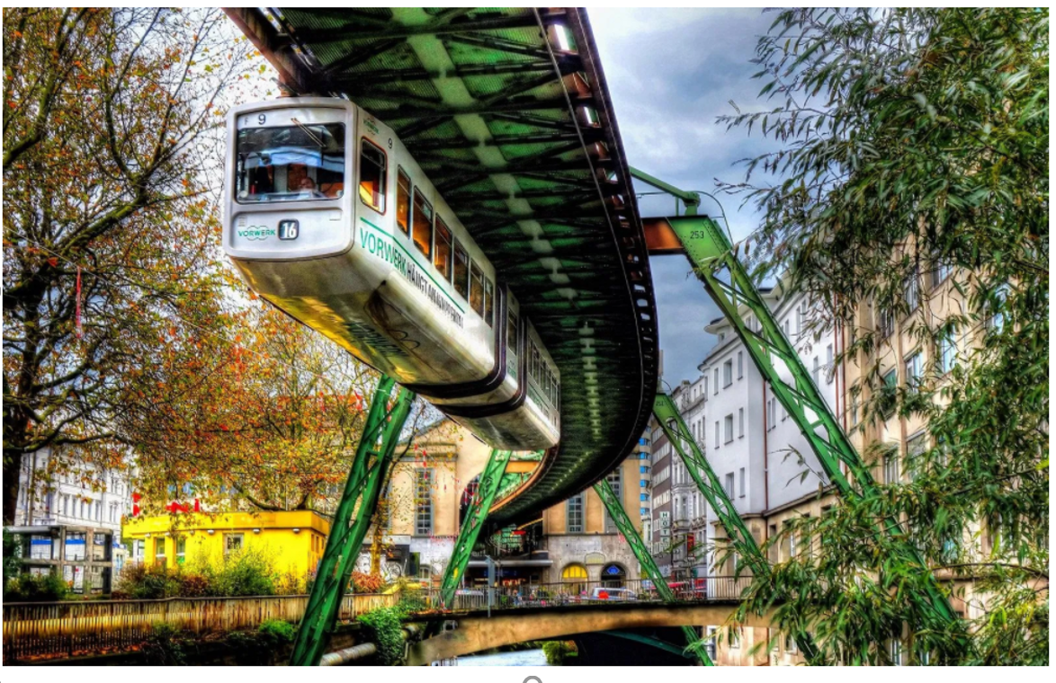
Suspension railway in Germany. It is the oldest elevated railway with hanging cars in the world and is a unique system.

Slide 38
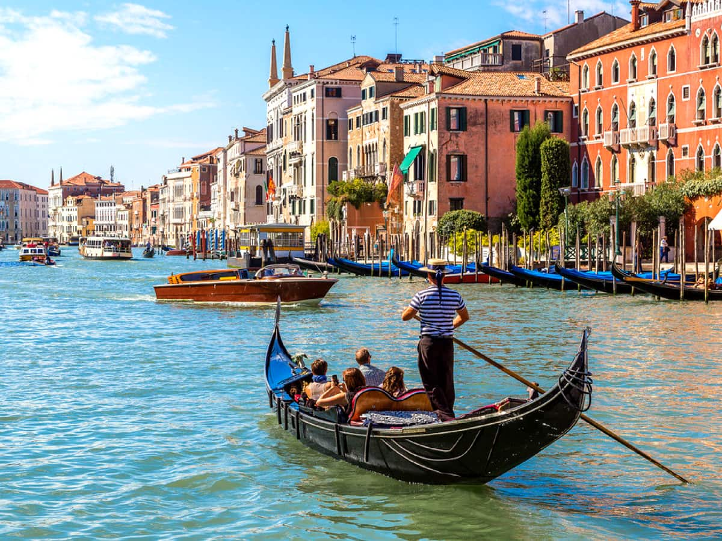
A traditional wood carved gondola in Venice. For centuries this way the main way to travel. There were over 10,000 in 18th century.

Slide 39
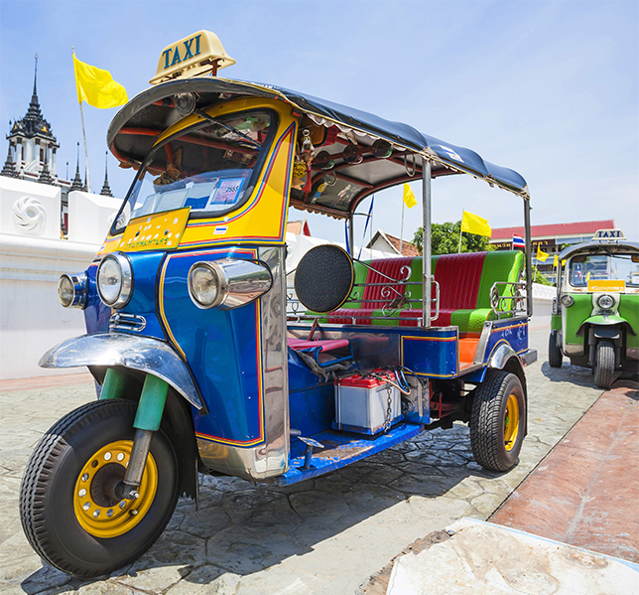
Tuk tuk in Thailand. It is a popular motor tricycle that has been around for 100 years.

Slide 40
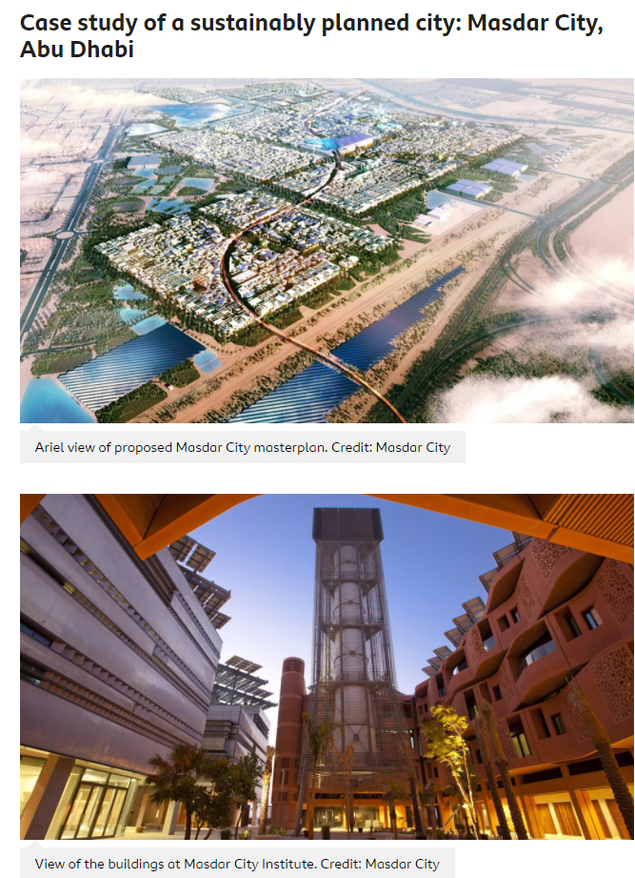
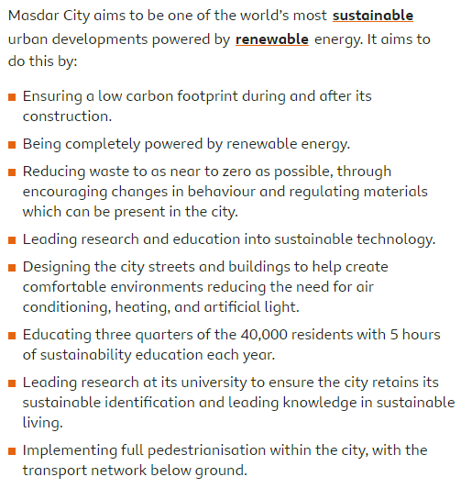

Slide 41
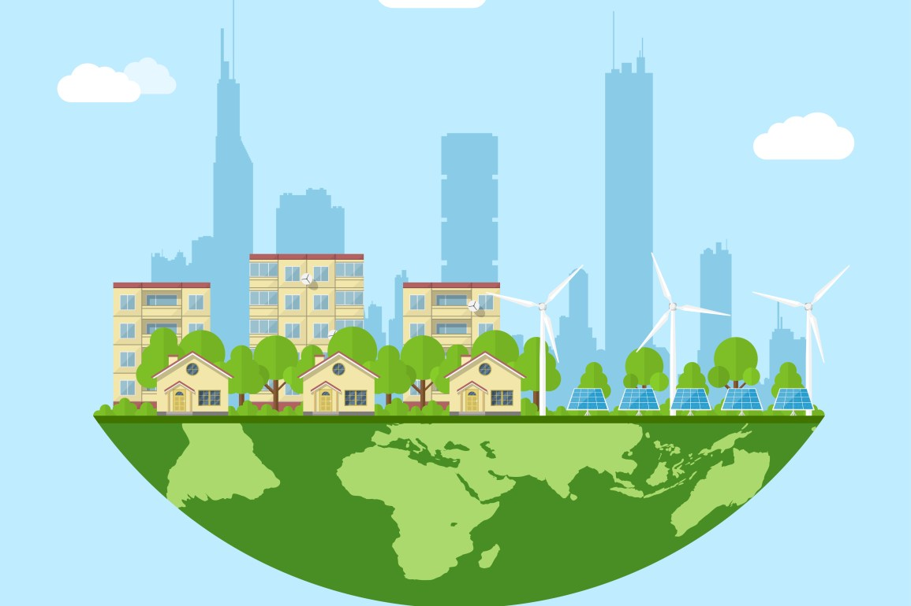
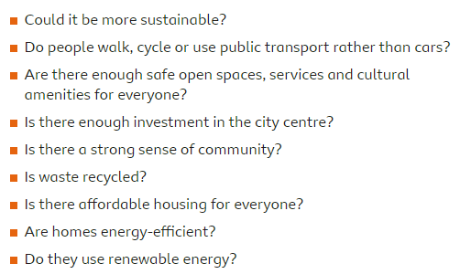
IS YOUR CITY A SUSTAINABLE ONE?

Slide 42
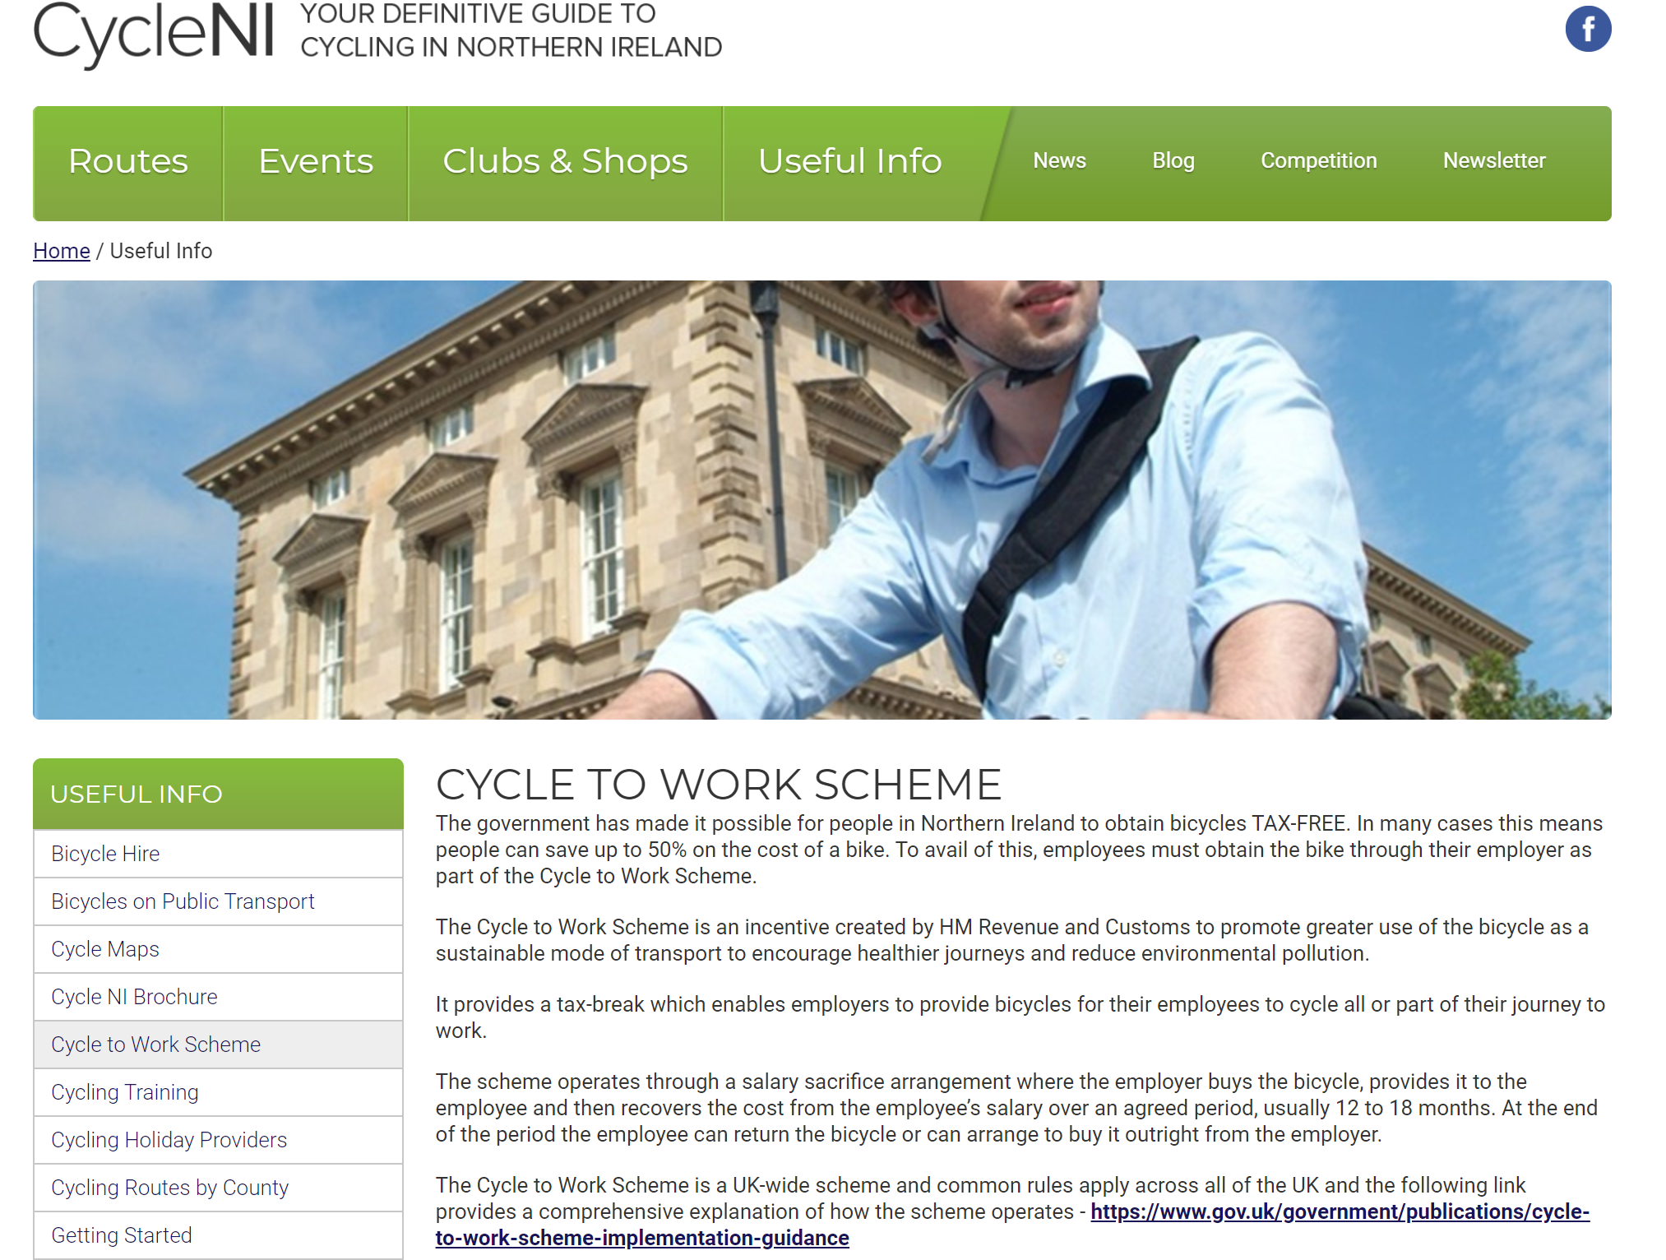
Notes:
Should we have to pay for the Cycle To Work scheme?
Should it be the responsibility of the government to pay for the scheme?

Slide 43
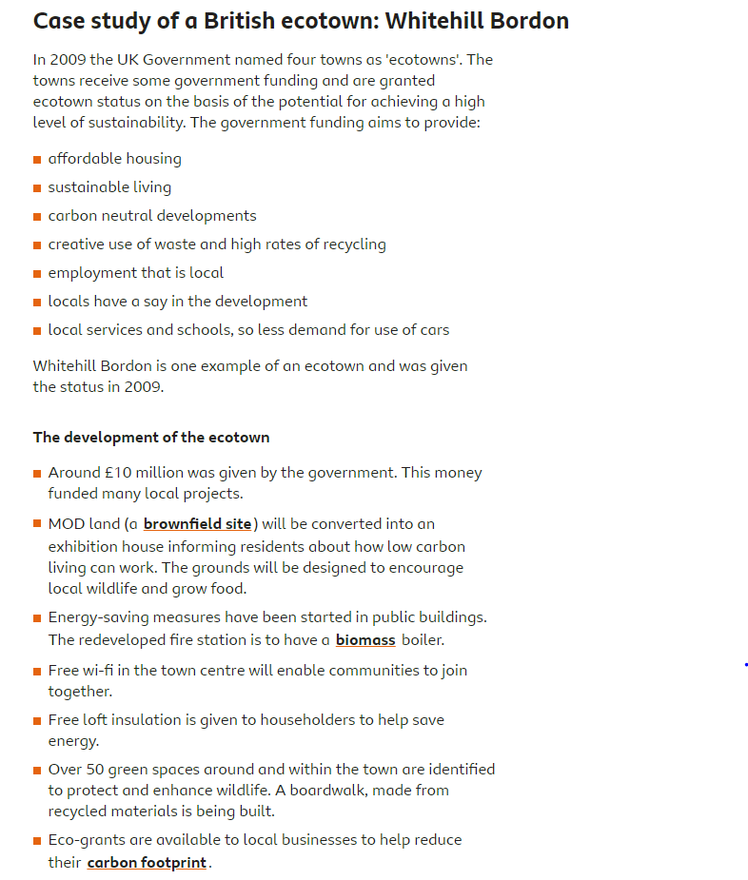
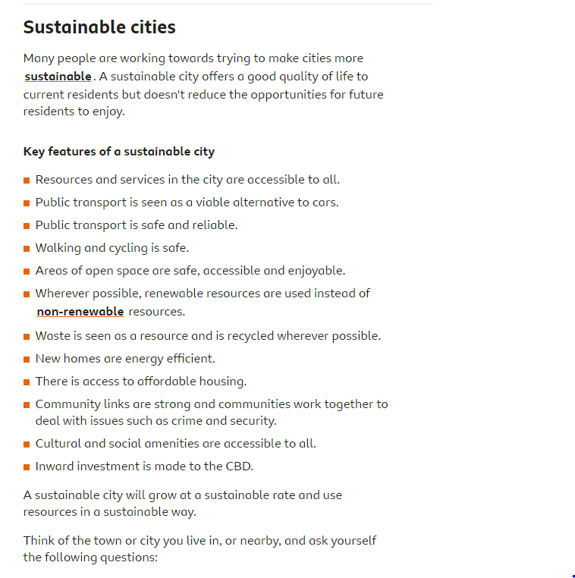

Slide 44


Slide 45



