Slide 1




















Slide 2








WELCOME,
STUDENTS!

Slide 3


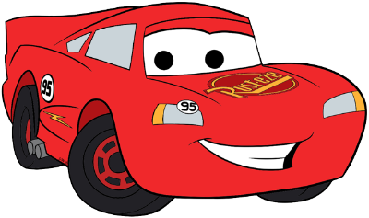


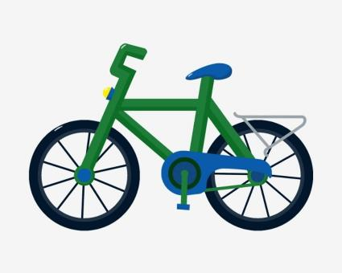



transport
KEY STAGE 2

Slide 4


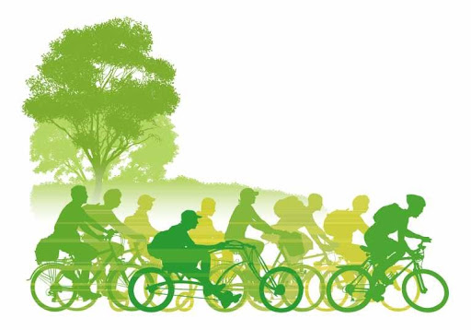
CLASS OBJECTIVES
What are the different types of transport?
How does transport affect the environment?
What is the most/least harmful form of transport?
What type of transport should I use to go to school?

Slide 5

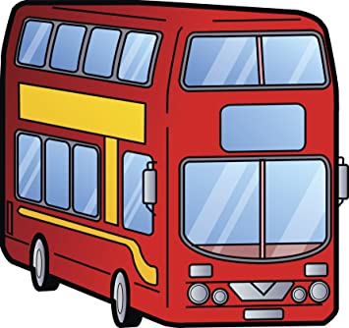

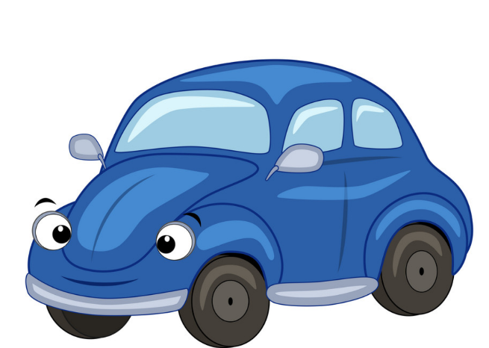

Notes:
Name the types of transport. What do they have in common?
How many children have used each of these?

Slide 6
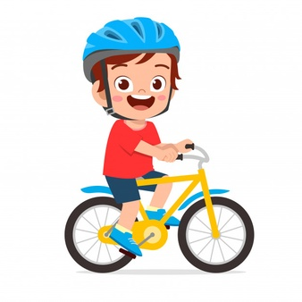
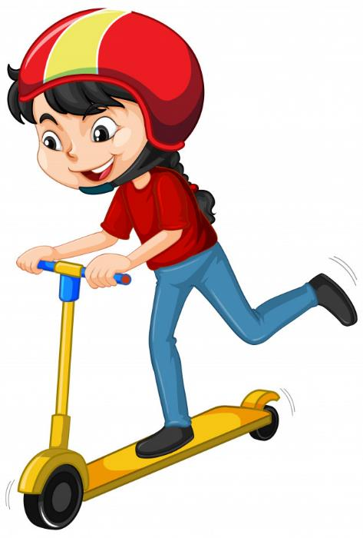


Slide 7
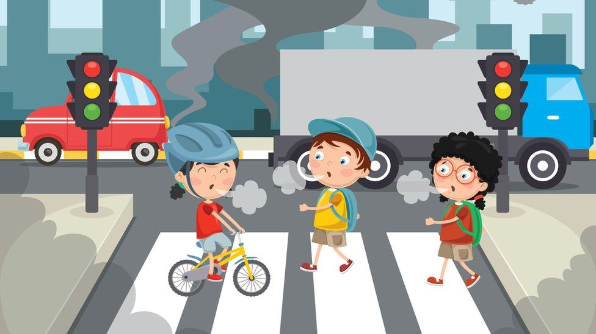
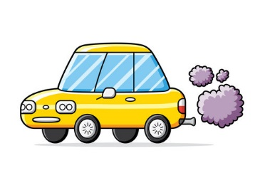
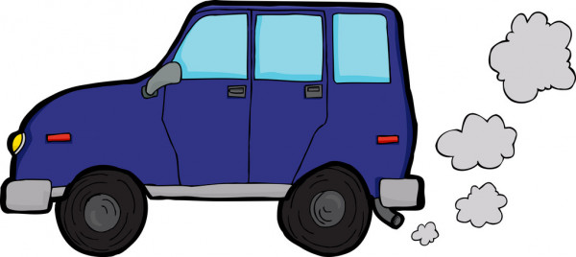
Is this good or bad for you?
Is it good or bad for the environment?
Would you like to breathe this air?

Slide 8
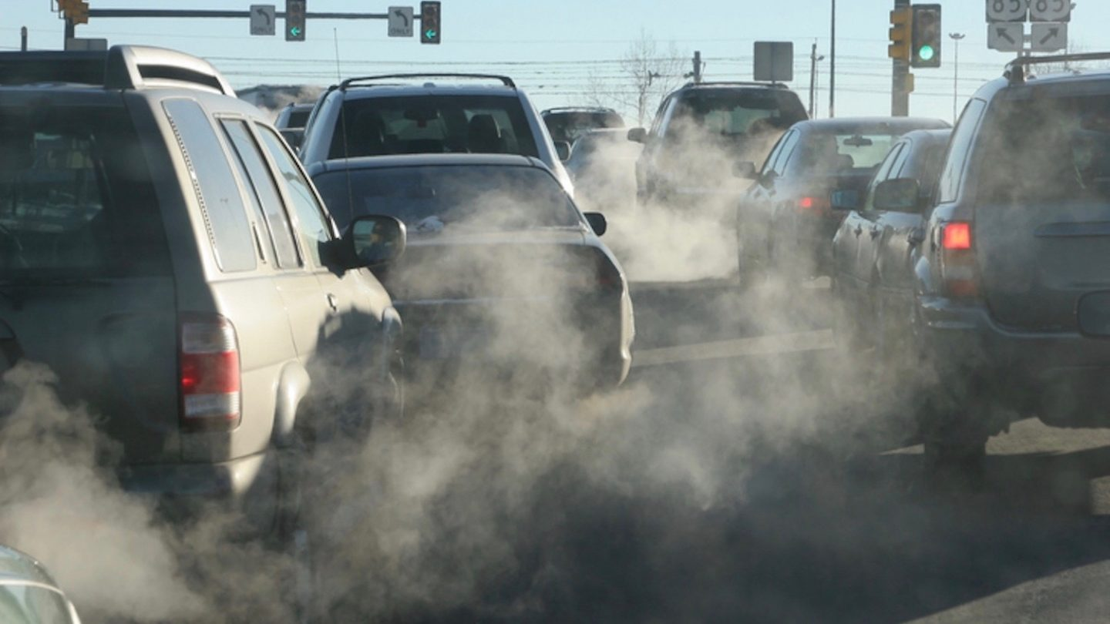

Slide 9
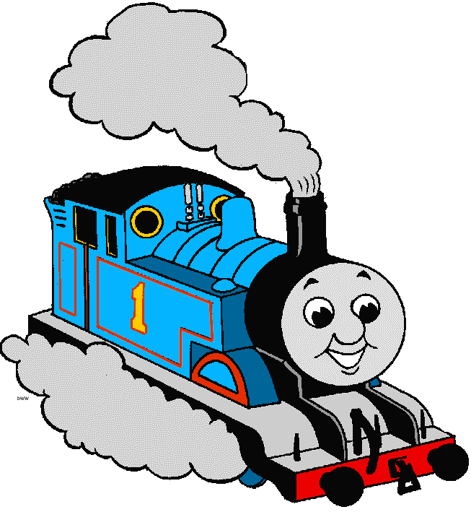
Is this good or bad for you?
Is it good or bad for the environment?
Would you like to breathe this air?

Slide 10
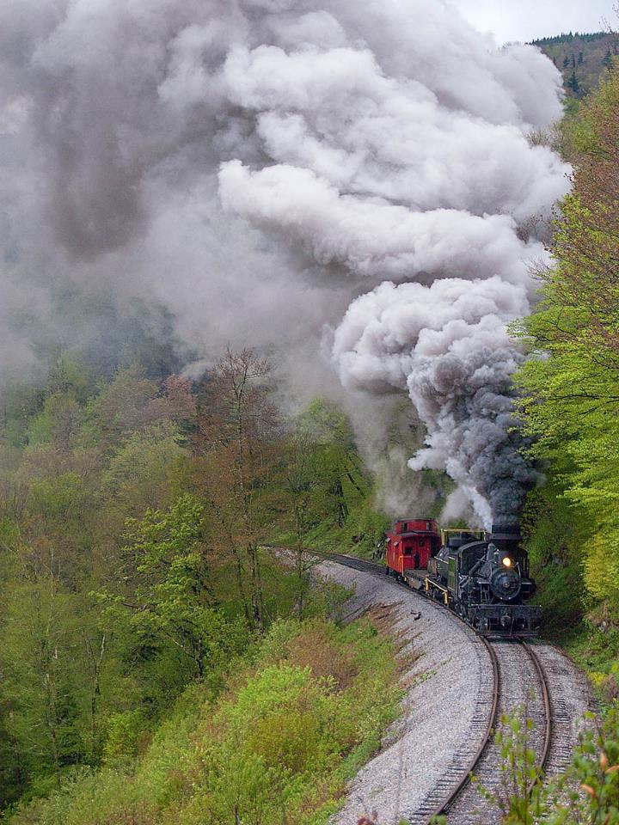
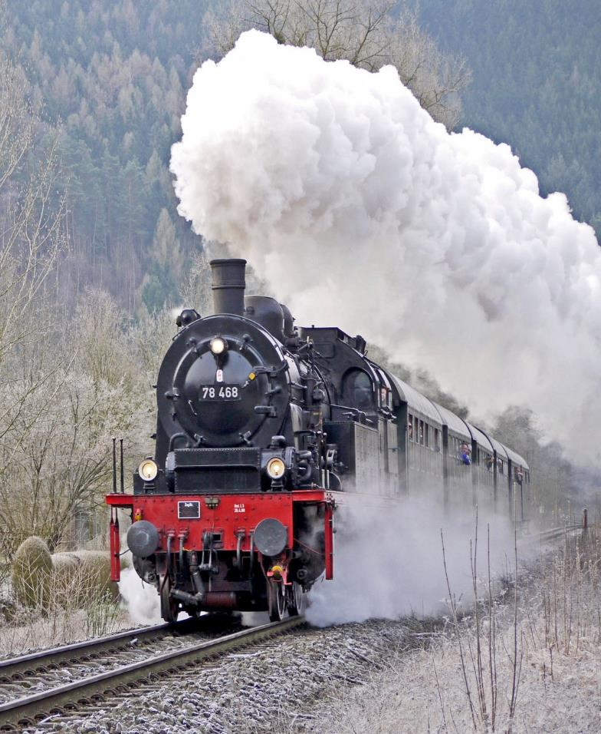

Slide 11
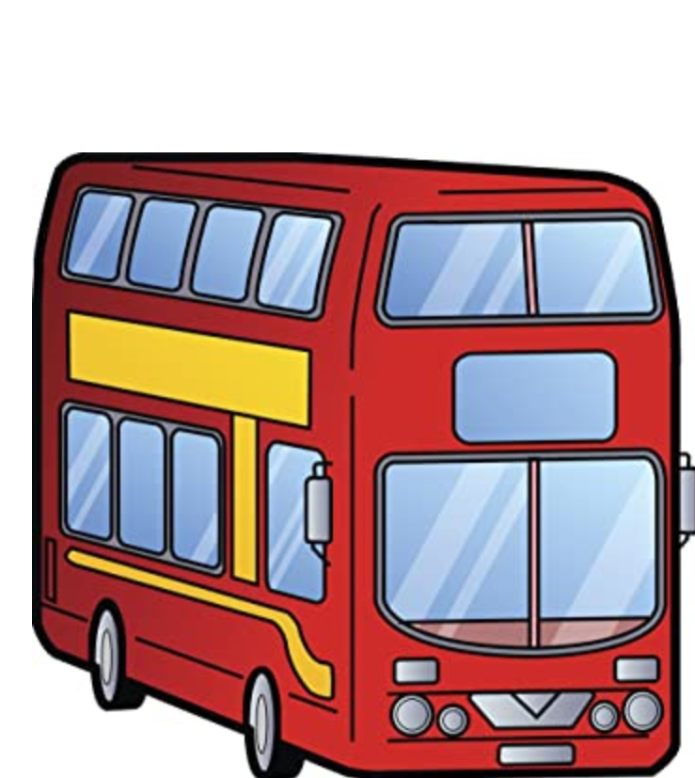

Is this good or bad for you?
Is it good or bad for the environment?
Would you like to breathe this air?

Slide 12
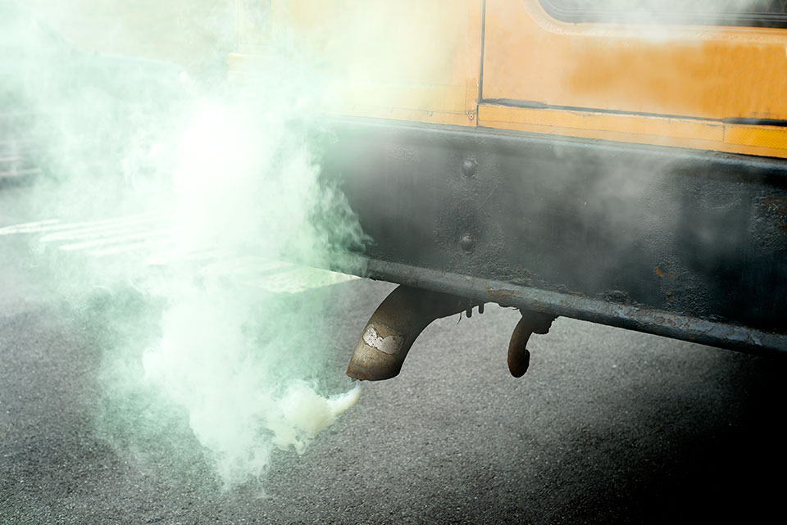
Notes:
Is this air good or bad for you? Would you like to breathe this air? Is it good or bad for the environment?

Slide 13


How do you get to school?
How many children travel to school
By car?
By train?
By bike?
On foot?
Find out how everyone in your class go to school this morning.
Notes:
Do a tally chart to show how many pupils came to school by different modes of transport.
Ask pupils beforehand which they think will be the most common.

Slide 14

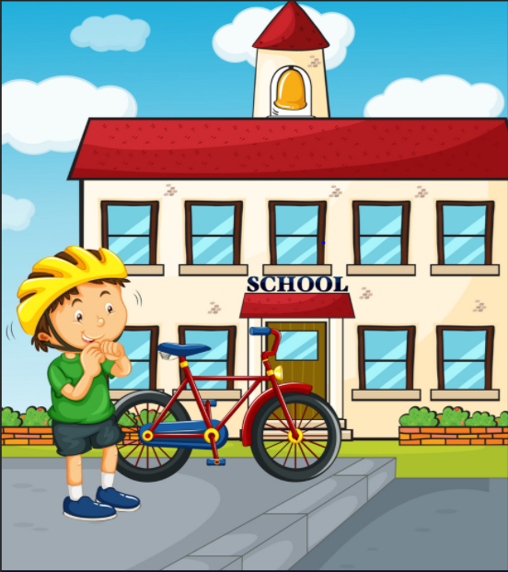


Different types of transport
The main forms of transport used for getting to school:
Car
Bus
Train
Bike
Our feet!!!!

Slide 15
Most popular form of transport was car.
Why do you think this is the most common?
Survey of school pupils 2019
Notes:
Ask pupils before, which they think is the most common among Primary and Secondary pupils?
Is there a difference? If so, why?

Slide 16
Notes:
Ask pupils to look at both charts and see if they can work out why there is a difference
Why do more Primary school pupils go by car?
Why do more Secondary school pupils walk?

Slide 17
Most popular form of transport was train.
Why do you think this is the most common?
Survey of school pupils 2019
Notes:
Ask pupils before, which they think is the most common among Primary and Secondary pupils?
Is there a difference? If so, why?

Slide 18
Notes:
Ask pupils to look at both charts and see if they can work out why there is a difference
Why do more Primary school pupils go by car?
Why do more Secondary school pupils walk?

Slide 19
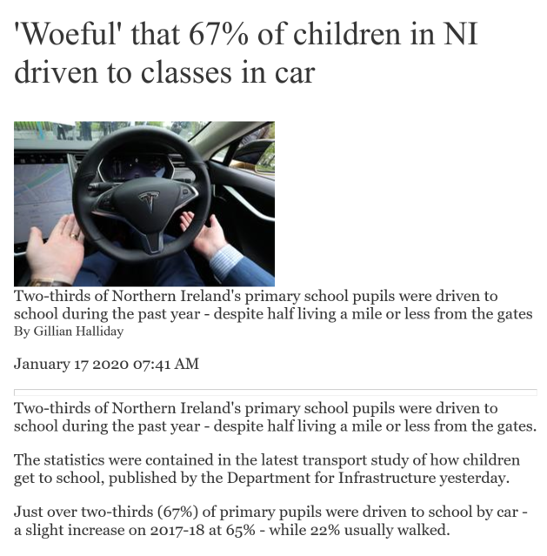
Why do you think that over two thirds of school pupils travelling by car is “woeful”?
Should primary school children walk to school?
Should secondary school children walk to school?
Notes:
Should pupils who live near the school walk? Why?
What are the effects on the environment of so many cars driving children to school?

Slide 20
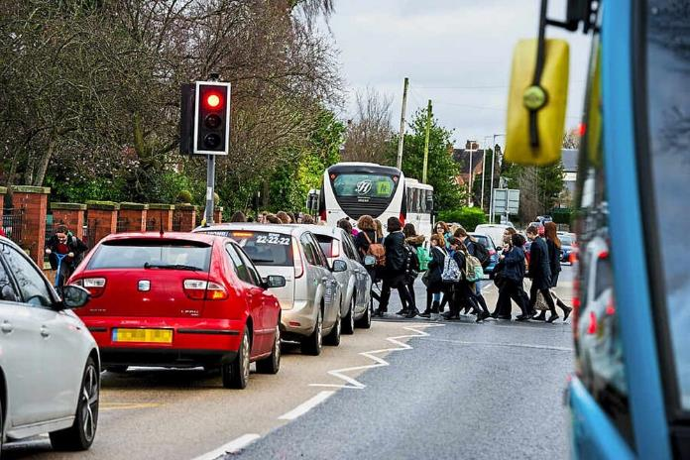
Too many cars at the school gates?
The traffic outside your school could be making the air in their playground and classroom dangerous to breathe.
Many parents take their children to school by car because it’s the most convenient option, but that could be contributing to the pollution outside the school gate and in the playground, especially if the engines are left on while the cars are parked.

Slide 21
How do cars harm the environment?
Car exhausts give off nasty fumes that are harmful and dangerous.
They can also cause acid rain which damages plants and water supply.
These fumes are 1 of the major causes of global warming.
.
Cars can also be very noisy. Too many cars together is very loud!!
Fuel spills can be dangerous for other road users.

Slide 22

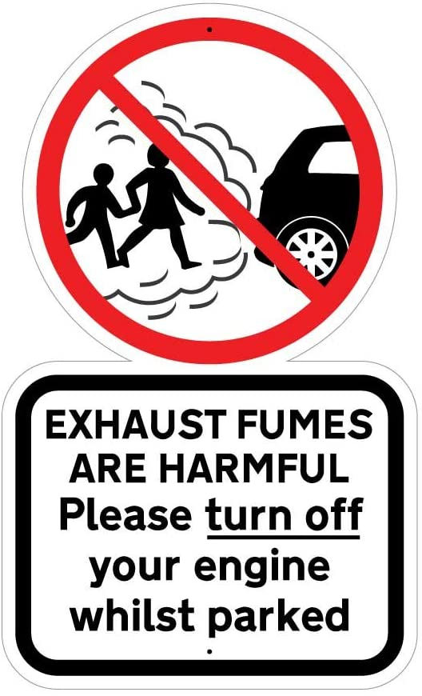
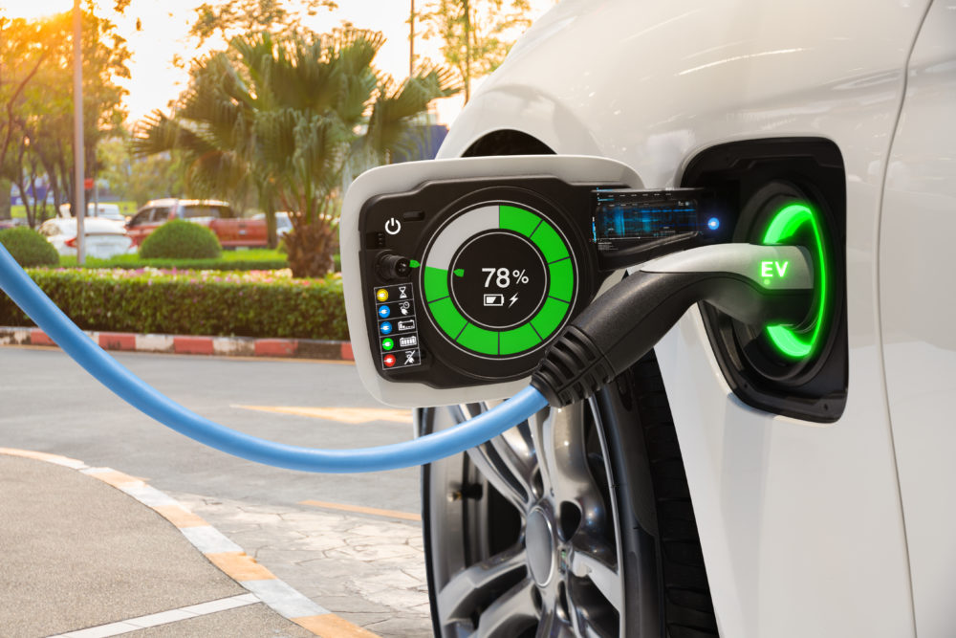
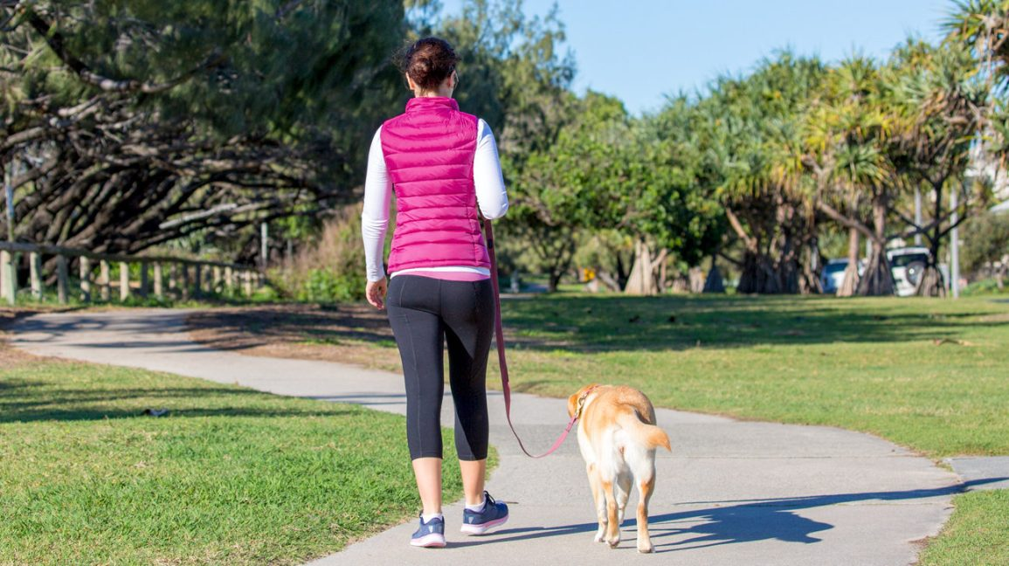

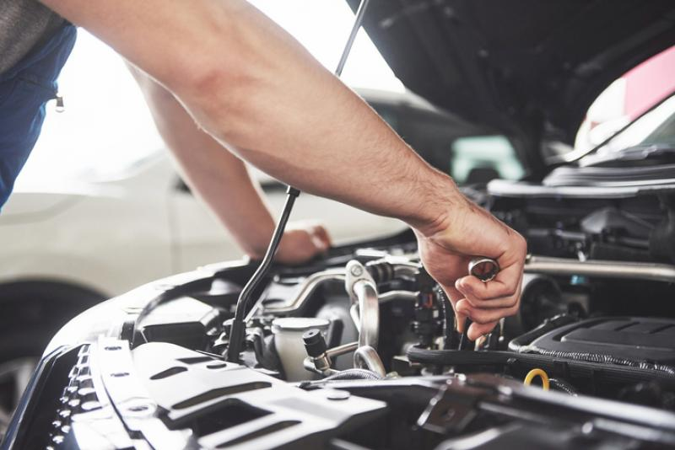
Reducing car pollution
.
Notes:
Switch your engine off if you’re going to be parked for a while. This will also help you to use less fuel, saving money.
Slower, steadier driving will help save fuel and reduce emissions.
Get your car serviced regularly, this should keep everything working as efficiently as it should.
Drive an electric or a hybrid car
If it’s a short journey, walk instead

Slide 23
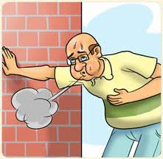

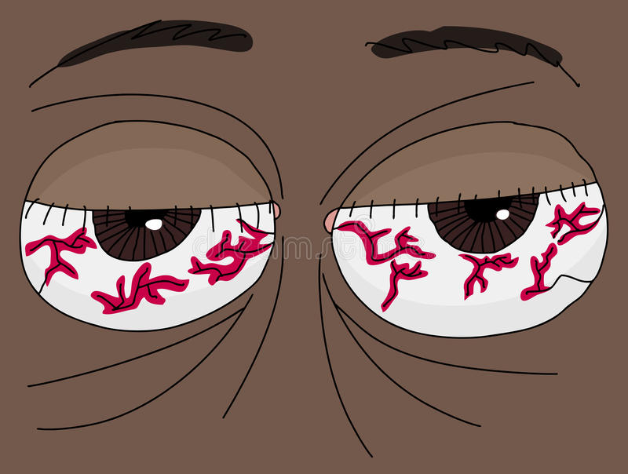
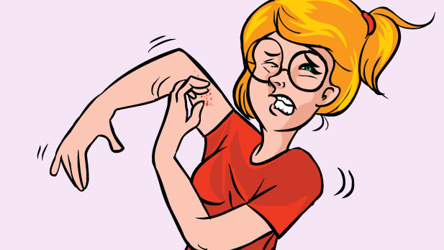
We suffer as well!!
.
Notes:
Car pollutants harm human health. Diesel engines emit high levels of airborne particles of soot and metal.
These cause skin and eye irritation and allergies, and very fine particles lodge deep in lungs, where they cause respiratory problems.
Air pollution has been linked to cancer, asthma, stroke and heart disease, diabetes, obesity and dementia either as a cause or as a complicating factor contributing towards premature death.

Slide 24


What is the least harmful form of transport?
Public transport is generally considered to be one of the better options when it comes to reducing the negative environmental impact of transport.
Taking a bus is better than taking a car or taxi.
Why do you think this is better form of transport?
Notes:
Bus full of people versus 1 person in on his own
Which is better for environment? Why?
Introduce idea of car sharing.

Slide 25
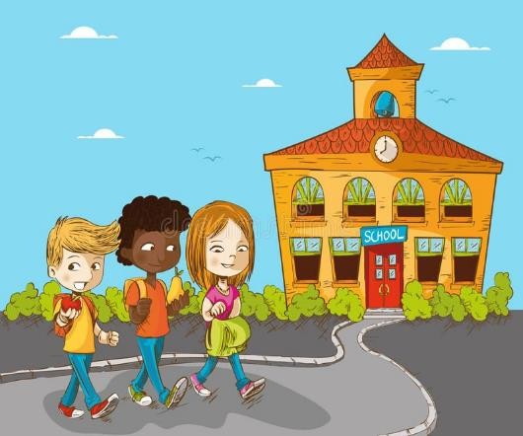
What is the least harmful form of transport?
Walking is undoubtedly the best way to get to school if you want to help the environment.
Children who walk to school have been found to have.
higher academic performance in terms of attention, concentration and alertness.
higher degree of pleasantness and lower levels of stress during the school day.
higher levels of happiness, excitement and relaxation on the journey to school.

Slide 26
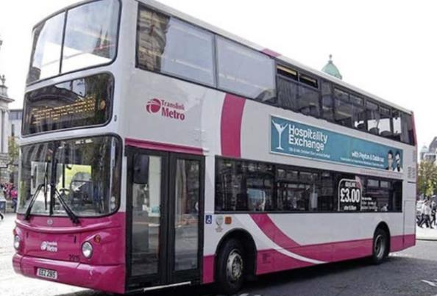
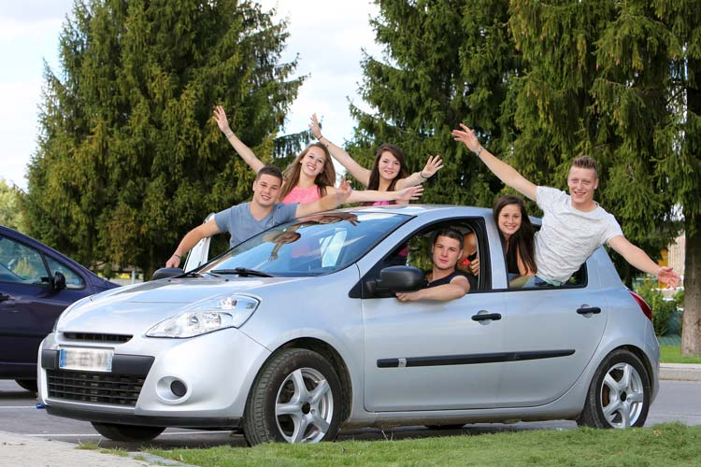
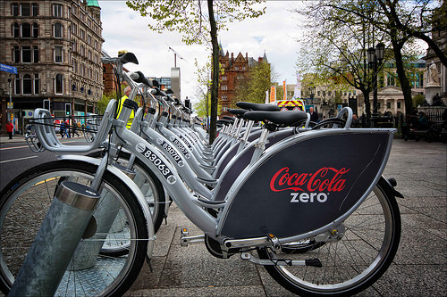
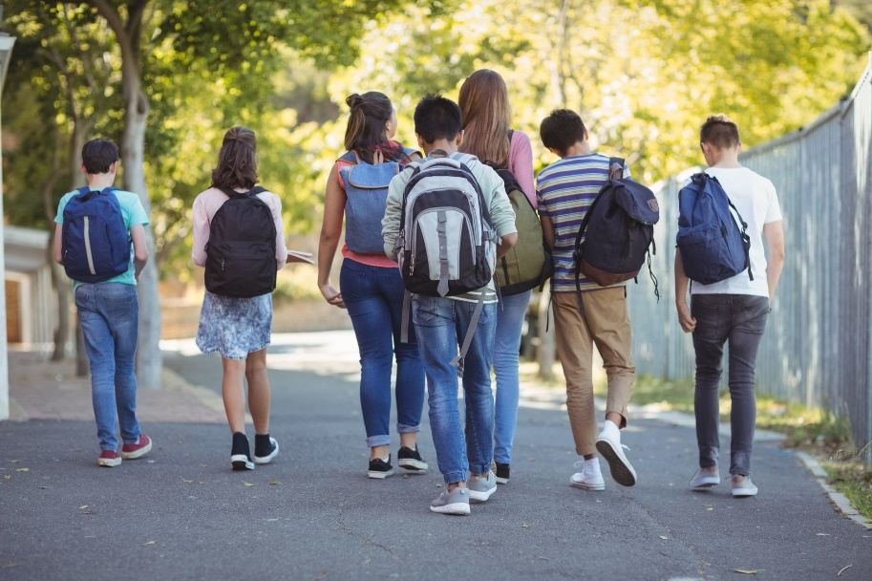
Are you up for a challenge?
Could you swap the car for the bus?
Could you car share with a friend?
Could you walk instead of taking the bus?
Could you cycle instead of using the car?

Slide 27

Contact Francesca.dipalo@keepnorthernirelandbeautiful.org
Can you do the Translink Travel Challenge?
The Translink Travel Challenge is a 2 week challenge that runs all year long.
You can complete your Challenge in any 2 week period you chose.
The Challenge can be done by one class, lots of classes, the whole school, a group of enthusiasts – whichever works best for your school – obviously the more the merrier.
The Challenge will help your school, pupils and parents to consider more environmentally friendly and healthy ways to travel to school sustainably – walk, bike, bus, train, scoot – it’s all good!
The Challenge will help you work towards your Eco-Schools Green Flag Award.

Slide 28


In order to make a good before and after comparison of your pupils’ efforts in the Travel Challenge you will need to provide 2 surveys:
Before - ‘My Old Travel’ an estimate by the pupils of how they have travelled in the 2 weeks prior to the challenge.
After - ‘My New Travel’ a tally and total of their journeys during the challenge which will hopefully show an increase in sustainable journeys.

Slide 29
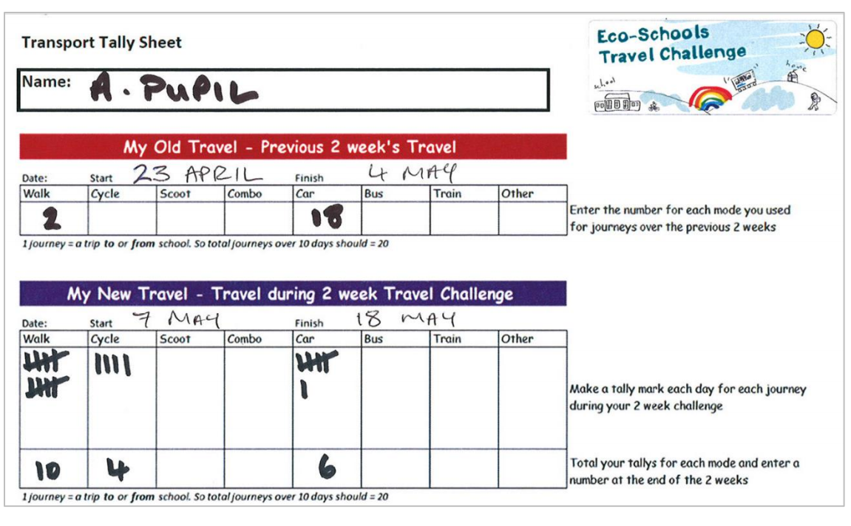

Slide 30
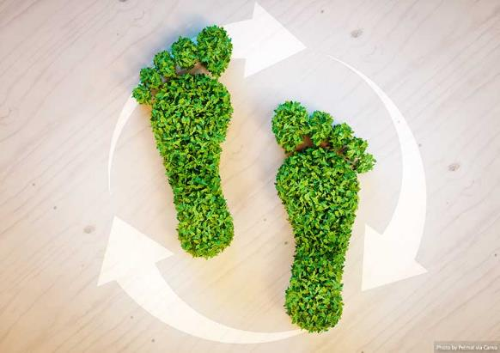
What is sustainable travel?
Sustainable Transport refers to any means of transport that is 'green' and has low impact on the environment.
Sustainable travel is about valuing the environment and looking after our natural resources.
Sustainable transport is also about balancing our current and future needs.

Slide 31

SCOOT
SKATEBOARD
ROLLERBLADE
.
WALK
CYCLE

Slide 32

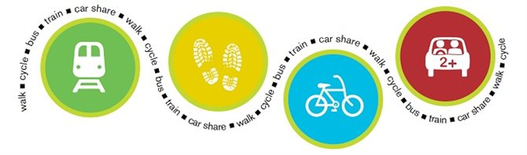
What is sustainable travel?
Examples of sustainable transportation include walking, cycling, carpooling, car sharing and green vehicles.

Slide 33
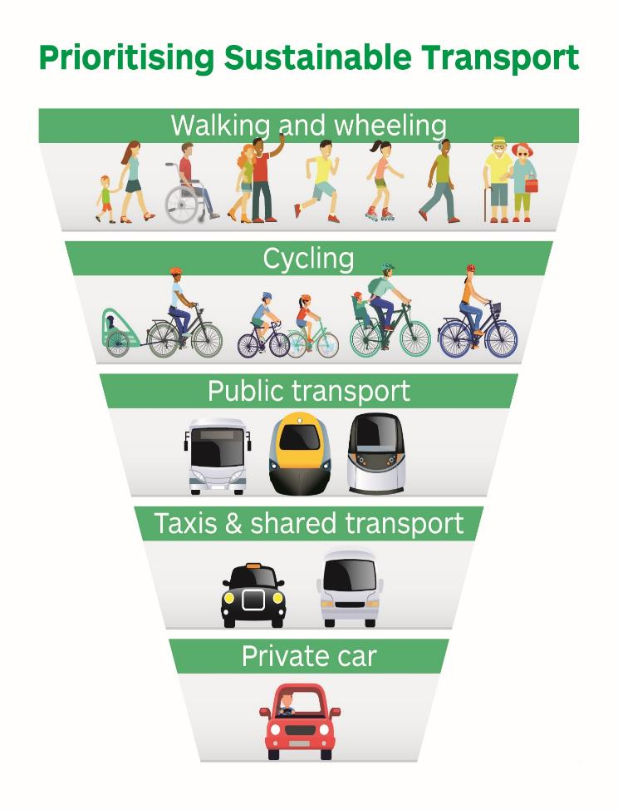


Slide 34
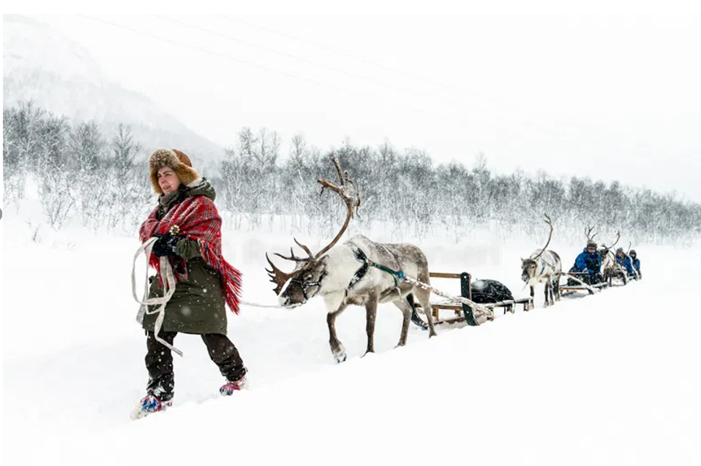
Sustainable travel around the world
Reindeer sledding in Finland is the oldest form of transport!!

Slide 35
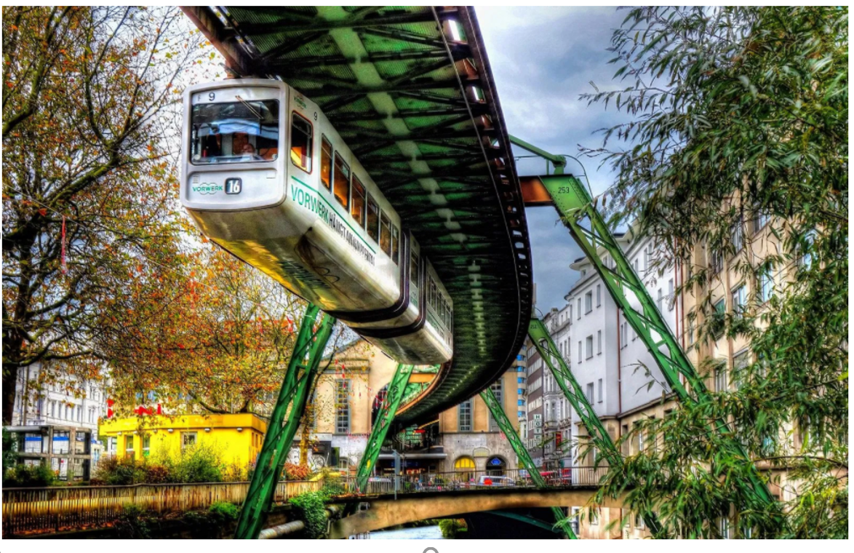
Suspension railway in Germany. It is the oldest elevated railway with hanging cars in the world and is a unique system.

Slide 36
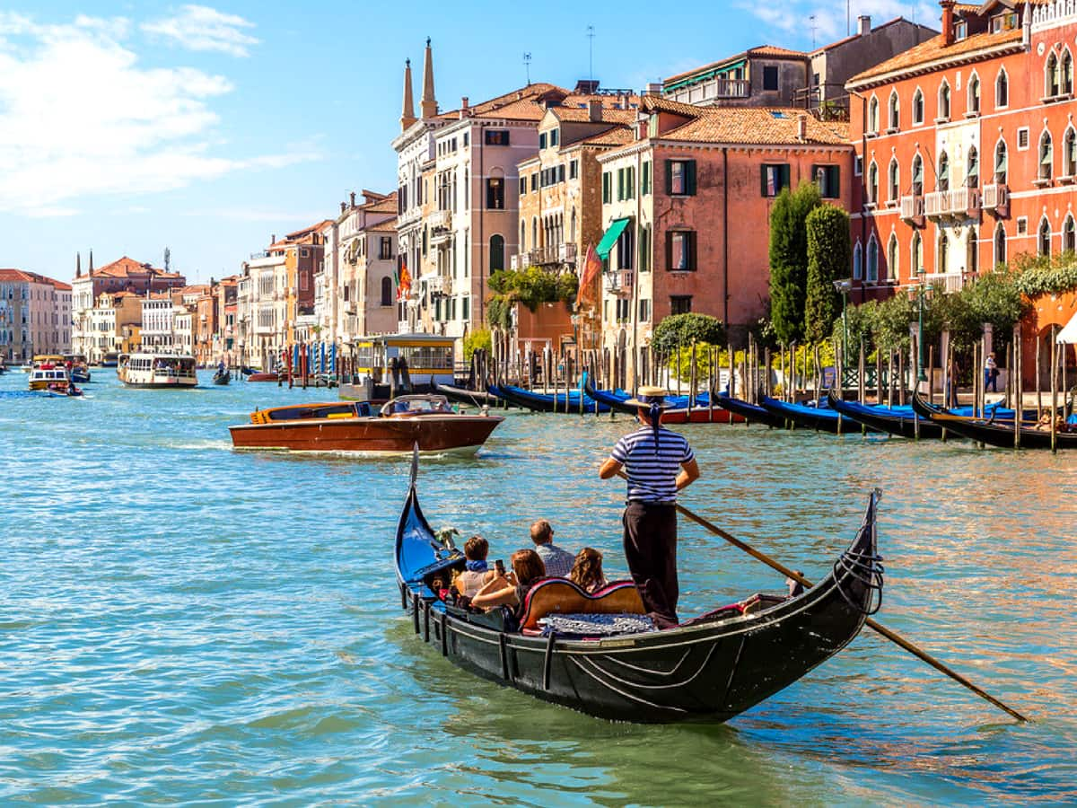
A traditional wood carved gondola in Venice. For centuries this way the main way to travel. There were over 10,000 in 18th century.

Slide 37
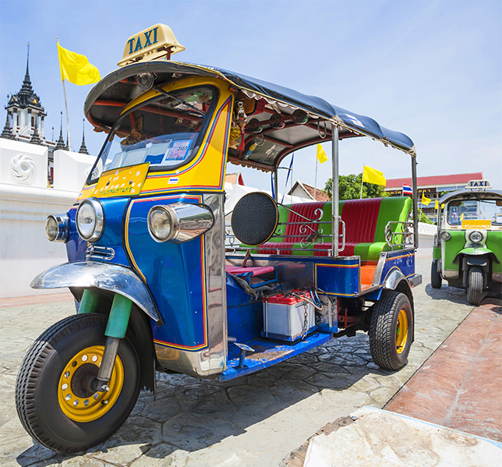
Tuk tuk in Thailand. It is a popular motor tricycle that has been around for 100 years.
Notes:
Pupils can research different types of sustainable travel around the world.

Slide 38
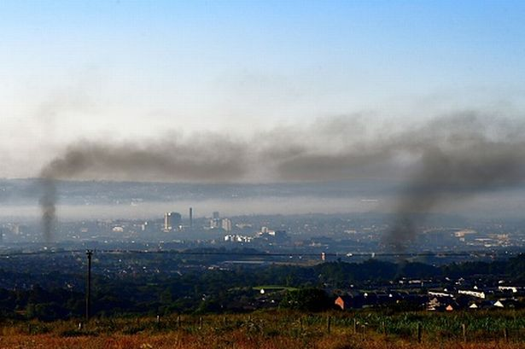
What is air pollution?
Air pollution is the term given to the small particles, chemicals and gases that are released into the air.
These air pollutants can have a harmful impact on the environment and our health if they are breathed in.
However, most of the time air pollution can’t be seen. Like oxygen, the particles can be invisible, but that doesn’t stop them from being very harmful.

Slide 39
Reducing car pollution
Avoid idling. Switch your engine off if you’re going to be parked for a while. This will also help you to use less fuel, saving money.
Drop your speed. Slower, steadier driving will help save fuel and reduce emissions.
Avoid short journeys. Try combining several shorter trips or consider walking or cycling. Both of which will help keep you active, reduce air pollution and reduce wear and tear on your car.
Get your car serviced regularly, this should keep everything working as efficiently as it should.
Keep your tyres pumped up. Under-inflated tyres mean your car has to work harder and use more fuel.

Slide 40
Reducing car pollution
Older models will use more fuel and produce more toxic emissions than newer models.
Hybrid vehicles and electric vehicles are even greener alternatives.
Electric vehicles produce no exhaust emissions when being driven, meaning no impact on local air pollution.
When buying a new car, check the fuel economy and environment label. High ratings mean low pollution levels.

Slide 41
We suffer as well!!
Car pollutants harm human health. Diesel engines emit high levels of particulate matter, which is airborne particles of soot and metal.
These cause skin and eye irritation and allergies, and very fine particles lodge deep in lungs, where they cause respiratory problems.
Air pollution has been linked to cancer, asthma, stroke and heart disease, diabetes, obesity and dementia either as a cause or as a complicating factor contributing towards premature death.

