Slide 1




















Slide 2








WELCOME,
STUDENTS!

Slide 3


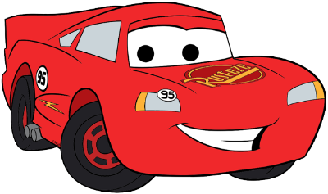


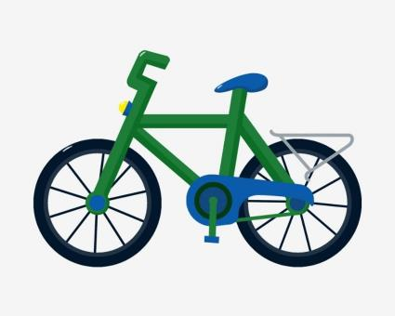



transport
Foundation stage

Slide 4

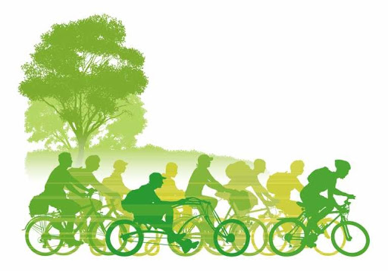
CLASS OBJECTIVES
What are the different types of transport?
How does transport affect the environment?
What is the most/least harmful form of transport?
What type of transport should I use to go to school?

Slide 5

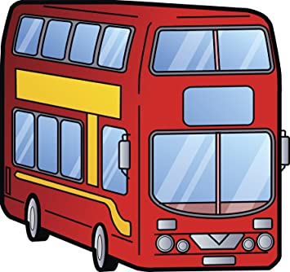
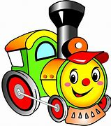
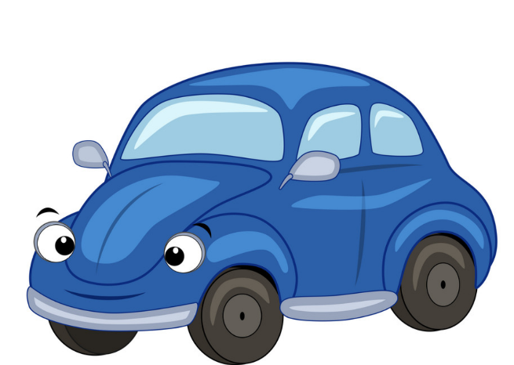

Notes:
Name the types of transport. What do they have in common?
How many children have used each of these?

Slide 6
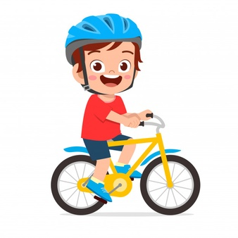
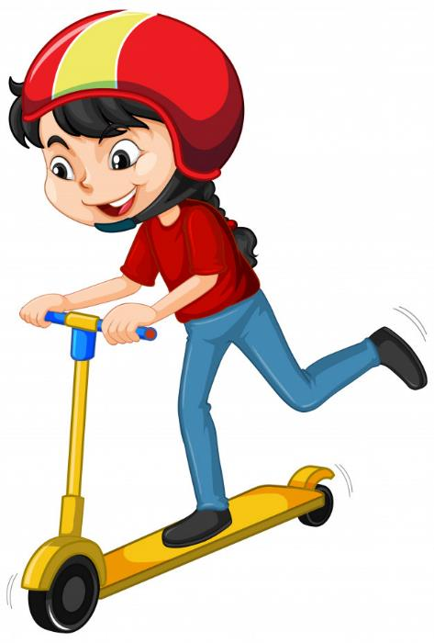
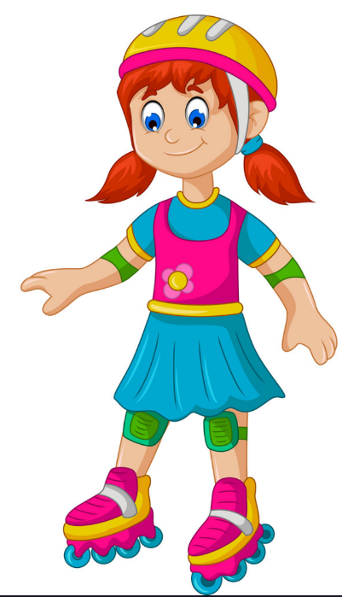
Notes:
What’s the difference between the transport in these 2 slides?

Slide 7


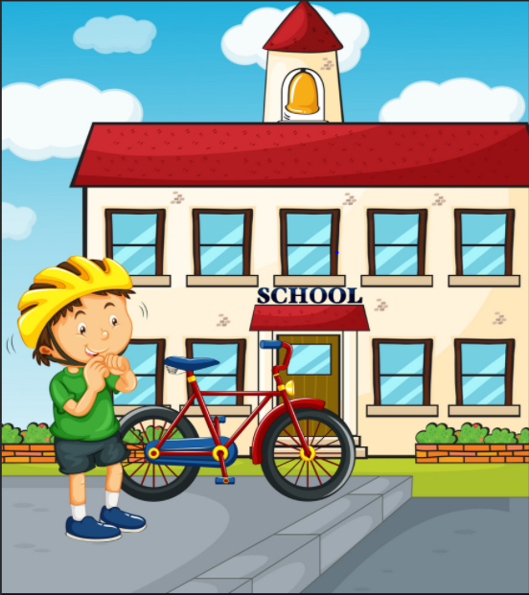

Different types of transport
The main forms of transport used for getting to school:
Car
Bus
Train
Bike
Our feet!!!!

Slide 8

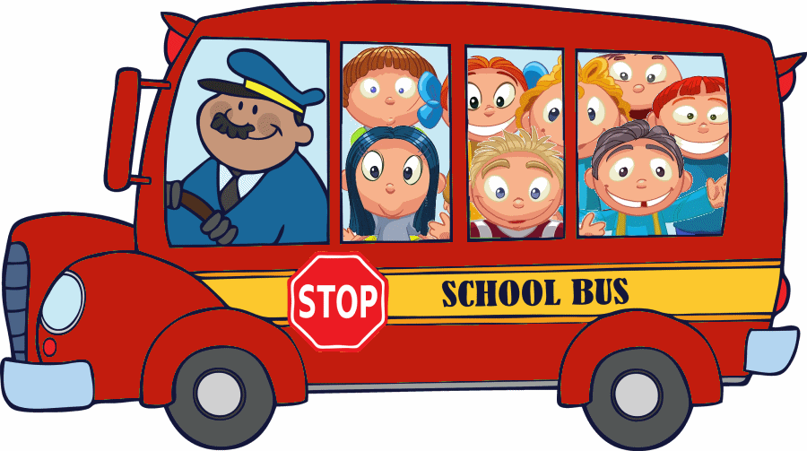
How do you get to school?
.
Notes:
Do a tally of how many children came to school by different modes of transport

Slide 9
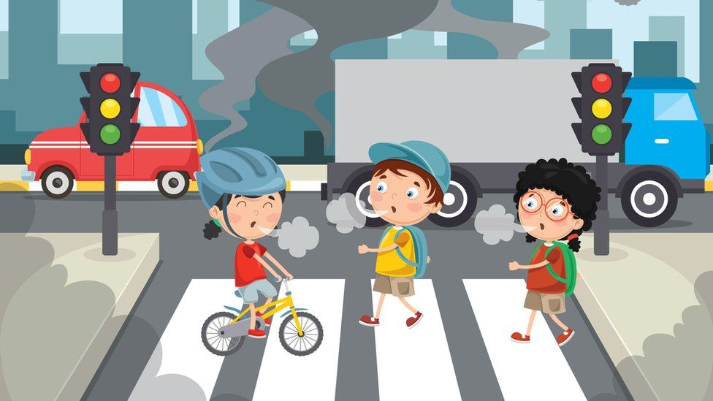
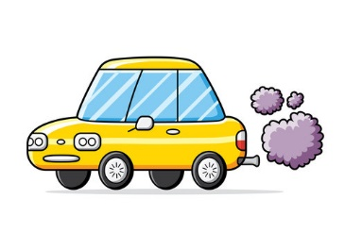
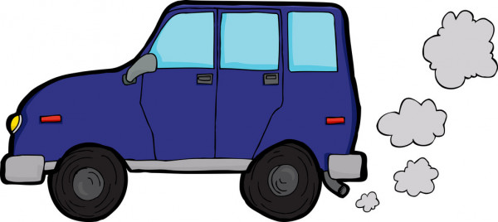
Is this good or bad for you?
Is it good or bad for the environment?
Would you like to breathe this air?

Slide 10
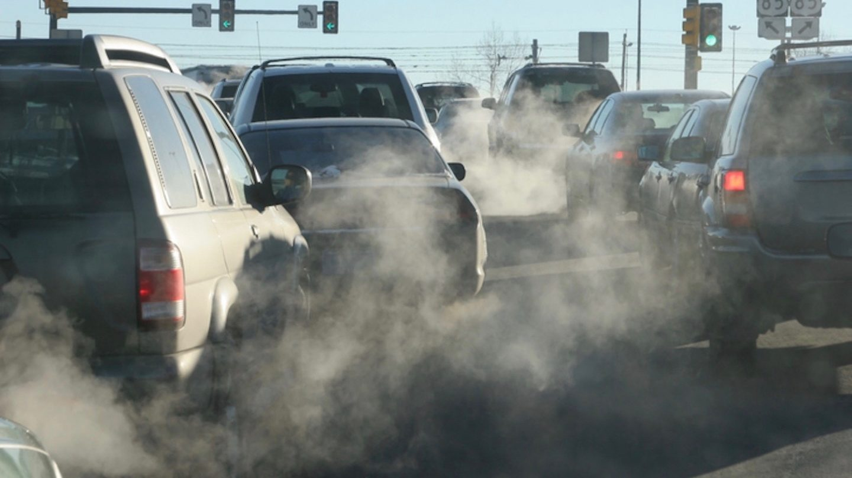
Notes:
Is this air good or bad for you? Would you like to breathe this air? Is it good or bad for the environment?

Slide 11
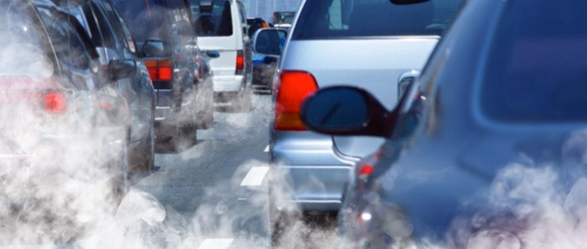

Slide 12
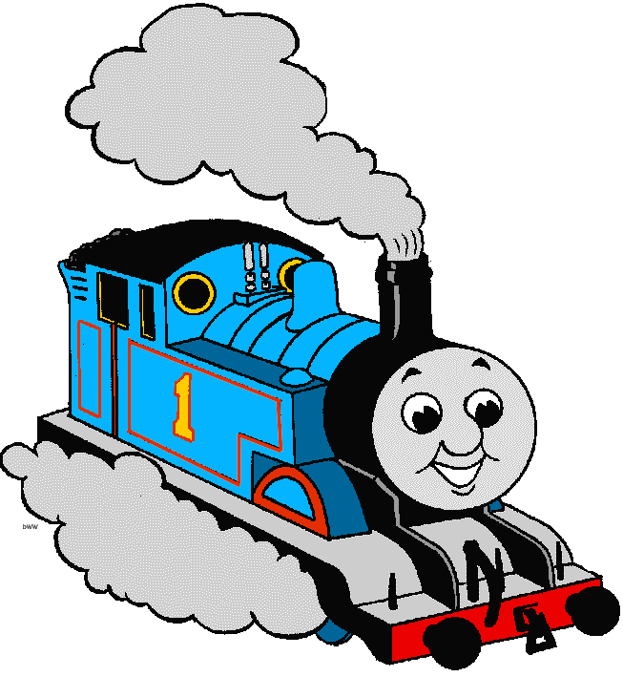
Is this good or bad for you?
Is it good or bad for the environment?
Would you like to breathe this air?

Slide 13
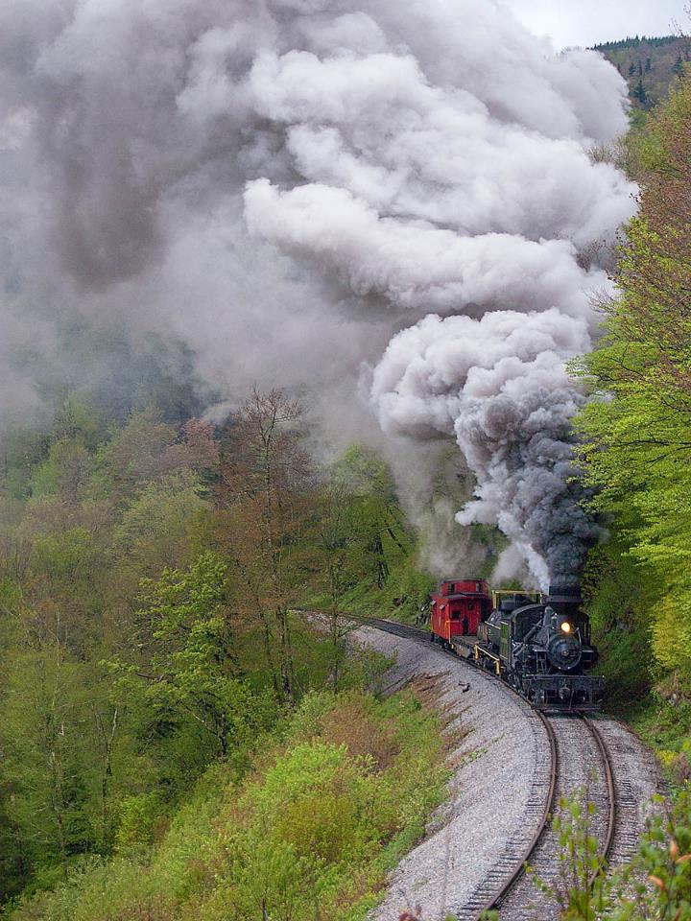
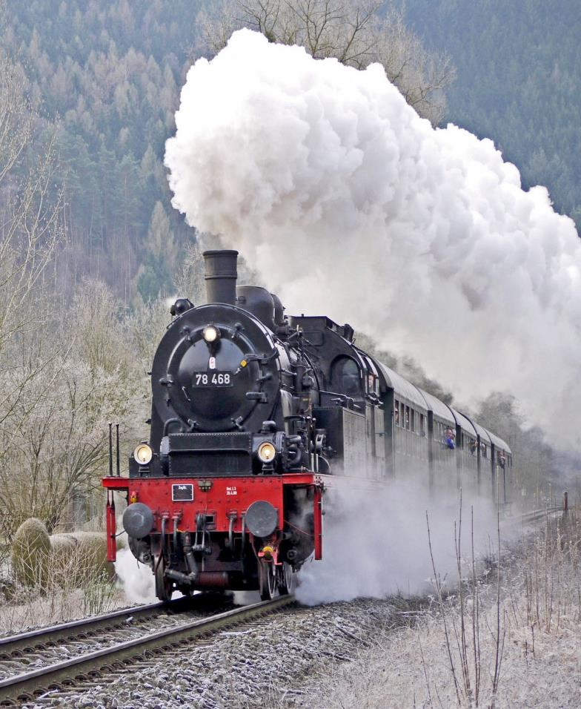
Notes:
Is this air good or bad for you? Would you like to breathe this air? Is it good or bad for the environment?

Slide 14
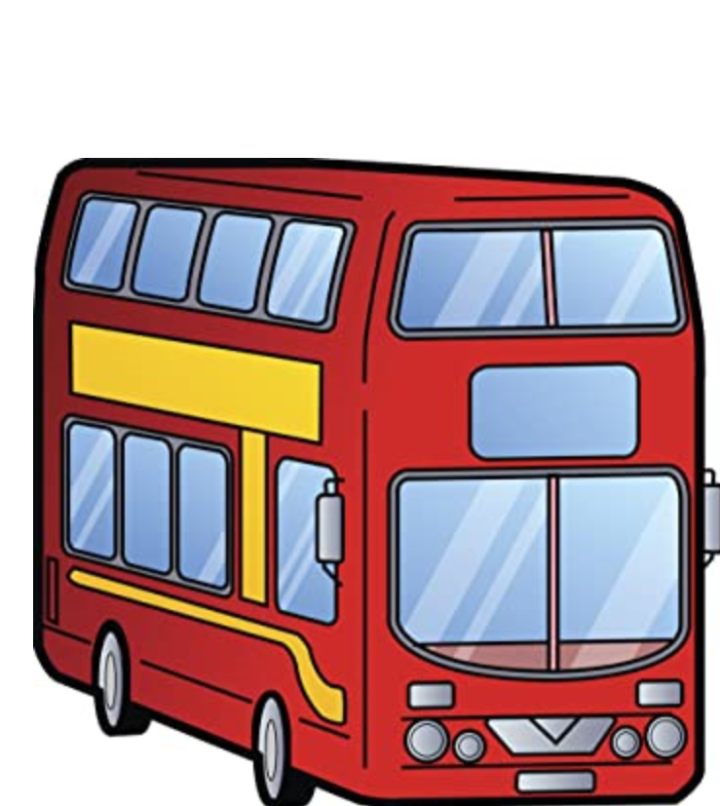

Is this good or bad for you?
Is it good or bad for the environment?
Would you like to breathe this air?

Slide 15
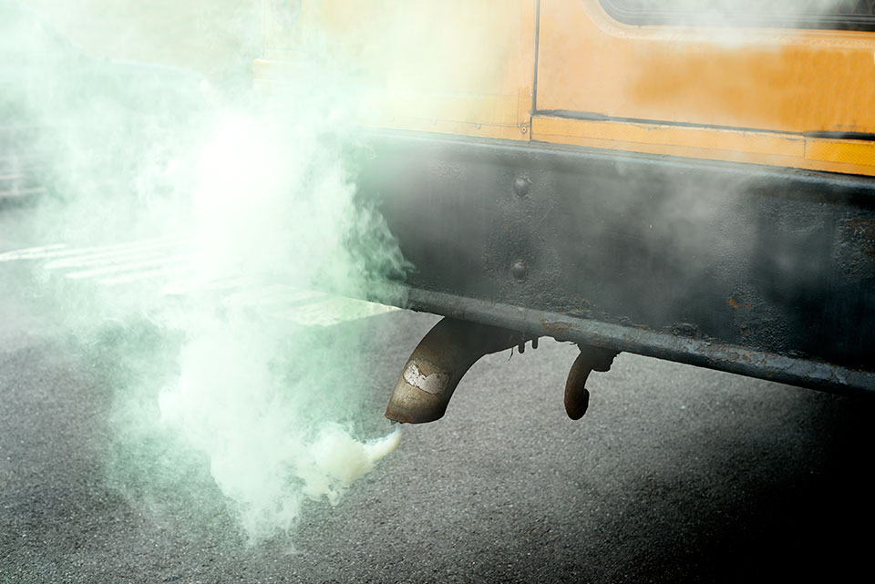
Notes:
Is this air good or bad for you? Would you like to breathe this air? Is it good or bad for the environment?

Slide 16



Slide 17




Slide 18




Slide 19
How do cars harm the environment?
Car exhausts give off nasty fumes that are harmful and dangerous.
They can also cause acid rain which damages plants and water supply.
These fumes are 1 of the major causes of global warming.
.
Cars can also be very noisy. Too many cars together is very loud!!
Fuel spills can be dangerous for other road users.

Slide 20
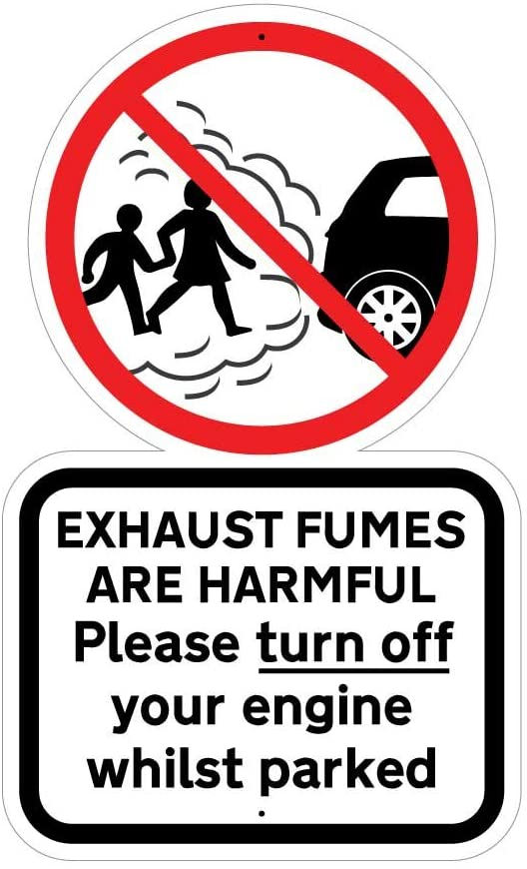
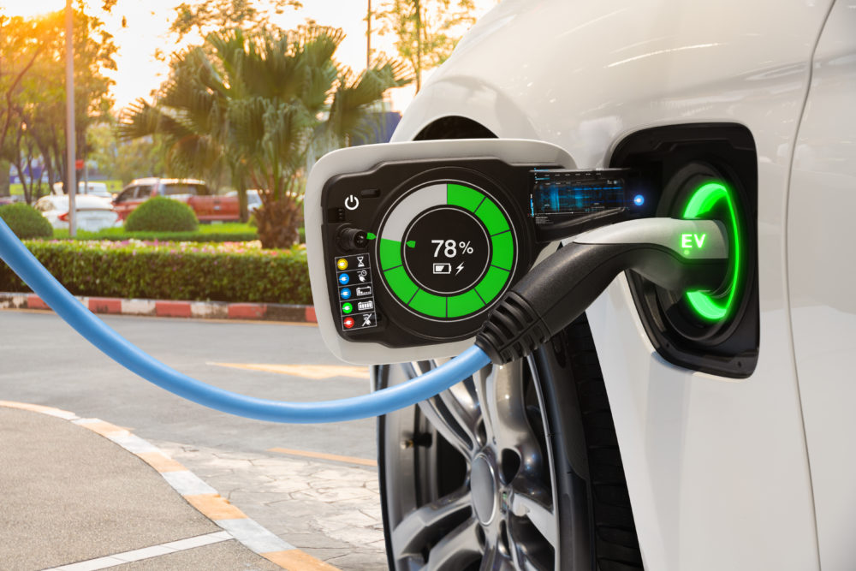
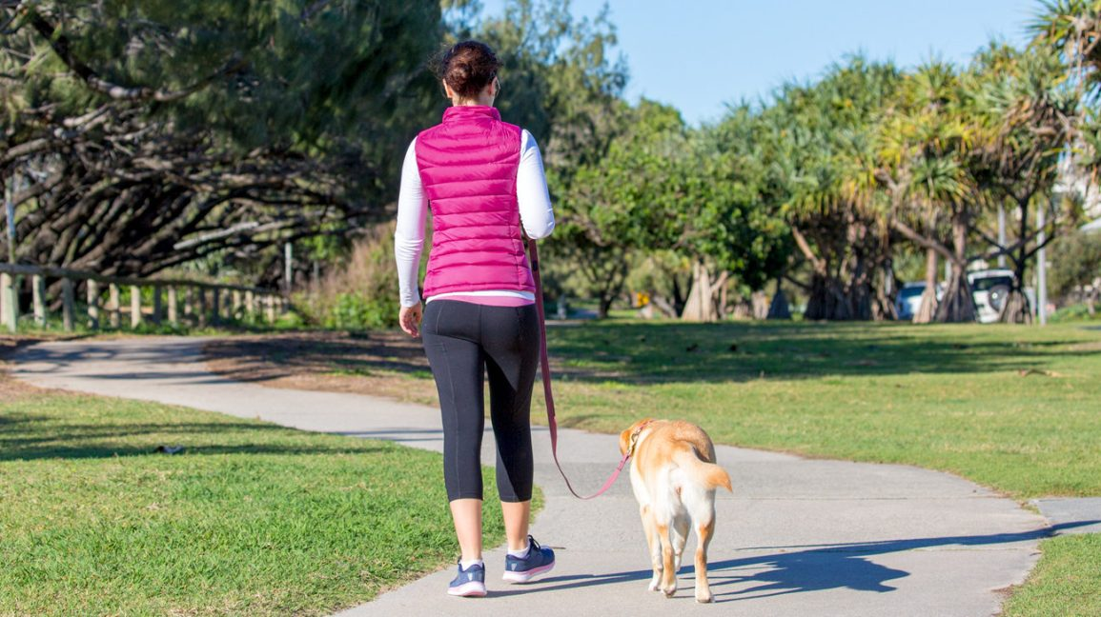

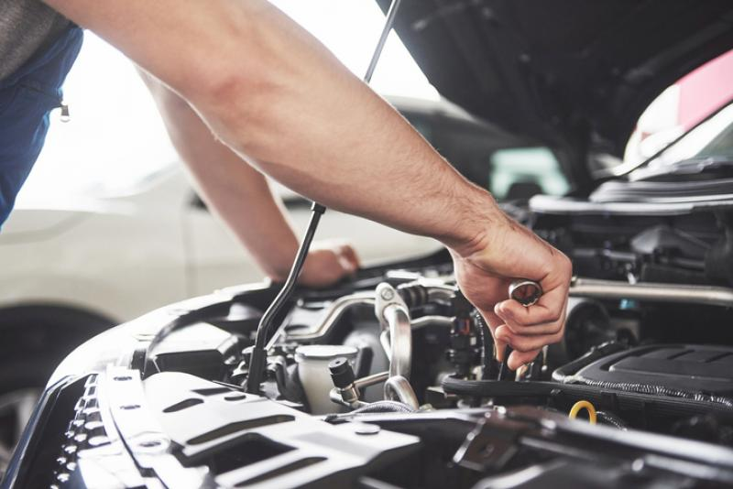
Reducing car pollution
Notes:
Switch your engine off if you’re going to be parked for a while. This will also help you to use less fuel, saving money.
Slower, steadier driving will help save fuel and reduce emissions.
Get your car serviced regularly, this should keep everything working as efficiently as it should.
Drive an electric or a hybrid car
If it’s a short journey, walk instead

Slide 21

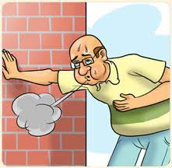

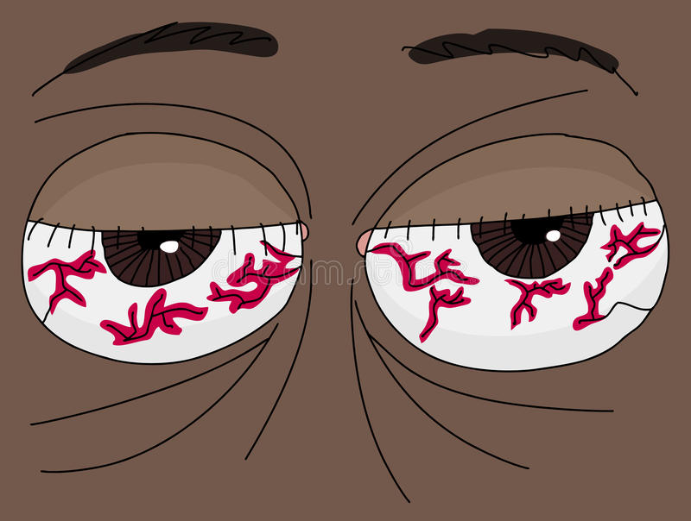
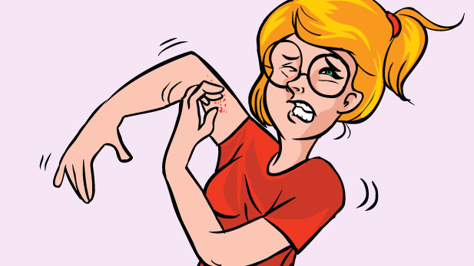
We suffer as well!!
.
Notes:
Car pollutants harm human health. Diesel engines emit high levels of airborne particles of soot and metal.
These cause skin and eye irritation and allergies, and very fine particles lodge deep in lungs, where they cause respiratory problems.
Air pollution has been linked to cancer, asthma, stroke and heart disease, diabetes, obesity and dementia either as a cause or as a complicating factor contributing towards premature death.

Slide 22
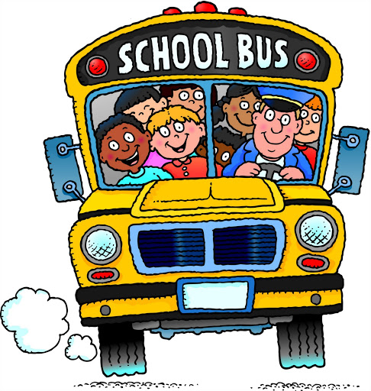

What is the least harmful form of transport?
Public transport is generally considered to be one of the better options when it comes to reducing the negative environmental impact of transport.
Taking a bus is better than taking a car or taxi.
Why do you think this is better form of transport?
Notes:
Bus full of people versus 1 person in on his own
Which is better for environment? Why?
Introduce idea of car sharing.

Slide 23
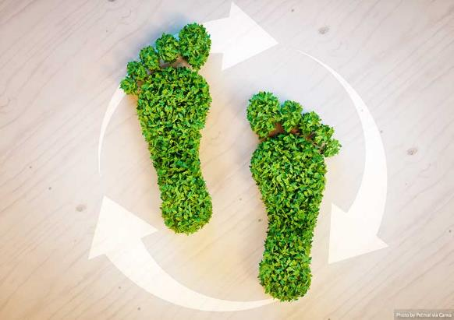
What is sustainable travel?
Sustainable Transport refers to any means of transport that is 'green' or has a low impact on the environment.
Sustainable travel is about looking after the environment and looking after our natural resources.
Sustainable transport is about balancing our current and future needs.

Slide 24

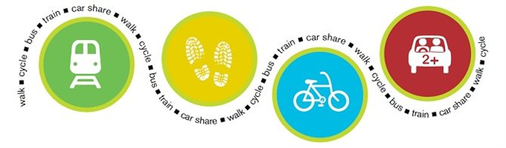
What is sustainable travel?
Examples of sustainable transportation include walking, cycling, carpooling, car sharing, and green vehicles.

Slide 25

SCOOT
SKATEBOARD
ROLLERBLADE
.
WALK
CYCLE

Slide 26
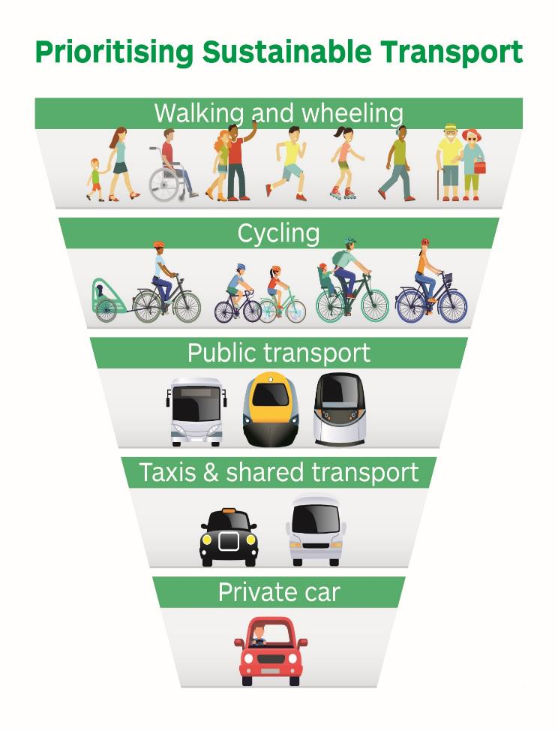


Slide 27
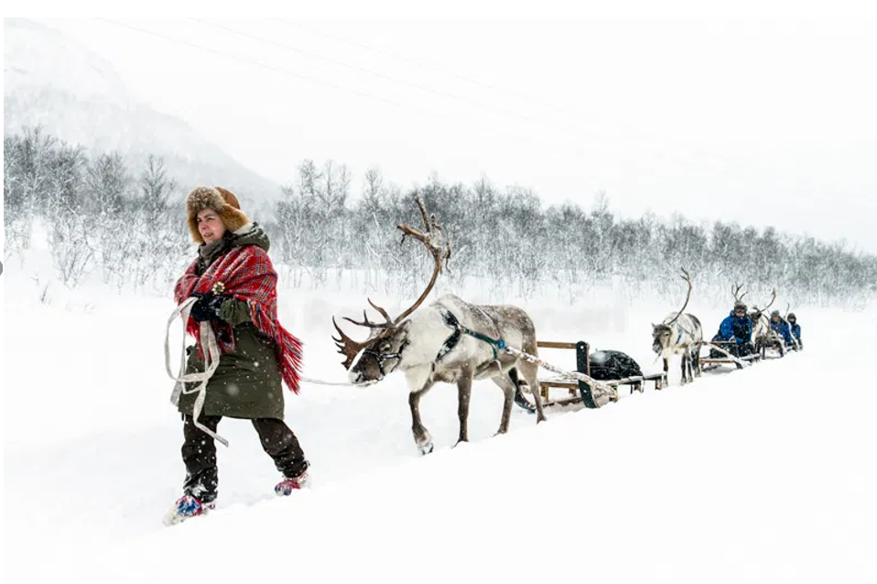
Sustainable travel around the world
Reindeer sledding in Finland is the oldest form of transport!!

Slide 28
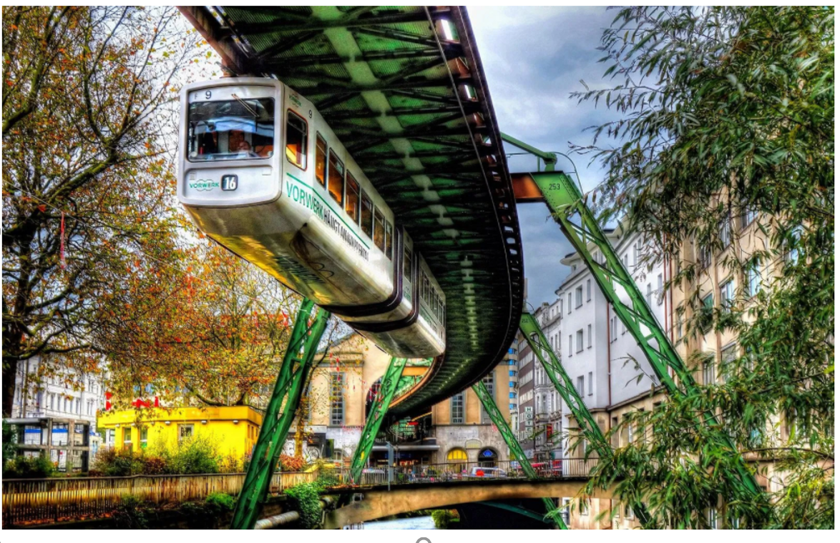
Suspension railway in Germany. It is the oldest elevated railway with hanging cars in the world and is a unique system.

Slide 29
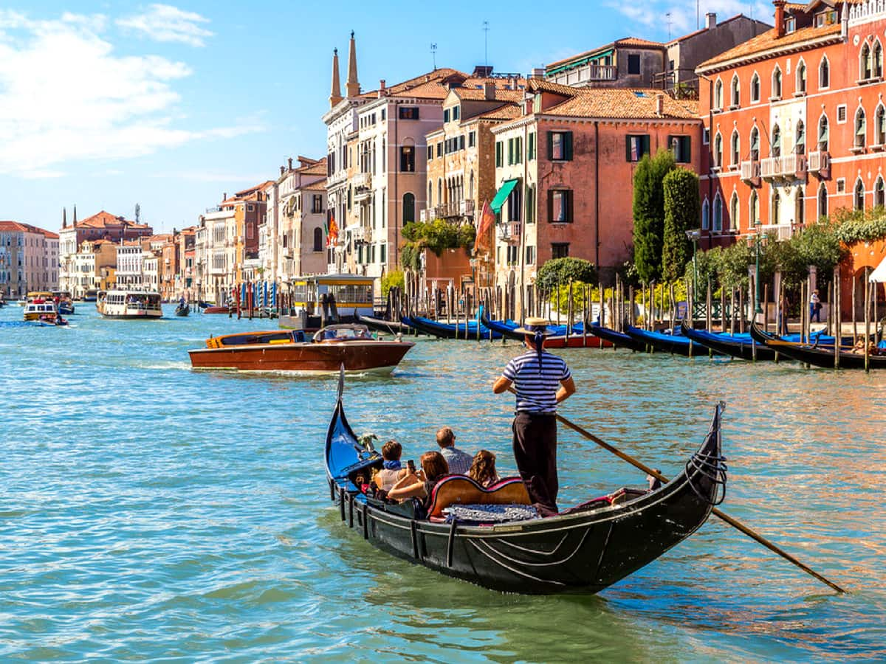
A traditional wood carved gondola in Venice. For centuries this was the main way to travel. There were over 10,000 in 18th century.

Slide 30
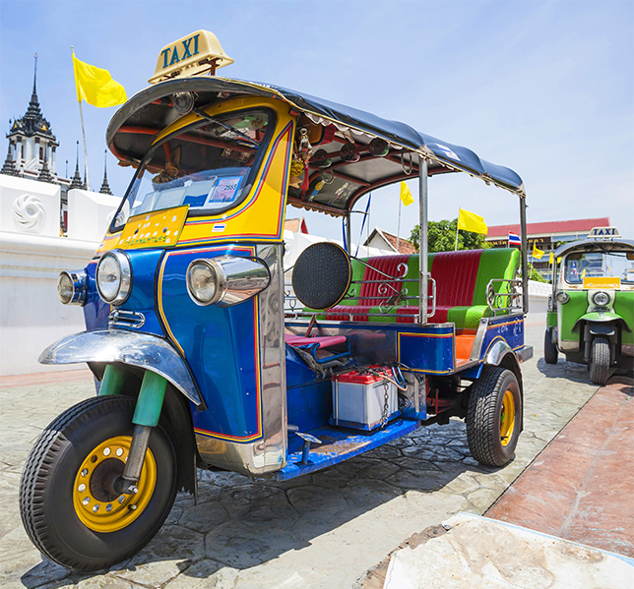
Tuk tuk in Thailand. It is a popular motor tricycle that has been around for 100 years.

