Slide 1




















Slide 2










WELCOME,
STUDENTS!

Slide 3













LESSON FOR THE DAY
KEY STAGE 4

Slide 4






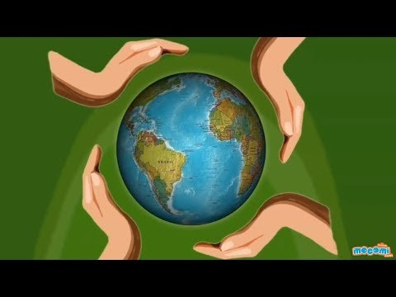


Let’s understand sustainability
CONCEPTS AND DEFINITIONS
We know what Energy is but do we understand what is the meaning of Energy Efficiency, Energy Conservation and Sustainable Energy?
The purpose of sustainability is to manage resources or run projects or industries, so future generations can use the resources too.
To meet the increasing global demand for energy, while reducing the risk of damage to the environment or contributing to global warming,
it is important that:
Countries find new types of energy, while developing and expanding existing sources that are more sustainable than fossil fuels.
Industry and domestic users of energy use it more efficiently
So let’s stop wasting it!

Slide 5
Water Conservation
Another energy we use and need to reduce is water.
Reducing our water usage saves water and also saves us money in the long term.
Water is a precious resource – but it can’t be taken for granted. Climate change, and the more extreme weather that comes with it, means that water supply is becoming more unpredictable than in years gone by.
Water is also intrinsically linked to energy. But most of us underestimate the energy water companies need to treat and pump water into homes.
Then there’s the energy required to produce hot water at home.
CONCEPTS AND DEFINITIONS
Sustainable Energy
Sustainable energy is, as defined by the National Science Foundation, the energy that every human can use without damage to the environment around them. Sustainable energy includes energy efficient products and renewable energy.

Slide 6
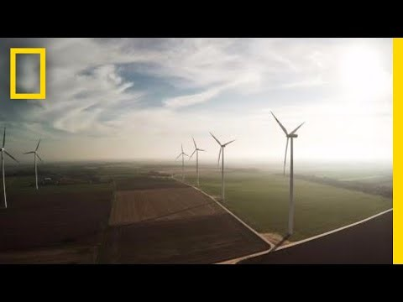
A key message
CONCEPTS AND DEFINITIONS
With a growing world population, the need for energy also continues to grow. That is why it is so important for us to save energy within our homes, at work, and at school whenever possible.
Energy conservation also cuts down on greenhouse gases that can contribute to climate change and reduces pollution in general. Even the simplest actions can have a big effect.
2 key CONCEPTS AND DEFINITIONS
Renewable Energy vs Fossil Fuels
Countries find new types of energy, while developing and expanding existing sources that are more sustainable than fossil fuels.

Slide 7
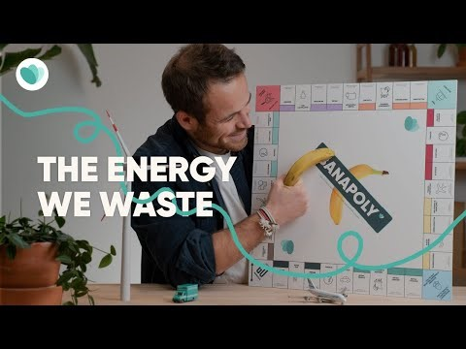
DID YOU KNOW?
There is a lot of energy required to transport food to us?
Watch this video and why not participating in the Trocaire Game Changers creating your own game just like the Banapoly in this video?
CONCEPTS AND DEFINITIONS
2 key CONCEPTS AND DEFINITIONS
Energy Efficiency
Industry and domestic users of energy use it more efficiently
https://www.youtube.com/watch?v=-nJj5x9ixeM
With energy consumption rising, it is important that industry, transportation and consumers in their homes use energy more efficiently, so that less is wasted.
This will also save money on fuel bills.
TIP OF THE DAY
This could be your actions to tackle Food Waste and for your Global Perspective topics

Slide 8

How to be more
energy efficient
CONCEPTS AND DEFINITIONS
By changing our behaviours and doing things like not using as much water to shower, sharing rides to school or work, even purchasing an electric or hybrid vehicle, you can help conserve these precious resources and help keep the environment cleaner.
Energy Efficiency and Energy Conservation
Energy conservation is the effort we make to reduce the consumption of energy by using less of an energy resource or service, and transitioning to clean, renewable energy.

Slide 9
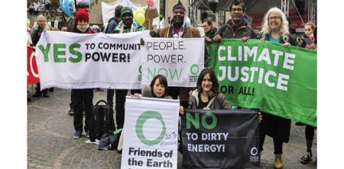
Our use and production of energy have a massive impact on the climate and the converse is also increasingly true. Climate change can alter our energy generation potential and energy needs. For example, changes to the water cycle have an impact on hydropower, and warmer temperatures increase the energy demand for cooling in the summer, while decreasing the demand for heating in the winter.
CONCEPTS AND DEFINITIONS
Energy Efficiency and Climate Change
Globally, the use of energy represents by far the largest source of greenhouse gas emissions from human activities. About two thirds of global greenhouse gas emissions are linked to burning fossil fuels for energy to be used for heating, electricity, transport and industry.

Slide 10
Our use and production of energy have a massive impact on the climate and the converse is also increasingly true. Climate change can alter our energy generation potential and energy needs. For example, changes to the water cycle have an impact on hydropower, and warmer temperatures increase the energy demand for cooling in the summer, while decreasing the demand for heating in the winter.
CONCEPTS AND DEFINITIONS
Climate Justice and Energy– ks5
Globally, the use of energy represents by far the largest source of greenhouse gas emissions from human activities. About two thirds of global greenhouse gas emissions are linked to burning fossil fuels for energy to be used for heating, electricity, transport and industry.

Slide 11


EXAMPLES AND ILLUSTRATIONS
What can we do to save energy? We can all help by making changes to our lifestyles and our houses - for example by:
Example 1
Example 2
Example 3
walking, cycling, or using public transport rather than fossil-fuel powered cars (our Translink Travel Challenge will guide you in this sustainable journey)
using energy-efficient light bulbs and rechargeable batteries
using smaller more energy-efficient cars
insulating house roofs, blocking drafts, using double-glazing and more efficient heating systems
considering introducing solar panels, or switching to an electricity supplier that supplies green electricity
REFUSING, REUSING and RECYCLING plastics and oil-based products
(SIGN OUR PLASTIC PLEDGE)
reducing the number of aircraft journeys taken (especially short-haul flights) – Calculate your CO2 and reduce your Carbon Footprint – Global Forest Fund
switching off lights, power sockets, phone chargers and televisions when not in use

Slide 12




EXERCISE
Provide this check list as exercise to practice in the classroom and at home
Use the worksheet provided to find out if you are good at saving energy.
The word document can be edited and adapted to your convenience.
Families can play together.

Slide 13

WORKSHEET
Dear Teenagers: Saving energy matters. It will help limit greenhouse gas emissions, which are a major factor in climate change and global warming. There are many simple actions that you can take in schools and at home to save energy.
As intelligent, thoughtful young people you are passionate about making a difference in our world.
Here’s your chance.
Note – Use the question below to encourage an interesting debate and to inspire to take actions
Question - How could you be cool?
Answer 1: When the outside temperature falls, don’t automatically turn up the central heating. Why not reach for a sweater instead of the thermostat? And don’t be embarrassed to put on those cosy slippers Grandma bought you.
Answer 2: Turn Off – list all items you could turn off.
Answer 3: Get around the green way – what transport alternatives do you have?
Answer 4: Boycott baths – a bit of research on this one.
Answer 5: Go veggie – If you help out with family meal preparation, suggest cutting down on meat.
Answer 6: Stop shopping…or at least cut down. New clothes, tablets and other consumer goods take energy to produce and transport to your local shopping centre, or to your home address when you order online. Do you really need so much stuff?
Answer 7: Check it out. Try suggesting this great idea to your classmates and Eco-Committee pals: an energy audit.

Slide 14

ACTIVITY TIME

Slide 15


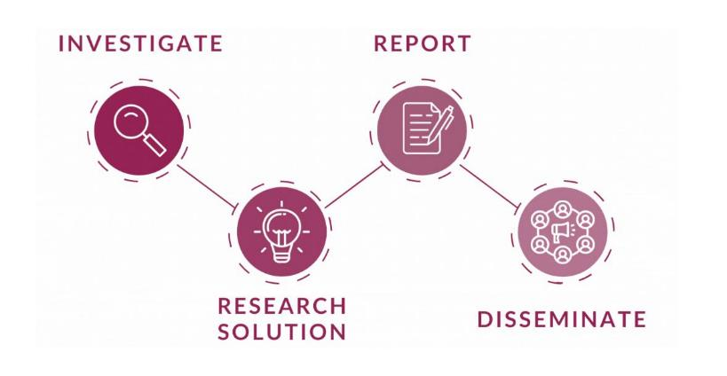
Activity
Young Reporters for the Environment (YRE)
Find out more about energy waste and energy saving by investigating the topic and have fun being a reporter enter the national and International competition
https://www.youtube.com/watch?v=5rtij3ygSk0
Visit our website for more info on the competition https://eco-schoolsni.etinu.net/cgi-bin/generic?instanceID=46

Slide 16
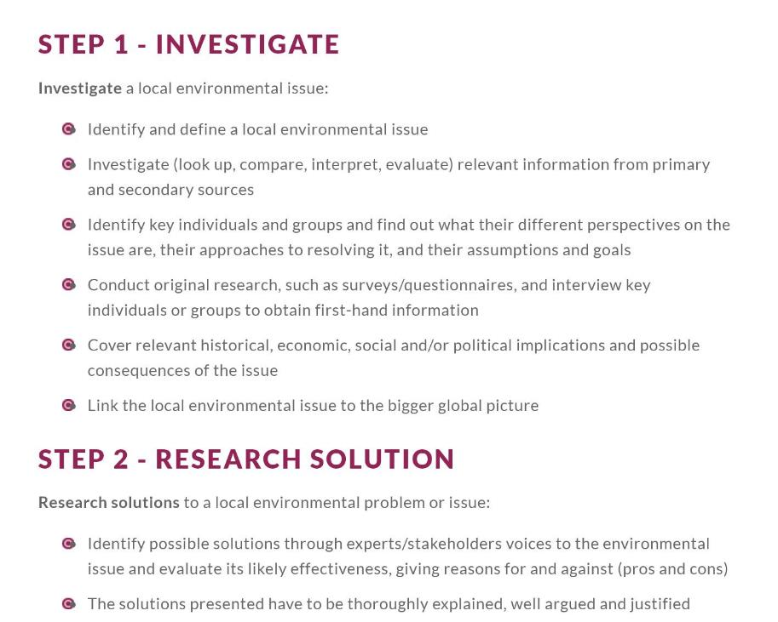
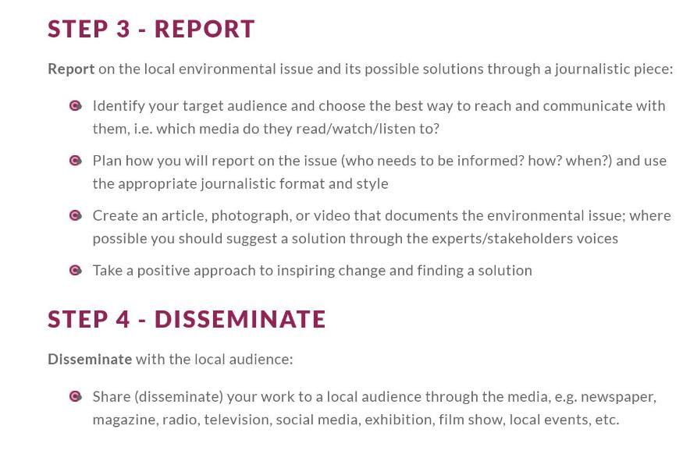
Activity
Young Reporters for the Environment
Visit Eco-Schools NI website for more info
https://eco-schoolsni.etinu.net/cgi-bin/generic?instanceID=46

Slide 17
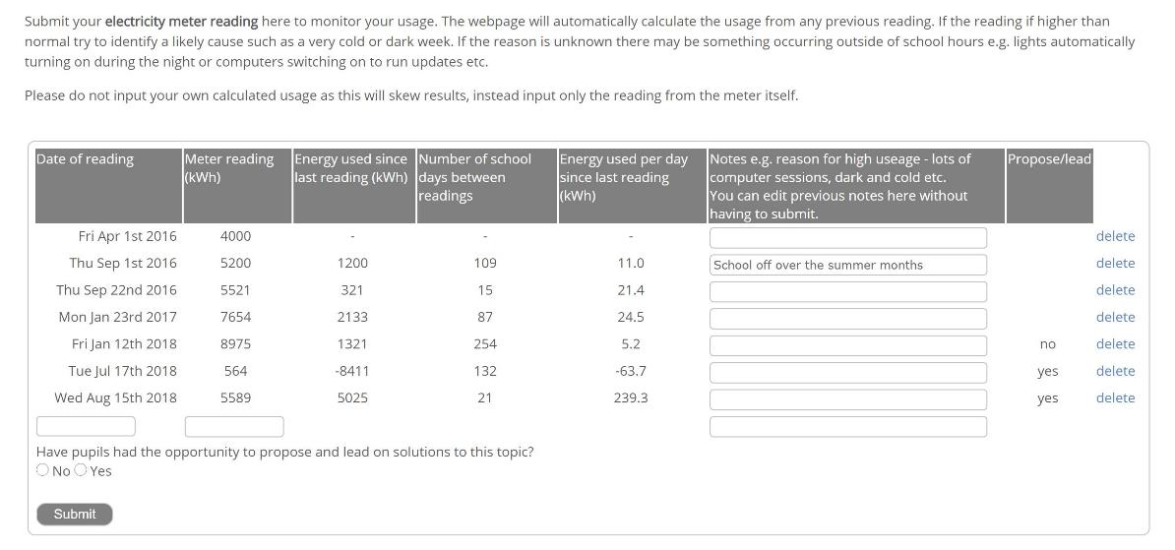
Activity
Start your Electricity audit and enter your data into your Data Zone – A classroom activity
If your school has solar panels submit readings from your solar panel display unit – access your data zone to get fill your form

Slide 18


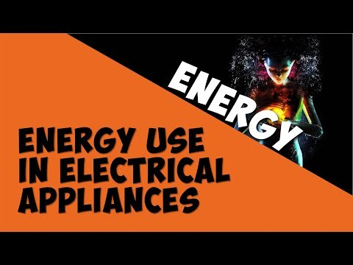
SUPPLEMENTAL VIDEO

Slide 19







ADDITIONAL RESOURCES
A series of creative activities themed around energy
Select KS4 to find the best suited resources for your pupils
https://energysparks.uk/activity_categories
Documentary highlights how mining and burning coal affects South Africahttps://vimeo.com/111593436
It's something they can easily look back on or search online in case they need a refresher.

