Slide 1



















Slide 2







WELCOME,
STUDENTS!

Slide 3










LESSON FOR THE DAY
KEY STAGE 1

Slide 4








SAVING ENERGY
Saving energy means you spend less money on school and household bills.
It also has a positive impact on the environment.
In turn, that helps contribute to a happier, healthier planet for everyone.
CONCEPTS AND DEFINITIONS
What is energy?
Before kids can understand why saving energy is important
they need to understand what energy is!
Energy is another word for power.
Energy makes things move.
It makes machines work.
Energy also makes living things grow.

Slide 5
SAVING ENERGY
Saving energy means you spend less money on school and household bills.
It also has a positive impact on the environment.
In turn, that helps contribute to a happier, healthier planet for everyone.
CONCEPTS AND DEFINITIONS
Did you know?
Water is energy too - Conserving water is a big part of conserving energy.
Some devices use energy even when they are not on – can you think of any?
Answer: kettle, phone charger, lamps, fans, etc.

Slide 6
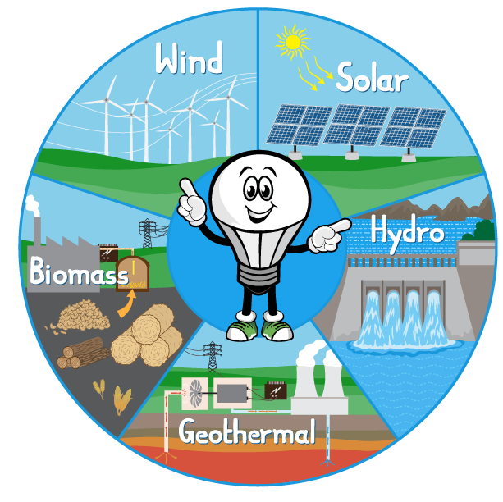
Why don't we use renewable energy all the time?
Unlike natural gas and coal, we can't store up wind and sunshine to use when we need to make more electricity.
If the wind doesn't blow or the sun hides behind clouds, there sometimes isn’t enough power for everyone.
Scientists are working to develop ways to store renewable energy.
CONCEPTS AND DEFINITIONS
What is renewable energy
Renewable energy is made from resources that nature will replace, like wind, water and sunshine.
Renewable energy is also called "clean energy" or "green power" because it doesn't pollute the air or the water.

Slide 7

EXAMPLES AND ILLUSTRATIONS
What can we do to save energy?
Example 1
Example 2
Example 3
Switch off the lights when you leave a room
Open the curtains during the day to let natural light in
Turn off the tap when you are not using it. For example when you are brushing your teeth or washing your hands (this does not mean skimping on your hand-washing time!)
Put on a jumper and thick socks instead of turning the heating on
Close the door behind you when you come inside

Slide 8




EXERCISE
Provide this check list as exercise to practice in the classroom and at home
Use the worksheet provided to find out if you are good at saving energy.
The word document can be edited and adapted to your convenience.
Families can play together.

Slide 9
Question 2: Can you keep track of all actions to save energy you take in a week?
WORKSHEET
Answer 2: Create a tally board with pupils’ names and 3-4 actions to save energy and track their progress
Based on the list of examples previously shown, here are answers to the following questions
Question 1: Can you suggest any other example of good practices to save energy?
Question 3: How many renewable energy sources do you know?
Answer 1:
Answer 3: Wind Power; Solar Power; Geothermal; Biomass; Hydro Energy
Answer 1: Switch off the television and any consoles when you are not using them.
Use the shut down function on your computers and laptops.
Turn off or unplug electric items when you are finished with them.

Slide 10

ACTIVITY TIME

Slide 11
Activity Time

Slide 12
Activity Time
This game can be done as a role-playing game in the classroom.
Your pupils will pretend to be at home.
They will then repeat the game at home with their family.
Cut out this spinner to play.
Place a paper clip on the point of the pencil and place the point of the pencil (with the paper clip) in the small white circle in the middle of the spinner.
Fling the paper clip around.
It will land on one of the sections of the spinner.
Read the comment and act accordingly.
Everyone should have a paper clip, eraser, a piece of paper with their name on it or something else small to use as their playing piece.
Now spin.
If the paper clip dial lands on an energy conservation tip, move forward two spaces
If the paper clip dial lands on something that uses energy, move back one space
The first player to come to the end wins the game.

Slide 13

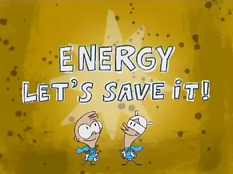
SUPPLEMENTAL VIDEO

Slide 14
Activity Time

Slide 15

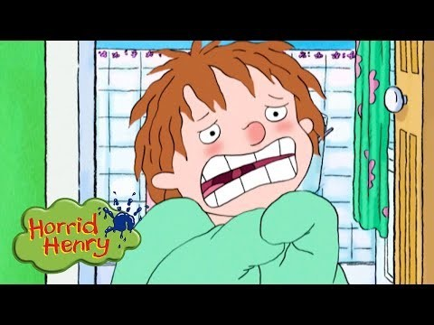
ADDITIONAL RESOURCES
Horrid Henry - Energy Saving
Cartoons For Children
https://www.youtube.com/watch?v=9t5QpuueZ_k
https://www.eco-schoolsni.org/eco-schoolsni/documents/006528.pdf
https://www.eia.gov/kids/games-and-activities/

