Slide 1



















Slide 2








WELCOME,
STUDENTS!

Slide 3











LESSON FOR THE DAY
KEY STAGE 2

Slide 4








SAVING ENERGY
Saving energy means you spend less money on school and household bills.
It also has a positive impact on the environment.
In turn, that helps contribute to a happier, healthier planet for everyone.
CONCEPTS AND DEFINITIONS
What is energy?
Before kids can understand why saving energy is important
they need to understand what energy is!
Energy is another word for power.
Energy makes things move.
It makes machines work.
Energy also makes living things grow.

Slide 5
SAVING ENERGY
Saving energy means you spend less money on school and household bills.
It also has a positive impact on the environment.
In turn, that helps contribute to a happier, healthier planet for everyone.
CONCEPTS AND DEFINITIONS
Did you know?
Water is energy too - Conserving water is a big part of conserving energy.
Some devices use energy even when they are not on – can you think of any?
Answer: kettle, phone charger, lamps, fans, etc.

Slide 6
Why don't we use renewable energy all the time?
CONCEPTS AND DEFINITIONS
Unlike natural gas and coal, we can't store up wind and sunshine to use when we need to make more electricity.
If the wind doesn't blow or the sun hides behind clouds, there sometimes isn’t enough power for everyone.
Scientists are working to develop ways to store renewable energy.
What is renewable energy
Renewable energy is made from resources that nature will replace, like wind, water and sunshine.
Renewable energy is also called "clean energy" or "green power" because it doesn't pollute the air or the water.

Slide 7

How to be more
energy efficient
CONCEPTS AND DEFINITIONS
By changing our behaviours, and doing things like not using as much water to shower, sharing rides to school or work, even purchasing an electric or hybrid vehicle, you can help conserve these precious resources and help keep the environment cleaner.
Energy Efficiency and Energy Conservation
Energy conservation is the effort we make to reduce the consumption of energy by using less of an energy resource or service, and transitioning to clean, renewable energy.

Slide 8

EXAMPLES AND ILLUSTRATIONS
What can we do to save energy?
Example 1
Example 2
Example 3
Switch off the lights when you leave a room
Open the curtains during the day to let natural light in
Turn off the tap when you are not using it. For example when you are brushing your teeth or washing your hands (this does not mean skimping on your hand-washing time!)
Put on a jumper and thick socks instead of turning the heating on
Close the door behind you when you come inside

Slide 9


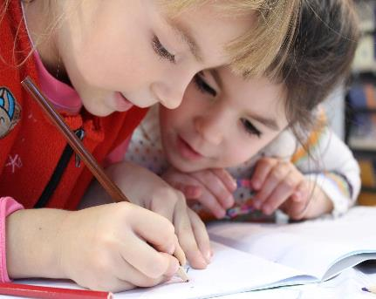

EXERCISE
Provide this check list as exercise to practice in the classroom and at home.
Use the worksheet provided to find out if you are good at saving energy.
The word document can be edited and adapted to your convenience.
Families can play together.

Slide 10

Question 2: Can you keep track of all actions to save energy you take in a week?
Some Questions
Answer 2: Create a tally board with pupils’ names and 3-4 actions to save energy and track their progress.
Question 1: Can you suggest any other example of good practices to save energy?
Answer 1: Switch off the television and any consoles when you are not using them.
Use the shut down function on your computers and laptops.
Turn off or unplug electric items when you are finished with them.
Question 3: How many renewable energy sources do you know?
Answer 3: Wind Power; Solar Power; Geothermal; Biomass; Hydro Energy.

Slide 11

ACTIVITY TIME

Slide 12
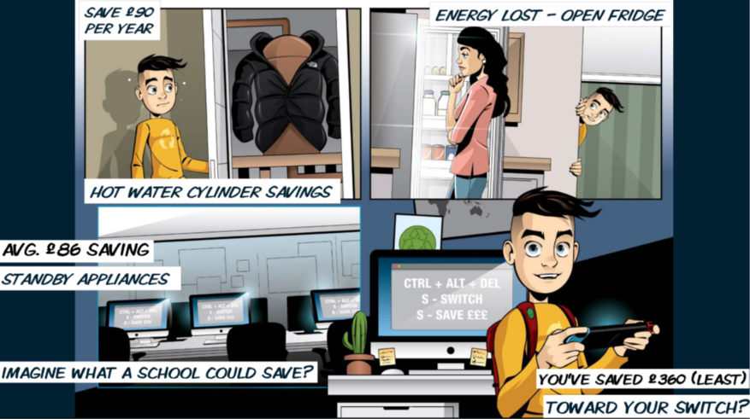
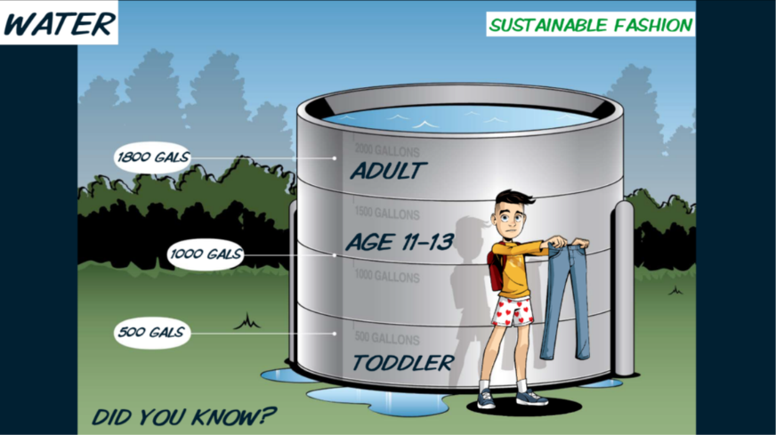
Complete the Energy Efficiency Competition by creating an eco-hero
Activity Time
visit our website (link below) and download the presentation with instructions on this activity
https://issuu.com/cowles_g/docs/competition_details_final_2021_-_plus_seeap_pres
https://www.eco-schoolsni.org/cgi-bin/generic?instanceID=53

Slide 13
Activity Time

Slide 14
Activity Time

Slide 15
Activity Time
This game can be done as role-playing game in the classroom.
Your pupils will pretend to be at home.
They will then repeat the game at home with their family.
Cut out this spinner to play.
Place a paper clip on the point of the pencil and place the point of the pencil (with the paper clip) in the small white circle in the middle of the spinner.
Fling the paper clip around.
It will land on one of the sections of the spinner.
Read the comment and act accordingly.
Everyone should have a paper clip, eraser, a piece of paper with their name on it or something else small to use as their playing piece.
Now spin.
If the paper clip dial lands on an energy conservation tip, move forward two spaces
If the paper clip dial lands on something that uses energy, move back one space
The first player to come to the end wins the game.

Slide 16
Activity Time

Slide 17


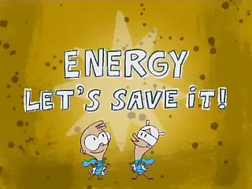
SUPPLEMENTAL VIDEO

Slide 18




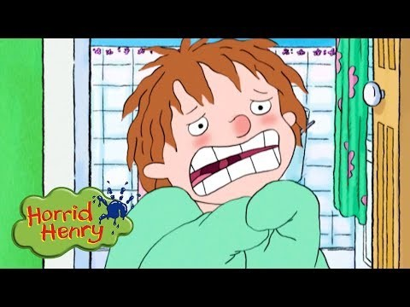
ADDITIONAL RESOURCES
Duplicate this page as many times as needed to give you more space for discussion.
https://www.eia.gov/kids/games-and-activities/
A series of creative activities themed around energy
Select KS3 to find the best suited for your pupils
https://energysparks.uk/activity_categories
Horrid Henry - Energy Saving
Cartoons For Children
https://www.youtube.com/watch?v=9t5QpuueZ_k
https://www.eco-schoolsni.org/eco-schoolsni/documents/006528.pdf

