Slide 1



















Slide 2







WELCOME,
STUDENTS!

Slide 3






MATERIALS NEEDED FOR CLASS
List the things your students need to get ready before class. It can be a particular textbook, the accomplished homework due for the day, or any specific materials for the topic you're about to discuss. You can also match it with corresponding photos or icons.

Slide 4







CLASS OBJECTIVES AND RULES
Objectives inform students the learning outcomes of the class. What will they know? What will they be able to do? Why is this important to know? It's an effective way to assess their learning progress.
Rules provide the structure necessary for an engaging and productive class. Keep it simple and easy to follow. It can be general to cover different situations or very specific to your students.

Slide 5




LESSON FOR THE DAY
FOUNDATION STAGE

Slide 6








SAVING ENERGY
Saving energy means you spend less money on school and household bills.
It also has a positive impact on the environment.
In turn, that helps contribute to a happier, healthier planet for everyone.
CONCEPTS AND DEFINITIONS
What is energy?
Before kids can understand why saving energy is important
they need to understand what energy is!
Energy is another word for power.
Energy makes things move.
It makes machines work.
Energy also makes living things grow.

Slide 7
SAVING ENERGY
Saving energy means you spend less money on school and household bills.
It also has a positive impact on the environment.
In turn, that helps contribute to a happier, healthier planet for everyone.
CONCEPTS AND DEFINITIONS
Did you know?
Water is energy too - Conserving water is a big part of conserving energy.
Some devices use energy even when they are not on – can you think of any?
Answer: kettle, phone charger, lamps, fans, etc.

Slide 8

EXAMPLES AND ILLUSTRATIONS
What can we do to save energy?
Example 1
Example 2
Example 3
Switch off the lights when you leave a room
Open the curtains during the day to let natural light in
Turn off the tap when you are not using it. For example when you are brushing your teeth or washing your hands (this does not mean skimping on your hand-washing time!)
Put on a jumper and thick socks instead of turning the heating on
Close the door behind you when you come inside

Slide 9
WORKSHEET
Based on the list of examples previously shown, here are answers to the following questions
Question 1: Can you suggest any other example of good practices to save energy?
Question 2: Can you keep track of all actions to save energy you take in a week?
Answer 1: Switch off the television and any consoles when you are not using them.
Use the shut down function on your computers and laptops.
Turn off or unplug electric items when you are finished with them.
Answer 2: Create a tally board with pupils’ names and 3-4 actions to save energy and track their progress

Slide 10

ACTIVITY TIME

Slide 11

Activity Time
Play “I spy” an energy waste item.
All kids love the game “I spy”, so why not try it with a power saving twist?
So rather than spying something starting with a letter, your kids will be given the challenge of spying the energy sucks in the classroom and in the house.
Lights left turned on in an unused room
Technology and appliances still plugged into the socket.
And for their energy saving efforts a nice little reward is always the way to go.

Slide 12
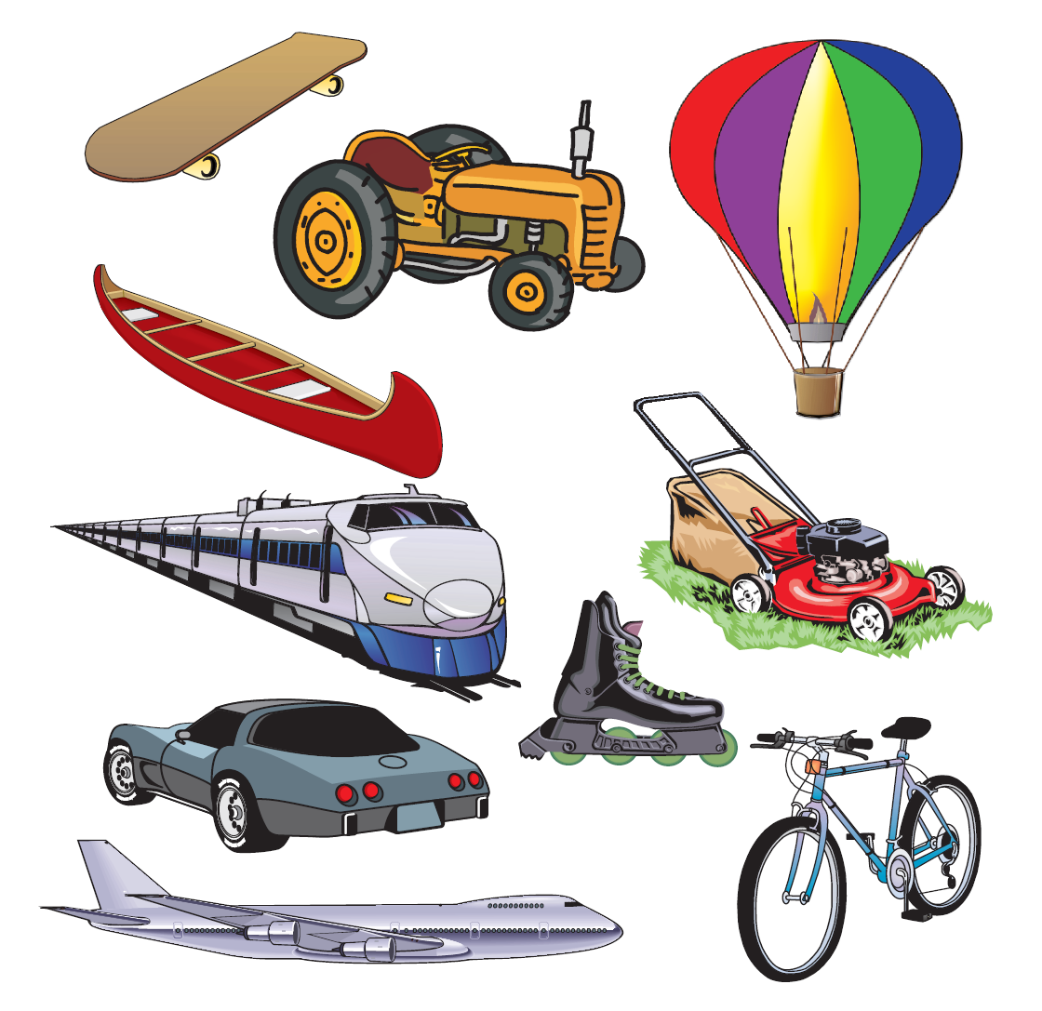
Activity Time
Energy in Motion
Make a circle around the objects that burn fuel to move.
Make an X through the objects that need people power to move.

Slide 13


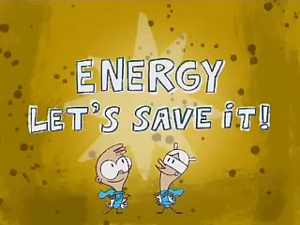
SUPPLEMENTAL VIDEO

Slide 14

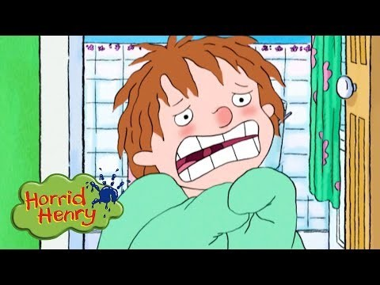
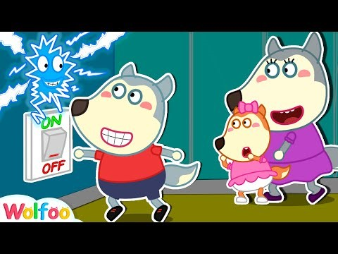
ADDITIONAL RESOURCES
Horrid Henry - Energy Saving
Cartoons For Children
https://www.youtube.com/watch?v=9t5QpuueZ_k
Yes Yes Save Energy!
Wolfoo Learns Good Habits for Kids https://www.youtube.com/watch?v=uyY_sYTmKn0

