Slide 1



Notes:
Welcome to the Wheelie Big Challenge from Eco-Schools supported by Belfast City Council

Slide 2

Wheelie’s Lessons
learn and think
Wheelie Big Actions
research and act
Wheelie Big Competition
report, display and win!
Notes:
The Challenge is in 3 parts.

Slide 3
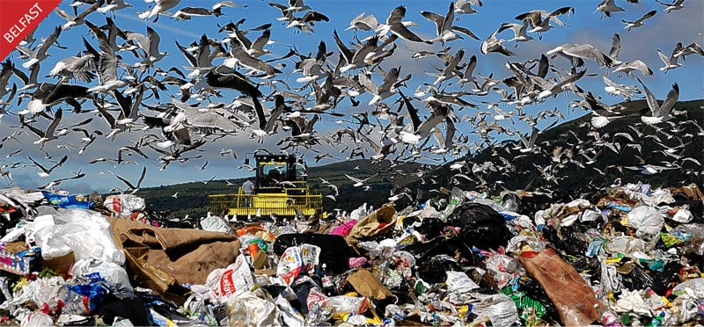
What is Waste?
Waste is rubbish that goes to landfill (the dump)
Notes:
What is waste? – for this challenge we are talking about our rubbish that goes to landfill and is not recycled.

Slide 4


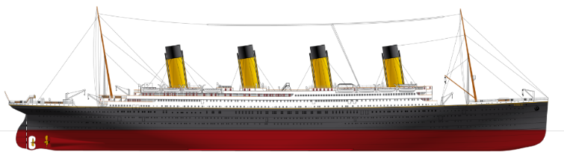
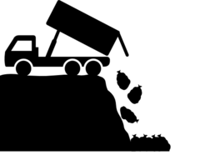
People in Belfast send waste heavier than the Titanic to landfill each year!
We recycle less than we send to landfill so we need to do much better!!
Notes:
The Titanic weighed 46,000 tonnes. People in Belfast send 49,000 tonnes to landfill each year. That’s 3000 tonnes more than the Titanic weighed!
We recycle around 40% of our waste in Belfast – but we could recycle around 70% - so although this is a good improvement it could be better.

Slide 5
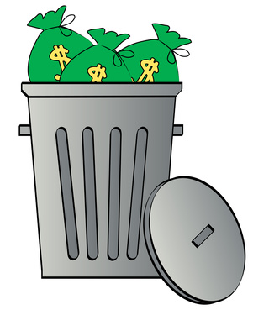

That’s a lot of waste!
Why should we care?
Because it costs money
and it’s bad for the environment
(plants and animals).
Notes:
Disposing of waste costs the tax payer and your council a lot of money. That money could be spent on better things like parks and leisure facilities. Landfill sites are also very bad for the environment, as well as being unsightly, they cause litter and air pollution, harm wildlife and contribute to global warming.

Slide 6
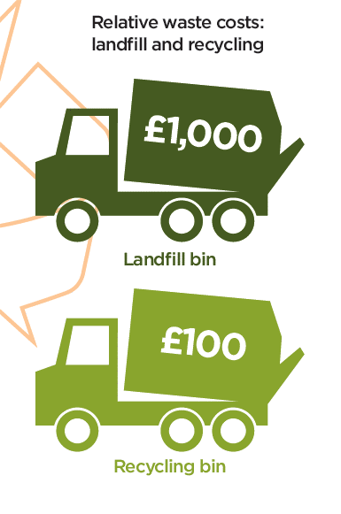
Black bin landfill waste costs nearly 10 times more than recycling.
Black Bin Waste > Landfill costs £1000 / lorry to dispose of.
Recycling Box/Bin > Recycling costs £100 / lorry to recycle.
Notes:
Landfill taxes are increasing all the time which means that disposing of waste this way is expensive. Landfill taxes will cause the cost of a lorry of waste to landfill to increase to £1000 in April 2015. Recycling is a much better option for the environment an our purse strings as it provides a valuable resource for manufacturers and is cheaper than producing new products from raw materials.

Slide 7
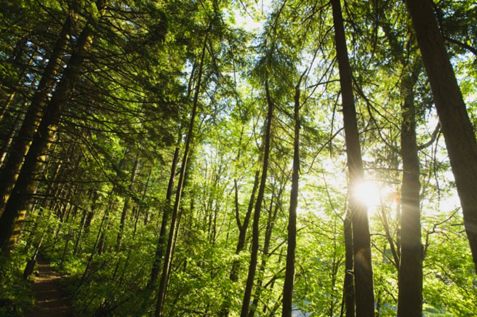
What is paper made from?
TREES
Notes:
Paper is made from trees. The UK needs a forest roughly the size of Wales to meet its paper usage each year.

Slide 8
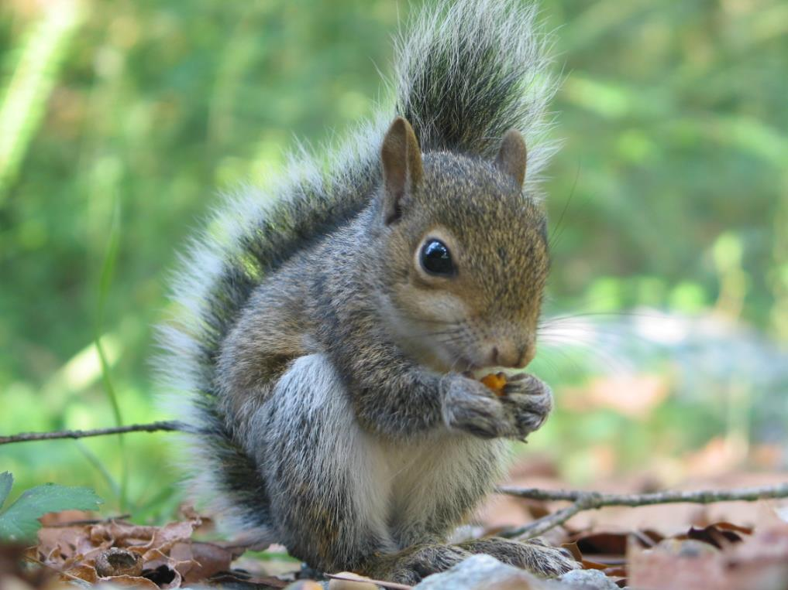
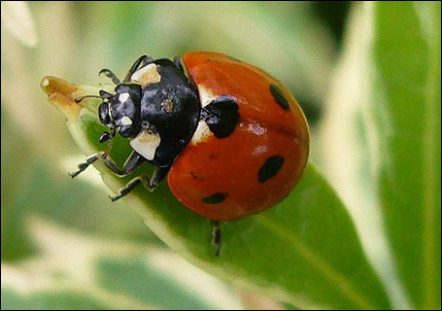
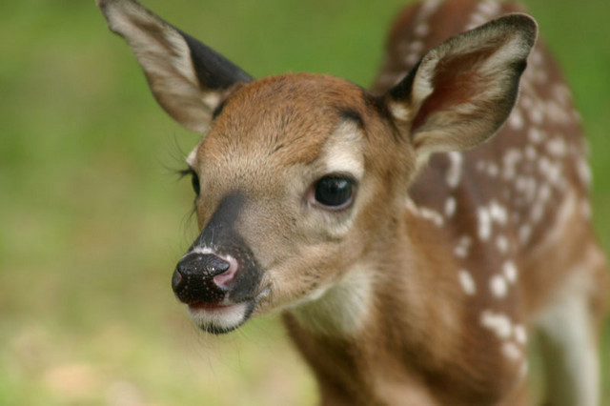
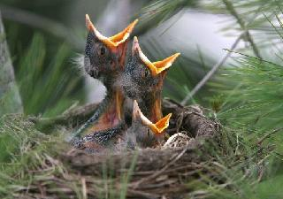
What sort of animals
live in forests?
Notes:
By removing the trees, we take away homes and food for animals such as squirrels, birds. Can you think of any other animals that depend on trees?

Slide 9
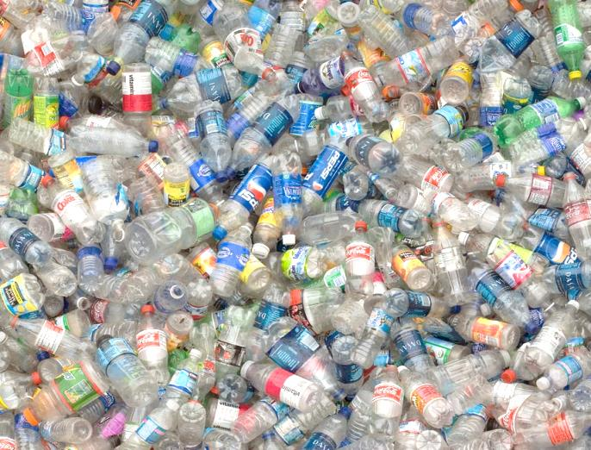
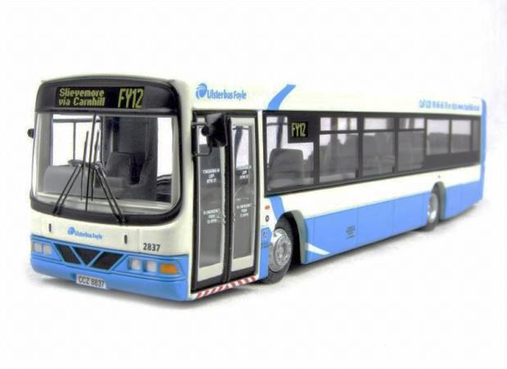
Too many plastic bottles!
when squashed fill 200 Ulster buses.
200
Every person uses on around 95 plastic bottles each year.
Notes:
Over 250 million plastic bottles are thrown out each year in Northern Ireland.
We use a huge amount of plastic bottles every year – have the pupils think of everything they buy plastic in – shampoo, drinks, milk, household cleaners, toiletries, medicine etc. Are we too blasé about how many bottles we use?

Slide 10
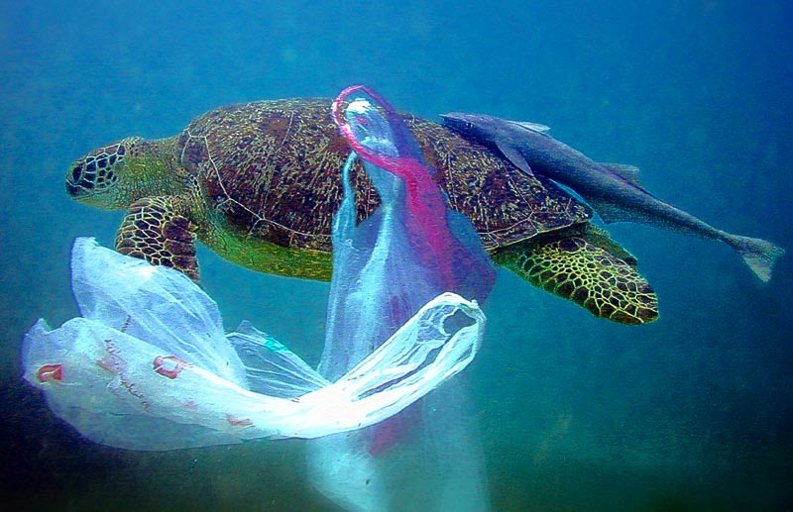
Animals eat plastic or get stuck in it.
Notes:
Plastic takes a long time to breakdown and hurts wildlife who eat it or get stuck in it.

Slide 11
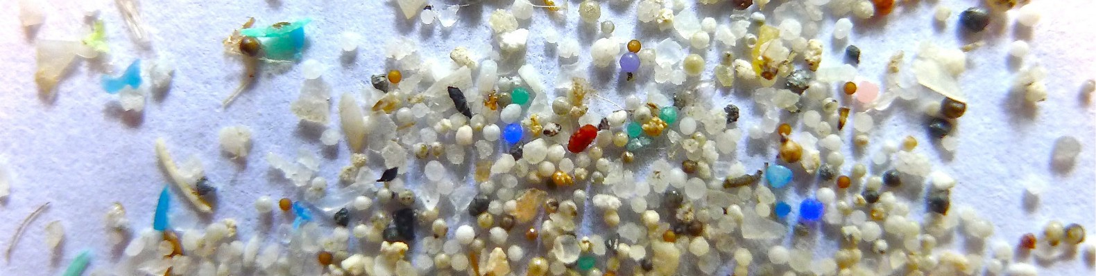
Plastics breaks down into tiny pieces that fish and other creatures eat.
Notes:
Plastic takes a long time to breakdown and hurts wildlife who eat it or get stuck in it.

Slide 12

What can we do?
Notes:
The 3 R’s are important if we are to become a sustainable society – but which is best?

Slide 13


is the best option
Use less paper
  write/print on both sides
Use less plastic
  less packaging
  reuse bottles
Save the environment
Save money
Notes:
Reduce is always the best option because it will use less natural resources and less energy in the first place. Also there is a limit to recycling. Paper can only be recycled around 7 times before the fibres lose their structure so fresh wood pulp will always be needed in paper production. The world would run out of paper in around 3 months if we did not introduce fresh wood pulp into the process. Plastic bottles are not recycled into more bottles. Plastic loses some structural integrity in the recycling process and is commonly ‘down-cycled’ into other products like car dashboards, household items, plastic lumber, clothing etc.

Slide 14

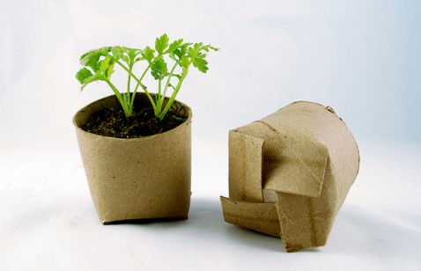
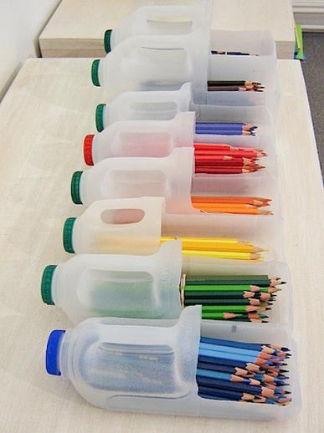
Put scrap paper trays in classrooms
Refill a drinks bottle to help the environment!
Notes:
Reusing is important too – can the pupils think of ways they could reuse materials at home and at school. Encourage them to think of materials as a valuable resource and not just to be thrown away.

Slide 15
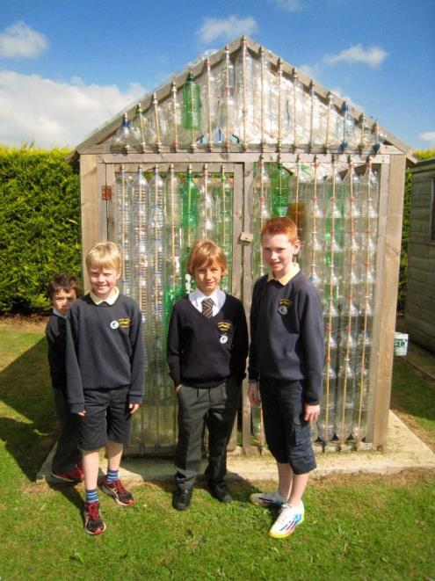
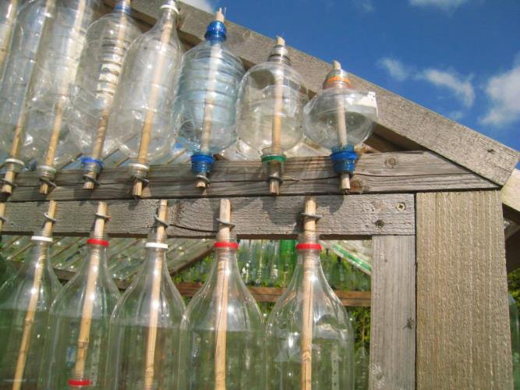
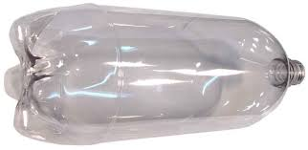
Lots of schools are making their own greenhouses from plastic bottles.
This one is at Limavady Primary School.
You would need around 200 2 litre bottles and a wooden frame to attach them to.
www.ecofriendlykids.co.uk/build-greenhouse-plastic-bottles
Notes:
This is a great project to get the whole school community involved in and really raises awareness of reusing plastic in a practical way which results in a really useful addition to your school grounds and eco-work. Check out http://www.ecofriendlykids.co.uk/build-greenhouse-plastic-bottles.html for more hints and tips.

Slide 16
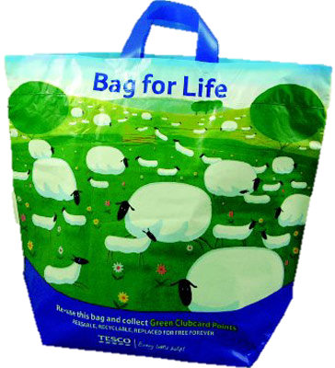
Use a reusable shopping bag
Remember to use your bag!!
Notes:
The first phase of the bag levy in 2013 was very successful and caused a massive reduction in single use carrier bags being used, as well as raising money for environmental projects through the Challenge Funds. The second phase will introduce a small 5p levy on cheap reusable bags (those costing less than 20p) to encourage shoppers to actually reuse their bags and not buy new ones each time they go to the shop.
The second phase of the bag levy is coming in January 2015. Remember to use your bag!!

Slide 17

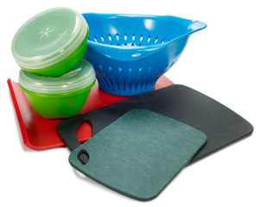
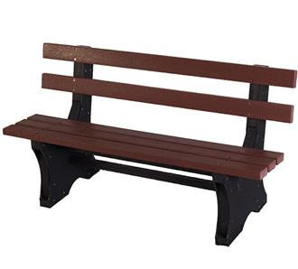
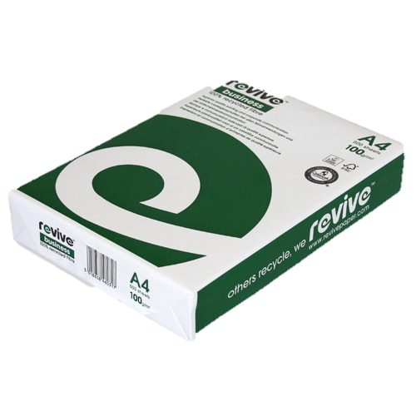
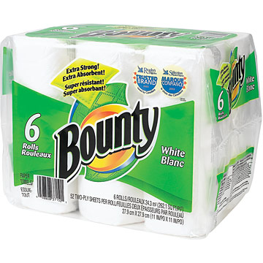
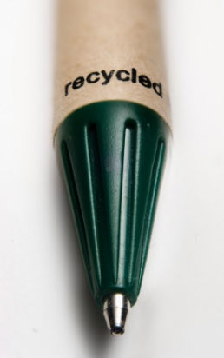
New products
can be
made from
recycled paper
and plastic
Notes:
Can the pupils think of any other products they have commonly seen made from recycled materials.

Slide 18
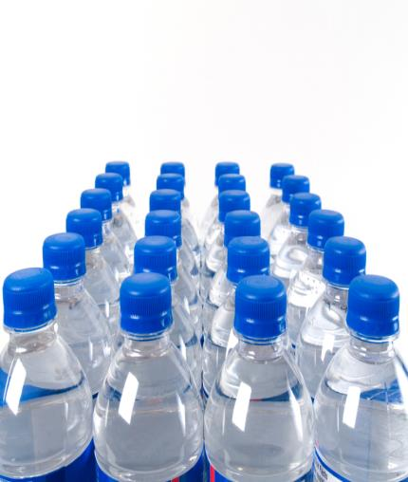
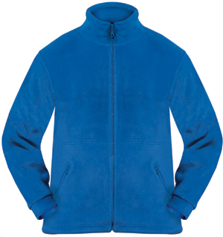
Did you know?
25 recycled plastic bottles can make one fleece jacket.
Notes:
Plastic fibres can be spun into fabric and used to make fleeces and sports wear. Lots of big sports clubs now advertise the fact that their kit is made from recycled materials (for example Manchester United). Puma have launched a recycled and biodegradable range of sports clothing.

Slide 19
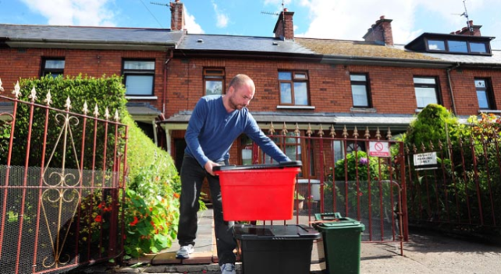
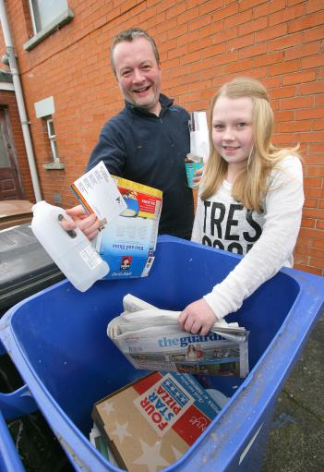
Do you know where your recycling bin is at school?
What colour is your
recycling bin at home?
www.belfastcity.gov.uk/waste
Notes:
Ask the pupils what sort of bins they have at home. It’s possible that there is a selection of different things happening at home depending on location and collection routes. Information can be found on your local council website about collections and what can go into which bin.

Slide 20
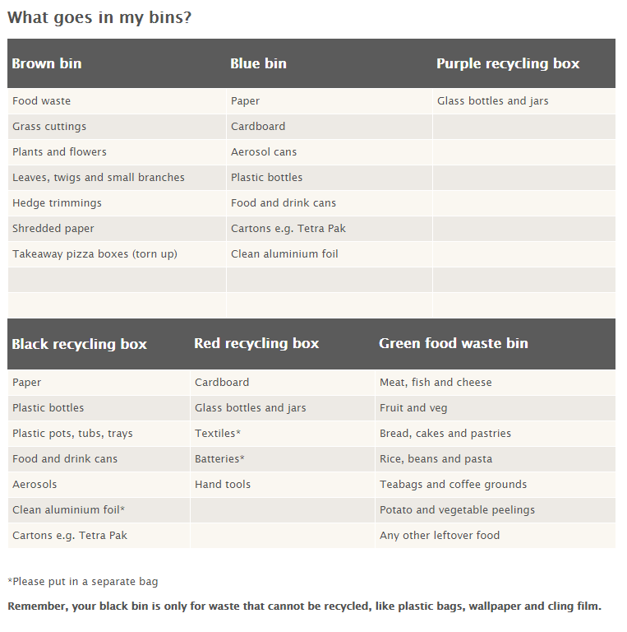


Notes:
This information is from the Belfast City Council website where there is lots of helpful advice on recycling at home.

Slide 21
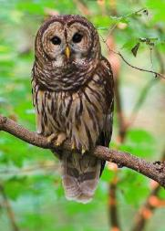
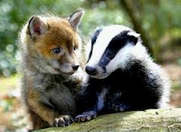
Tree Home Activity
Using scrap paper, magazines and newspapers make a big tree shape for display on the wall.
Pupils can then create their favourite creature that lives in the forest.
Put the creatures in and around the tree
Why is it important to look after our tree?
What can we do to help?
Notes:
It is best to use recycled materials for this task. The important message is that trees are precious and by reducing and recycling our paper usage we are helping to protect trees.

Slide 22


Home Actions
1. Have a sneak peek into the waste bin at home. Is there stuff in there that could be recycled?
2. Visit the Belfast City Council website http://www.belfastcity.gov.uk/bins-recycling/bins-recycling.aspx and check what goes in your bins.
Notes:
It is important that pupils recycle not only in school but at home as well. Here are 4 ideas that you could set as a homework task for pupils and they can follow up and discuss the results in class. Include home actions taken in your reporting for the Wheelie Big Competition – we love to hear your ideas and the results.

Slide 23

School Actions
Help your Eco-Committee research waste at school.
How many recycling bins does the school have?
Are they being used in the best way?
Are items in your waste bin that should be in the recycling bin?
What could you do to improve things?
Keep a record of your actions – have they worked?
Notes:
Use the Worksheets Audit 1 and Audit 2 to investigate and report on actions in school.

Slide 24


Submit your findings, actions and results on waste to Eco-Schools by 25th April to be entered into the Wheelie Big Competition.
Shortlisted schools will be invited to present their waste projects in an interesting display at Belfast City Hall on 17th May for final judging.
Win your school a great prize, up to £500, and help work towards your next Eco-School award.
Notes:
Use the Worksheets Audit 1 and Audit 2 along with a short explanation of actions and results at the school and home as your Wheelie Big Competition Entry. Return them by Friday 13th May to be shortlisted. Shortlisted schools will be invited to Belfast City Hall to present a display on their Wheelie Big Waste actions to judges in June. This is a great chance to see what other schools are doing and win a prize for your Eco-Schools work!

Slide 25
Useful Contact Information:
Belfast City Council: For educational visits wasteeducation@belfastcity.gov.uk
BCC Cleansing for brown food bins gibsonmichael@belfastcity.gov.uk 07802322892
BELB Waste Contact:
Geoff Alcorn 028 9056 4178
Email: GEOFF.ALCORN@BELB.CO.UK
Eco-Schools :028 9073 6920 eco-schools@keepnorthernirelandbeautiful.org

